Slide 1

Effect of surface area on rate of filtration
KRISHNA VISHWA VIDYAPEETH
(DEEMED TO BE UNIVERSITY), KARAD
UNIVERSITY EDUCATION AND TECHNOLOGY CELL &
CENTRE OF DISTANCE AND ONLINE EDUCATION KVV
By
Ms. Sandhyarani R Sagavkar
Assistant Professor,
Krishna Institute of Pharmacy, Karad

Slide 2
Aim:
To study effect of surface area on rate of filtration
Requirements:
1. Chemicals : Calcium Carbonate and Distilled Water
2. Glassware : Beaker, Stirrer, measuring cylinder, buchner funnel
Theory :
Filtration : filtration can be defined as process in which solid is seperated from fluid (liquid /gaseous)by means of porous medium which retains solids but allows the fluid to pass.

Slide 3
Fundamental terms associated with filtration.
1) Slurry : The suspension of solid in liquid to be separated is called slurry,
2) Filter medium- The porous medium which retains solids but allow the fluid to pass is called filter medium.
3) Filter cake- The solids collected on the filter medium is called Filter cake
4) Filterate. The clear liquid obtained after filtration is called Filterate
5) filter aid The inert substances added in the slurry to increase the rate of filtration is called filter cald -eq alberta Applications of filtration- cellular, asbestos

Slide 4
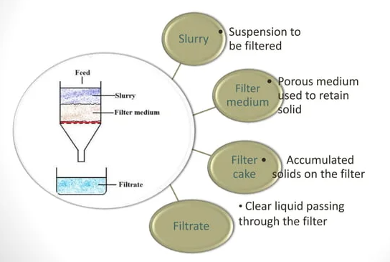
Terms associated with filtration:

Slide 5
Applications of filtration-
To clarify potable water.
To separate the particles from the liquid which interfere with of liquid e.g Solutions
to recover solids from liquids
To remove micro-organisms from sterile pharmaceutical Preparations. E.g. injections, eye drops

Slide 6
Mechanism of filtration :
The basic mechanism by which particles are retained by filter, medium are as follows:
1) Straining:
Particles of larger size are retained by small pore size of filter medium
2) Impingment :
Particles having momentum move along the flow & impinge on the filter medium
3) Entanglement:
Particles become entangled in the mass of fibres & retained by filter medium
4) Attractive foces: Particles are retained by filter medium due to nattractive forces Between the particles & filter medium Procedure

Slide 7
Procedure :
Prepare 2% W/V slurry of calcium carbonate in distilled water.
Take 2 Buchner funnel having different size. Measure radius of each funnel & calculate surface area
Cut the filter paper having same size as that of internal diameter of funnel & place the filter paper in the funnel
Prepare filtration unit by placing the funnel on the measuring cylinder.
Pour prepared slurry in filtration unit with constant stirring
Measure the volume of filtrate collected at different time interval
Note down the observation & calculate rate of filtration

Slide 8
Observations:
Radius of small funnel (r₁): 2.5cm
Radius of large funnel (r₂) : 3.7 cm
Area of small funnel : πr₁² :19.62 cm ²
Area of large funnel : πr₂² : 42.98 cm²

Slide 9
Observation table:
Sr.no | Time (min) | Volume of filtrate collected at 2 min time interval |  | Rate of filtration
 |  | Small funnel | Large funnel | Small funnel | Large funnel
1 | 2 | 27 | 76 | 13.5 | 38
2 | 4 | 18 | 18 | 9 | 9
3 | 6 | 14 | 1 | 7 | 0.5
4 | 8 | 8 |  | 4
5 | 10 | 5 |  | 2.5
6 | 12 | 3 |  | 1.5
7 | 14 | 1 |  | 0.5

Slide 10
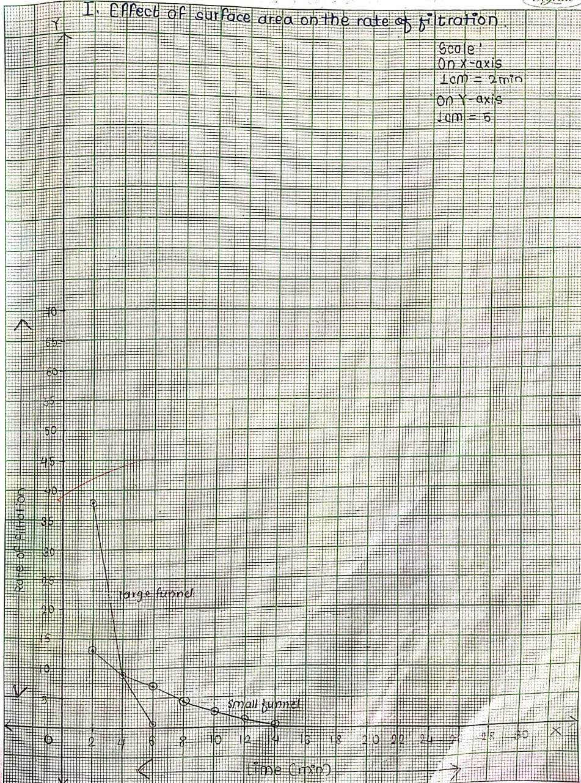
GRAPH :
Plot a graph of time (X axis ) versus rate of filtration(Y axis)

Slide 11
Conclusion:
From the observation table and graph it can be concluded that as surface area increases rate of filtration increases.

Slide 12
Thanks for support and guidance:
Prof. (Dr) Namdeo R. Jadhav
Dean, Krishna Institute of Pharmacy,
Krishna Vishwa Vidyapeeth, Karad
Dr. M. V. Ghorpade
Registrar,
Krishna Vishwa Vidyapeeth, Karad

Slide 13
And above all
Hon. Dr. Sureshji Bhosale
Chancellor, KVV,
Chairman, Krishna Charitable Trust, Karad

Slide 14
END CREDITS
Concept, script and cast:
Location:
Graphics:
Narration:
Editor:

