Slide 1

KRISHNA VISHWA VIDYAPEETH
( deemed to be university) krishna institute of nursing sciences, karad.

Slide 2
TOPIC- Assessment of Pulse.
NAME SELF- Mrs. Mayuri Vijay More,
Clinical Instructor, Krishna Institute of Nursing Sciences, KVV(DU), Karad
MOB. NO.-8888904517

Slide 3

CENTRE FOR DISTANCE AND ONLINE EDUCATION(CODE)
IN ASSOCIATION WITH
EDUCATIONAL TECHNOLOGY CELL
PRESENTS

Slide 4
INTRODUCTION
Pulse is the wave of expansion and recoil occurring in an artery is response to the pumping action of the heart.
Pulse is the heart beat, conveniently felt at the wrist and at any point where an artery passes superficially over the bone.

Slide 5
Definition
Pulse is defined as checking rate, rhythm and volume of throbbing of an artery against a bony prominence.

Slide 6
Purpose
To determine number of heart beats acquiring per minutes create.
To evaluate amplitude (strength )of pulse.
To assess the vascular status of limb.
To assess response of heart to cardiac medications, activity, blood volume and gas exchange.

Slide 7
Normal Rate
Newborn: 140 beats/minute
Infant: 120 beats/minute
2-3 years: 100 beats/minute
5-10 years: 90 beats/minute
Adults: 70 to 80 beats/minute

Slide 8
Common 8 Sites Of Taking Pulse
Radial artery: in front of wrist
Brachial artery: above the elbow
Carotid artery: sides of the neck
Temporal artery: over the temporal
Facial artery: above the lower jaw
Femoral artery: in the groin
Tibial artery: below the popliteal fossa
Dorsalis pedis artery : on the foot

Slide 9
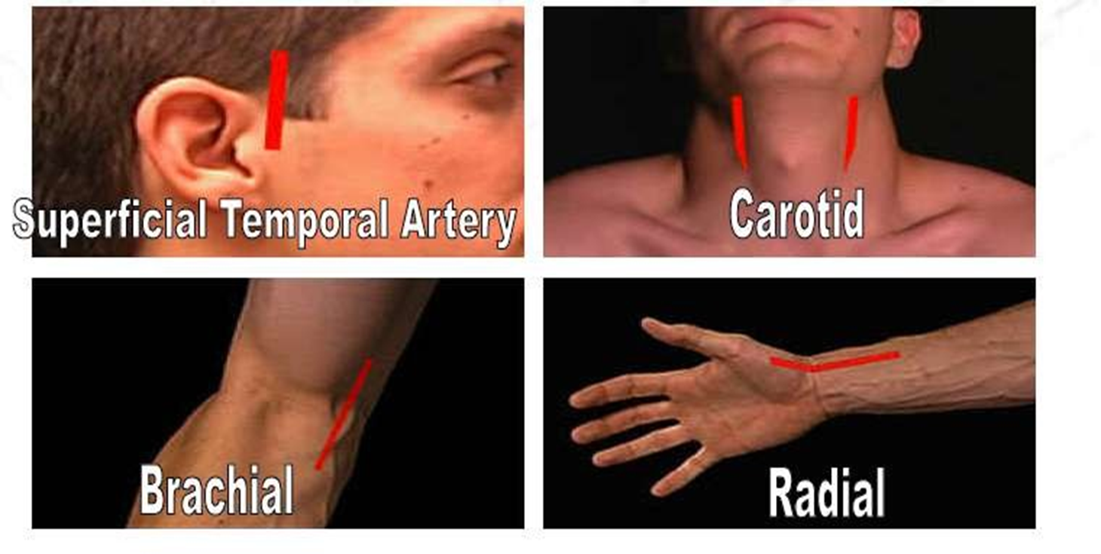
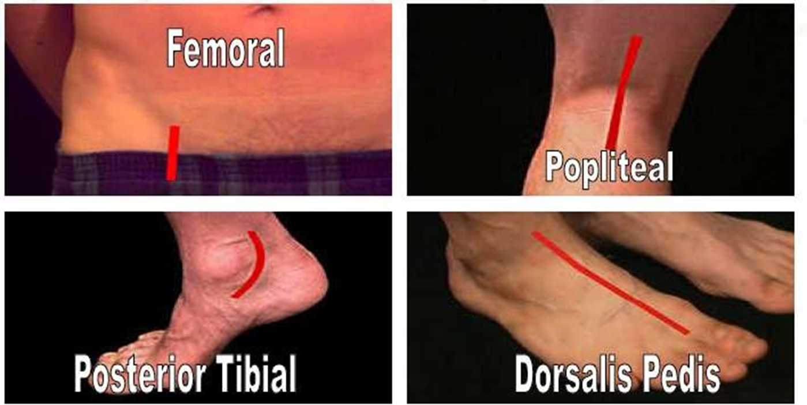
Pulse points

Slide 10
General Instructions For Taking Pulse
Count the pulse for one full minute, especially when there is irregularity.
Observe rate, rhythm, volume and tension of pulse.
Pulse should not be taken immediately after exercise in emotional stress or after a painful treatment.
Record the pulse immediately.

Slide 11
Cont..
Choose suitable site for taking pulse.
Nurse to be aware if patient is on any medication that can interfere with heart rate.
To check pulse after 10 to 15 minutes, after physical exercise.
Notify physician if pulse rate is below <60/minute or above>100/minute.
Record in TPR record.

Slide 12
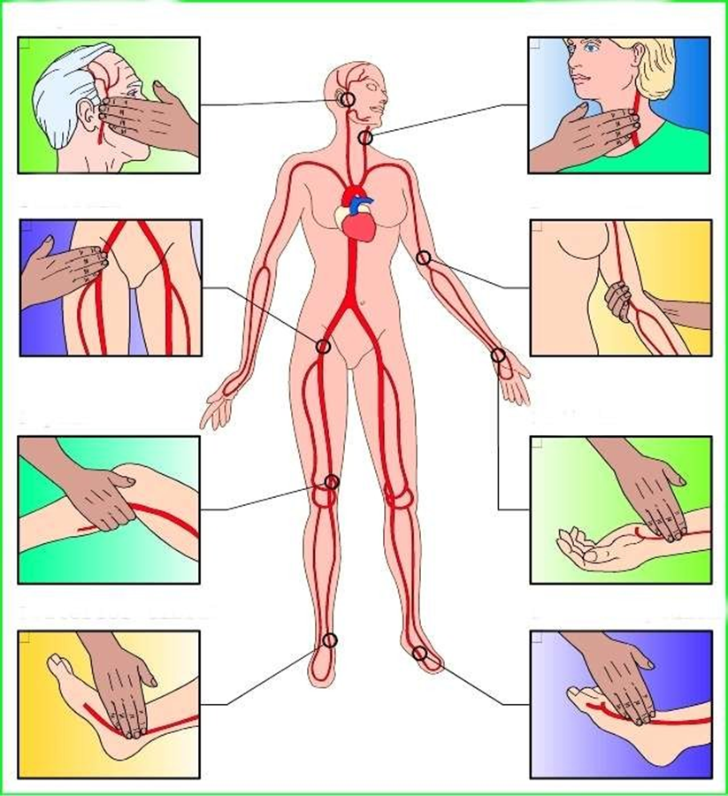
Sites of pulse

Slide 13
Procedure
Wash hands.
If supine, place clients forearm across lower chest with wrist extended straight.
If sitting, bend clients elbow 90 degrees and support lower arm on nurse’s arm. Slightly extend wrist with palm down.
Place tips of the first two or middle three fingers of dominant hand over groove along radial or thumb side client’s.

Slide 14
Lightly compress against radius pulse initially and then release pressure so pulse become easily palpable.
If pulse is easily palpable, look at watch’s second hand and begins to count rate.
If count is regular count rate for 30 seconds and multiply total by 2.
Is pulse is irregular count for full minute.
assist client in returning to comfortable position.

Slide 15
After care
Wash hands.
If pulse is assessed for first time established.
Record characteristics of pulse on nurses note.
Report abnormal findings.

Slide 16
Cast
Mrs. Mayuri Vijay More.
Clinical Instructor,
Krishna Institute of Nursing Sciences,
KVV(DU),Karad
Concept
Mrs. Mayuri Vijay More.
Clinical Instructor,

Slide 17
Thanks for Support and Guidance
Dr. ( Mrs) Vaishali Rajnish Mohite.
Dean KINS, Karad.
Special Thanks to
Dr. M.V. Ghorpade,
Registrar, KVV, Karad.
Dr. Yugantara Kadam.
Dean, KVV.

Slide 18
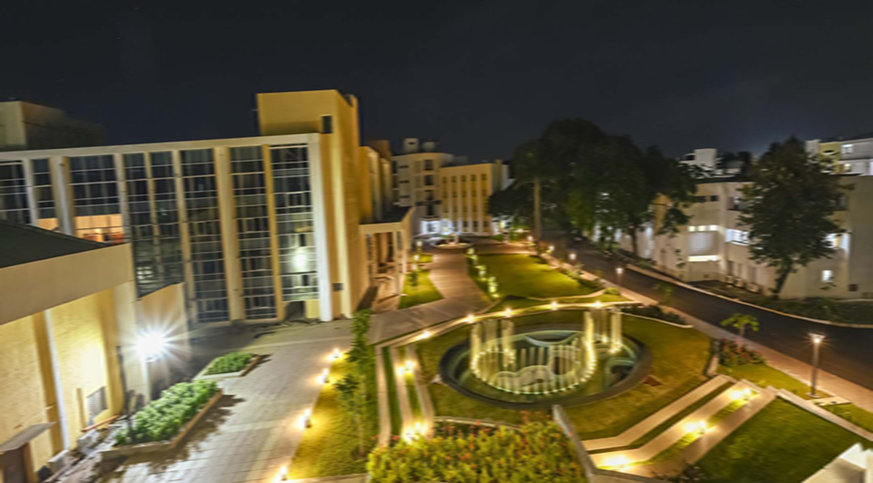
Thank you..

