Slide 1
Exploratory laparotomy for ovarian mass
Dr Gauri Raghunath Shinde
Assistant professor
OBGY DEPT. KIMSDU, KVV, KARAD

Slide 2
INDICATIONS
Acute abdomen
Trauma
Infection
Suspicion of malignancy ( diagnostic & theraputic)
Foreign body removal
As a part of uro-gynecological procedures

Slide 3
Type of incision
Paramedian
Infraumbilical
SUMI ( subumbilical median incision)
Incision may need to extend above umbilicous depends on extent of exploration

Slide 4
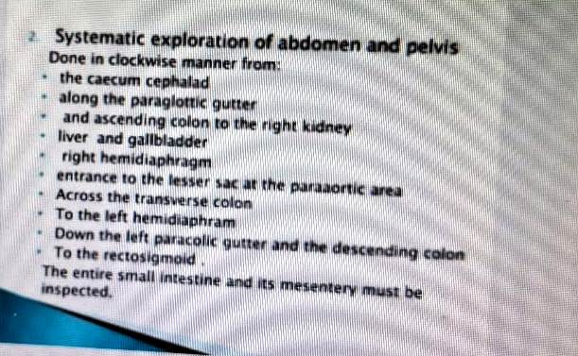
Steps of exploration of abdomen

Slide 5
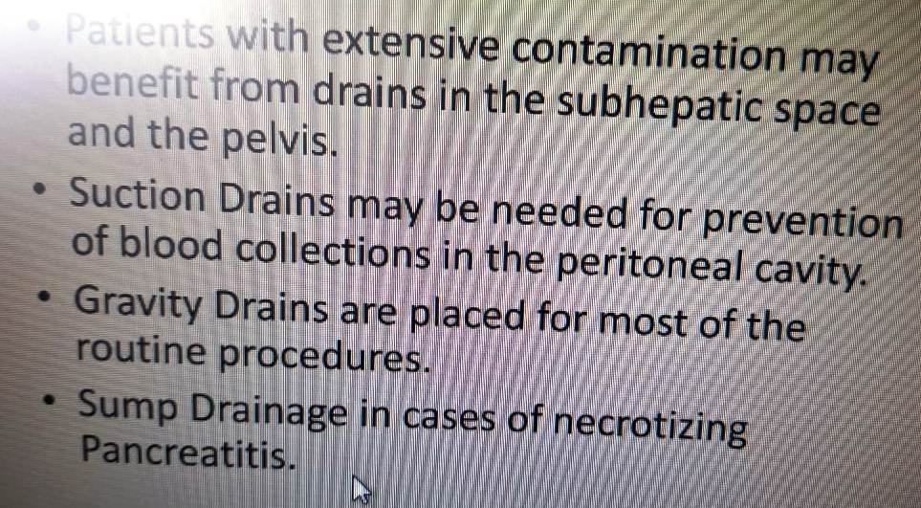

Slide 6
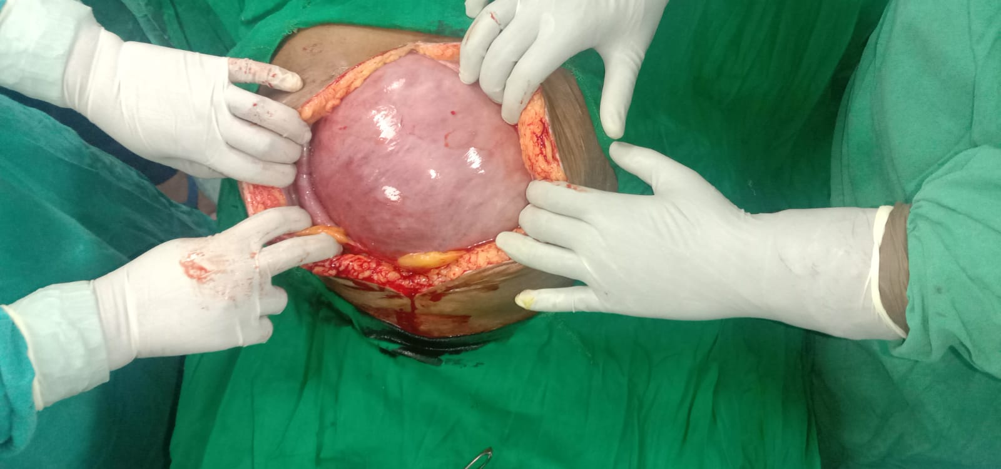
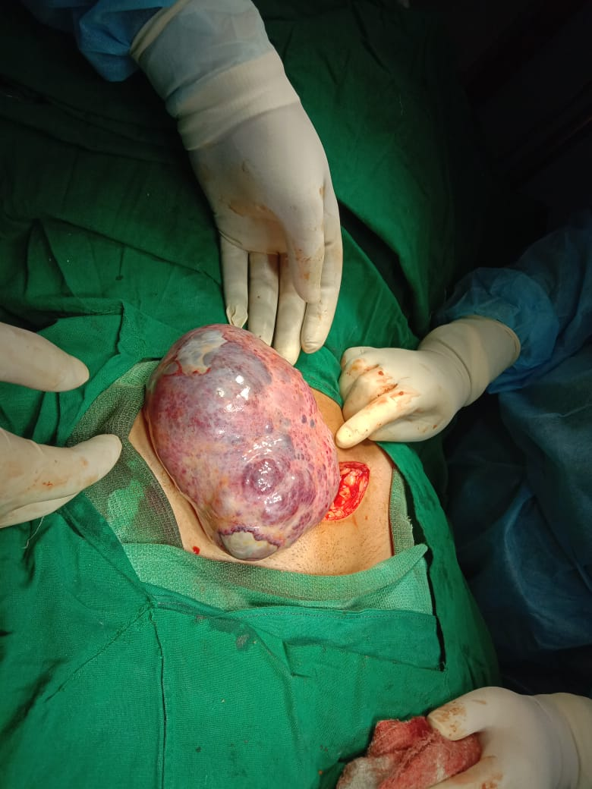
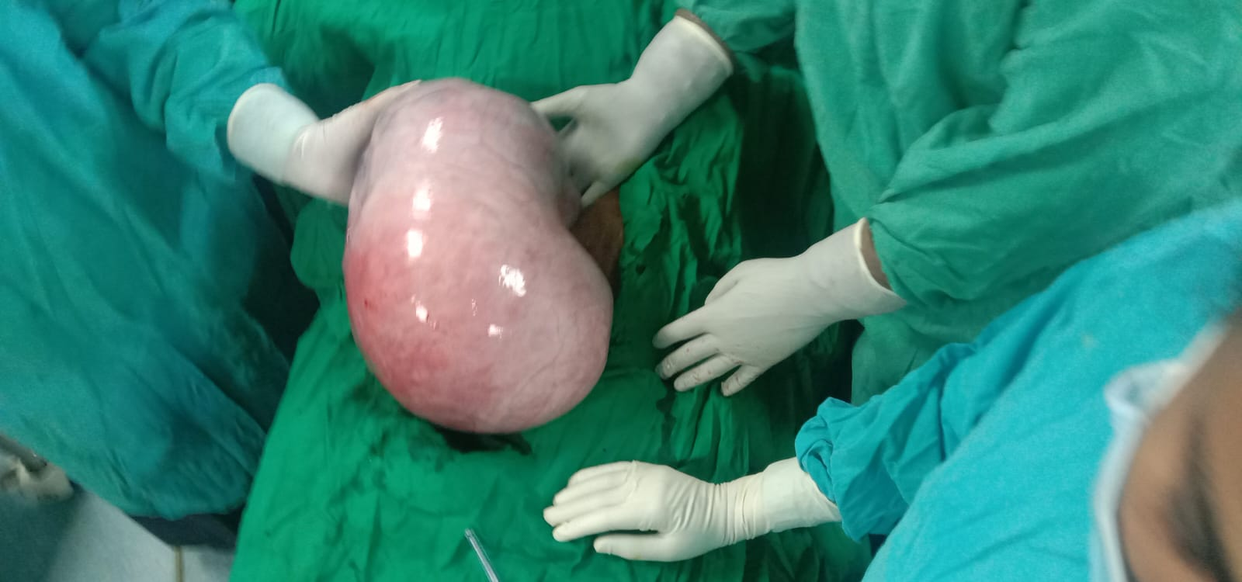

Slide 7
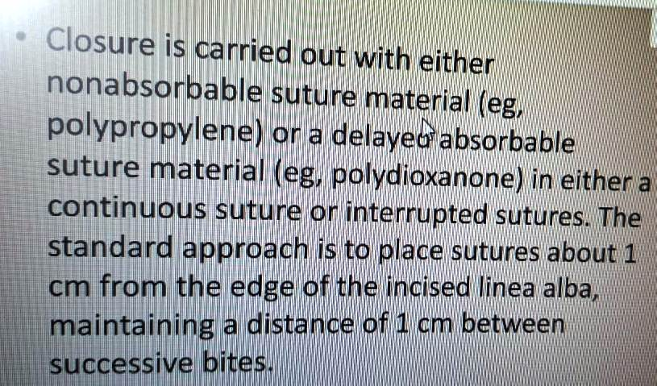
Closure of incision in exploratory laparotomy

Slide 8
