Slide 1
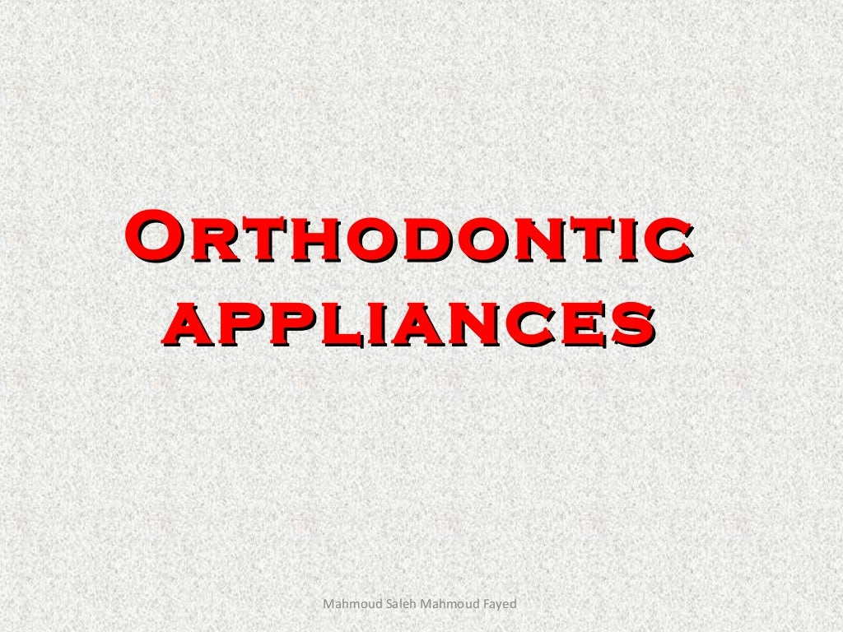


General Principles
Dr. PRATAP MANE

Slide 2
Orthodontic appliances are devices by means of which mild pressure may be
Applied to a tooth or group of teeth and their supporting structure so as to bring about necesary changes within the bone Which will allow the tooth movement

Slide 3

Classification of orthodontic appliances
Mechanical
appliances
Removable appliances
Fixed appliances
Myofunctional
appliences
Removable appliances
Fixed appliances

Slide 4
Mechanical appliances:- exert mild pressure on tooth or group of teeth and their supporting structure in a pre-determined direction with the help of active components, which are part of the appliances itself.
Myofunctional appliances:- are loose fitting or passive appliances that harmless the natural forces of the oro-facial musculature, which trasmitted to the teeth and alveolar bone through the medium of the appliances

Slide 5
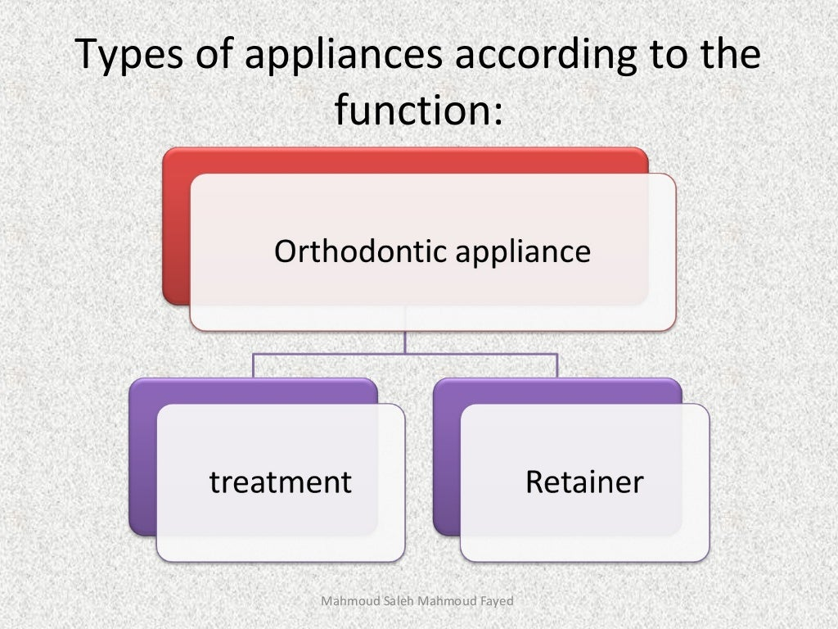


Slide 6
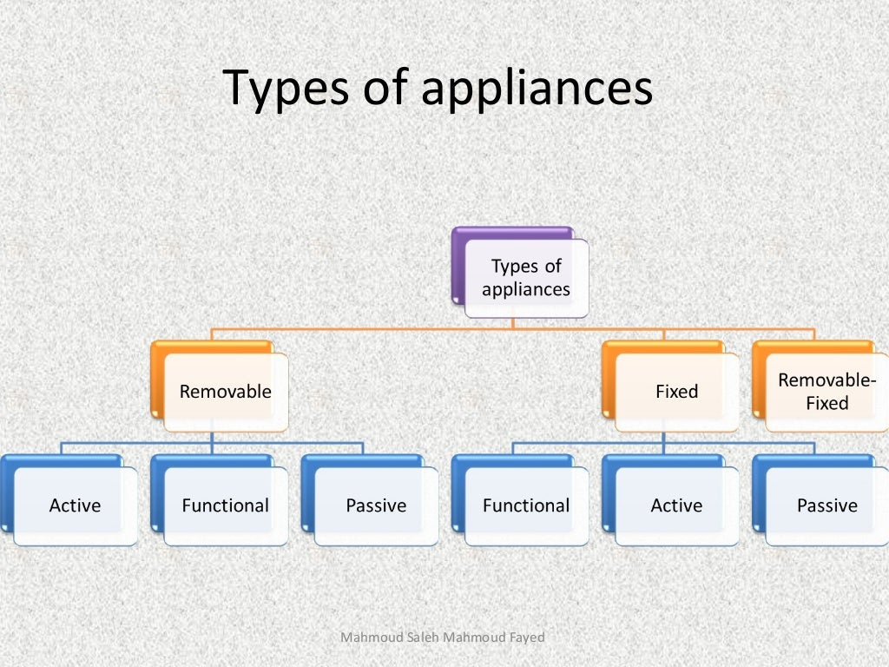

Slide 7
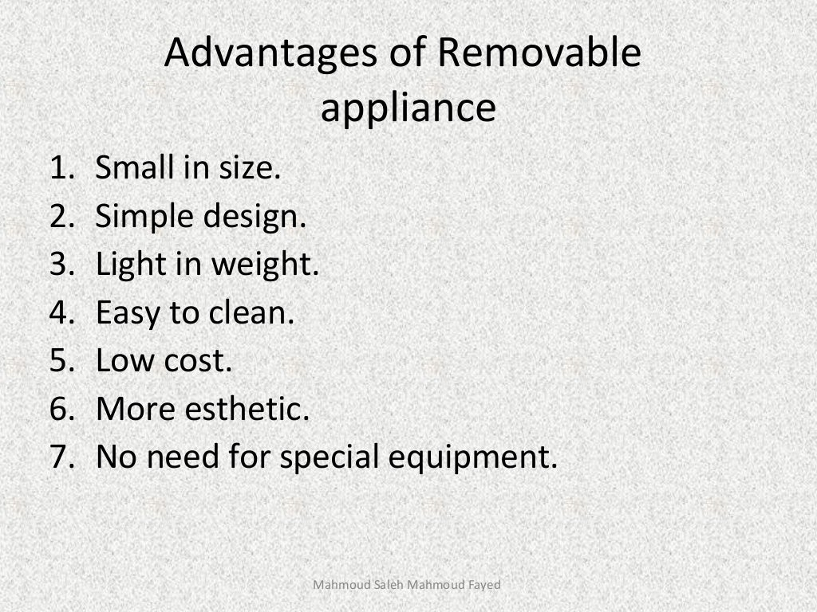

Slide 8
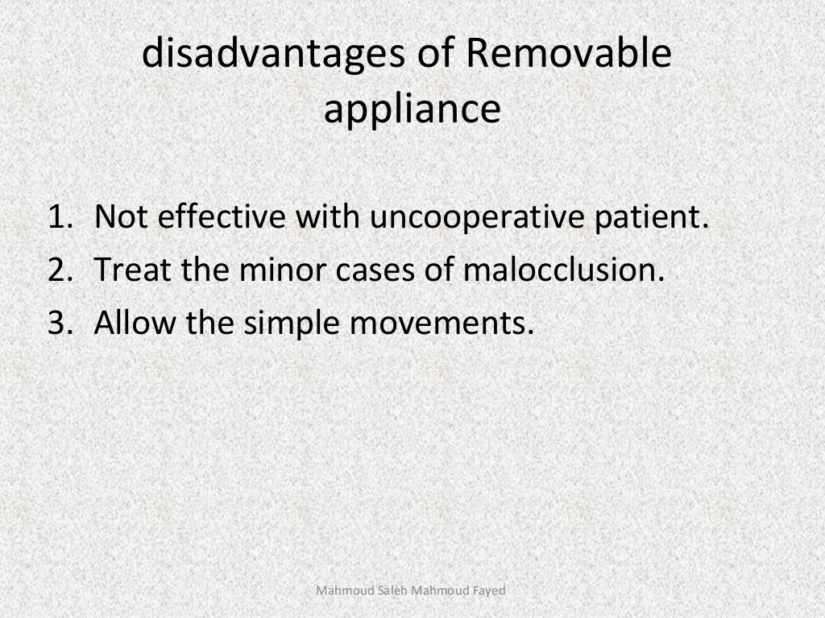

Slide 9
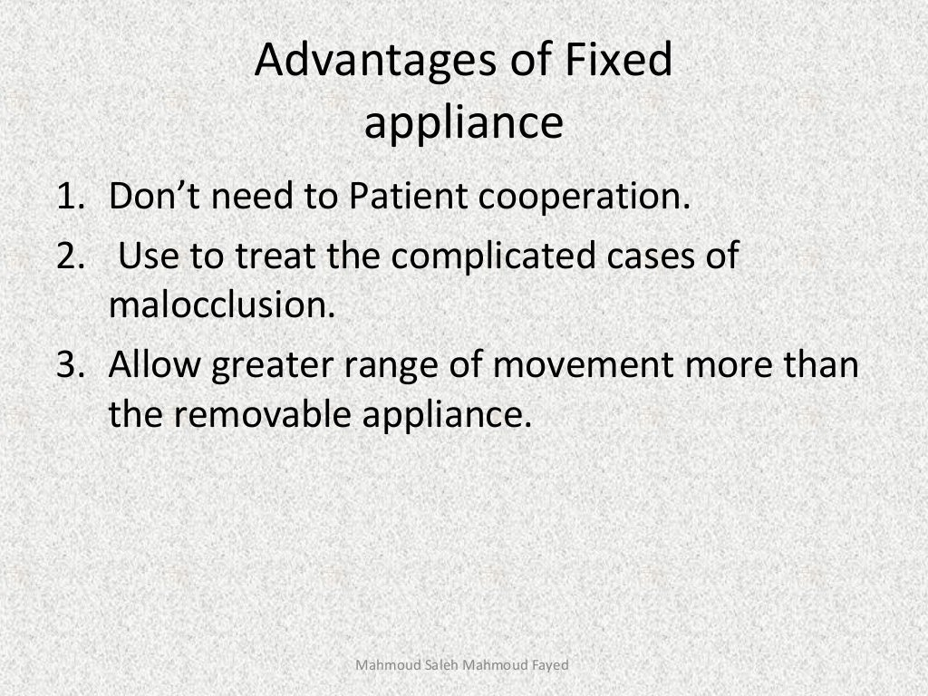

Slide 10
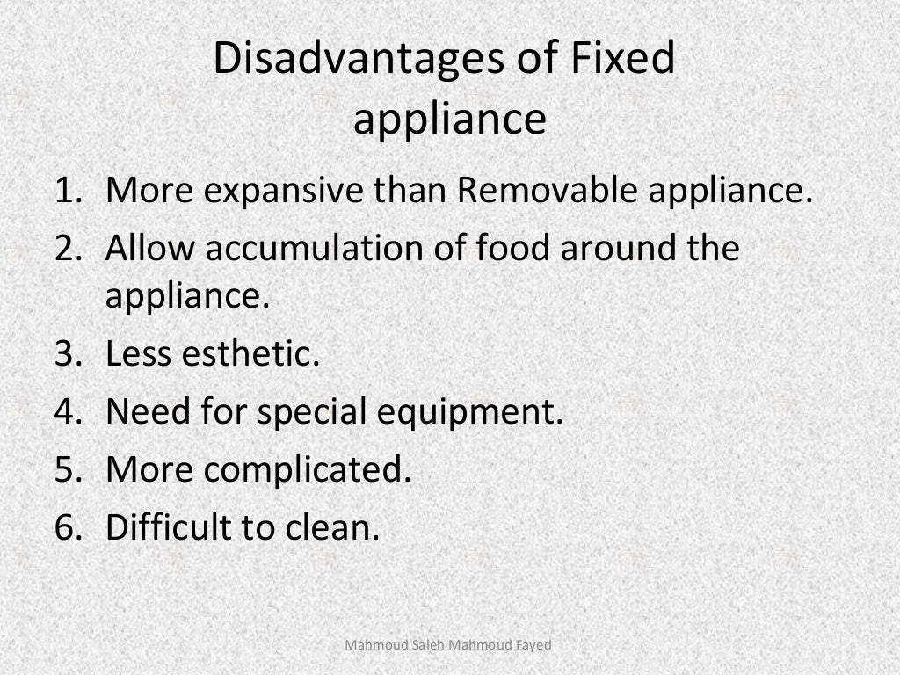

Slide 11
Ideal requirements of an orthodontic appliances
Biological requirements
Mechanical requirements
Hygeinic requirements
Esthetic requirements

