Slide 1

CERTIFICATE MOOC COURSE ON MENOPAUSAL HEALTH
CERTIFICATE MOOC
COURSE ON
MENOPAUSAL HEALTH
Notes:
A very warm welcome in Certificate MOOC Course on Menopausal Health.

Slide 2

"Menopause is a natural phase in every woman’s life. Yet, for many, it comes with questions, confusion, and even silence."

Slide 3
"Hi, I’m DR. Manda Phuke, and today we’re talking about something every woman deserves to understand—that is menopausal health."

Slide 4
Course Description
This course offers students a comprehensive exploration of menopausal health, covering key topics such as the concept of menopause in women, physiological changes during menopause, hormonal influences, assessment of menopausal women, and effective management strategies. The curriculum blends theoretical knowledge with practical learning through video lectures, interactive assignments, case studies, and quizzes to enhance understanding and application.

Slide 5
Course Objectives
On completion of course the students will be able to
Council the women and her families.
Understand the endocrinology of menopause.
Perform the assessment and diagnosis the women and plan proper nursing care.
Educate the women about the self care
Prepare the women for hormone replacement therapy.

Slide 6
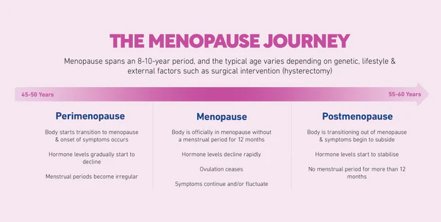
"Menopause usually occurs between the ages of 45 to 55 years. It marks the end of a woman’s reproductive years—defined as 12 months after her last menstrual period."

Slide 7
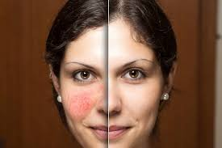
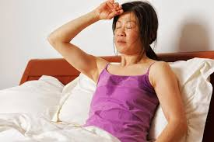


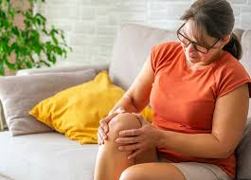
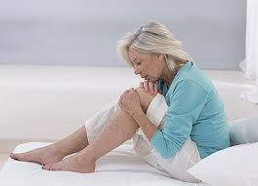
"Common Symptoms”

Slide 8


Slide 9
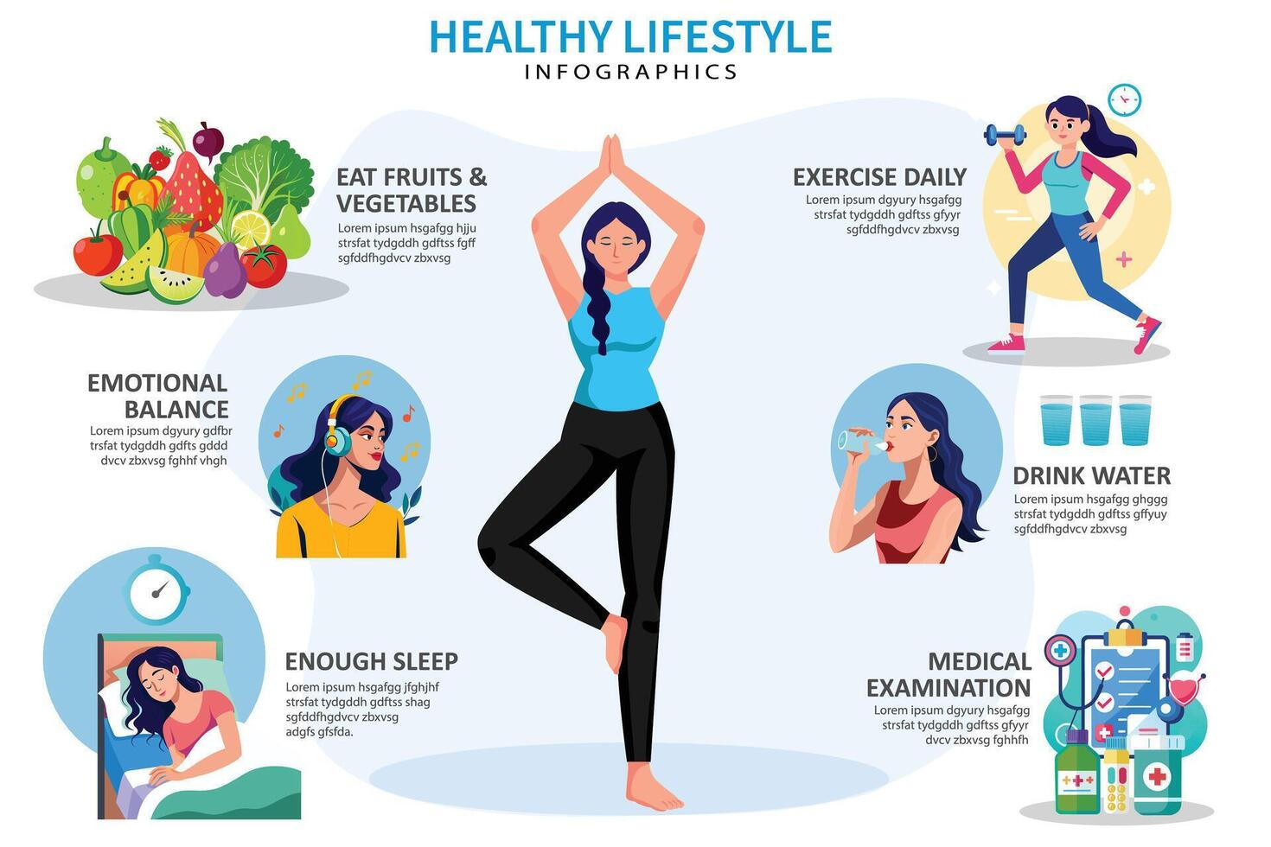

Slide 10
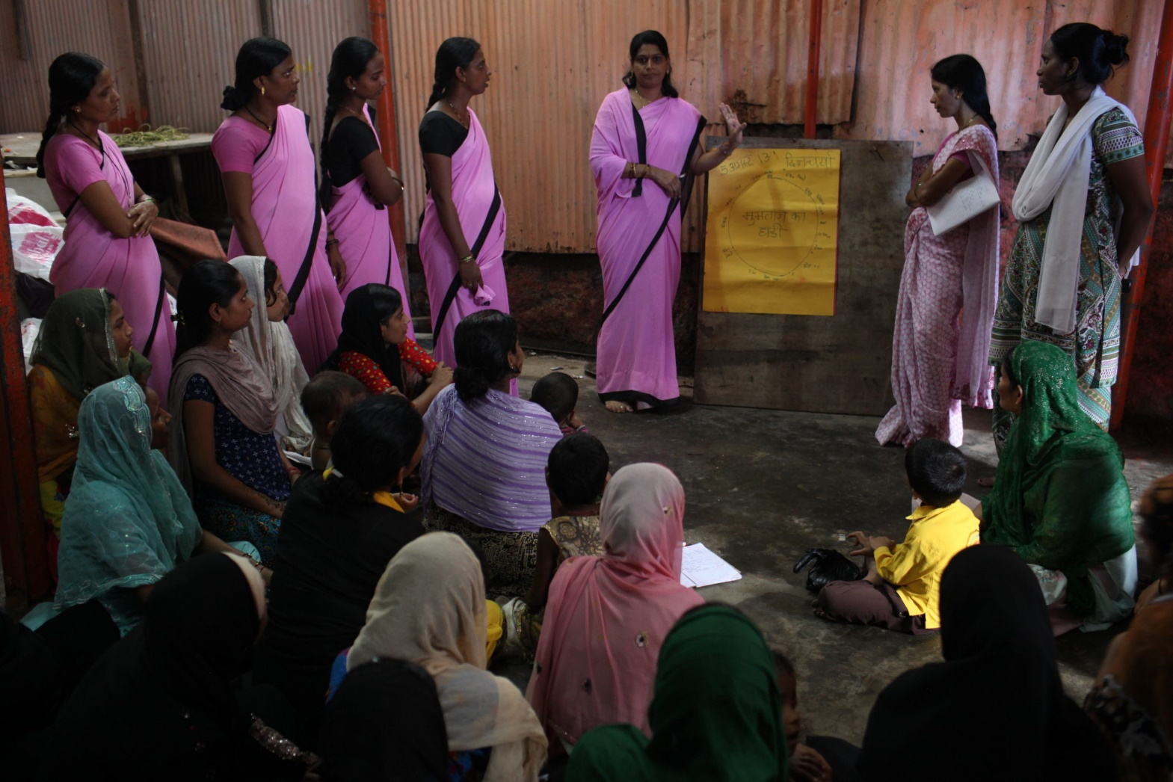

Slide 11

"Menopause is not the end—it's a new beginning. Let’s talk about it, understand it, and support one another."

Slide 12

“Menopausal Health Matters. Talk. Learn. Support.”

