Slide 1

NAME-Mrs. Shabanam Y. Pathan, PhD. Scholar, Krishna Institute of Nursing Sciences, KVV(DU), Karad
TOPIC- INFERTILITY.
NAME SELF- Mrs. Shabanam Y. Pathan, PhD. Scholar, Krishna Institute of Nursing Sciences,
MOB. NO.-9049809900, 7020436271

Slide 2
CENTRE FOR DISTANCE AND ONLINE EDUCATION
(CODE)
IN ASSOCIATION WITH
KRISHNA INSTITUTE OF NURSING SCIENCE,
PRESENTS

Slide 3



INFERTILITY
PhD. Scholar,
Krishna Institute of Nursing Sciences,
Karad.

Slide 4
content
Introduction
definition
Types
Incidence
Causes
Investigation
Role of nurse infertility.

Slide 5
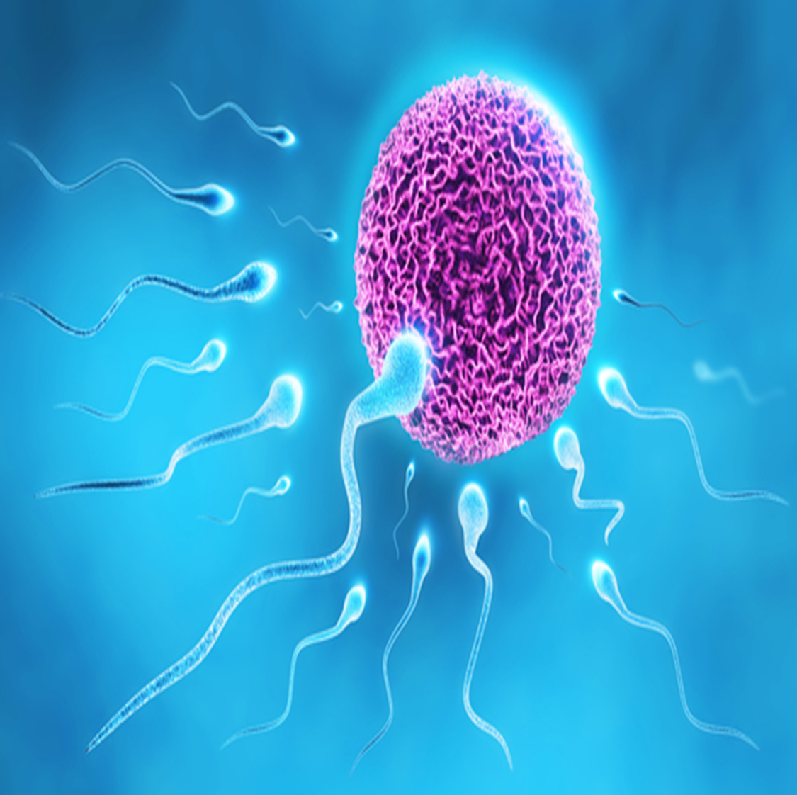
INTRODUCTION
•Successful pregnancy requires the union of a mature ovum and
sperm fertilisation and its implantation in the uterus.
This process can be disturbed at several stages.
Infertility is a complex disorder with significant psychosocial and
medical problems affecting couples.

Slide 6

Definition
Infertility is “a disease of the reproductive system defined by the failure to achieve a clinical pregnancy after 12 months or more of regular unprotected sexual intercourse.”
–WHO

Slide 7
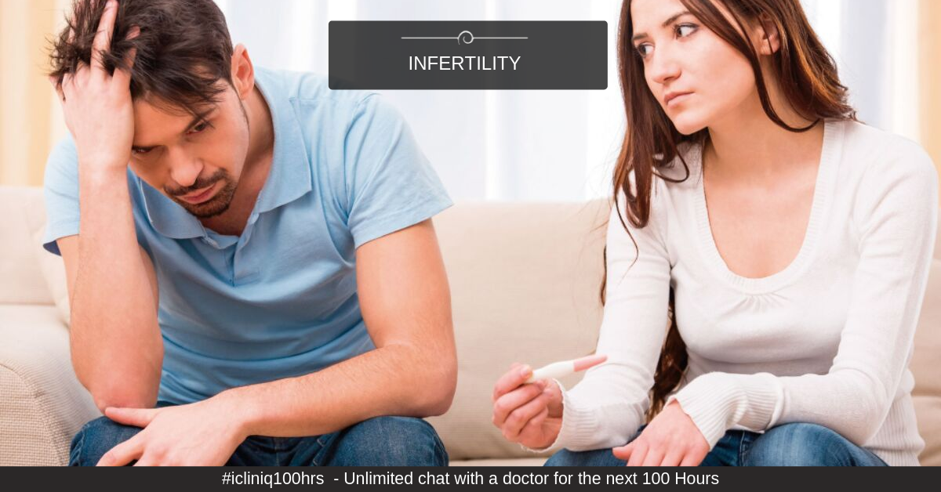
TYPES OF INFERTILITY
Primary infertility refers to couples who have not become pregnant after at least 1 year of having sex without using the birth control method.
Secondary infertility refers to couples who have been able to get pregnant at least once, but now are unable to get pregnant.

Slide 8
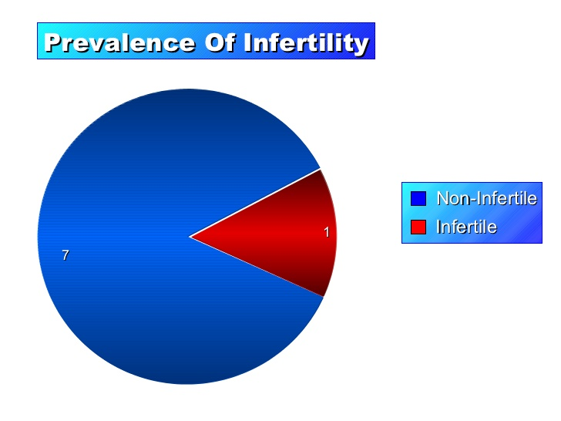
INCIDENCE
Eighty percent of the couples achieve conception if they so desire, within one year of having regular intercourse with adequate frequency.
Another 10 per cent will achieve the objective by the end of the second year

Slide 9
Causes for male infertility
1) Congenital- Undescended testes, Kartagener syndrome, Hypospadias
2) Thermal factor- varicocele
3) Infection- Mums orchitis, Bacterial &viral infection, chronic systemic illness
4) General factors- Chronic debilitating diseases, smoking, alcohol consumption.
5) Endocrine- Kallmann’s syndrome, Sertoli cell–only syndrome, hyperprolactinemia
6) Genetic- Klinefelter’s syndrome
7) Iatrogenic- Radiation, cytotoxic drugs, cimetidine, beta blockers, antihypertensive, anticonvulsants,% antidepressant.
8) Immunological factor- Antibodies against spermatozoa surface antigens.
-

Slide 10
Continue….
2. Obstructing efferent ducts: Infection e.g. TB, gonococcal, Young’s syndrome, Surgical trauma e.g. vasectomy.
3.Failure to deposit sperm high in the vagina: Erectile dysfunction, Sperm abnormality, Hypospadias, Ejaculatory defect.
4.Errors in the seminal fluid: High or low-volume ejaculate, undue viscosity, Low fructose content, High prostaglandin content

Slide 11
Female infertility causes
Ovarian factor
Anovulation or oligo-ovulation, Thyroid or adrenal dysfunction, LPD
Tubal/ Peritoneal factor
Peri tubal adhesions, Previous tubal surgery, Salpingitis Tubal endometriosis, Polyps.
Uterine hypoplasia, Fibroid uterus, Endometritis, Congenital malformation
Uterine factor
Cervical factor
Anatomic defects, 2nd DEGREE UTERINE PROLAPSE, Cervical polyps, Chr. Cervicitis
Vaginal factor
Atresia of vagina, Transverse vaginal septum, Narrow introitus, Vaginitis
Combined factor
General factors, General factors. Infrequent intercourse, Anxiety & Apprehension, Use of lubricants during intercourse, Immunological factors

Slide 12
Objectives of investigation
  To detect the etiological factor(s).
  To rectify the abnormality in an attempt to improve fertility.
  Give assurance with an explanation to the couple if no abnormality is detected.

Slide 13
Treatment for male infertility
1. History collection
Age, marriage
General medical history
Surgical history
Occupational history
Social habits
2. Examination
Reproductive system
3. Investigations
Routine investigations – urine and blood
Seminal fluid analysis
Biochemical tests
4. Hormonal study
Serum FSH, LH, testosterone, prolactin, and TSH
5. Fructose content in the seminal fluid
6.Testicular biopsy
7 TRUS
8.Vasogram
9.Karyotype analysis.
10.Immunological tests

Slide 14
Female Investigation
Age
medical history
Surgical history
Menstrual history
Previous obstetric history
Contraceptive practice
Sexual problems

Slide 15
2. Examination
General
Systemic
Gynecological
Speculum

Slide 16
3. Special Investigation
0varion factor
  Anovulation or oligo-ovulation
  LPD: - BBT chart, endometrial biopsies. progesterone.
  LUF:- sonography, laparoscopy, ovarian biopsy.
Tubal factor
  Dilatation & insufflation test
  HSG
  Laparoscopy
  Sonohysterosalpingography
  Fluoroscopy
  Salpingoscopy

Slide 17
DIAGNOSIS OF OVULATION
1. INDIRECT
Menstrual history, Evaluation of peripheral or in-organ changes, BBT
Cervical mucus study
Vaginal cytology
Hormone estimation
Serum progesterone, Serum LH, Urinary LH
Endometrial biopsy
Sonography (TVS)
2. DIRECT
Laparoscopy
3. Conclusive
Pregnancy

Slide 18
Role of nurse in infertility
Give psychological support throughout the counselling.
collect other information about various prior test reports and documents.
The nurse has to encourage the family and patient to ask questions about conditions diseases etc.
Provide all explanations about questions.
Maintain privacy and confidentiality of all cases.
Ensure follow-up and supportive services to individuals and families during counselling.
Explains the infertility management and specific treatment.

Slide 19
Continue….
Performing inseminations.
Performing embryo transfers.
Advice about maintaining ideal coital frequency. (3-4 times/week in fertile period).
Explain avoid lubricants, spermicidal jellies and creams.
Avoid fertility-impairing medications.
Maintenance of body weight
Helps the couple overcome the dilemmas and decide the right fertility treatment.
The nurse provides care for the individuals and couples before, during, and after infertility treatment.

Slide 20
SUMMARY
Infertility is a sensitive issue that should be handled with great care with continuous professional counselling.
Psychological support is important.
Most young couples will conceive naturally within two years.
Evaluation of both partners for causes is essential
Treatment depends on the cause and varies from medical treatment to surgery to ART

Slide 21
CONCLUSION
Infertility is a problem for couples.
Psychological support is important.
Infertility should be evaluated after one year of unprotected intercourse.
History and physical examination usually will help to identify an aetiology.
If patients fail the initial therapies, then the proper referral should be made to a reproductive specialist.

Slide 22
Bibliography
D.C. Dutta. TEXTBOOK OF GYNECOLOGY. 9TH ed. Kolkata: NEW CENTRAL BOOK AGENCY;2019. P.P:220-234.
Lily Podder. Fundamentals of Midwifery Obstetrical Nursing. New Delhi: ELSEVIER; 2019. P.P:407.
Dr. Shally Magon- Sanju Sira. Textbook of MIDWIFERY AND OBSTETRICS. 4th ed. Jalandhar Punjab: Lotus Publishers; 2019. P.P:836,875.
Annamma Jacob. A COMPREHENSIVE TEXTBOOK OF MIDWIFERY & GYNECOLOGICAL NURSING. 4th ed. New Delhi: Jaypee 2015. P.P:857-866.
Dr. Haresh U. Doshi. Clinical Cases in Obstetrics and Gynecology. 2nd ed. Ahmedabad: Arihant Publishers; 2006. P.P:277-287.
Diane M. Fraser. Myles Textbook For Midwives. 14th ed. New Delhi: ELSEVIER; 2003. P.P:174-180.

Slide 23
Cast
Mrs. Shabanam Y. Pathan
PhD. Scholar
Krishna Institute of Nursing Sciences,
KVV(DU),Karad
Concept
Mrs. Shabanam Y. Pathan
PhD. Scholar

Slide 24
Thanks for your support and guidance
Dr. Jyoti A. Salunkhe,
M.Sc. Ph.D. (Ob-Gyn Nursing)
Professor, Dean (Academics)
KINS, Karad.
Dr. Vaishali Rajnish Mohite.
Dean KINS, Karad.
Special Thanks to
Dr. M.V. Ghorpade,
Registrar, KVV, Karad.
Dr. Yugantara Kadam.
Dean, KVV.

Slide 25



