Slide 1

Good Morning..

Slide 2

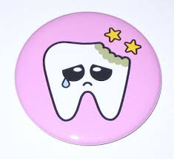
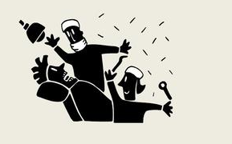
Classification Of Cavities
&
Chair Position
Classification Of Cavities
&
Chair Position

Slide 3

Caries Cavity Restoration
Physiological Form
Esthetic Form
Functional Form

Slide 4
Cavity
Definition :
  A defect in enamel or dentin resulting from pathologic process of dental caries.
  Breach in the continuity of the surface integrity of tooth.

Slide 5
The term cavity was used to describe a lesion in a tooth that has progressed to the point that part of tooth structure had been destroyed

Slide 6

Classification Of Cavities

Slide 7
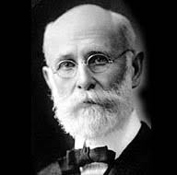
G. V. BLACK
First Classification
Universally accepted
Based on type of treatment
&
area involved

Slide 8
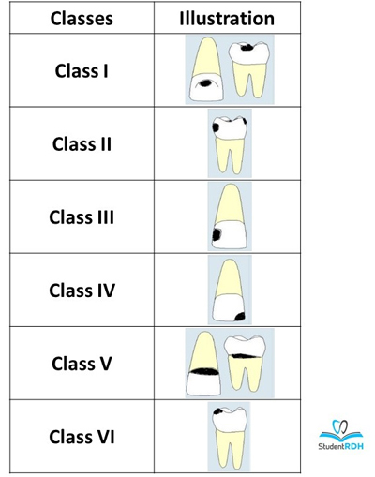

Slide 9
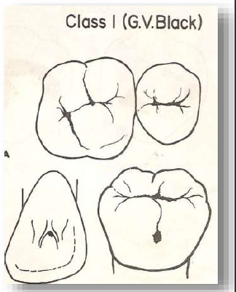
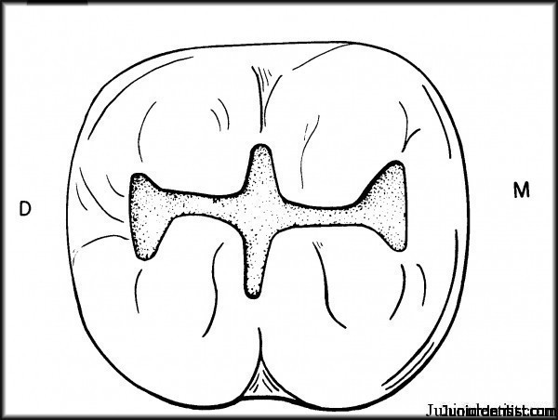
Class I Cavity
All pit-and-fissure cavity

Slide 10
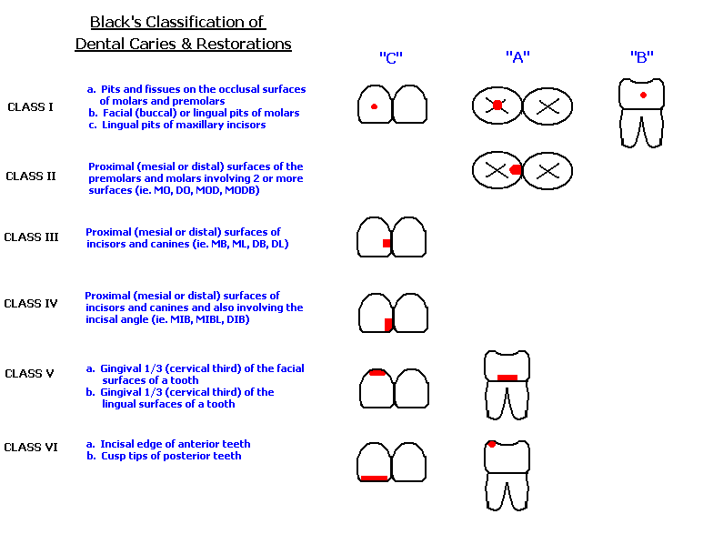
Class I
Cavity on the occlusal surface
of premolars and molars
Cavity on Occlusal Two Thirds
of the Facial and Lingual
Surfaces of Molars.
Cavity on the lingual surface of
maxillary incisors

Slide 11
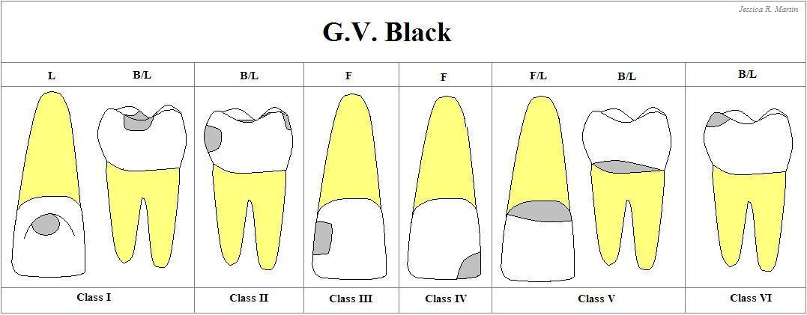
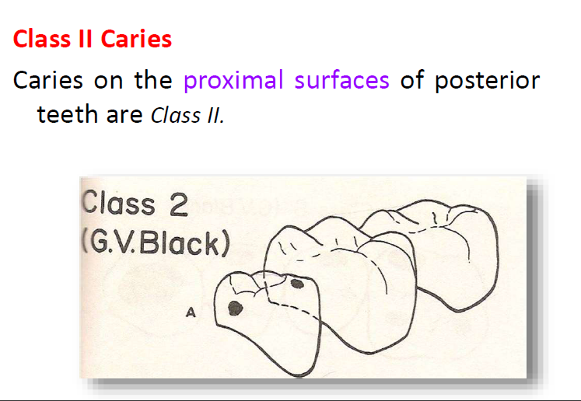
Class II Cavity
Cavity

Slide 12
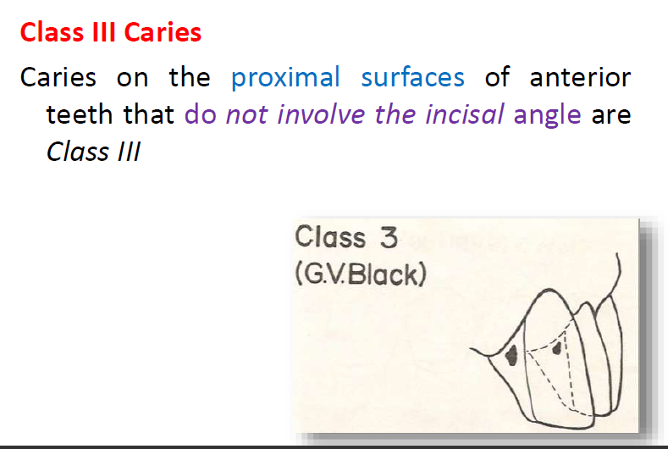
Class III Cavity
Cavity

Slide 13
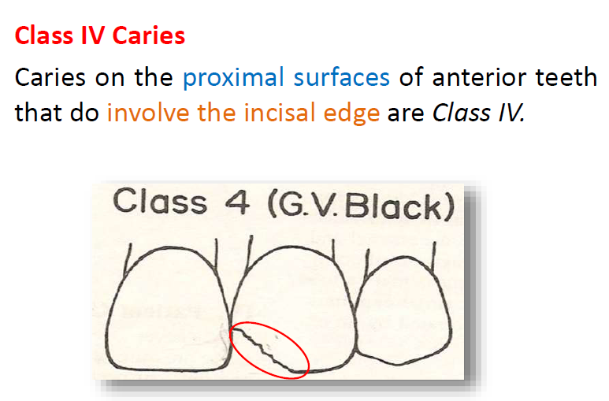
Class IV Cavity
Cavity

Slide 14
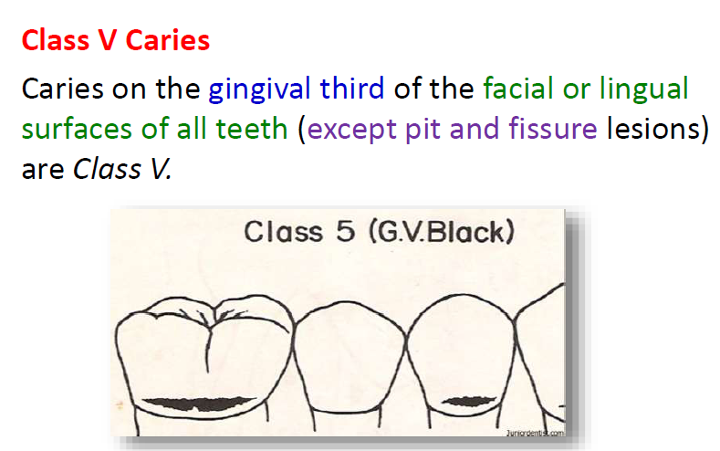
Class V Cavity
Cavity

Slide 15
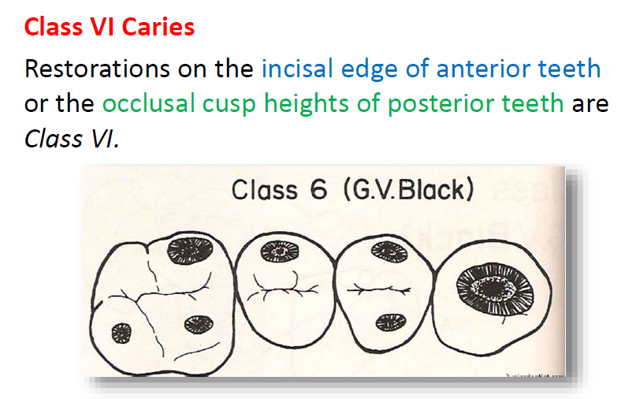
Class VI Cavity
Cavity

