Slide 1
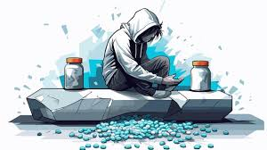
Commonly Abused Drugs
Dr Sujata Jadhav
Professor, Pharmacology,
KIMS, Karad

Slide 2
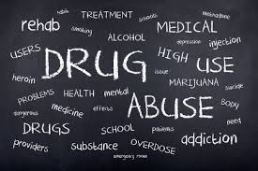

Slide 3
introduction
Drug is a substance that when absorbed in the body of a living organism alters normal body function. Drugs are chemicals that change the way a person’s body works by altering emotions and thoughts.
Drug abuse – drug abuse is a patterned use of a drug in which the user consumes the substance in amounts or with methods neither approved not supervised by medical professionals.

Slide 4
Gateway drugs
These are legal drugs, that non-drug users also try
That can be legally sold, processed and used with some restrictions
Ex. Caffeine, Nicotine and Alcohol
These are stimulants, Cause alertness, increase energy and improve focus and elevate the mood
Notes:
Classification of drug is needed to organize the drugs into logical groups. It helps to give evidence based treatment, understanding of pharmacological actions

Slide 5
Classification of Drugs of abuse
1) Depressant Drugs -
Slow down person’s Central nervous system
Opioids (Narcotics)
They relieve the pain and also cause euphoria
Morphine, Codeine, Heroin, Marijuana etc.
High potential for addiction
Heroin – commonly abused opioid. Sold illegally as a street drug in powder form.
Injected, smoked or snorted.

Slide 6
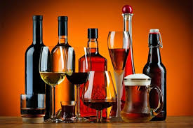
Alcohol –
Alcoholic beverages are legally available and consumed world over.
Thus it is not a drug of abuse unless it is produced and consumed illegally.
The most commonly used depressant

Slide 7
Benzodiazepines – Most commonly used prescription drugs.
Used as sedative and hypnotic for the treatment of anxiety and insomnia.
Subjects continue to take them for months or years together: Therefore dependence is quite common.
They cause - Relaxation, drowsiness, slowed reflexes, and a decrease in coordination.
Barbiturates – Used as anaesthetic or antiepileptics
Not commonly prescribed
Produce marked physical and psychological dependence

Slide 8
3) phychoStimulants
Stimulate the central nervous system – mesolimbic and cortical areas
They speed up the overall functioning of the CNS
They produce feeling of energy and euphoria
Caffeine – The most commonly used stimulant
Amphetamine and Methamphetamine
Cocaine
Crack Cocaine

Slide 9
4) Phychedelics (Hallucinogen)
These drugs distorts reality and facts.
they affects all the senses and make the person perceive illusions.
Abuse of psychedelics is infrequent.
Ex. Lysergic acid diethylamide (LSD), Psilocybin (Magic mushrooms), Mescaline, Phencyclidine, Ketamine (Special K), Peyote

Slide 10
5) Antidepressants
These drugs used to treat depression
Ex. SSRI (Selective serotonin reuptake inhibitor)
SNRI (Selective serotonin – norepinephrine reuptake inhibitor)
They improve the mood, reduce symptoms of depression

Slide 11
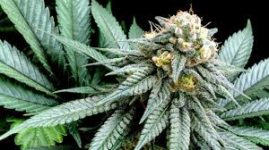
6) cannabis- Most popular recreational ritualistic intoxicant used world wide
The hemp plant cannabis yields marijuana (THC & cannabidiol – active principles)
Cannabis – Extensively used in India.
Ex: Bhang – dried leaves and seeds
Consumed orally after making paste
Ganja – dried flowering tops and leaves of cannabis
Smoked usually mixed with tobacco
Charas – dried resinous extract from the flowering tops and leaves of cannabis
Consumed as Smoking

Slide 12
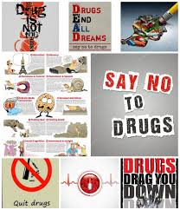
Thank you

