Slide 1

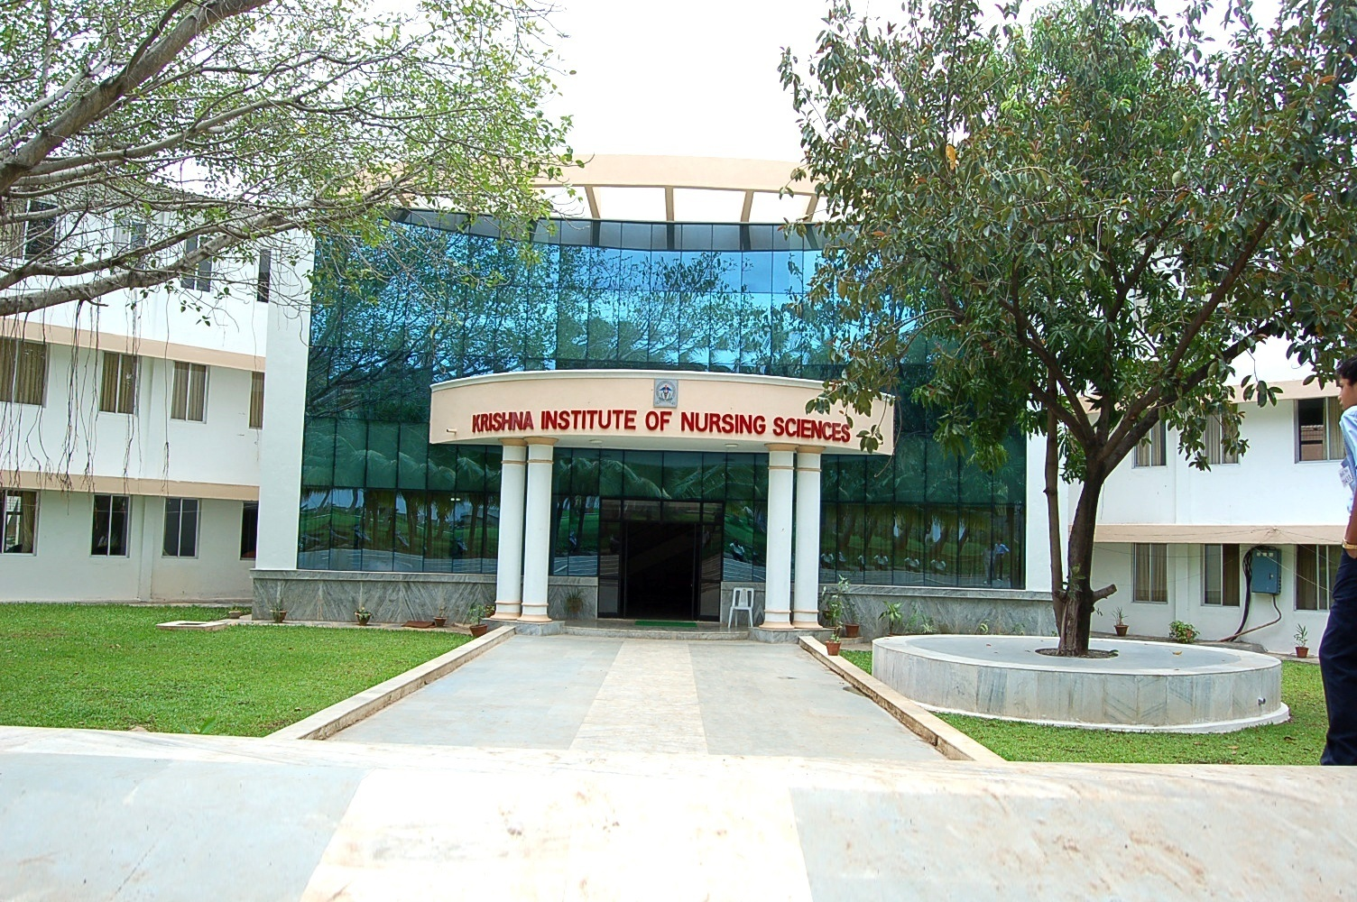
KRISHNA VISHWA VIDYAPEETH
(Deemed to be university) krishna institute of nursing sciences, karad.

Slide 2
TOPIC- Assessment of Blood Pressure.
NAME SELF- DR Swati Astik Ingale,
Assistant Professor, Krishna Institute of Nursing Sciences, KVV(DU), Karad
MOB. NO.- 9834859156

Slide 3
CENTRE FOR DISTANCE AND ONLINE EDUCATION(CODE)
IN ASSOCIATION WITH
EDUCATIONAL TECHNOLOGY CELL
PRESENTS

Slide 4
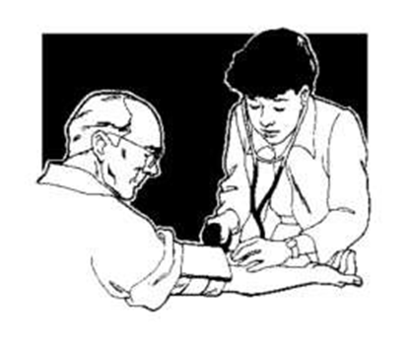
Blood Pressure

Slide 5
Definition
Blood Pressure may be defined as the force exerted by blood against the walls of the vessels in which it is contained.

Slide 6
Purpose
To obtain baseline data for diagnosis and treatment.
To compare with subsequent changes that may occur during care of patient.
To assist in evaluating status of patients blood volume, cardiac output and vascular system.
To evaluate patients response to change in physical conditions s a result of treatment with fluids or medications.

Slide 7
Indication
To determine baseline, blood pressure recording and monitor fluctuation.
To aid in the diagnostic disease.
To aid in the assessment of cardiovascular system.

Slide 8

Types of blood pressure
Systolic pressure
Diastolic pressure

Slide 9
Factors influencing blood pressure
Age
Stress
Medication
Diurnal variation
Sex
Exercise
Bleeding

Slide 10
Preliminary assessment
Identify the patient
Check the diagnosis, reason for taking BP schedule frequency of obtaining blood pressure.
Previous measurement and range of blood pressure.
Physical and mental state of the patient.
Blood pressure taking, on a patient who is angry, anxious or in pain or crying child.

Slide 11
Cont….
Assess the arm on which the blood pressure can be taken.
Do not take blood pressure on patient arm.
The arm has an intravenous infusion.

Slide 12
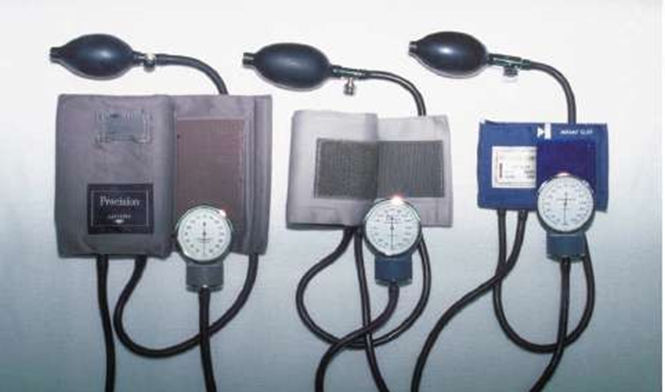
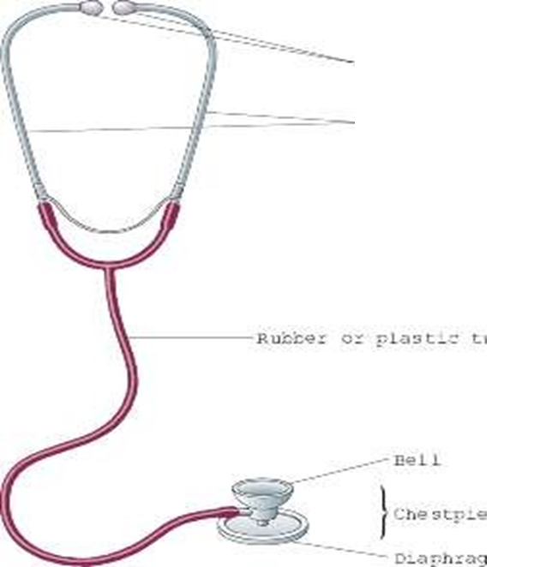
Articles
Sphygmomanometer
Stethoscope
Piece of paper

Slide 13
Preparation of patient
Explain the procedure to the patient
To provide comfortable position to client

Slide 14
Procedure
Wash hands.
Take equipment to the bedside.
Apply deflated cuff above 2 inch above the anticubital fossa.
Palpate the brachial artery place the bell of stethoscope on the brachial pulse.
Pump up air in the cuff until the sphygmomanometer registers about 20 mm above the point at which radial pulsation disappears
Note the number on manometer where sound first begins i. e. systolic Blood Pressure.
Continue to release pressure slowly. Note the point where the sound ceases i.e. Diastolic blood pressure.

Slide 15
Conti..
Repeat the procedure if any doubt.
Give comfortable position to the client.

Slide 16
After care
Remove the cuff place in box.
Assist the patient to cover the arm.
Records and reports.
Wash hands.
Replace the eqipments.

Slide 17
Conclusion
Vital signs are a quick and efficient way of monitoring a patients condition or identifying problems and evaluating the patient response to interveing changes.
To determine abnormality like hypertension and hypotension.
To understand the patient response on treatment and medication.

Slide 18
Cast
DR Swati Astik Ingale
Assistant Professor,
Krishna Institute of Nursing Sciences,
KVV(DU),Karad
Concept
DR Swati Astik Ingale
Assistant Professor.

Slide 19
Thanks for Support and Guidance
DR.(Mrs)Vaishali Rajnish Mohite.
Dean KINS, Karad.
Special Thanks to
Dr. M.V. Ghorpade,
Registrar, KVV, Karad.
Dr. Yugantara Kadam.
Dean, KVV, Karad.

Slide 20


