Slide 1
COMMUNITY
BAG TECHNIQUE

Slide 2
INTRODUCTION
The Community health bag is designed to carry equipment and material needed during a visit to the home, school or factory.
Equipment and material are needed to perform basic tests like urine examination, preparation of slides, physical examination and to demonstrate patient care such as application of ointments, medications, etc.
It contains basic medications and articles which are necessary for giving care.

Slide 3
DEFINITION
Community health bag technique is the effective way of using community health bag to perform nursing procedures during his/her home visit with ease and neatness, saving time and efforts with the end in view of rendering effective nursing care.

Slide 4
PURPOSE
To prevent spread of infection from one patient to another and from one place to another by keeping bag and its contents as clean as possible.
To demonstrate the principles of cleanliness to patients and family members by using the bag in orderly way.
To carry out selected procedure, demonstrations, teaching and follow up services for patients and family members.

Slide 5
INDICATIONS
Provide antenatal, intra-natal and postnatal care to mother and child.
Perform certain diagnostic procedures such as Hb testing, urine testing for early detection of high risk cases and provide timely treatment.
Demonstrate certain Procedures to family members or community such as preparing oral dehydration solution (ORS),baby bath, application of benzyl benzoate in cases of scabies.
Notes:
The public health bag is used by public health nurse to-

Slide 6
Cont….
4. Provide emergency and first aid services in case of accidents and minor ailments.
5. Provide and demonstrate care in case of communicable diseases such as chickenpox.
6. Provide follow up services in chronic illness such as diabetes, paraplegia or amputation.

Slide 7
BAG CONTENTS
The contents of the bag;
A bag having three pockets at outer side-
one back side &
two both side of the bag
One Outer side pocket: clean square piece of newspaper or plastic sheet to keep the bag on it.
Notes:
is used f dairy to maintain records, clean paper bags and a square piece of newspaper or plastic sheet to keep the bag on. The other one is used for keeping things for hand washing

Slide 8
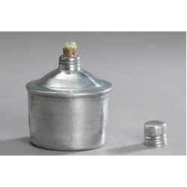

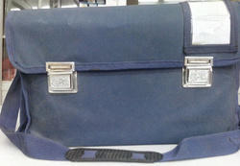

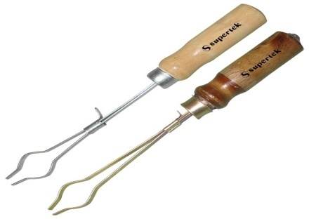
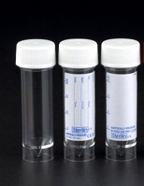


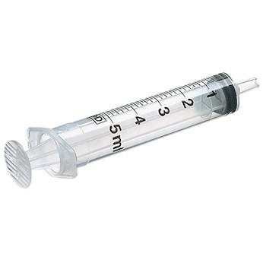
Cont…
Other Outer side pocket contents sugar testing articles-

Slide 9
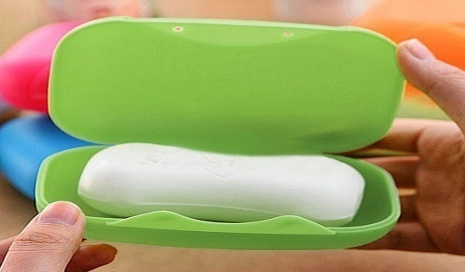

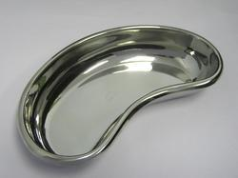


Hand washing articles

Slide 10
Cont….
Internal compartment:
• These are used for keeping solutions and medicines for internal and external use, simple instruments for dressing, articles for certain procedures such as temperature taking, urine testing, antenatal examination and few additional things for health teaching.

Slide 11
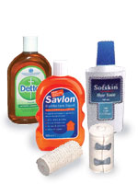

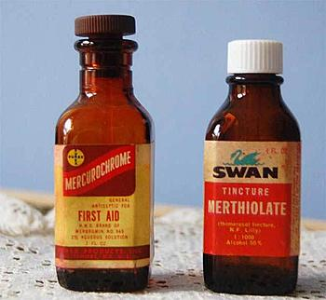
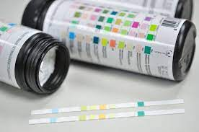






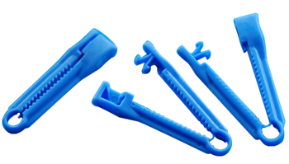


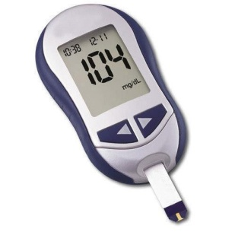

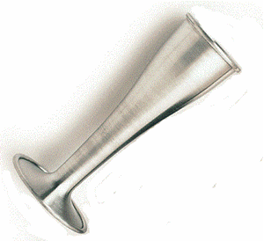

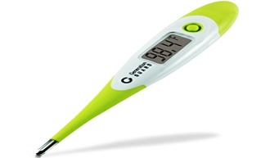
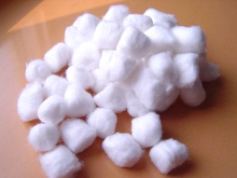
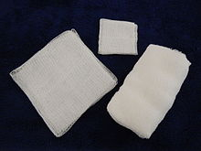
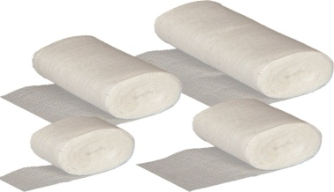
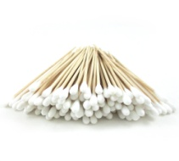

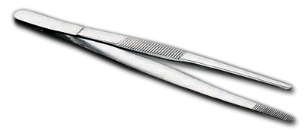
Internal compartment

Slide 12
PROCEDURE
Place the bag at proper place on news paper
Hand Washing - Remove hand washing material, spread newspaper. Select area of work.
Arrange the articles needed for procedure on the news paper & carry out procedure.
After procedure wash & replace articles on proper place in the bag. Use cotton swab moistened with spirit and wipe outside of used bottles.

Slide 13
Cont…
Write a report of what was observed, what was done, instructions given. Close the bag.
Fold used newspaper with used side inside, and return to outside pocket.

Slide 14
EVALUATION AND DOCUMENTATION
Record all relevant findings about the client and members of the family.
Take note of environmental factors which affect the clients/family health.
Include quality of nurse-patient relationship.
Assess effectiveness of nursing care provided.

Slide 15
CARE OF THE BAG
In order to keep the bag ready for use at any time, community health nurse responsibile for-
Clean the bag daily, protect from excessive heat or rain to preserve it in a good condition.
Replace the drugs, dressing and linen daily in the bag.
Empty all the contents, wash the bag with soap and water once in a week or more frequently depending on how much it has been used and dry it under the sun.

Slide 16
Cont..
Wash the articles such as instruments, linen and utensils with soap and water and boil them or send for sterilization.
Replace cotton or plastic bags containing swabs and dressing with sterile one.
Check gloves, thermometer and glass articles, replace if spoil or broken.
Repack the bag in an orderly way; keep articles in their usual places to make them easily traceable.

