Slide 1
PATHOPHYSIOLOGY OF HYPERTENSION
Resource Person
Mrs. Pratiksha P. Jadhav
Assistant Professor
Department of Pharmacology,
Krishna Institute of Pharmacy,
Krishna Vishwa Vidyapeeth (Deemed to be University), Karad, Maharashtra, INDIA

Slide 2
Learning Outcomes
By the end of this session, students will be able to:
Define hypertension and differentiate between primary and secondary hypertension.
Explain the normal regulation of blood pressure.
Describe the key mechanisms leading to elevated blood pressure.
Identify the roles of the nervous system, RAAS, and vascular changes in hypertension.

Slide 3
Contents
01
Introduction and classification of Hypertension
03
Role of RAAS and sympathetic nervous system
02
Pathophysiology of Hypertension.
04
Reflection spot and summary.

Slide 4
INTRODUCTION TO HYPERTENSION
Hypertension is a chronic elevation of blood pressure >140/90 mmHg.
Often called a "silent killer" as it's asymptomatic in early stages.
Major risk factor for heart disease, stroke, kidney failure, and vision loss.

Slide 5
Classification of Hypertension
1. Primary (Essential) Hypertension: No identifiable cause; accounts for ~90-95% cases.
2. Secondary Hypertension: Due to identifiable causes like renal disease, endocrine disorders, or drug-induced.

Slide 6
Normal regulation of BP
-BP = Cardiac Output x Peripheral Resistance
-Key regulators:
Baroreceptor reflex
Renin-Angiotensin-Aldosterone System (RAAS)
Sympathetic nervous system
Antidiuretic hormone (ADH)

Slide 7
Pathophysiology of Hypertension
Increased sympathetic activity
Overactivation of RAAS
Sodium and water retention
Endothelial dysfunction and reduced nitric oxide
Increased vascular resistance and arterial stiffness.

Slide 8
RAAS in Hypertension
Renin released by kidneys
Converts angiotensinogen to Angiotensin I
ACE converts it to Angiotensin II
Ang II causes vasoconstriction and aldosterone release
Aldosterone causes sodium and water retention
Result: Increased blood volume and BP

Slide 9
Sympathetic nervous system in Hypertension
Chronic activation leads to:
Increased heart rate and contractility
Peripheral vasoconstriction
Renal sodium retention
Structural vascular changes

Slide 10
Reflection Spot
Think-Pair-Share:
How do the nervous system and RAAS contribute to sustained elevation of blood pressure?
1. Think individually (30 seconds)
2. Pair up and discuss (1 min)
3. Share your ideas with the class

Slide 11
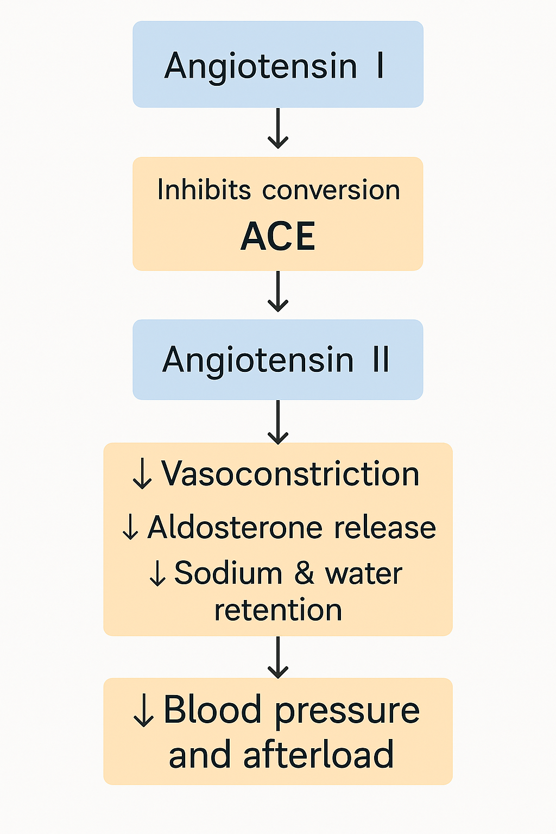
MECHANISM OF ACTION OF ENALAPRIL

Slide 12
SUMMARY
To summarize:
Hypertension results from complex interplay of genetic, neural, renal, and hormonal factors.
Major contributors: RAAS activation, sympathetic overdrive, endothelial dysfunction, and fluid retention.
Understanding pathophysiology helps in selecting rational pharmacological and lifestyle interventions.

