Slide 1
MECHANISM OF ACTION OF CARDIOVASCULAR DRUGS
Resource Person
Mrs. Pratiksha P. Jadhav
Assistant Professor
Department of Pharmacology,
Krishna Institute of Pharmacy,
Krishna Vishwa Vidyapeeth (Deemed to be University), Karad, Maharashtra, INDIA

Slide 2
Learning Outcomes
By the end of this session, students will be able to:
Define the concept of mechanism of action of cardiovascular drugs.
Classify drugs acting on cardiovascular system based on mechanism of action.
Explain the action of key cardiovascular drugs.
Relate drug action to therapeutic effects.

Slide 3
Contents
01
Introduction of CVS drugs.
03
Detailed mechanism of action of ACE inhibitors.
02
Classification of CVS drugs.
04
Reflection spot and summary.

Slide 4
INTRODUCTION TO CV DRUG MECHANISM
Cardiovascular drugs act on heart rate, blood pressure, cardiac output, and vascular resistance.
Drug targets include receptors, enzymes, ion channels, and hormonal pathways.
Understanding mechanisms helps optimize therapy and minimize side effects.

Slide 5
Classification of drugs acting on CVS
Class | Example | Mechanism
ACE Inhibitors | Enalapril | Inhibit angiotensin-converting enzyme (↓ Ang II)
Beta-blockers | Atenolol | Block β1 receptors (↓ HR & contractility)
Diuretics | Furosemide | Inhibit Na⁺/K⁺/2Cl⁻ transporter (↑ Na⁺ excretion)
Calcium Channel Blockers | Amlodipine | Inhibit L-type Ca²⁺ channels (↓ vascular resistance)
Nitrates | Nitroglycerin | Release NO (vasodilation)

Slide 6
Reflection Spot
Think-Pair-Share:
How does the inhibition of a single enzyme (ACE) cause both a drop in blood pressure and fluid excretion?
1. Think individually (30 seconds)
2. Pair up and discuss (1 min)
3. Share your ideas with the class

Slide 7
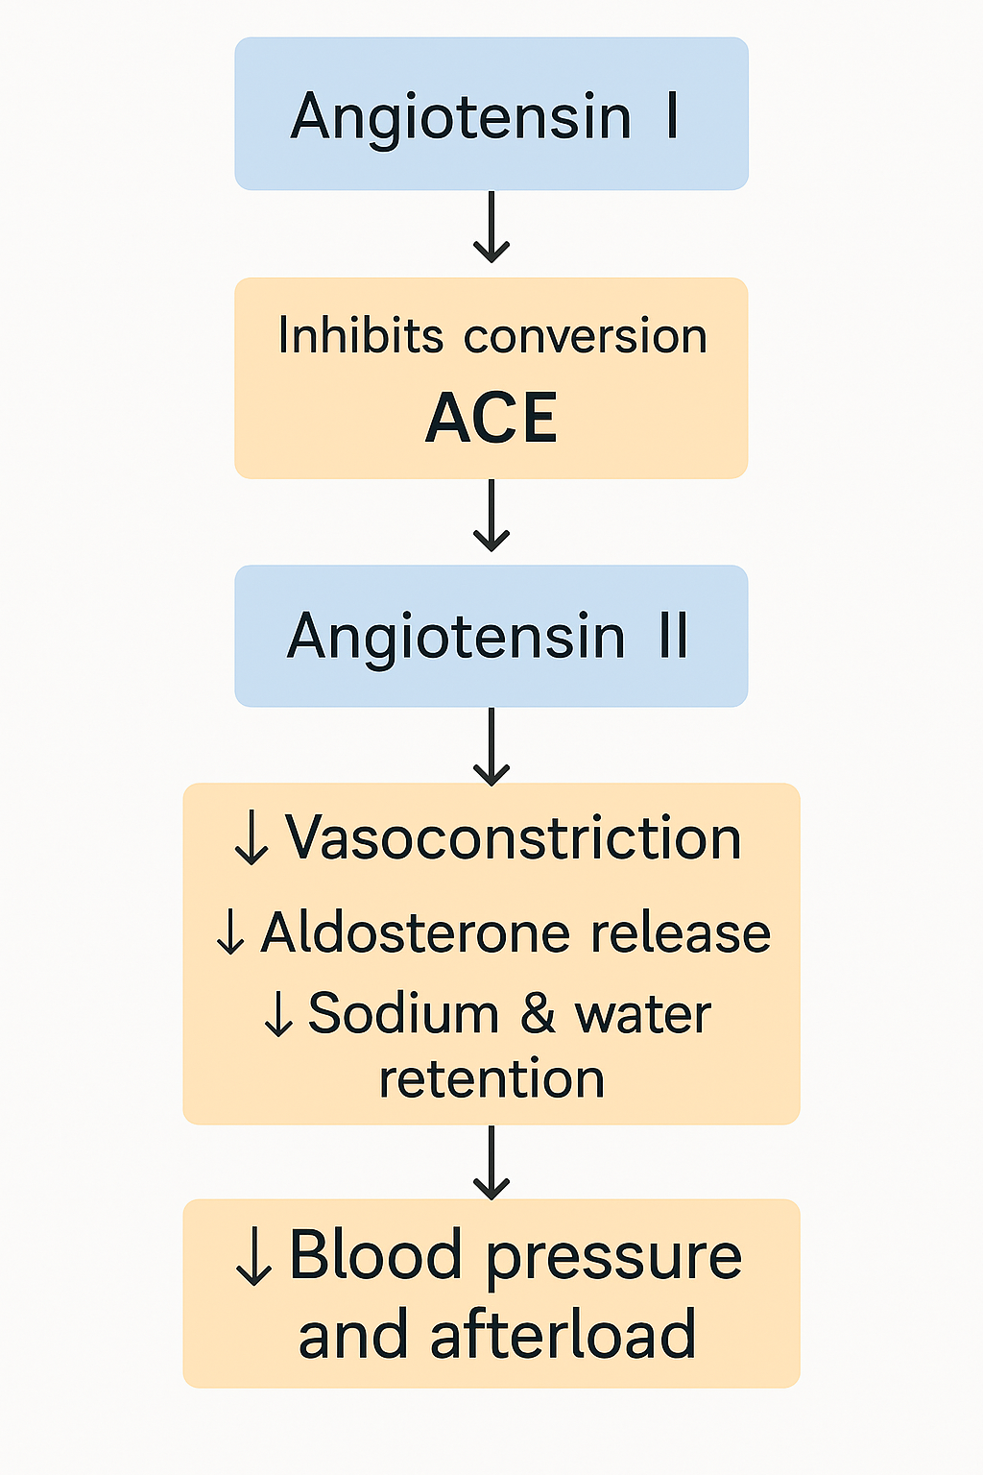
MECHANISM OF ACTION OF ENALAPRIL

Slide 8
Blocks β1-adrenergic receptors in the heart
↓ Heart rate (negative chronotropy)
↓ Myocardial contractility (negative inotropy)
↓ Cardiac output
↓ Blood pressure

Slide 9
SUMMARY
To summarize:
Cardiovascular drugs act via specific mechanisms to restore hemodynamic balance.
Mechanisms include receptor blockade, enzyme inhibition, and ion channel modulation.
Example: ACE inhibitors reduce Ang II production, causing vasodilation and natriuresis.
Mechanism knowledge improves drug selection and therapeutic outcomes.

