Slide 1
CLASSIFICATION OF ANTIHYPERTENSIVE DRUGS
Resource Person
Mrs. Pratiksha P. Jadhav
Assistant Professor
Department of Pharmacology,
Krishna Institute of Pharmacy,
Krishna Vishwa Vidyapeeth (Deemed to be University), Karad, Maharashtra, INDIA

Slide 2
Learning Outcomes
By the end of this session, students will be able to:
Understand the need for classification of antihypertensive agents.
Describe the major classes of antihypertensive drugs.
Explain the mechanism of action of each class.
Provide clinical examples and uses of each group.
Correlate the drug classes with pathophysiological targets in hypertension.

Slide 3
Contents
01
Introduction and need for classification.
03
Mechanism of action and clinical uses
02
Major classes of antihypertensive drugs
04
Reflection spot and summary.

Slide 4
INTRODUCTION
Antihypertensive drugs are used to lower and control elevated blood pressure.
Selection depends on the cause and severity of hypertension.
Drugs target different systems involved in BP regulation: RAAS, SNS, vasculature, kidneys, etc.

Slide 5
Need for Classification
1. Helps in systematic learning and prescribing.
2. Correlates drug mechanism with pathophysiological changes.
3. Supports rational combination therapy.

Slide 6
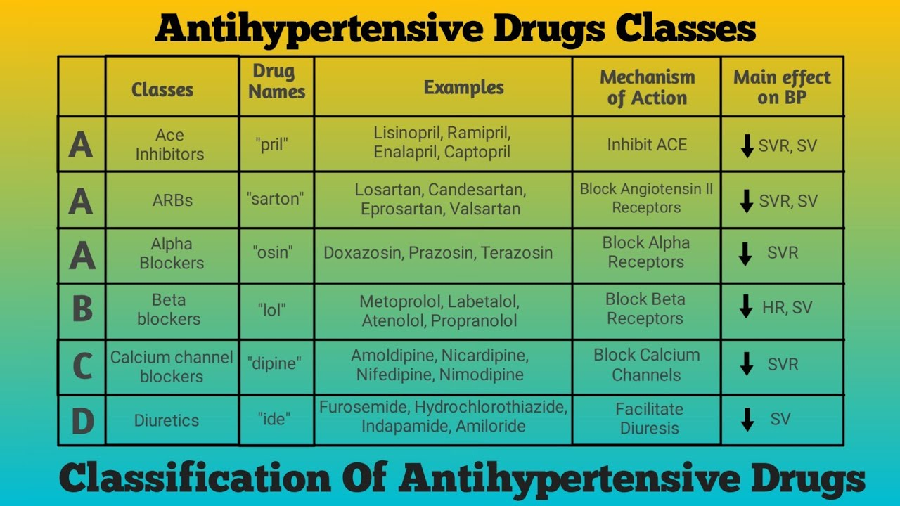
Classification of Antihypertensive drugs

Slide 7
Reflection Spot
Think-Pair-Share:
Why is it important to use different antihypertensive drug classes in combination therapy?
1. Think individually (30 seconds)
2. Pair up and discuss (1 min)
3. Share your ideas with the class

Slide 8
SUMMARY
To summarize:
Multiple drug classes exist to manage hypertension via different mechanisms.
Understanding classification helps guide therapy.
Choice depends on comorbidities, age, and individual patient factors.

