Slide 1
Concept of Osmotic Pressure, Freezing Point, and Molecular Weight in Pharmaceuticals
Miss.Vaishnavi Anil Mane
Assistant Professor
Department of Pharmaceutics,
Krishna Institute of Pharmacy,
Krishna Vishwa Vidyapeeth (Deemed to be University), Karad, Maharashtra, INDIA

Slide 2
Learning Outcomes
After completing this session, students will be able to:
Understand the concepts of osmotic pressure, freezing point, and molecular weight in pharmaceuticals.
Calculate molecular weight using osmotic pressure and freezing point data.

Slide 3
Contents
01
Concept of Osmotic Pressure
02
Freezing Point
03
Molecular Weight in Pharmaceuticals

Slide 4
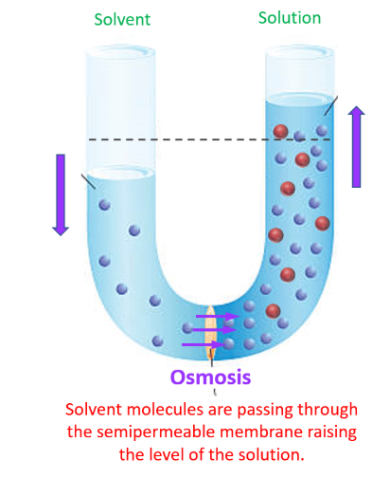
OSMOSIS
Osmosis is the movement of water (or another solvent) through a semipermeable membrane from a region of lower solute concentration to a region of higher solute concentration until equilibrium is reached.

Slide 5
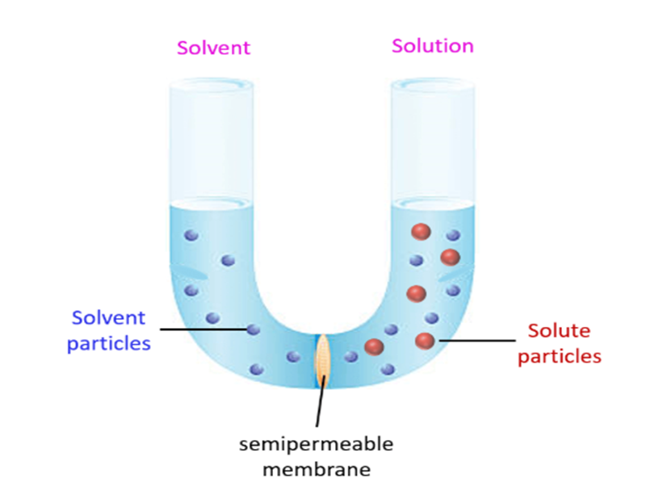
OSMOTIC PRESSURE
Osmotic pressure is the pressure required to prevent the net movement of solvent molecules across a semipermeable membrane due to osmosis.

Slide 6
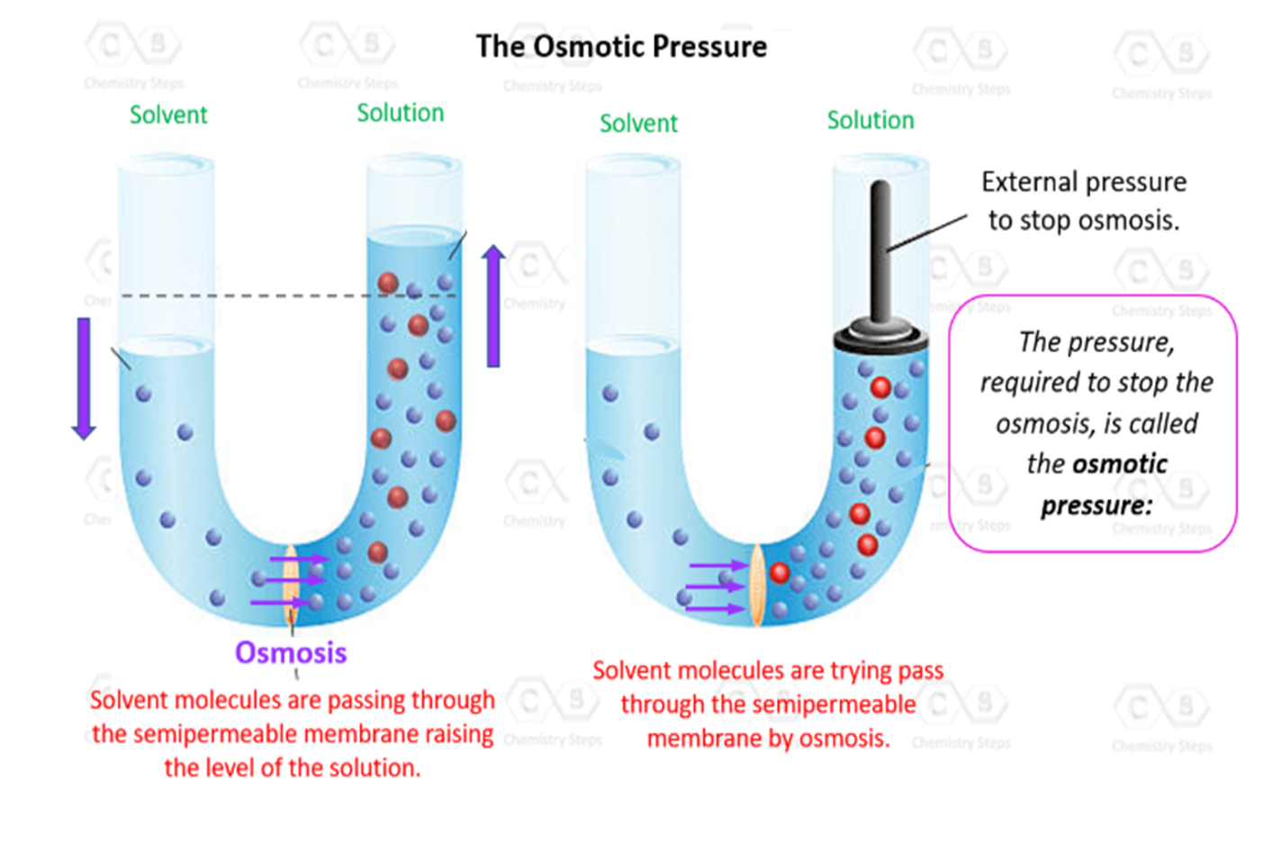

Slide 7
Calculating Osmotic Pressure
Formula:
Where,
M is the molarity of the solution
T is the temperature (in Kelvin)
R is the ideal gas constant (0.08206 L · atm / mol · K).
𝜋=MRT

Slide 8
For example,
A 0.5 M solution of sodium chloride (NaCl) is prepared at 27
°C. Calculate its osmotic pressure in atm
Answer:
Given,
Molarity (M) = 0.5 M
Gas constant (R) = 0.0821 L·atm/mol·K
Temperature (T) = 27°C = (27 + 273) K = 300K
π=MRT
π=(0.5)×(0.0821)×(300)
π=12.315atm
The osmotic pressure of the solution is 12.32 atm

Slide 9
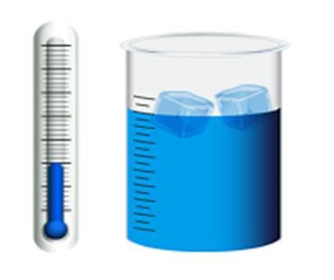
FREEZING POINT
FREEZING POINT
FREEZING POINT
The freezing point of a substance is the temperature at which it changes from a liquid to a solid under normal atmospheric pressure.

Slide 10
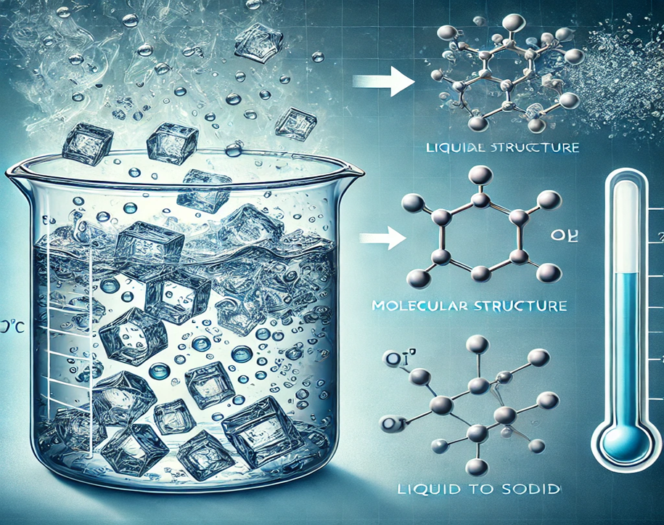
PHASE TRANSITION

Slide 11
Factors Affecting Freezing Point
Purity of the substance
Pressure
Nature of Substance

Slide 12
Calculating Freezing Point
Formula,
Where,
i = van 't Hoff factor
K_{f}​ = cryoscopic constant,
m = molality
ΔT_{f} freezing temperature
ΔT_{f} ​=iK_{f} ​m

Slide 13
ΔT_{f} (Freezing Point):
The difference between the freezing point of the pure solvent and the freezing point of the solution.
i (van't Hoff factor):
Represents the number of particles a solute dissociates into when dissolved in the solvent. For example, NaCl dissociates into two ions (Na+ and Cl-), so i = 2.
K_{f} (Cryoscopic Constant):
A constant that depends on the solvent, not the solute. For water, K_{f} is 1.86 °C/m (or K kg/mol).
m (Molality):
The concentration of the solution, expressed as moles of solute per kilogram of solvent.

Slide 14
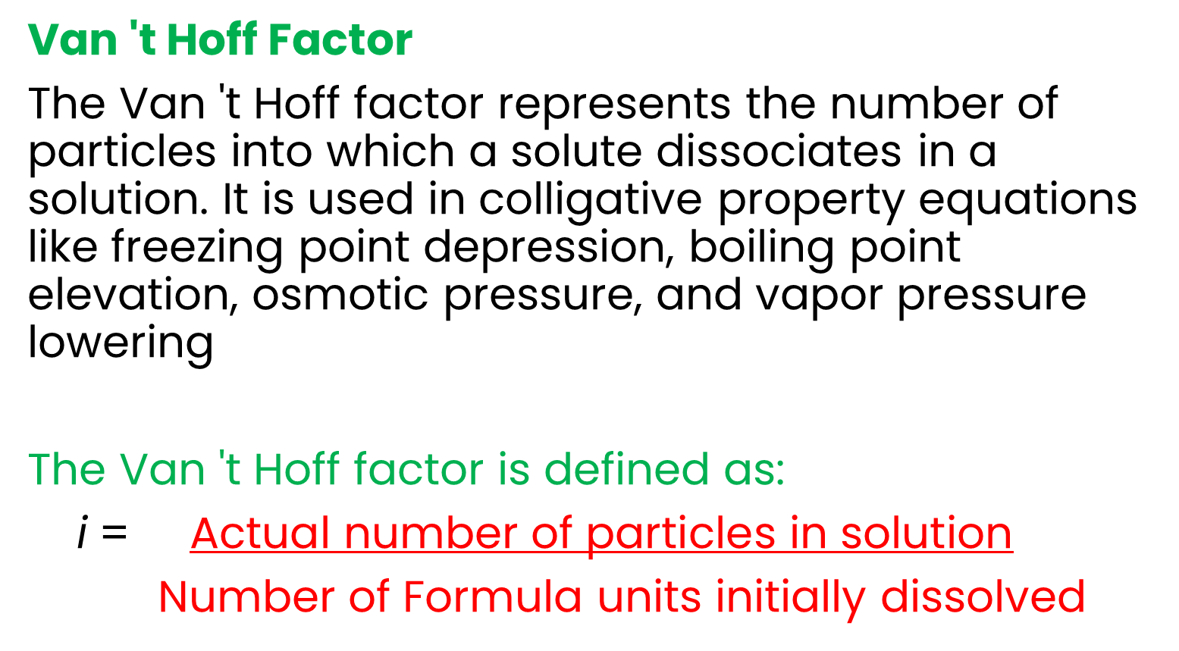
Van 't Hoff Factor
The Van 't Hoff factor represents the number of particles into which a solute dissociates in a solution. It is used in colligative property equations like freezing point depression, boiling point elevation, osmotic pressure, and vapor pressure lowering
The Van 't Hoff factor is defined as:
i = $\text{A}\text{ctual} \text{number} \text{of} \text{particles} \text{in} \text{solution}$
Number of Formula units initially dissolved

Slide 15
For Example,
What is the freezing point of water when 1 mole of glucose is dissolved in 1 kg of water?
Answer:
Given:
K_{f}​ for water = 1.86°C·kg/mol
i=1
m=1.0 mol/kg
ΔT_{f} ​=iK_{f} ​m
ΔT_{f =} (1)(1.86)(1.0) = 1.86 °C
The solution freezes at 1.86°C. T

Slide 16

MOLECULAR WEIGHT
Molecular weight (also called molar mass) is the mass of one mole of a substance, expressed in grams per mole (g/mol). It represents the sum of the atomic masses of all atoms in a molecule.
For example, the molecular weight of water (H₂O) is 18.02 g/mol, meaning one mole of water molecules weighs 18.02 grams.

Slide 17
Atomic Mass and Mole Concept
Atomic Mass Unit (amu): The atomic mass of each element is measured in atomic mass units (amu), based on the mass of protons and neutrons in an atom.
Mole (mol): A mole is a quantity representing 6.022×10²³ times particles (Avogadro's number).
Relation Between Atomic Mass and Molar Mass: The atomic mass of an element in amu is numerically the same as its molar mass in g/mol.
Example: Carbon (C) has an atomic mass of 12.01 amu → Molar mass = 12.01 g/mol.

Slide 18
Calculation of Molecular Weight
Identify the chemical formula of the compound.
Find the atomic mass of each element from the periodic table.
Multiply the atomic mass by the number of atoms of that element.
Sum the total masses of all elements.

Slide 19
Example:Carbon Dioxide (CO₂)
Step 1: Identify the elements and their atomic masses
Carbon (C) = 12.01 g/mol
Oxygen (O) = 16.00 g/mol
Step 2: Multiply by the number of atoms
(1×12.01) +(2×16.00)=12.01+32.00=44.01 g/mol
Molecular weight of CO₂ = 44.01 g/mol

