Slide 1

Drug profile of Acidifiers and Antacid
KRISHNA VISHWA VIDYAPEETH
(DEEMED TO BE UNIVERSITY), KARAD
UNIVERSITY EDUCATION AND TECHNOLOGY CELL &
CENTRE OF DISTANCE AND ONLINE EDUCATION KVV
By
Ms. Monali M Shewale
Assistant Professor,
Krishna Institute of Pharmacy, Karad

Slide 2
Objectives
Objectives of this topics are:
1. To understand the significance of acidifiers and antacids.
2. To know the various drug profile of acidifiers and antacids.
3.To understand the clinical condition of the same.

Slide 3
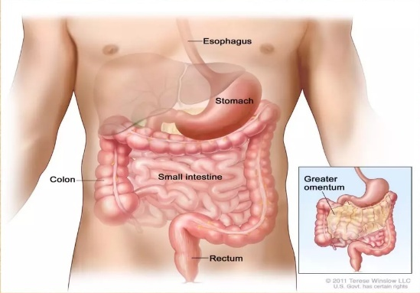
GIT Consists of a series of organs involved in the digestion of food ,right from the indigestion of food to the expulsion of waste or faeces.
Git includes :
Oseophagus
Stomach
Intestine ( Small and large )
Rectum with anus

Slide 4
In case the functions of GIT is impaired, following condition can take place:
i) Absence or insufficient secreation of hydrochloric acid in stomach leading to achlorhydria .
ii) Excessive secreation of hydrochloric acid in stomach leading to hyperacidity, which cause acid enzyme imbalance and finally leads to ulcer, inflammation and pain.
iii) Accumulation of toxin, gases, toxic substance or insufficient absorption of fluid or electrolytes in intestine stimulates motility leading to frequent stools or diarrhoea .
iv) Insufficient intestine motility or peristalsis leading to constipation .

Slide 5
It is possible to bring the above condition to their normal state and various agents which are used for this are :
i) Products for altering gastric PH (Acidifying agents and antacid)
ii) Protective and adsorbents
iii) Saline Cathartics or Laxatives

Slide 6
ACIDIFYING AGENTS :
Defination
Acidifying agents are used in condition when there is absence or insufficient Secreation of hydrochloric acid in stomach ,which leads to disease called Achlorhydria or Hypochlorhydria.

Slide 7
The gastric hydrochloric acid secreted by the stomach walls, kills the bacteria in the ingested drink /food ,soften fibrous food and helps in the secretion of pepsin
PH below
Pepsinogen Pepsin
6
Pepsinogen is converted into pepsin when the gastric PH is below 6. not only this, pepsin shows its best action below 3.5.thus the absence of gastric acid (HCl) can cause lack of pepsin activity .this finally leads to impairment of protein digestion .

Slide 8
Hydrochloric acid (HCl )
Molecular Formula : HCl
Molecular weight : 36.5 g
Synonyms : Muriatic acid ,Sprit of salt
Standards : It contain NLT 35% w/w and NMT 38% w/w of HCl

Slide 9
Method of preparation :
1) It is manufactured by the action of sulphuric acid on sodium chloride.
NaCl + H2SO4 →NaHSO4 + HCl
Sodium sulphuric sodium hydrochloric
Chloride acid Bisulphate acid
NaHSO4 + NaCl → Na2SO4 +HCl
sodium sodium sodium hydrochloric
bisulphite chloride sulphate acid

Slide 10
Physical properties :
1) It is a colourless liquid , strongly acidic.
2)It is miscible with water, alcohol.
3)It is a strong acid and attacks metals, forming their hydrochlorides with the evolution of hydrogen gas.
4) Even in high diluted form, it is very strongly acidic to litmus.

Slide 11
Assay:
4 g of HCl is transferred into a stoppered flask which is having 40 mL of water. Now the solution is titrated with 1 N NaOH, using Methyl orange as an indicator.
NaOH + HCl → NaCl + H2O
Simple acid‐base neutralization reaction.

Slide 12
Storage
It should be stored in well closed container of glass or other material at a temperature not exceeding 30 °C.
It is mainly used as a pharmaceutical aid or as an acidifying agent.
Used as gastric acidifier when levels of hydrochloric acid in gastric juice are low
Externally used as a solvent.
It acts as catalyst in basic pharmaceuticals .
Uses

Slide 13
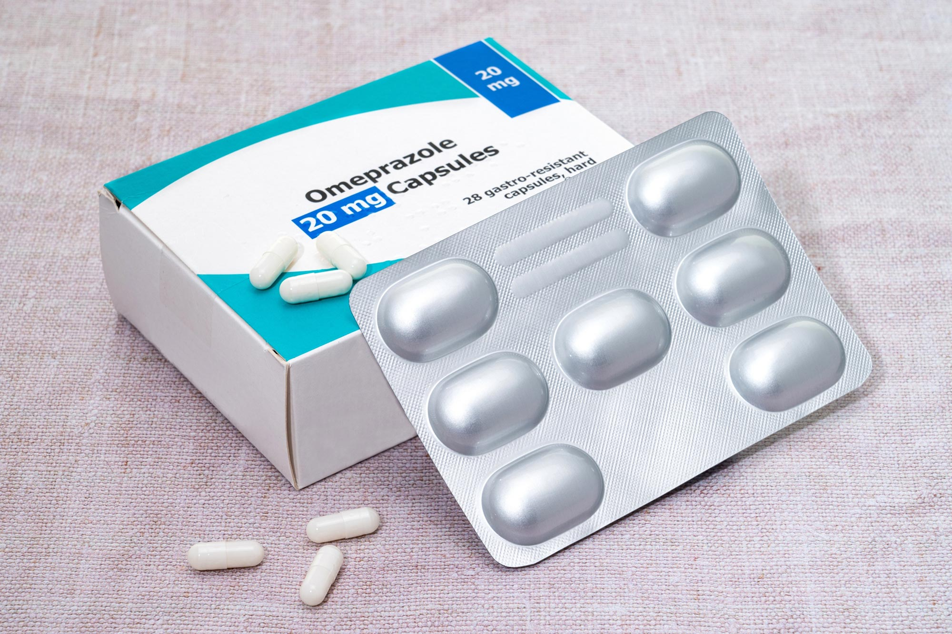
ANTACIDS
These are the alkaline substances which on intake ,reacts with the gastric acid, neutralize it and lower the acidity of gastric content.

Slide 14
Ideal characteristics of antacids
1) It should be insoluble in water and has fine particle form.
2) It should not get absorbed otherwise they can cause systemic alkalosis.
3) It should not liberate carbon dioxide.
4) it should neither be laxative nor be constipatory in action.
5) it should be quick acting and exert its effect for a longer period of time.
6) It should be stable and easily available.
7) The antacid should buffer in the PH range of 4-6.

Slide 15
Classification of Antacids
Systemic ( Absorbable ) antacids
Non systemic ( Non Absorbable )
Aluminium Containing Antacids
Calcium containing Antacids
Magnesium containing Antacids
Combination antacid Preparation

Slide 16
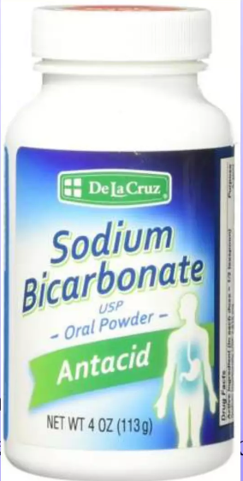
Systemic ( Absorbable antacids ) :
These antacid get systemically absorbed. Theses are highly soluble and potent neutralizer. These are not suitable for the treatment of peptic ulcer because of risk of ulcer perforation which can occur due to production of carbon dioxide in stomach.
E.g sodium bicarbonate .

Slide 17

Non- Systemic ( Non absorbable ) Antacids :
These are the insoluble and poorly absorbed systemically.
e.g: Magnesium and aluminium salts.

Slide 18
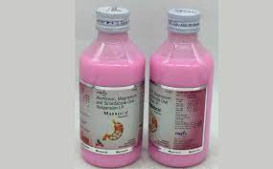
A) Aluminium containing Antacids :
Aluminium hydroxide is a weak and slow reacting antacid. The aluminium ion relaxes smooth muscle and cause constipation .
e.g: Aluminium hydroxide , aluminium phosphate , Basic aluminium Carbonate, etc.

Slide 19
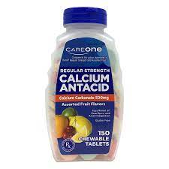
Calcium containing Antacids :
Calcium carbonate is potent antacid with rapid acid neutralizing capacity,but on long term use, it can cause Hypercalcaemia, hypercalceuria and formation of calcium stone in the kidney .
e.g: Calcium Carbonate, Tribasic calcium Phosphate

Slide 20
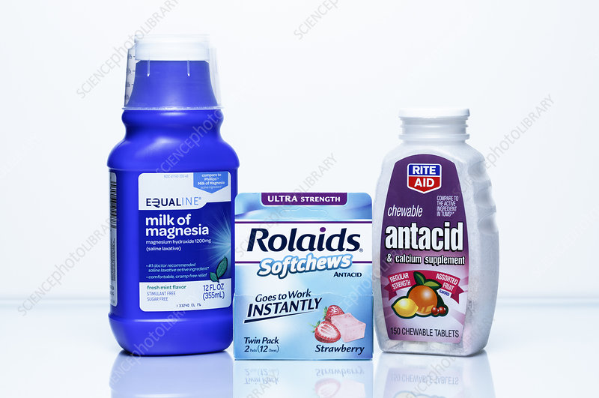
Magnesium containing Antacids :
Magnesium Carbonate is most water soluble.
e.g: Magnesium carbonate, Magnesium hydroxide, magnesium phosphate, Magnesium trisilicate, etc.

Slide 21
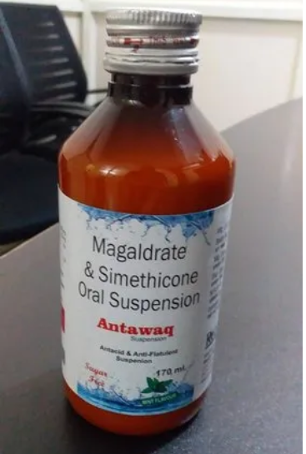
Combination antacid preparation :
e.g : Aluminium hydroxide gel and magnesium hydroxide , Aluminium hydroxide gel and Magnesium trisilicate.

Slide 22
conclusion
In todays class we all have completed with concept of the gastrointestinal tract, acidifires and antacids with their drug profile and classification.

Slide 23
Thanks for support and guidance:
Prof. (Dr) Namdeo R. Jadhav
Dean, Krishna Institute of Pharmacy,
Krishna Vishwa Vidyapeeth, Karad
Dr. M. V. Ghorpade
Registrar,
Krishna Vishwa Vidyapeeth, Karad

Slide 24
And above all
Hon. Dr. Sureshji Bhosale
Chancellor, KVV,
Chairman, Krishna Charitable Trust, Karad

Slide 25
END CREDITS
Concept, script and cast:
Location:
Graphics:
Narration:
Editor:

