Slide 1

WELCOME
TOPIC- TRAUMA
-DR SONALI KISAN WAGHMODE
DEPT OF PEDIATRIC DENTISTRY
SCHOOL OF DENTAL SCIENCES, KARAD

Slide 2
Objectives
To know about definition, prevalence of trauma
To know classification in details
To know how to treat each and every class of trauma
Case studies

Slide 3
INTRODUCTION
Traumatic dental injuries (TDI’s) are for the most part Unanticipated Events that, if not managed appropriately, can have serious consequences for the patient.
Traumatic dental injuries have always been a neglected oral condition despite availability of a sound knowledge about its prevalence, causative factors, treatment and significant impact on individual’s quality of life.

Slide 4
TRAUMA ??
It refers to injury, damage, impairment, external violence producing injury or degeneration
TRAUMATOLOGY ??
The branch of surgery that deals with wounds and disabilities from injuries
Dental trauma is injury to the mouth, including teeth, lips, gums, tongue, and jawbones
DENTAL TRAUMA ??

Slide 5
Prevalence and Incidence
Oral traumas are not frequent and make up to 5% of all injured parts of the body of all ages.
TDI’S: In age group of 0-6 years it comprises about 17%
Acc to Andreasen: prevalence of dental injuries varies from 4-14%
Acc to Andreasen: by the age of 5 yrs. up to 40% boys and 30% girls experienced TID’s.
Zaleckiene V, Peciuliene V, Brukiene V, Drukteinis S. Traumatic dental injuries: etiology, prevalence and
possible outcomes. Stomatologija, Baltic Dental and Maxillofacial Journal, 16: 7-14, 2014.

Slide 6
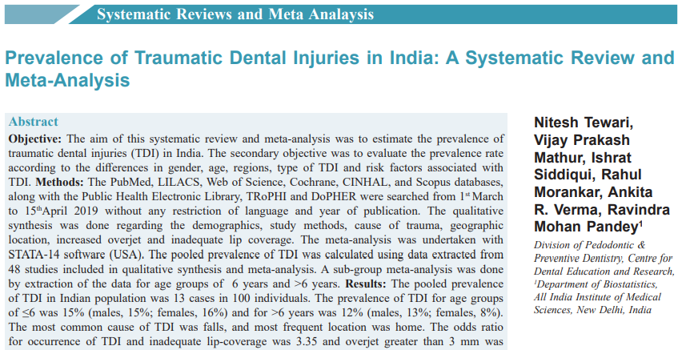
Tewari N, Mathur VP, Siddiqui I, Morankar R, Verma AR, Pandey RM. Prevalence of traumatic dental injuries in India: A systematic review and meta-analysis. Indian J Dent Res 2020;31:601-14.

Slide 7
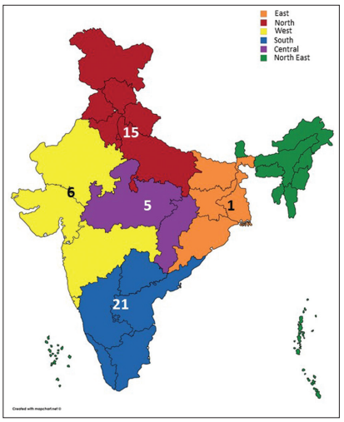
The pooled prevalence of TDI for age groups and genders in India was estimated as 13%
The pooled prevalence of TDI in children less than 6 years of age was found to be slightly higher than their older counterparts
Inadequate lip coverage and increased overjet are the risk factors associated with TDI
Tewari N, Mathur VP, Siddiqui I, Morankar R, Verma AR, Pandey RM. Prevalence of traumatic dental injuries in India: A systematic review and meta-analysis. Indian J Dent Res 2020;31:601-14.
Notes:
48 studies all over india

Slide 8
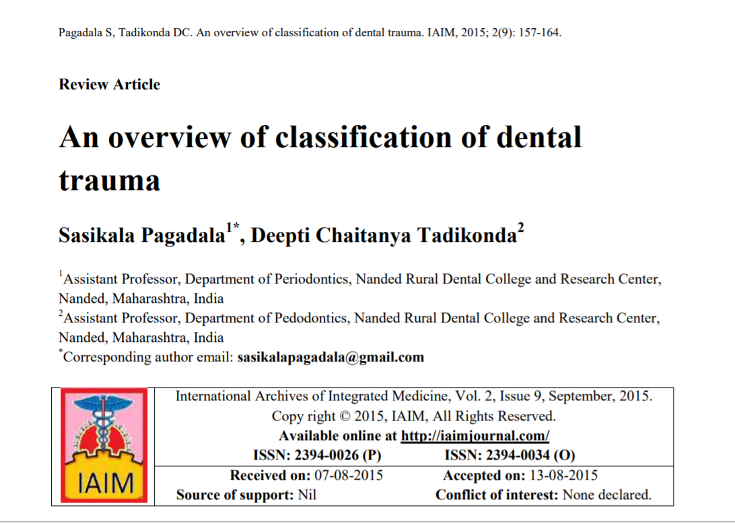

Slide 9
Classification of anterior teeth trauma by Sweets (1955)
Classification by Rabinowitch (1956)
Bennet classification (1963)
Classification by Ulfohn (1969)
Ellis and Davey classification (1970)
Classification by Hargreaves and Craig (1970)
WHO classification (1978)
Garcia Godoy classification (1980)
Andreasen classification (1981)
Johnson classification(1981)
Classification by Basrani (1982)
Classification by Galea (1984)
Classification by Burton, et al. (1985)
Classification by Stockwell (1988)
Classification by Lee-Knight, et al. (1989)
Classification by Bijella, et al. (1990)
Classification by Forsberg and Tedestam (1990)
Classification by Perez, et al. (1991)
Classification by Zerman and Cavellari (1993)
Classification by World Health Organization in its application of International Diseases of Dentistry and Stomatology (1994)
Classification by Burden (1995)
Classification of dental trauma of primary teeth by Fried and Erickson (1995)
Classification by Hamilton, et al. (1997)
Classification by Spinas (2002)
Classification by McDonald (2004)
Pagadala S, Tadikonda DC. An overview of classification of dental trauma. IAIM, 2015; 2(9): 157-164

Slide 10
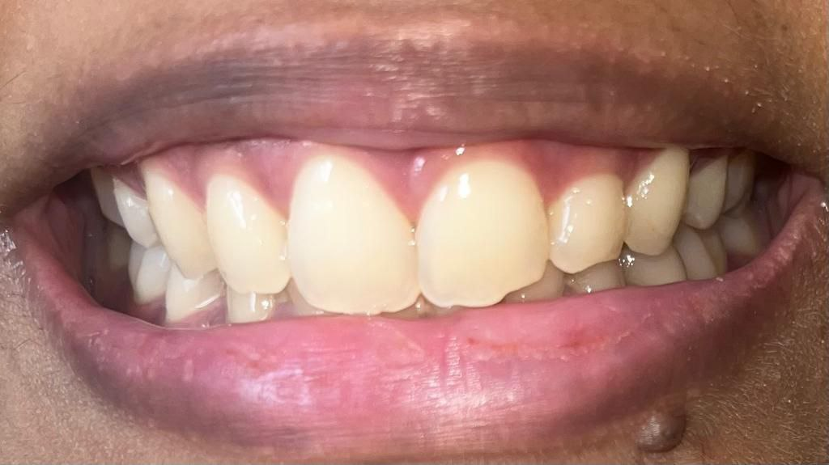
ELLIS AND DAVEY CLASSIFICATION (1970)
Class 1 - Simple fracture of the crown-involving enamel with little or no dentin

Slide 11
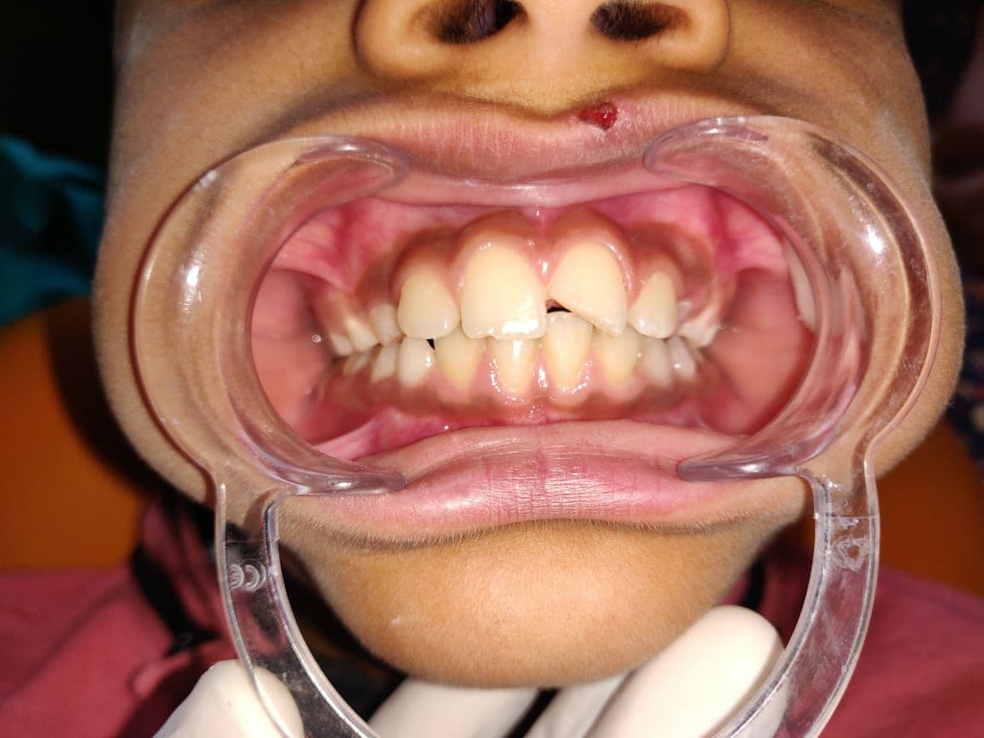
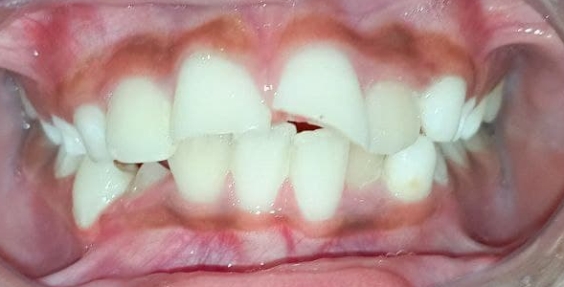
Class 2 - Extensive fracture of the crown – involving considerable dentin, but not the pulp
Class 3 - Extensive fracture of the crown- involving considerable dentin, and
exposing the dental pulp

Slide 12
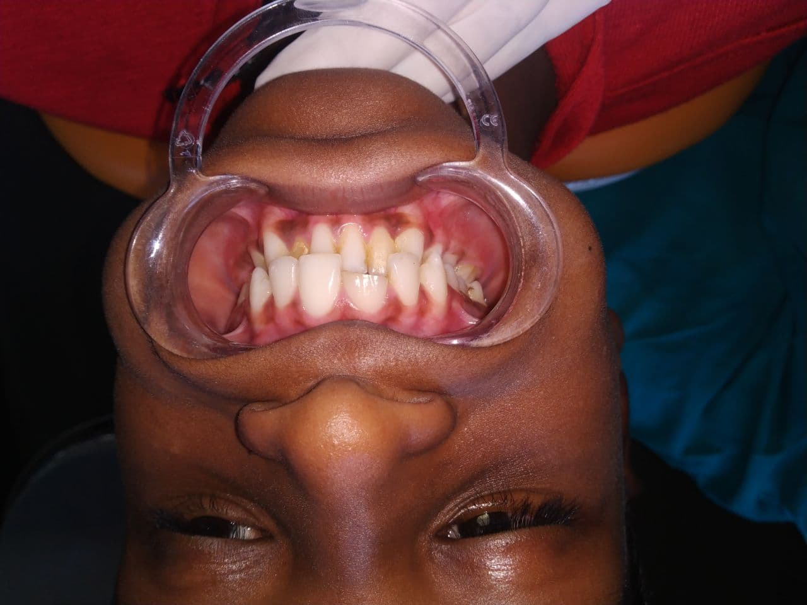
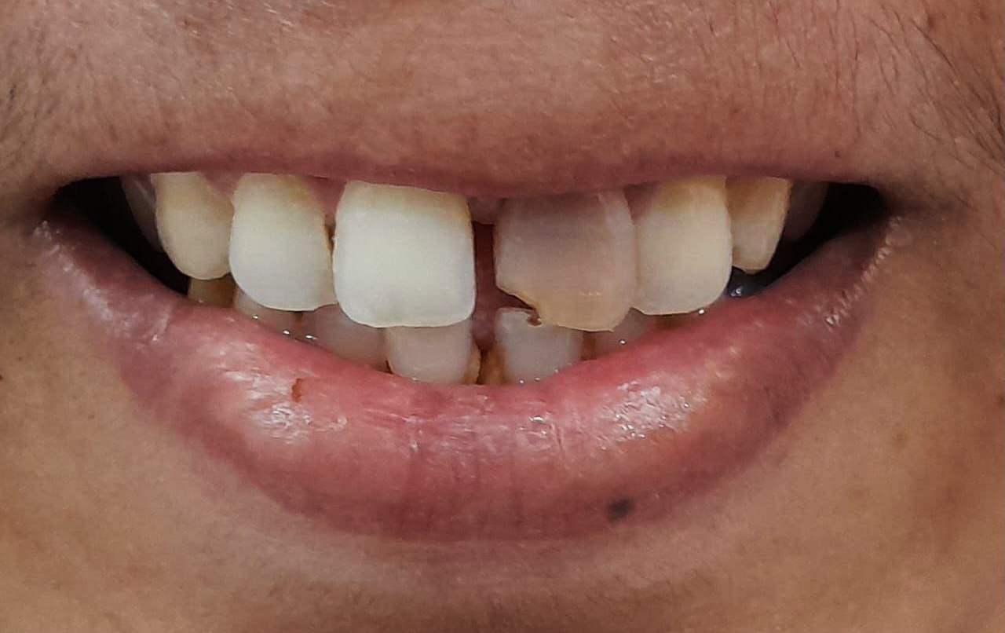
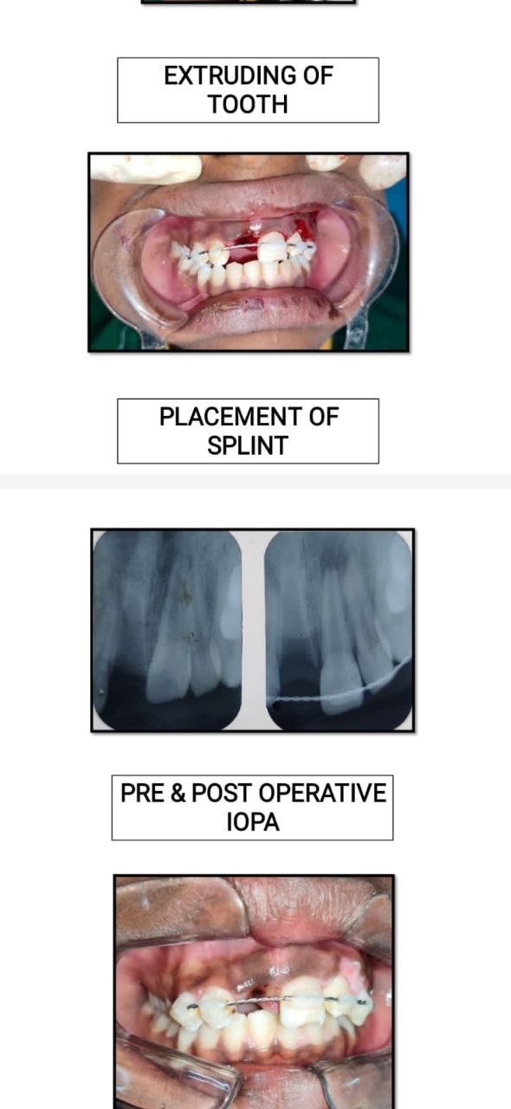
Class 4 -The traumatized tooth which becomes nonvital-
with or without loss of crown structure
Class 5 -Tooth lost as a trauma (exarticulation/avulsion)

Slide 13
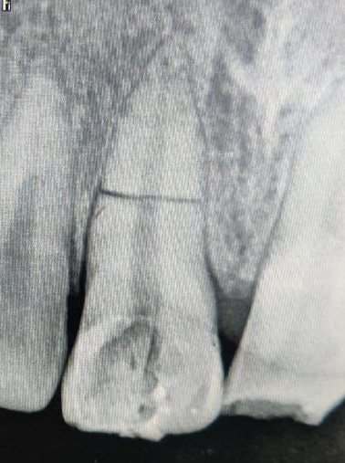
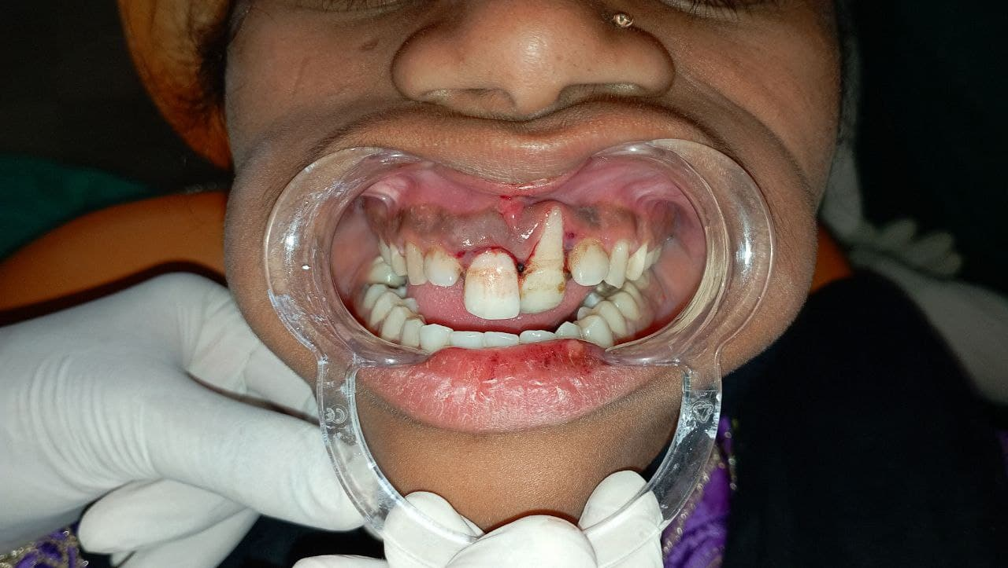
Class 6 -Fracture of the root - with or without loss of crown structure
Class 7 -Displacement of the tooth-without fracture of crown or root

Slide 14
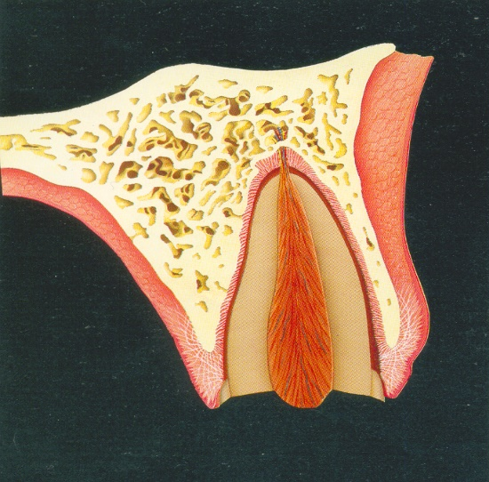
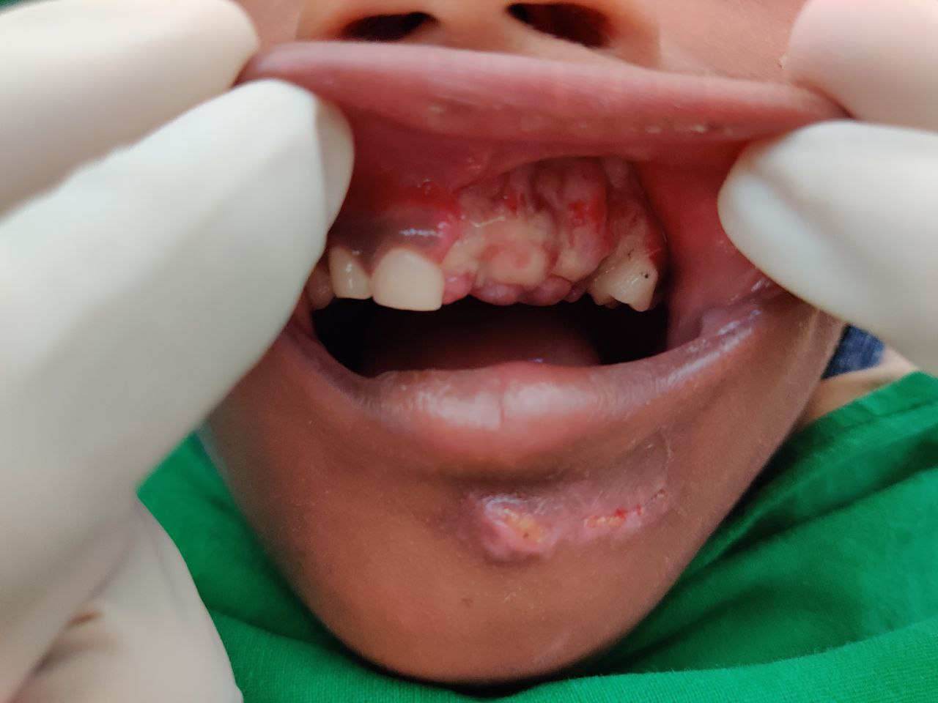
Class 8 - Fracture of the crown en-masse and its replacement.
Class 9 – Traumatic injury to deciduous tooth

Slide 15

Examination and Diagnosis in TDI’s
Notes:
Should be considered an emergency and treated immediately in certain types.

Slide 16
ANDREASEN: Guide-path to examine TDI’s
Information about the injury
Clinical examination
Mobility test
Percussion test
Pulpal sensibility test
Radiographic examination
ALWAYS START WITH :
Name, age, sex, address, telephone number :
Record keeping
Medico-legal aspect
Future reference
Ability to answer: clue to possible cerebral involvement or not and also gives information about general mental status of patient.

Slide 17
Case: Management Ellis class I with 11,21

Slide 18
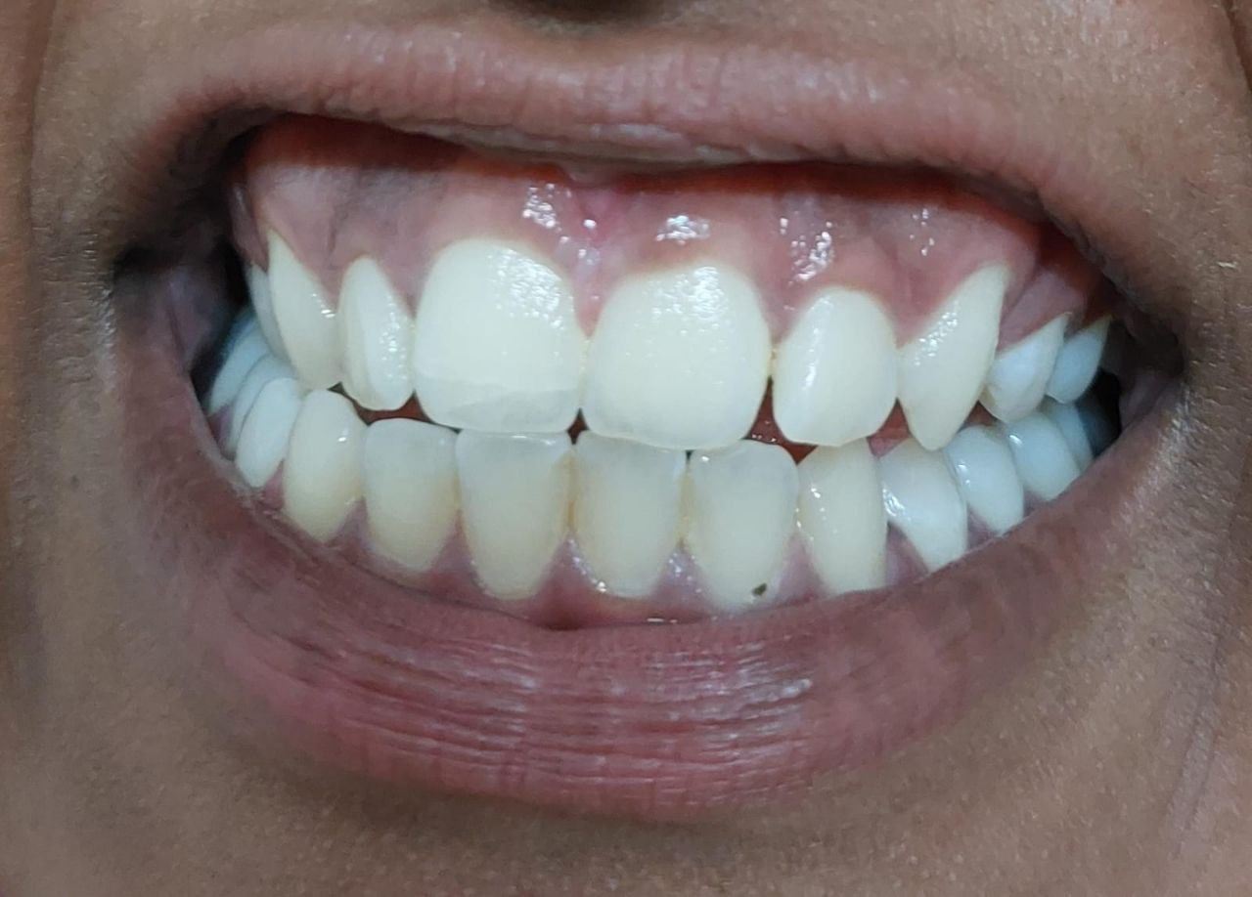
Enamel fracture, a fracture with loss of tooth substance confined to enamel (uncomplicated crown fracture)
Enamel infraction, an incomplete fracture (crack) of the enamel without loss of tooth substance

Slide 19
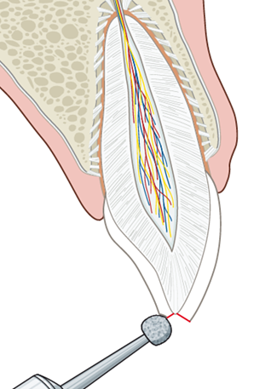
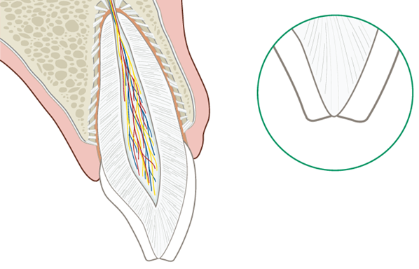
Enamel infractions | Enamel fractures
microcracks in the enamel without tooth structure loss | uncomplicated crown fracture i.e. fracture limited to the enamel without exposing dentin or pulp
usually asymptomatic | located at a proximal angle or the incisal edge of the anterior region
normal response to pulp vitality tests, (1-8 weeks) no tooth mobility, no sensitivity to percussion | normal response to pulp vitality tests, (1-8 weeks) no tooth mobility, no sensitivity to percussion
Unremarkable Xray | The radiographic examination will show the extension of the enamel loss
do not require treatment | Smoothing of rough edges with a burr
if the crack is more severe, etching and sealing with composite resin | If the loss of substance necessitates replacement, use composite resin
Pulp survival 0 – 3.5% | Pulp survival 0.2 – 1.0%
FOLLOW UP – 6 months
Notes:
but if the crack is more severe, etching and sealing with bonding resin is advised to prevent bacterial contamination and discoloration
If pulp vitality is retained at 6 months post trauma no further follow up is needed.
In case of pulp necrosis, appropriate endodontic therapy has to be implemented

Slide 20
Case: Management Ellis class II with 11,21 –composite buildup

Slide 21
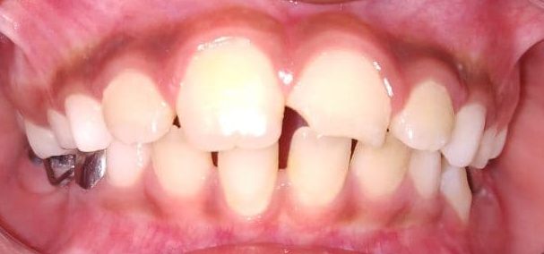
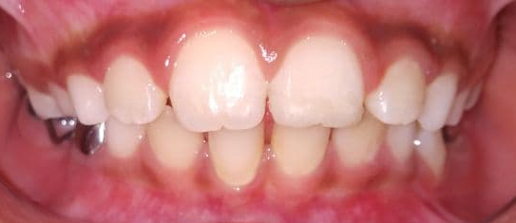
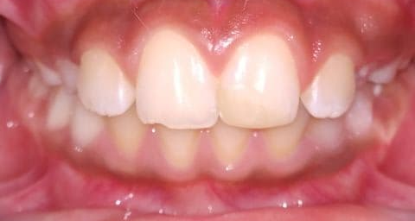
Pre-Operative
Post-Operative
Notes:
vital tooth with no sensitivity to percussion and no mobility.
Sensitivity to thermal changes and mastication
Dentin and dentinal tubule exposure
therapeutic measures should be directed towards dentin coverage in order to avoid bacterial ingress and thereby permit the pulp to recover and elicit repair

Slide 22
Management of crown and crown‑root fractures pose a challenge to the clinician as several factors may play a role in their management.
The extent of the fracture (complicated or uncomplicated, violation of biological width, alveolar bone fracture, concomitant luxation injury)
Restorability of the fractured tooth and fracture pattern (subgingival extension of the fracture line and/ or associated root fracture)
Availability of the fractured fragment and its condition for use (fit of the fragment to the remaining tooth structure)
Secondary soft‑tissue injuries
Occlusion, esthetics and finance.
Simonsen RJ. Restoration of a fractured central incisor using original teeth. J AmDent Assoc 1982;105:646-48

Slide 23
COMPOSITE BUILDUP AND REATTACHEMENT
Tennery (1988) was the first to report the reattachment of a fractured fragment using acid-etch technique.
Subsequently, Starkey (1979) and Simonsen (1982) have reported success with similar cases.
Direct composite restoration technique is minimally invasive, economical and successful in repairing tooth fracture with excellent longevity in carefully selected cases and with superior matching ability. | Reattachment techniques for tooth fragments present several advantages over restorations obtained with composite resin systems: better and long-lasting esthetics, improved function, immediate results, a positive psychosocial response, and faster and less complicated procedures.
poor abrasion resistance in comparison to enamel, water absorption, and staining. | change in color due to inadequate rehydration of the fragment; and possibility of detachment of the fragment
Notes:
→composite in combination with the use of acid-etch technique to bond composite to enamel, made restoration possible for the fractured incisor, with minimal preparation.
→Reattachment of fractured tooth fragments offers a viable restorative option for the clinician because it restores tooth function and esthetics with the use of a very conservative and cost-effective approach. Also provide immediate natural esthetics and functional rehabilitation

Slide 24
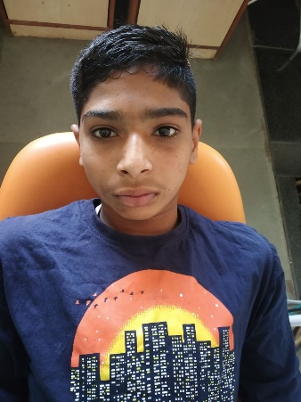
Name: Pranav Pawar
Age: 14 years/M
Case: Management Ellis class III with 11,21 – RCT followed by composite buildup

Slide 25
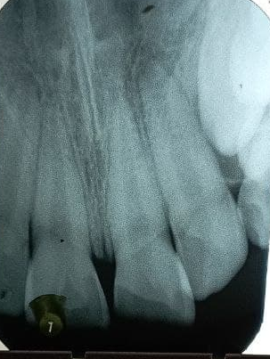
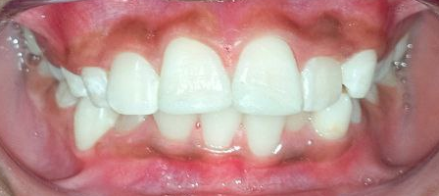
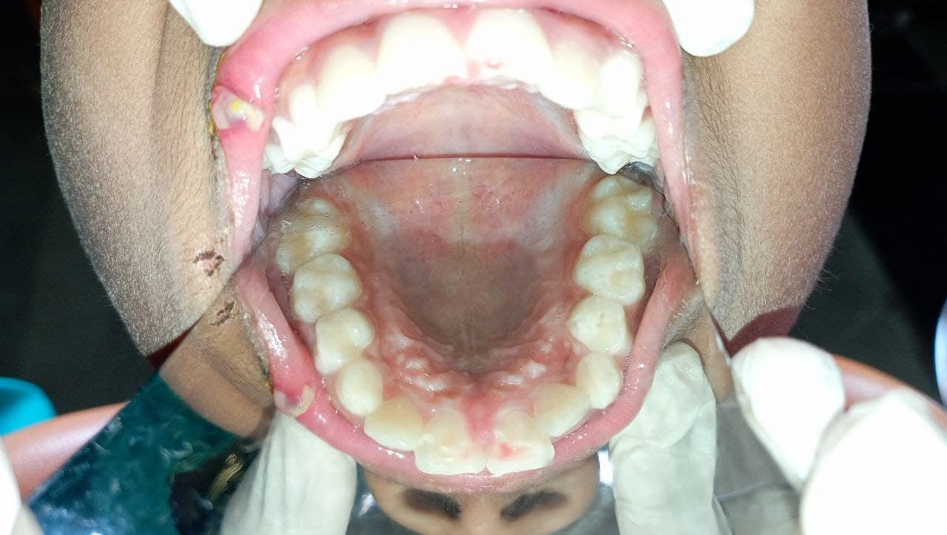
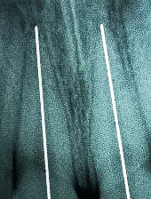
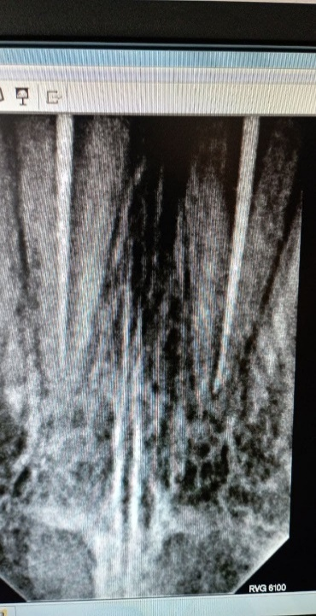
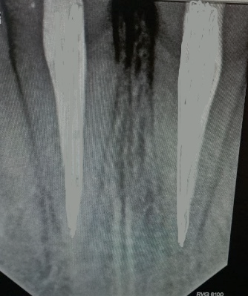
Pre-Operative
Post-Operative
RCT with 11,21 followed by composite esthetic build up
Notes:
Enamel-dentin fractures with pulp exposure (complicated crown fracture) are diagnosed clinically by observing a missing crown structure and pulp exposure.
The tooth is usually sensitive to air, temperature, and pressure

Slide 26
the stage of development of the tooth
Immature – vital pulp therapy
time between the accident and treatment
24- 48 hours of trauma
concomitant periodontal injury
Vital pulp therapy – composite restroration
the restorative treatment plan
compromise the nutritional supply of the pulp
Pulpectomy – crown
Notes:
Treatment options are (1) vital pulp therapy comprising pulp capping, partial pulpotomy, and full pulpotomy or (2) pulpectomy. The choice of treatment depends on→
-If the root is immature, the goal is to maintain a vital pulp to allow for root maturation/development and closure of the apex.
-In mature teeth, a direct pulp cap can be performed if the exposure is pinpoint and treatment is taking place soon after injury. teeth with closed apices if the pulp exposure is large is pulpectomy. Clinical and radiographic follow-up is at 6–8 weeks and 1 year

Slide 27
Requirements for Success in vital pulp therapy
Treatment of a healthy pulp
A microbial-tight seal
A proper pulp dressing
optimal time -first 24 hrs
inflammation is superficial
As time increases
between injury n therapy
extended apically
exposed pulp from microbial access
hard tissue barrier
Bioceramic materials
Calcium hydroxide
Notes:
Challenge by microorganisms during the healing phase will cause failure.
-Injury resulting in an exposure of the pulp in young patients often presents a challenge in diagnosis and treatment even greater than that of a pulp exposed by caries. In addition to treating the pulp at the exposure site, the dentist must keep in mind that, as a result of the blow, conditions may be present for many unpredictable reactions in the pulp or supporting tissues. The immediate objective in treatment, however, should be the selection of a procedure designed to maintain the vitality of the pulp whenever possible.

Slide 28
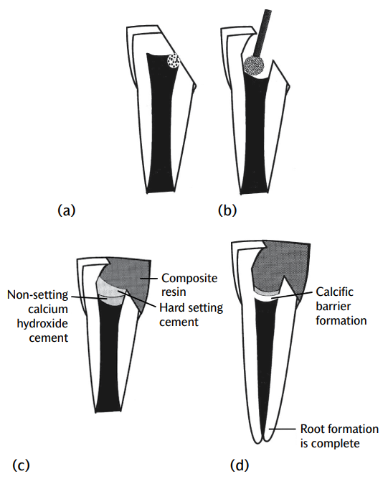
Partial pulpotomy
Complete Pulpotomy
complicated crown fracture of mature teeth (if conditions are not ideal for vital pulp therapy)
Pulpectomy
Pulp capping
removal of coronal pulp tissue to the level of healthy pulp tissue
traumatic exposures after 72 hours
should not be considered after traumatic pulp exposures
Follow up
Notes:
→The prime requisite of pulpal healing is an adequate seal against oral fluids. Therefore a restoration should be placed immediately to protect the pulp-capping material until the healing process is well advanced, at least 2 months.The radicular pulp has enormous capacity to remain healthy and undergo repair if all infected and inflamed coronal tissue is removed and an appropriate wound dressing and sealing coronal restoration are applied. Pulp amputation by partial pulpotomy or complete coronal pulpotomy is often the treatment of choice
→welbury Review after a month, at 3 months, and then every 6 months for up to 4 years in order to assess pulp vitality. Periodic radiographic review should also be arranged to monitor dentine bridge formation and root growth

Slide 29
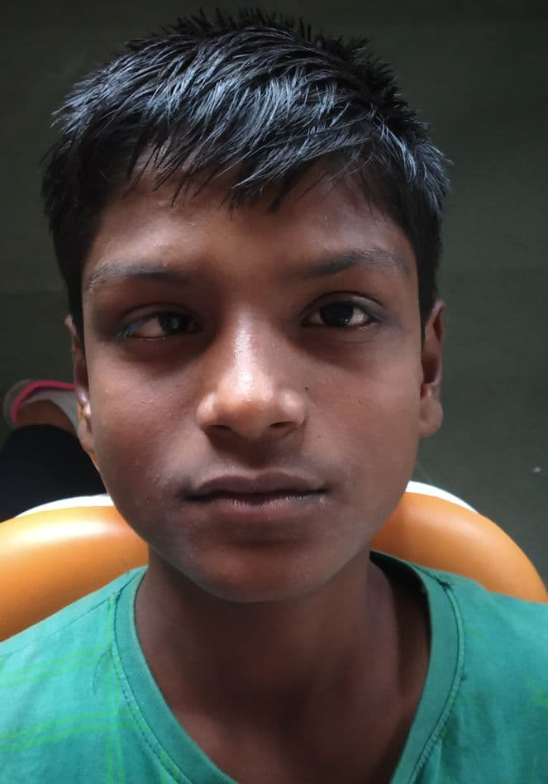
Name: Bilal Shaikh
Age: 14 years/M
Case: Management Ellis class IV with 11 – RCT followed by fiber post and composite build up

Slide 30
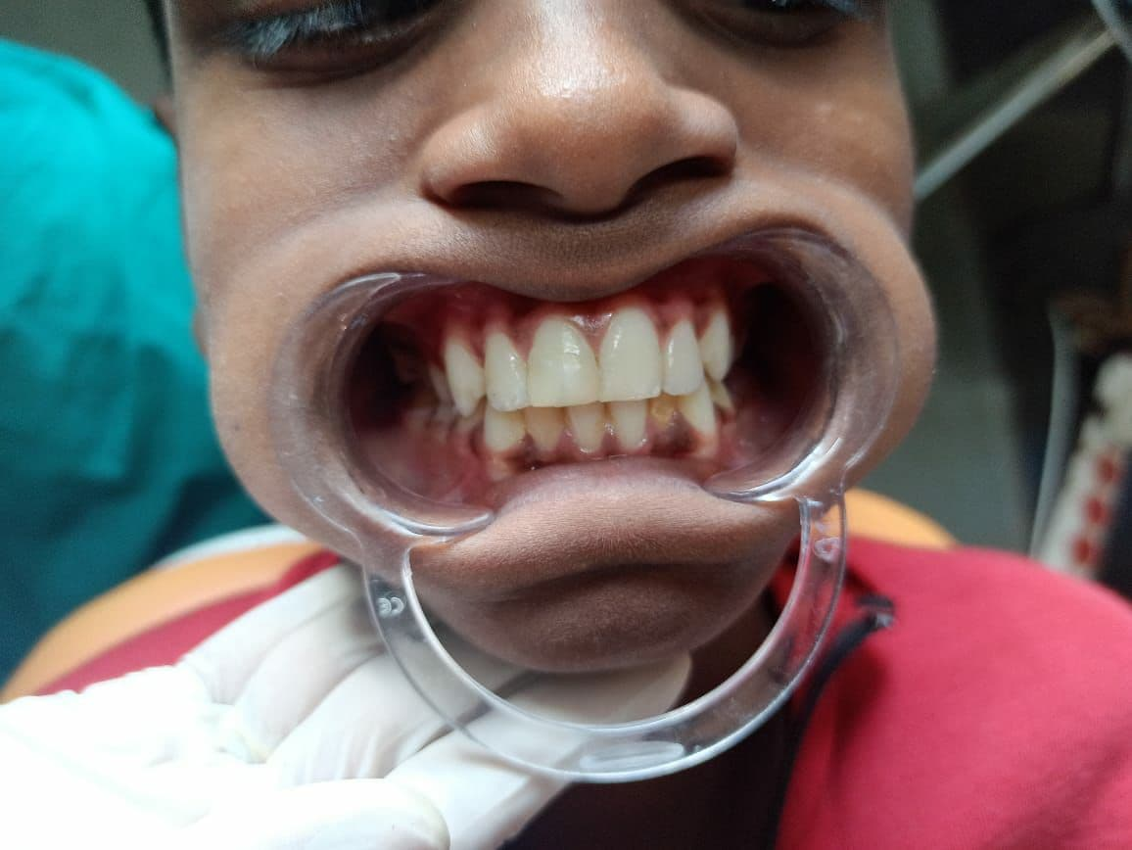
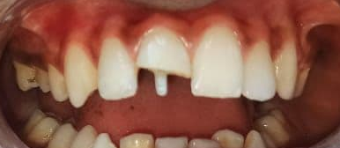
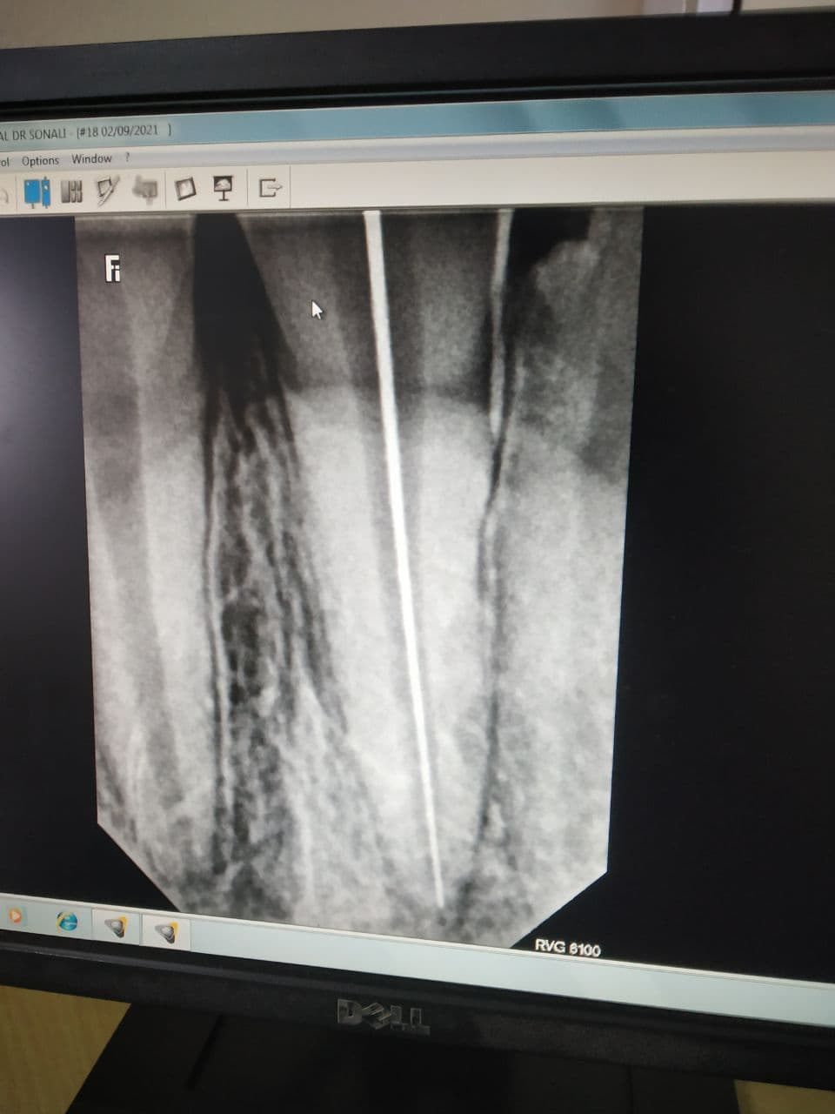
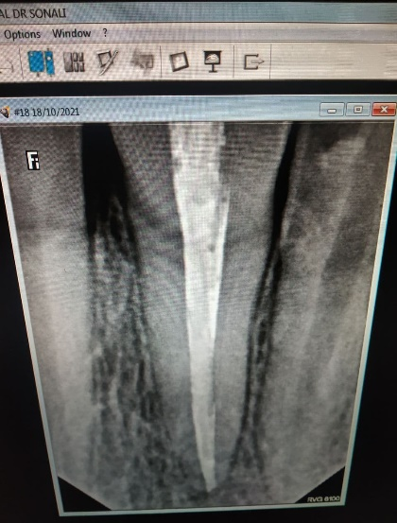
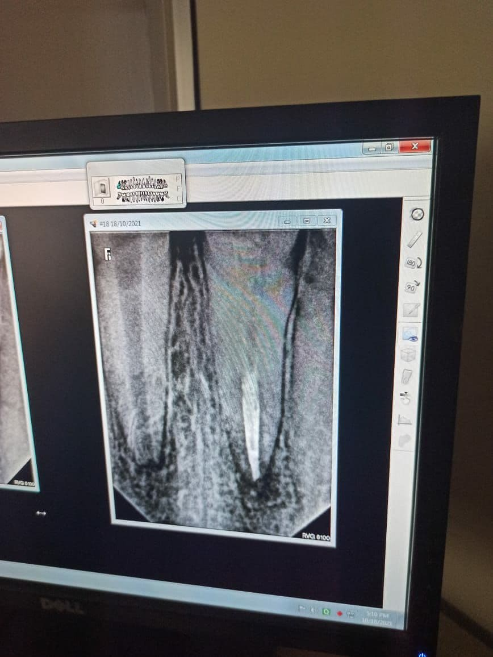
Pre-Operative
Post-Operative
Root canal treatment with 11 followed by fiber post and composite esthetic build up

Slide 31
Conventional endodontic treatment
revascularization was first introduced by por Nygaard-Ostby in 1961
Apexification/ root end closure
Immature tooth
Regenerative
Mature tooth

Slide 32
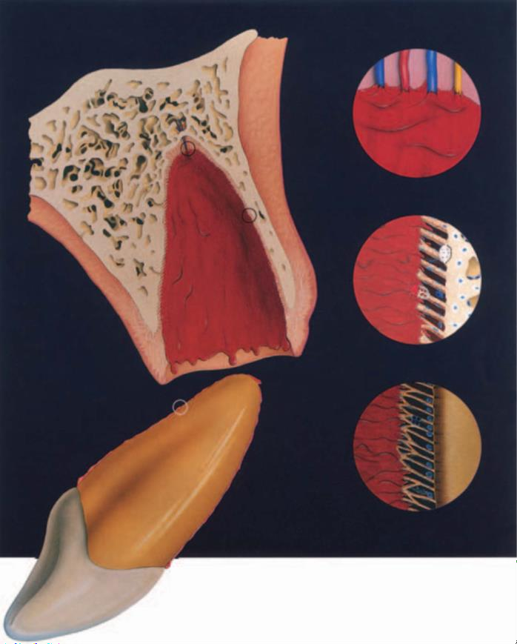
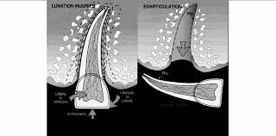
Avulsion : Most often in children from 7 to 9 years of age
Loosely structured periodontal ligament
Low mineralised bone surrounding erupting teeth
Provide only minimal resistance to an extrusive force
Tooth avulsion
Andreasen JO, Andreasen FM. Avulsions. In: Andreasen JO, Andreasen FM, Andersson L, editors. Textbook and color atlas of traumatic injuries to the teeth, 4th edn. Oxford, UK: Wiley-Blackwell; 2007. p. 444–88.

Slide 33
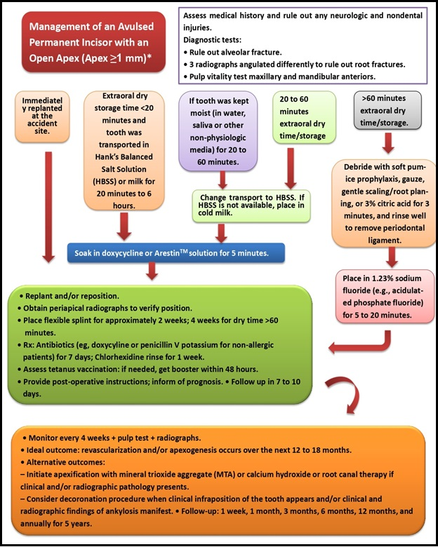

Slide 34
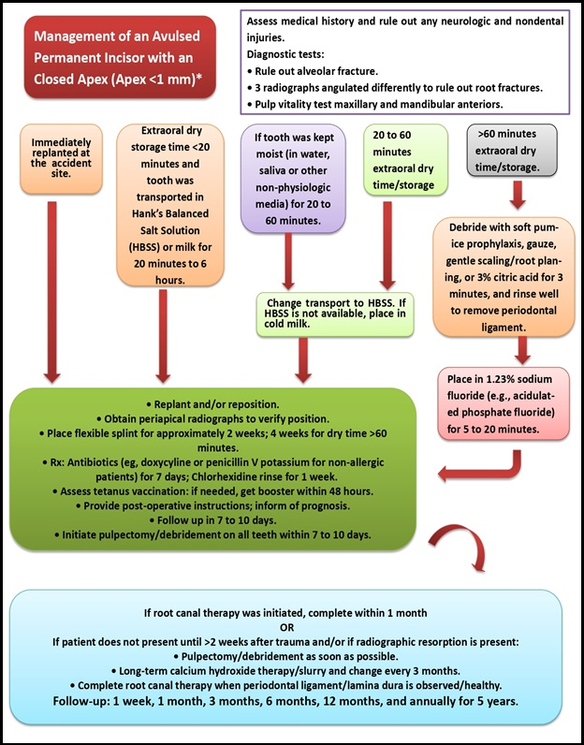

Slide 35
Patient instructions
Patient compliance with follow-up visits and home care contributes to satisfactory healing following an injury.
Both patients and guardians of young patients should be advised regarding care of the replanted tooth for optimal healing and prevention of further injury.
• Avoid participation in contact sports.
• Soft diet for up to 2 weeks.
• Brush teeth with a soft toothbrush after each meal.
• Use a chlorhexidine (0.1%) mouth rinse twice a day for 1 week
Clinical control:
Replanted teeth should be monitored by clinical and radiographic control after 4 weeks, 3 months, 6 months, 1 year, and yearly thereafter.
Clinical and radiographic examination will provide information to determine outcome.

Slide 36
STORAGE MEDIA FOR AVULSED TEETH
Andreasen (1981), observed that 30 minutes of dry storage elicited greater inflammatory resorption compared with saline and saliva storage.
HammarstrÖm, used logistic regression analysis and confirmed that the treatment of avulsed teeth stored in saliva, milk or saline was more successful than those that were allowed to dry.

Slide 37
Ideal requirements of storage medium
It should have antimicrobial characteristics.
Be able to maintain the viability of periodontal fibers for an acceptable period of time
have the same osmolarity as that of body fluids (290-330 mOsm/L)
Should not produce any antigen antibody reactions
Should reduce the risk of post reimplantation root resorption or ankylosis
Good shelf-life
Be effective in different climate and under different conditions
Wash off extraneous materials and toxic waste products

Slide 38
Saline
Tap water
Saliva
Contact lenses Solution
Gatorade
Propolis
Egg white
Emdogain
Milk
HBSS
Viaspan
Eagle’s Medium
Coconut water

Slide 39
Class VI
Root Fracture
Cervical
Middle
Crown-Root Fracture
Uncomplicated
Apical
Complicated

Slide 40
 | CLINICAL ASSESMENT AND FINDINGS | IMAGING AND RADIOGRAPHIC ASSESSMENT AND FINDINGS
Cervical | The coronal fragment is usually mobile and sometimes displaced. | One occlusal radiograph to determine the level of the root fracture at the apical and middle third. Two periapical radiographs with varying horizontal angles are needed to locate the fractures in the cervical third of the root. For a root fracture in the middle third, CBCT may rule out or confirm an oblique course of fracture involving the cervical third in the labiolingual dimension.
Middle | The middle fragment is slightly mobile.
Apical | The apical segment is usually not displaced.

Slide 41
Crown-root fractures
Sensitivity tests and vitality tests are likely to give positive results.
Tender to percussion.
Coronal fragment is mobile.
Fragment removal and gingival reattachment.
Fragment removal and surgical exposure of subgingival fracture.
Fragment removal and orthodontic extrusion.
Fragment removal and surgical extrusion.
One occlusal and two periapical radiographs from mesial and distal are recommended in order to rule out displacement or the possible presence of a root fracture. CBCT should be considered to reveal the extension and direction of the fracture.

Slide 42
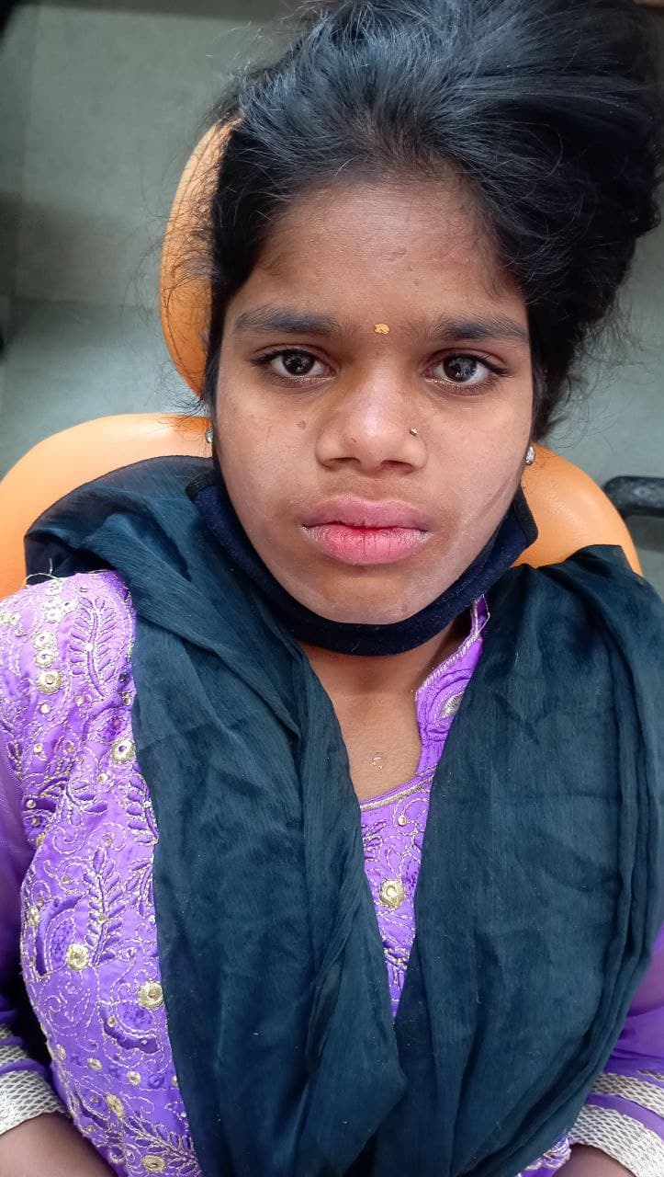
Name: Kanchan More
Age: 15 years/F
Case: Repositioning and Splinting for lateral luxation with 11 –
Ellis class VII with 11
(Case of physical abuse)

Slide 43
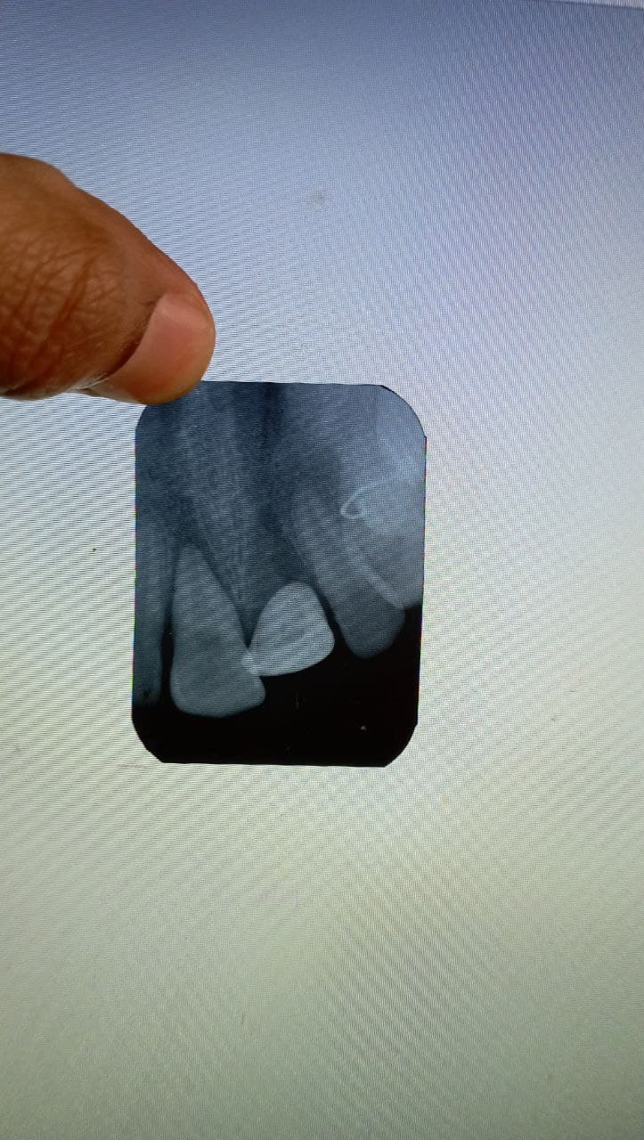
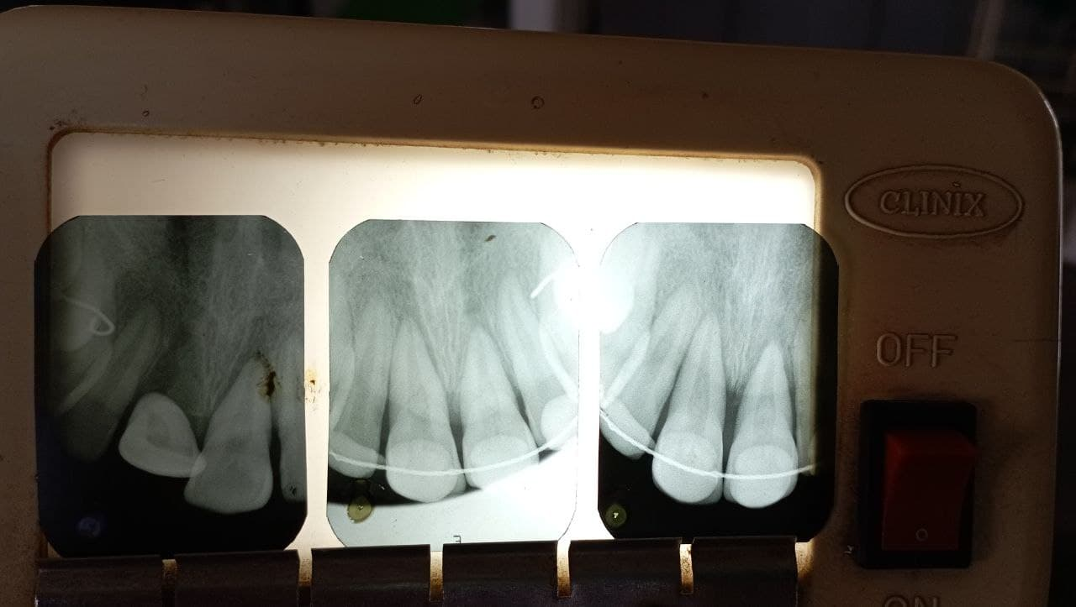
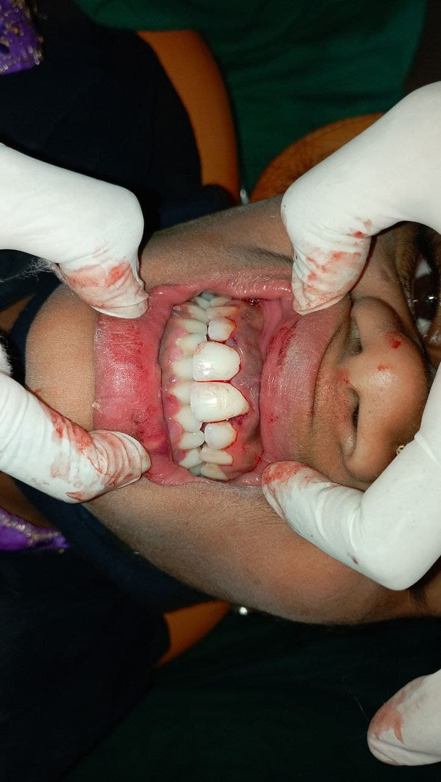
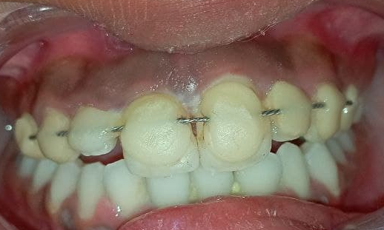
Pre-Operative
Post-Operative
Intra-Operative
Repositioning with 11 and Splinting done
Repositioning with 11
Splinting from 14 till 24

Slide 44
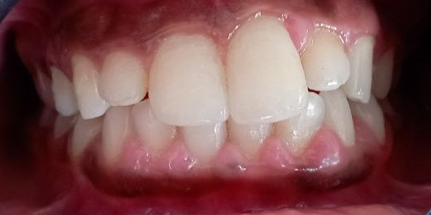
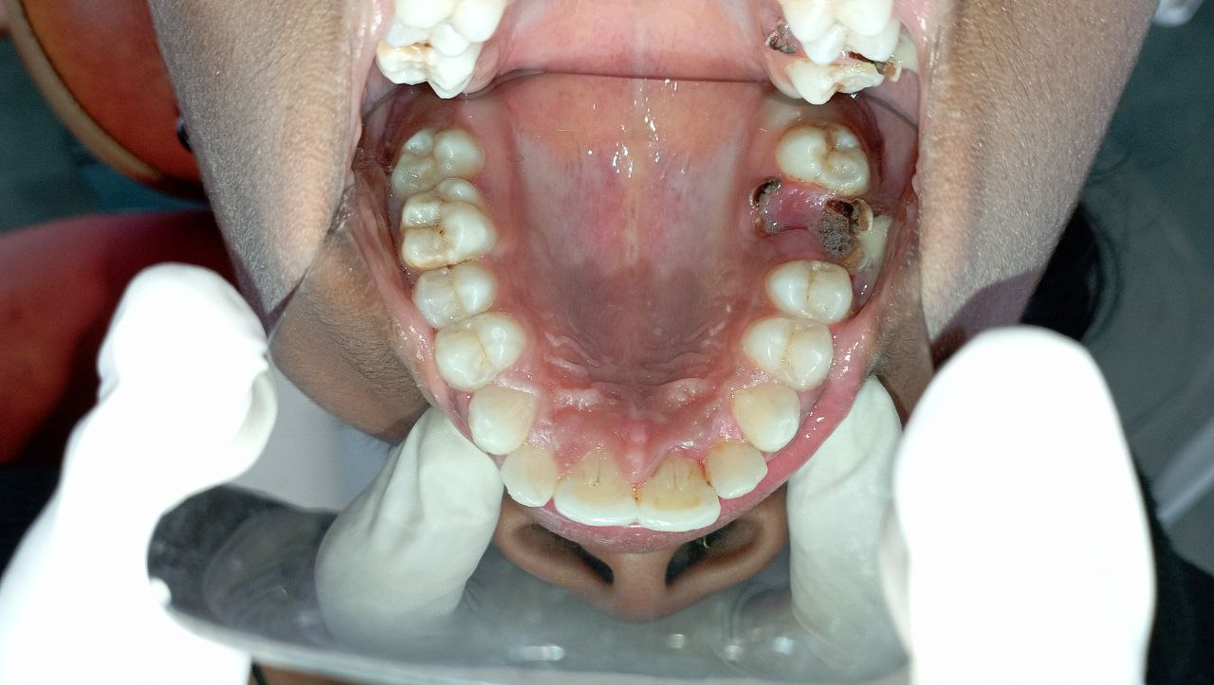
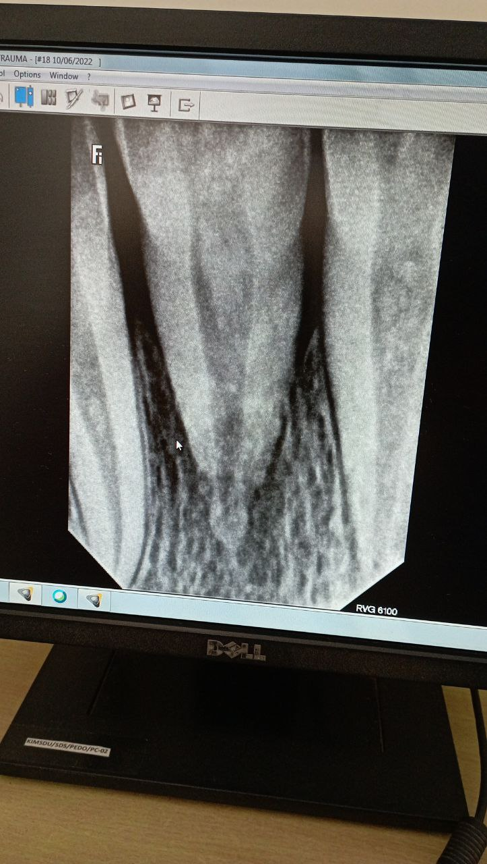
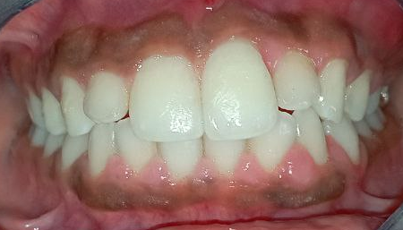
Follow up after 1 month
Removal of splinting followed by scaling and polishing
Under follow up for further Endodontic treatment
Follow up after 3 months

Slide 45
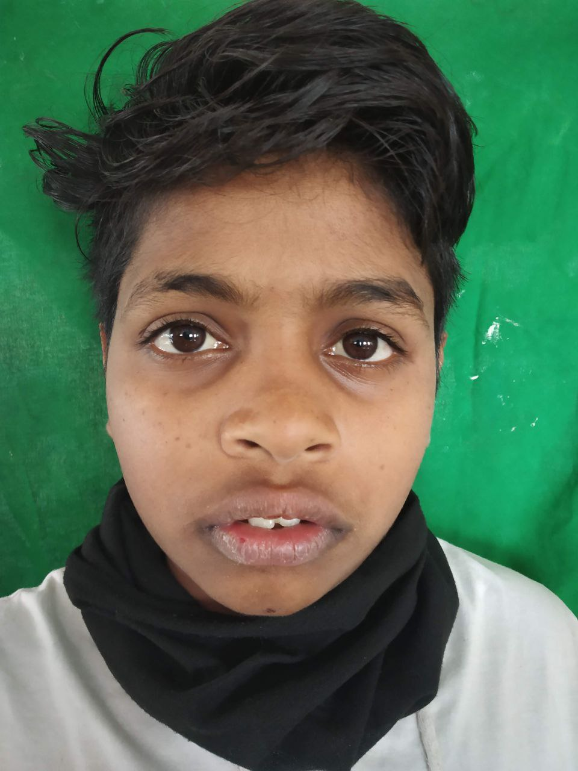
Name: Nikhil Koli
Age: 13 years/M
Case: Repositioning and Root canal treatment for subluxation with 21 and extrusion with 11
(Ellis class VII with 21,11)

Slide 46
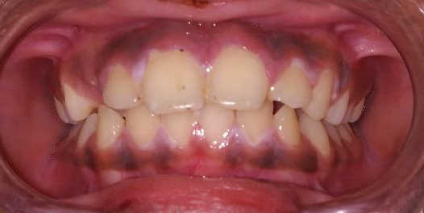
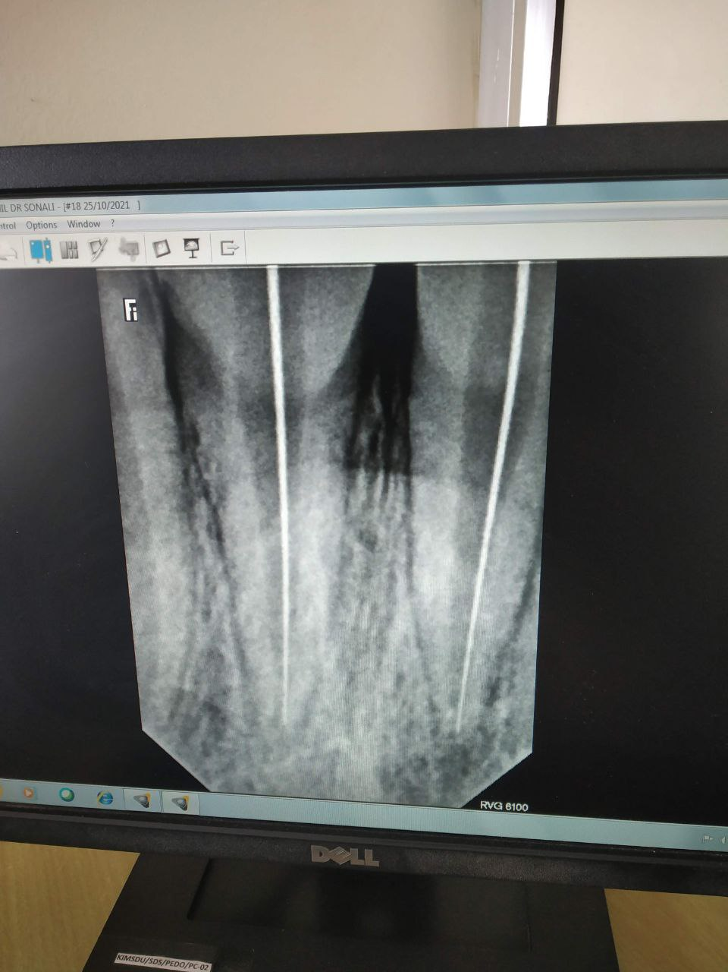
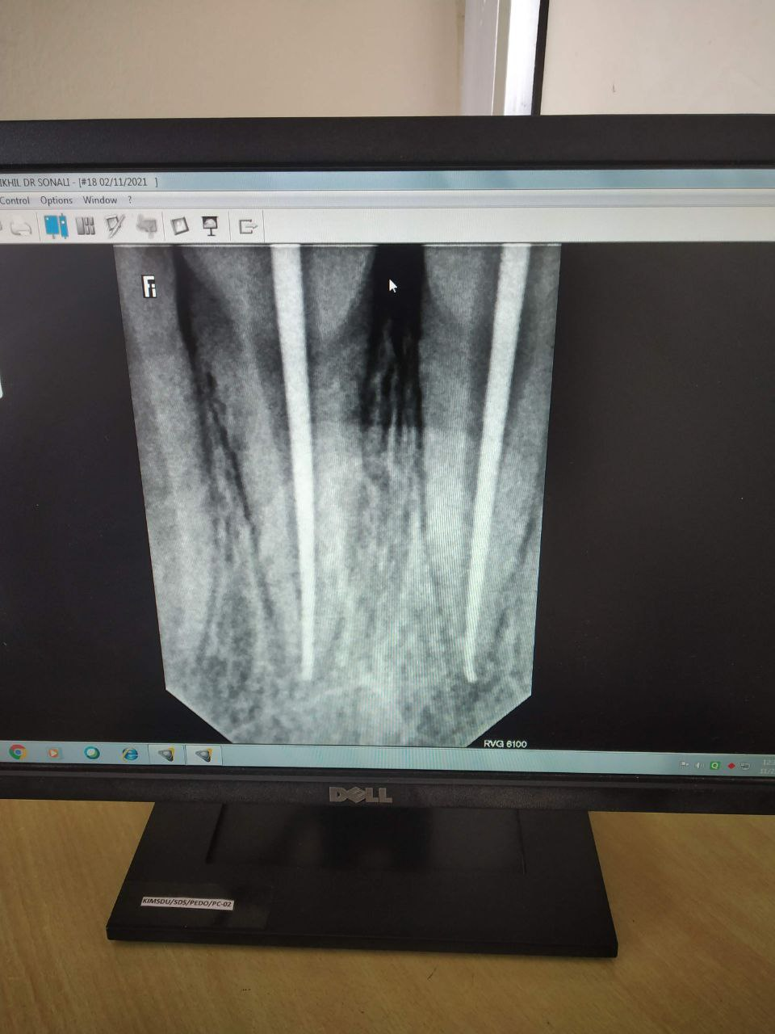



Pre-Operative
Root canal treatment with 11,21
Post-Operative
Repositioning with 11 and 21 followed by Splinting

Slide 47


Slide 48


Slide 49


Slide 50


Slide 51


Slide 52

Ellis Class VIII Fracture
Fracture of the crown en-masse and its replacement.
One occlusal and two periapical radiographs from mesial and distal are recommended in order to rule out displacement or the possible presence of a root fracture.
Radiograph of lip or cheek lacerations to search for tooth fragments or foreign material.
crown lengthening with osteotomy and gingivectomy
orthodontic extrusion and
surgical extrusion.

Slide 53

Name: Kamali Phasale
Age: 5 years/F
Case: Repositioning of maxillary left dentoalveolar segment followed by extraction with 61,62,63 and suture placement for lacerated lip
(Ellis class IX)

Slide 54






Pre -Operative
Post-Operative
Repositioning of maxillary anterior left dentoalveolar segment followed by extraction with 61,62,63
Intraoral and extraoral suture placement for lacerated lip

Slide 55





Follow up after 1 month
Follow up after 18 month
Removal of suture
Under follow up for further evaluation of erupting permanent teeth

Slide 56
Conclusion
Its more difficult to give than to take,
Its more difficult to love than to hate,
Its more difficult to make than to break.
A dental injury should always be considered as an emergency and treated immediately to relieve pain, facilitate reduction of displaced teeth, reconstruct lost hard tissue and improve prognosis.
Good knowledge of traumatology and models of treatments can also reduce stress and anxiety for both the patient and the dental trauma.

Slide 57
MCQ TEST
1. The tooth most frequently involved in a traumatic episode is the:
A Mandibular lateral incisor
B. Mandibular central incisor
C. Maxillary central incisor
D. Maxillary lateral incisor
2. The permanent teeth have all the following characteristics as compared to the milk teeth except:
A. Less vascular pulp
B. More prominent pulp horns
C. More pronounced contact points
D. Larger occlusal table
3. The incidence of trauma to the anterior teeth of children is:
A. Increasing
B. Decreasing
C. Remaining essentially constant
D. None of the above

Slide 58
4. There is a real relationship between the incidence of fractured anterior teeth and the:
A. Protrusion of those tooth
B. Hardness of the dentin
C. Hardness of the enamel
D. Caries in those teeth
5. An injury to the face of a 10 year old boy resulted in class II fracture of the crowns of maxillary central incisors and deep lacerations of lower lip. Which of the following radiograph are indicated for diagnosis of the case?
A. Radiograph of fractured teeth
B. Radiograph of mandibular incisor
C. Bite-wing radiograph
D. Both A and B

Slide 59
6. Which of the following is the least reliable finding from a clinical examination of teeth subjected to traumatic injury?
A. Mobility of teeth
B. Vitality of teeth
C. Displacement of teeth
D Loss of tooth structure
7. Initial vitality testing of traumatized teeth is most useful to:
A. Establish a base line for comparison with future testing
B. Predict the prognosis
C. Determine whether or not root canal treatment is indicated
D. None of the above
8. Your patient is 4 years old. Tooth E was traumatically intruded and approximately 50% of the crown is visible clinically. What is your treatment of choice?
A. Reposition and splint
B. Reposition, splint, and primary endodontics
C. Reposition, splint, and formocresol pulpotomy
D. None of the above

Slide 60
9. Your patient is 8 years old. A permanent central incisor is extruded 4 mm
following an injury 15 minutes ago. What is the treatment of choice?
A. No immediate treatment, monitor closely for vitality.
B. Reposition, splint, monitor closely for vitality.
C. Reposition, splint, initiate calcium hydroxide pulpotomy.
D. Reposition, splint, initiate calcium hydroxide pulpectomy.
10. Apexogenesis is:
A. Formation of the apical one-third of the root
B. Formation of the apical two-thirds of the root
C. Closure of the apical foramen in a developing tooth
D. Deposition of cellular cementum at the apex of the root

