Slide 1
Structure–Activity Relationship (SAR)
Presented by
Monali D. Jadhav
Assistant Professor
Pharmaceutical Chemistry

Slide 2
Content
Introduction to SAR
Concept of SAR
Importance of SAR
Factors Considered in SAR
Factors During Drug Modification
Modification of Parent Compound
Historical Development of SAR
Importance of SAR in Drug Development
Key Terminologies in SAR
SAR in Classical Drug Categories
Advantages of SAR Approach
Limitations of SAR
Conclusion

Slide 3
Learning Objectives
Understand the concept and principles of SAR
Explain the importance of SAR in drug design
Describe SAR in classical drug categories
Understand functional group contributions
Analyze important SAR case studies

Slide 4
Introduction to SAR
The STRUCTURE – ACTIVITY relationship (SAR) is the relationship between the chemical or 3D structure of a molecule and its biological activity.
Enables the determination of the chemical groups responsible for evoking a target biological effect in the organism.

Slide 5
A chemical structure includes molecular geometry, electronic structure, and crystal structure of a molecule.
Biological activity is an expression describing the beneficial or adverse effects of a drug on living matter.

Slide 6
Concept of SAR
SAR is an advanced design used to find the relationship between chemical structure and biological activity of studied compounds.
It links chemical structure to a chemical property or biological activity including toxicity.
The theory of SAR aims to produce new drugs with structures similar to the original compound but with greater potency and improved safety.

Slide 7
Importance of SAR
SAR is essential for toxicological studies of compounds.
SAR has long been used to design chemicals with desirable commercial properties.
It helps in designing drugs with desired pharmacological and therapeutic activities.

Slide 8
Factors Considered in SAR
Various factors should be considered while developing SAR:
Size and shape of the carbon skeleton
Nature and degree of substitution
Stereochemistry

Slide 9
Factors During Drug Modification
During modification of a drug analogue, the following should be considered:
Water solubility
Transport through membranes
Receptor binding
Metabolism and other pharmacokinetic properties
Computer-assisted molecular modeling helps provide accurate targeting.

Slide 10
Modification of Parent Compound
Modification of the parent compound is done to improve biological activity and reduce side effects.

Slide 11
Varying Size and Shape
Changing the number of methylene groups in chains and rings
Increases lipophilicity which may increase activity
Water solubility may decrease
Non-selective binding may occur due to micelle formation in aliphatic compounds

Slide 12
Increasing or decreasing the degree of unsaturation
A change in the degree of unsaturation causes an increase in rigidity,
complication of E-Z isomers,
more sensitivity and increased toxicity.
➤ Introducing or removing a ring system
This results to an increase in size, shape changes and stability of structure with the substitution of C=C double bonds.

Slide 13
Historical Development of SAR
Early drug discovery relied on trial-and-error methods
Systematic chemical modification improved understanding
Led to rational drug design and modern medicinal chemistry

Slide 14
Importance of SAR in Drug Development
Improves potency and selectivity
Reduces toxicity and adverse effects
Enhances pharmacokinetic properties
Guides synthesis of new analogs

Slide 15
Key Terminologies in SAR
Pharmacophore – Essential structural features for activity
Auxophore – Modifies intensity of activity
Isosterism – Replacement with similar atoms/groups
Bioisosterism – Biological property-preserving replacement

Slide 16
Types of SAR Studies
Qualitative SAR – Observational structure-activity trends
Quantitative SAR (QSAR) – Mathematical correlation models
3D-QSAR – Spatial and steric relationship analysis

Slide 17
Physicochemical Properties in SAR
Lipophilicity (Log P)
Electronic effects (Hammett constant)
Steric factors (Taft constant)
Hydrogen bonding capacity

Slide 18
SAR in Classical Drug Categories
Antibacterial agents
Antihistamines
Opioid analgesics
Other classical therapeutic agents

Slide 19
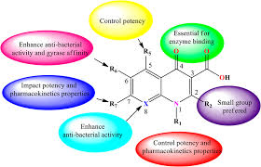
General SAR of Antibacterial Agents
Presence of ionizable groups for activity
Structural similarity to natural substrates
Lipophilicity influences bacterial penetration

Slide 20
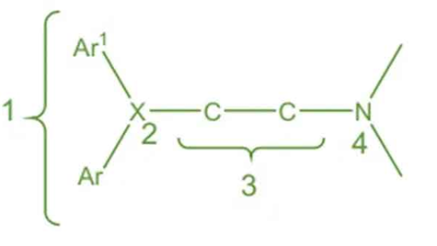
General SAR of Antihistamines
Aminoalkylether antihistamines contain a CHO connecting moiety (X) in their structure.
A 2–3 carbon atom chain links the diaryl group with the tertiary amine group.
Some drugs like clemastine and diphenylpyraline show slight variation from the basic structure.
In these compounds, the basic nitrogen and part of the carbon chain form a heterocyclic ring.
Three carbon atoms are present between the O and N atoms.
Para-substitution on the phenyl ring (–CH₃, –OCH₃, –Cl, –Br) increases activity and reduces side effects compared to diphenhydramine.
Replacing one phenyl ring with a 2-pyridyl group (e.g., doxylamine) increases oral antihistaminic activity about two times.
Most aminoalkylethers are optically active, and S-enantiomers are more active.

Slide 21
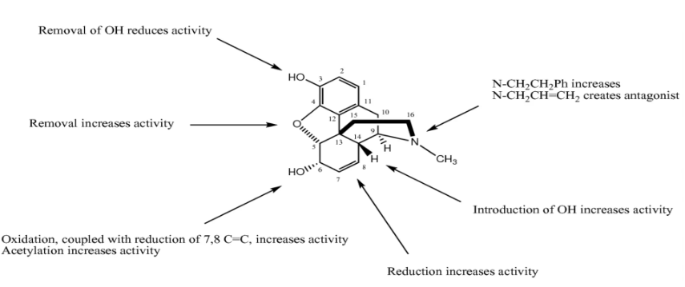
General SAR of Opioids
Aromatic ring structure
Tertiary amine required for receptor binding
Optimal distance between phenolic OH and amine group

Slide 22
Functional Group Contribution in SAR
Functional groups determine binding affinity
Influence solubility and permeability
Affect metabolic stability and toxicity

Slide 23
Role of Alkyl Groups
Increase lipophilicity
Improve membrane permeability
Excess bulk may reduce receptor binding

Slide 24
Role of Hydroxyl Group (-OH)
Forms hydrogen bonds
Increases aqueous solubility
May decrease CNS penetration

Slide 25
Role of Amino Group (-NH2)
Provides basicity
Forms ionic interactions with receptors
Essential for binding in many drugs

Slide 26
Role of Halogens
Increase lipophilicity
Improve metabolic stability
May enhance receptor binding

Slide 27
Electronic Effects in SAR
Electron-withdrawing groups alter activity
Electron-donating groups influence binding strength
Modify drug-receptor interaction patterns

Slide 28
Advantages of SAR Approach
Rational drug design
Improved therapeutic index
Cost-effective development
Predictable activity trends

Slide 29
Limitations of SAR
Complex biological systems
Unpredictable metabolic pathways
Time-consuming experimental validation

Slide 30
Thanku You

