Slide 1
Title - Ulcerative vesiculobullous lesions
(Part 1)
Dr Ashwini Rani SR
Associate Professor
Department of Oral Medicine & Radiology

Slide 2
Objectives of the topic
At the end of lecture the students should be able to define ulcer, vesicle, bullae and should be able to diagnose acute,chronic and recurrent ulcers of oral cavity.

Slide 3
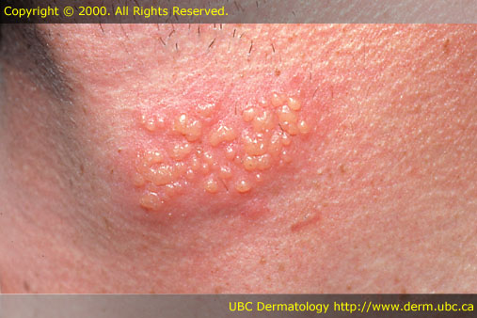
Terminologies
VESICLE
Elevated blisters containing clear fluid that are less than 1cm in diameter.

Slide 4
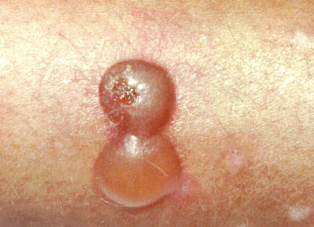
Terminologies
BULLA
Elevated blisters containing clear fluids that are greater than 1cm in diameter.

Slide 5
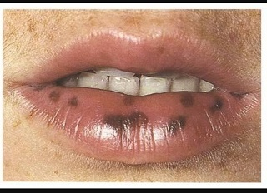
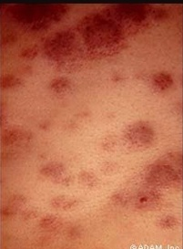
MACULES
Well-circumscribed, flat lesions change from normal skin color.
Red - vascular lesions or inflammation.
Pigmented –melanin, hemosiderin, and drugs.

Slide 6
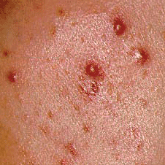
PAPULES
Solid lesions raised above the skin surface that are smaller than 1 cm in diameter.
Ex- Erythema multiforme
Rubella.

Slide 7
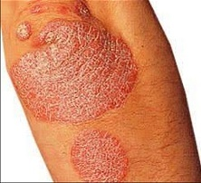
PLAQUES
Solid raised lesions that are over 1cm.

Slide 8
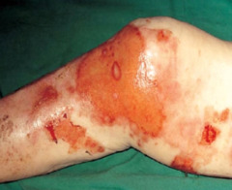
EROSIONS
Moist red lesions often caused by the rupture of vesicles or bullae as well as trauma.

Slide 9
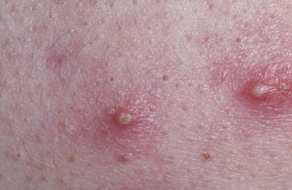
PUSTULES
Raised lesions containing purulent material.

Slide 10
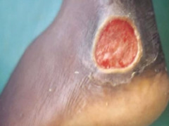
ULCERS
A defect in the epithelium; it is a well-circumscribed depressed lesion over which the epidermal layer has been lost.

Slide 11
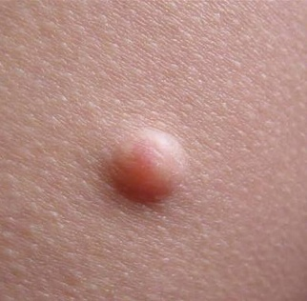
NODULES
lesions are present deep in the dermis,
and the epidermis

Slide 12
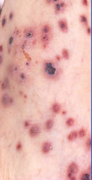
PURPURA
Reddish to purple flat lesions caused by blood from vessels leaking into the subcutaneous tissue.
Lesions do not blanch when pressed.

Slide 13
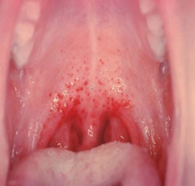
PETECHIAE
Purpuric lesions 1 to 2 mm in diameter
Larger purpuric lesions are called ECCHYMOSIS

Slide 14
Classification
ACUTE MULTIPLE ULCERS
Herpes simplex virus infection 1& 2
Cytomegalovirus infection
Erythema multiforme
Herpes zoster infection

Slide 15
Classification
ACUTE MULTIPLE ULCERS
Episten Barr virus infection
Coxsackie virus infection
ANUG
Contact Allergic reaction

Slide 16
CHRONIC ULCERS
Pemphigus
Pemphigoid
Cicatrical pemphigoid

Slide 17
CHRONIC ULCERS
Epidermolysis bullosa
Paraneoplastic pemphigus
Subepithelial bullos dermatoses
Chronic bullous disease of childhood

Slide 18
RECURRENT ULCERS
Recurrent apthous stomatitis
Bechcet disease
Recurrent HSV

Slide 19
4. SINGLE ULCERS
Traumatic injury causing solitary ulcers
Eosinophillic ulcers of tongue (traumatic ulcerative granuloma)
Infectious ulcers

Slide 20
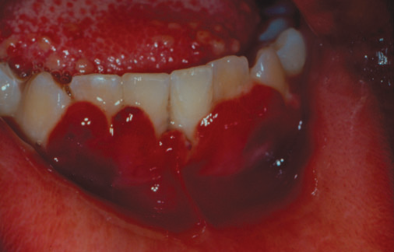
Based on clinical presentation
PREDOMINANTLY VESICULAR
HSV infection
Varicella infection
Dermatitis herpetiformis

Slide 21
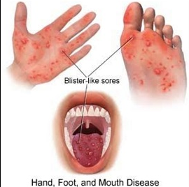
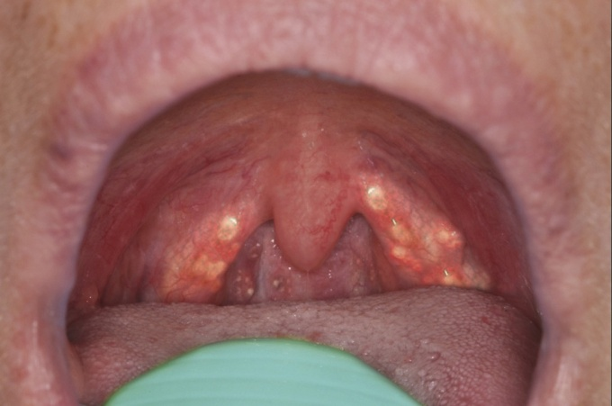
Based on clinical presentation
PREDOMINANTLY VESICULAR
Hand ,foot and mouth disease
Herpangina

Slide 22
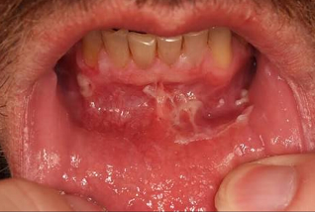
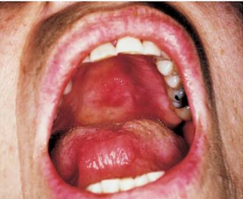
2. PREDOMINANTLY BULLOUS
Pemphigus vulgaris
Bullous pemphigoid
Benign mucous membrane pemphigoid
Bullous lichen planus

Slide 23
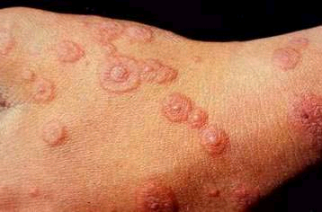
2. PREDOMINANTLY BULLOUS
Erythema multiforme
Stevevn johnson syndrome
Linear IgA disease

Slide 24
What should we look for?
Site
Number
Size
Shape
Base
Edge

Slide 25
Criteria to differentiate
Duration
lesion is acute or chronic

Slide 26
Criteria to differentiate
Symptoms associated
fever, malaise, headache, chills
Prodromal symptoms in viral infection

Slide 27
Criteria to differentiate
Similar types of lesions
to determine whether the lesion affects
Only mucosa or cutaneous also

Slide 28
Conclusion
Vesiculobullous lesions are classified based on duration,nature and history.
Careful diagnosis and treatment of lesions is needed to improve the quality of life of patients.

Slide 29
RFERENCES
Text book of Oral Medicine by Burkets – 12th edition
Text book of Oral Medicine,Oral diagnosis and Oral Radiology by Ravikiran Ongole,Praveen -2nd edition

Slide 30
