Slide 1
GOOD MORNING

Slide 2
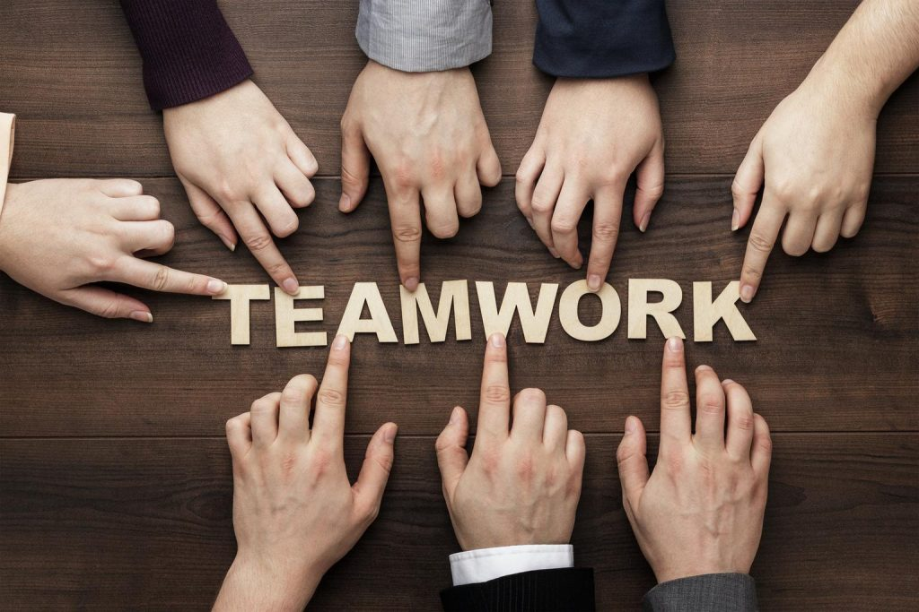
TEAM WORK

Slide 3
Meaning of Teamwork
Working collaboratively to achieve common goals.
Combining individual strengths for better results.
Importance in personal, academic, and professional life.

Slide 4
Importance of Teamwork
Encourages cooperation and coordination.
Improves problem-solving and decision-making.
Enhances creativity and innovation.
Builds trust and relationships.

Slide 5
Characteristics of Effective Teamwork
Clear communication.
Defined roles and responsibilities.
Respect and trust among members.
Conflict resolution skills.
Shared goals and accountability.

Slide 6
Benefits of Teamwork
Increased productivity.
Skill development through collaboration.
Higher motivation and morale.
Faster achievement of goals.

Slide 7
Conclusion
Teamwork is the foundation of success in every field.
“Alone we can do so little; together we can do so much.” – Helen Keller
Call to action: Let’s work together for shared success!

Slide 8
THANK YOU

