Slide 1
CASTING PROCEDURES IN DENTAL SCIENCES
Dr. Pronob Sanyal
Professor
Department of Prosthodontics and Crown &Bridge

Slide 2
Introduction
CASTING PROCEDURES
INVESTMENT
BURNOUT
CASTING

Slide 3
INVESTMENT
BURNOUT
CASTING
The process of covering or enveloping, wholly or in part, an object such as a denture, tooth, wax form, crown, etc., with a suitable investment material before processing, soldering, or casting.
The removal of wax from a mold, usually by heat.
The action of pouring or injecting a flowable material into a refractory mold.
Ferro KJ, Morgano SM, Driscoll CF, Freilich MA, Guckes AD, Knoernschild KL, McGarry TJ, Twain M. The glossary of prosthodontic terms.

Slide 4
SPRUE FORMER
LOST WAX TECHNIQUE
CRUCIBLE FORMER
A wax, plastic, or metal pattern used to form the channel or channels allowing molten metal to flow into a mold to make a casting.
The base to which a sprue former is attached while the wax pattern is being invested in refractory investment; a convex rubber, plastic, or metal base that forms a concave depression or crucible in the refractory investment.
The casting of metal alloy or ceramics into a mold produced by surrounding (investing) an expendable (wax) pattern with a refractory slurry that sets at room temperature, after which the pattern is removed through the use of heat.
Ferro KJ, Morgano SM, Driscoll CF, Freilich MA, Guckes AD, Knoernschild KL, McGarry TJ, Twain M. The glossary of prosthodontic terms.

Slide 5
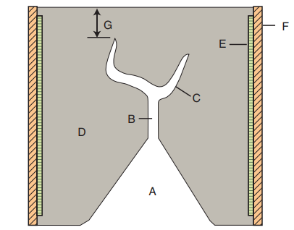
Anusavice KJ, Shen C, Rawls HR, editors. Phillips' science of dental materials. Elsevier Health Sciences; 2012 Sep 27.

Slide 6
Casting machines
1. Torch flame melting and centrifugal casting machines.
2. Electrically heating and centrifugal casting machines.
3. Induction heating and centrifugal casting machines.
4. Vacuum-arc melting and pressure casting in argon atmosphere casting machines.

Slide 7
CASTING CRUCIBLES
Clay crucibles
Carbon crucibles
Quartz crucibles
Zirconia-alumina crucibles

Slide 8
CLEANING THE CASTING
After casting is done, it is cleaned using various methods. These methods include pickling, quenching or sandblasting.

Slide 9
SPECIAL CASTING SITUATIONS

Slide 10
As given in Craig's restorative dental materials, following are some special casting situations-
For casting porcelain-fused-to-metal alloys, vacuum investing, use of phosphate bonded investment material, careful wax elimination, a gas-oxygen torch or other high temperature melting facility and centrifugal casting with adequate casting pressure are required.
For casting Co-Cr and Ni-Cr alloys and partial denture frameworks, painting a die spacer (varnish) on the die, short of the margin is necessary.
Titanium is cast under the protective atmosphere of argon or in a vacuum, to prevent absorption of gases. To achieve the high melting temperatures, arc melting in either graphite or water-cooled copper crucibles are used.

Slide 11
RECENT ADVANCES

Slide 12
Recent advances –
Electroforming Technology
Metal foil technology:
Captek system (capillary technology)
Sintered powder technology
CAD/CAM process such as additive and subtractive manufacturing

Slide 13
REFERENCES
Ferro KJ, Morgano SM, Driscoll CF, Freilich MA, Guckes AD, Knoernschild KL, McGarry TJ, Twain M. The glossary of prosthodontic terms.
Anusavice KJ, Shen C, Rawls HR, editors. Phillips' science of dental materials. Elsevier Health Sciences; 2012 Sep 27.
Ahmed H. Craig's restorative dental materials.
Vani HM, Saquib AS, Niranjan KC. DIMENSIONAL ACCURACY OF RINGLESS CASTING AND ACCELERATED WAX-ELIMINATION TECHNIQUE IN FABRICATING MULTIPLE UNIT CAST RESTORATIONS.

Slide 14
THANK YOU

