Slide 1
Centre For Distance And Online Education
(CDOE)
In association with
EDUCATIONAL TECHNOLOGY CELL
PRESENTS

Slide 2
Neonatal Jaundice
DR.MRS.RAJASHRI KARALE
Associate Professor,
KRISHNA INSTITUTE OF NURSING SCIENCES,KARAD.

Slide 3
Introduction
Neonatal Jaundice is defined as excessive levels of bilirubin in blood & characterised by jaundice / icterus called Hyperbilirubinaemia.
It is also termed as iterus neonatorum.
It is common in new born.
60% - term neonate & 80% preterm have greater than 5mg /dl bilirubin level in first week of life.
Normal bilirubin – 0.1 - 0.8mg/dl

Slide 4
Clinical Features
Neonatal Jaundice Characterized by yellow discoloration of skin of ,
FACE,NOSE,SCLERA,NAILS,DARK URINE,CLAY COLOR STOOL.
Yellow discoloration first seen on skin of face,nose.
It is detected by blenching the skin with digital pressure in the natural light.

Slide 5
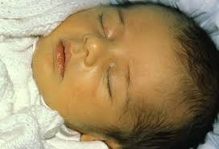
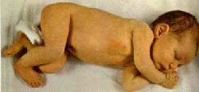
Baby’s with Neonatal Jaundice

Slide 6
Neonatal Jaundice -Classification
Physiological Jaundice
Phathological Jaundice
Breast feeding associated jaundice

Slide 7
Physiological Jaundice
Appears – 30-72 hrs
Maximum in 4th day –term neonate,
declines 7-10days
Maximum in 5-7th day – preterm neonate,
declines up to 14days
Causes –
Higher concentration of RBCs & less life span -70-90days.
Immature liver function

Slide 8
Pathological Jaundice
2/3 neonates develop within 24hrs
Persists beyond 10 days in term neonate
Persists beyond 14 days in preterm neonate
Causes – Hemolytic diseases in new born
Rh(Rhesus)/ABO incompatibility
Intra uterine infection
Stricture of common bile duct
bleary atresia

Slide 9
PATHOPHYSIOLOGY
Normal mechanism
Neonatal Jaundice
Break down of RBCs
Haem + Globin – used for body synthesis
Unconjugated bilirubin – insoluble form
UDPG-T
Conjugate bilirubin – soluble form … not conjugated by immature liver
Excreted through bile Remains unsoluable form
In Intestine converted to urobilinogen - Appears in blood….skin..brain
& excreted thro. Faeces & urine

Slide 10
Complications
Transitional Encephalopathy – reversible neurological complication
Increases lethargy by rising level of bilirubin
Recovery possible – Exchange blood transfusion
Kernicterus – Unconjugated - bilirubin deposited in brain cells …..necrosis of neurons
Poor sucking, lethargy, altered consciousness, fever, high pitched cry, hypotonia ..death
Complications –cerebral palsy, hearing loss, MR

Slide 11
Diagnosis
Assesment of new born – natural light
History
Icterus Face- 5-8mg/dl
Icterus Trunk-10-12mg/dl
Icterus Palm/sole - 15mg/dl
Bilirubinometer – Non invasive method
Blood for Bilirubin - total conjugated & unconjugated,Hb,RBC,Direct coomb test,LFT,
TORCH titre-
(TORCH infections-Toxoplasmosis,GonorrheaSyphilis,Varicella-zoster,Hepatitis B virus (HBV)Human immunodeficiency virus (HIV) and acquired immunodeficiency syndrome (AIDS)

Slide 12
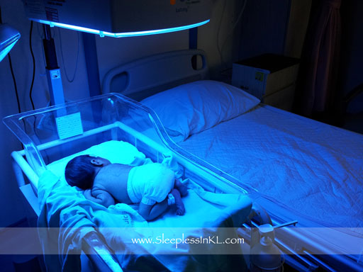
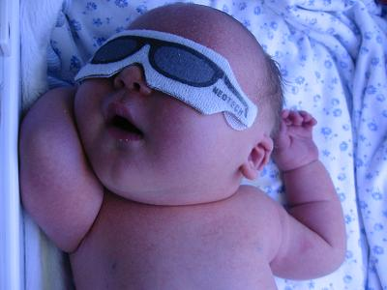
Phototherapy

Slide 13
MANAGEMENT
Phototherapy for Hyperbilirubinemia
Phototherapy – mechanism - bilirubin in skin converted into water-soluble bilirubin and excreted in bile & urine.
Keep baby open under phototherapy.
Cover the genitals with nappy.
Cover eyes with eye pads.
Side effects of phototherapy:
Frequent loose, green stools, skin changes-Bronze Baby Syndrome – skin looks dusky color,Gonadal damage,Retinal damage.

Slide 14
Risk for baby under Phototherapy
Risk of injury to eyes
Risk of injury to gonads
Risk of impaired skin integrity
Risk for fluid volume deficiency
Risk for hyperthermia or hypothermia
Risk of neurological injury
Imbalance nutrition
Parental anxiety

Slide 15
MANAGEMENT
Drug therapy – to bind unconjugated bilurubin in gut – charcol,agar, cholestyramine
To promote conjugation of bilurubin- orotic acid
Metabolic precursor – UDPG ACID
Albumin infusion before EBT-Exchange blood transfusion

Slide 16
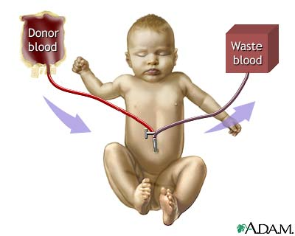
Exchange Blood Transfusion
EBT - 80 MI/KG DOUBLE VOLUME
Blood – compatible with mother is used

Slide 17
References:
1.Text book on Care of Newborn – Meharban Singh, VI
2.Ghai Essential Pediatrics- VI Edition- 2004.
Manual of Neonatal care – John P. Cloherty V
3.Nelson Text Book of Pediatrics – 17th Edition 2004.
4.Managing Newborn Problems. A guide for doctors, nurses, and midwives: WHO Publication, 2003
5.www.gmch.gov.in/e-study/e lectures/Pediatrics/managementoflwb.pdf · PDF file,Teaching Aids: NNF
6.Pediatric Nursing-2nd edition Parul Datta

Slide 18
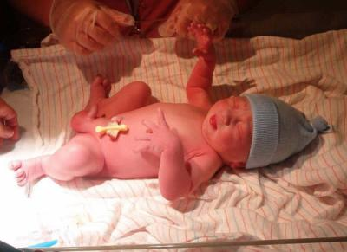
Isn’t he lovely?

Slide 19
Assignment
Q.1MCQ
1. Onset of physiological jaundice is ------------
a. After 24 Hrs
b. 2nd –4th Day
c. 4th –7th Day
d. First 24hrs after birth.
Q.2-BAQ
1.Define neonatal Jaundice.
2.Write classification of neonatal Jaundice.
3.List clinical symptoms of neonatal Jaundice.
Q3 SAQ
Care of baby under phototherapy

Slide 20
Thanks FOR SUPPORT AND GUIDANCE
DR.VAISHALI RAJSINH MOHITE
DEAN,KINS,KARAD
SPECIAL THANKS TO,
DR.MV.GHORPADE
REGISTRAR,KVV,KARAD
DR.YUGANDHARS KADAM
(Prof.and Head)

