Slide 1
GOOD MORNING

Slide 2
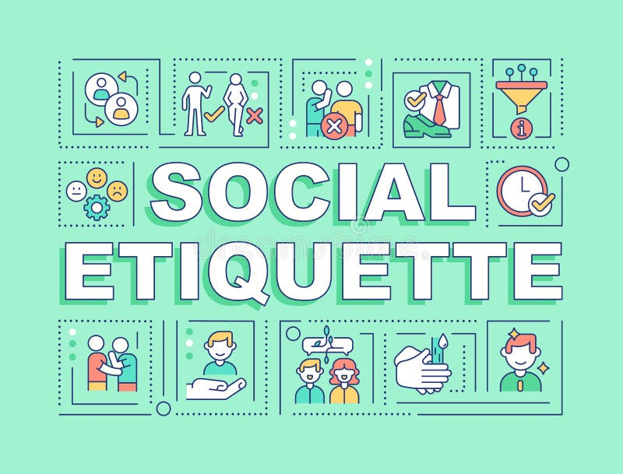

SOCIAL ETIQUATES

Slide 3
Meaning of Social Etiquettes
Social etiquette = accepted rules of polite behavior in society.
Helps in creating positive impressions.
Reflects respect, courtesy, and consideration for others.

Slide 4
Importance of Social Etiquettes
Builds good relationships.
Enhances personal and professional image.
Promotes respect and harmony.
Reduces misunderstandings and conflicts.

Slide 5
Types of Social Etiquettes
Greetings Etiquette – Handshakes, saying hello politely.
Dining Etiquette – Table manners, proper use of cutlery.
Communication Etiquette – Polite language, active listening.
Public Etiquette – Respecting queues, keeping noise low.

Slide 6
Do’s and Don’ts
Do’s:
Be punctual.
Show respect to elders.
Use polite words like please and thank you.

Slide 7
Don’ts:
Interrupt when others are speaking.
Speak loudly in public places.
Ignore cultural differences

Slide 8
THANK YOU

