Slide 1
GOOD MORNING

Slide 2
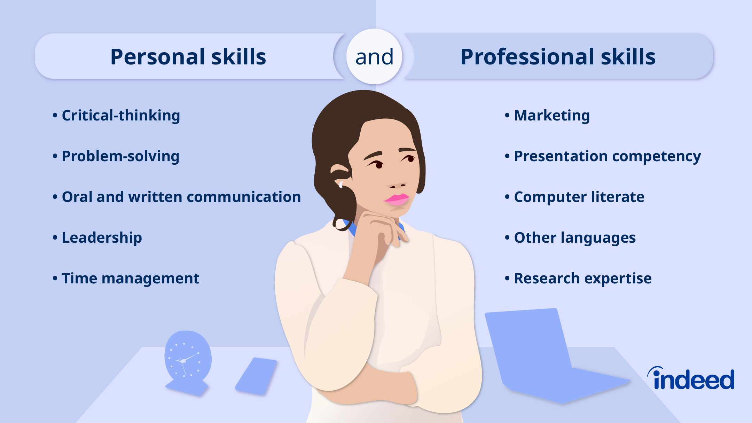
Introduction to Personal and Professional Skills

Slide 3
Introduction to Personal and Professional Skills
Personal skills: Qualities that define individual behavior and self-management.
Professional skills: Abilities required in workplace and career growth.
Both are essential for success in personal and professional life.

Slide 4
Examples of Personal Skills
• Self-confidence.
• Adaptability and flexibility.
Time management.
Self-motivation.
Emotional intelligence.
Stress management.

Slide 5
Examples of Professional Skills
• Communication skills.
• Teamwork and collaboration.
• Leadership.
• Problem-solving.
• Decision-making.
• Technical and digital literacy.

Slide 6
Importance of Personal Skills
• Build positive attitude.
• Improve emotional stability.
• Help in personal growth.
• Enhance relationships.
• Increase confidence in daily life.

Slide 7
Importance of Professional Skills
• Improve workplace performance.
• Enhance career opportunities.
• Help in achieving organizational goals.
• Strengthen teamwork and leadership.
• Boost employability.

Slide 8
Ways to Develop Personal Skills
• Practice self-discipline.
• Read and learn continuously.
• Set personal goals.
• Reflect on strengths and weaknesses.
• Stay positive and motivated.

Slide 9
Ways to Develop Professional Skills
• Take training and workshops.
• Gain practical experience.
• Improve networking and communication.
• Learn from mentors and leaders.
• Stay updated with industry trends.
• Practice leadership and teamwork.

Slide 10
THANK YOU

