Slide 1
GOOD MORNING

Slide 2
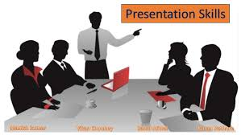
Presentation Skills

Slide 3
Introduction to Presentation Skills
Definition: Ability to communicate information clearly to an audience.
Importance: Builds confidence, conveys ideas, and engages listeners.
Applicable in academics, workplace, and public speaking.

Slide 4
Key Elements of a Good Presentation
Clear Objective
Organized Content
Effective Visuals (slides, charts, images)
Audience Engagement
Confident Delivery

Slide 5
Verbal & Non-Verbal Communication
Verbal: Clear voice, tone, pace, language choice
Non-Verbal: Eye contact, gestures, posture, facial expressions
Importance of body language

Slide 6
Use of Visual Aids
PowerPoint slides, charts, graphs, videos
Keep slides simple & uncluttered
Use bullet points for clarity
Limit text – focus on keywords

Slide 7
Tips for Effective Presentation
Know your audience
Practice well in advance
Maintain eye contact & confidence
Handle questions politely
Manage time effectively

Slide 8
Conclusion
Good presentation skills = Confidence + Clarity + Connection
“A strong presentation leaves a lasting impression.”
Thank You!

Slide 9
THANK YOU

