Slide 1
Significance of PAP SMEAR
DR. GAURI RAGHUNATH SHINDE
ASSISTANT PROFESSOR OBGY , KVV, KARAD

Slide 2
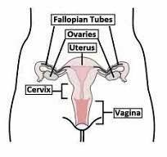

Slide 3
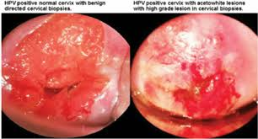
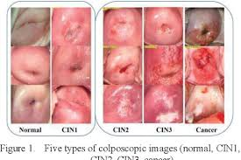
ABNORMAL CERVICAL LESIONS

Slide 4

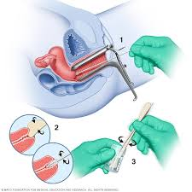
HOW TO TAKE PAP SMEAR

