Slide 1
CENTER FOR DISTANCE AND ONLINE EDUCATION
(CDOE)
IN ASSOCIATION WITH
EDUCATIONAL TECHNOLOGY CELL
PRESENTS

Slide 2
KRISHNA VISHWA VIDYAPEETH

Slide 3
ASSESSMENTR OF TEMPERATURE BY ORAL METHOD
KRISHNA INSTITUTE OF NURSING SCIENCES KARAD
NAME :- Mrs Sheetal A. Kadam
Assistant Professor
Krishna Institute Of Nursing Sciences, Karad
Cast – Mrs.Mayuri More

Slide 4
INTRODUCTION
Temperature is a degree of heat maintained by the body. It is the balance between the heat produced and heat lossed
Normal oral temperature is 98,6 degree F , axillary temperature is 97,6 degree F and Rectal Temperature is 99,6 degree F

Slide 5
Body temperature is of two types core temperature and surface temperature. Core temperature is most important including deep tissues such as temperature of cranial , thoracic and abdominal cavities.
Normal body temperature depends on when, where, and in whom it is measured. Body has regulatory system that keeps the core temperature normal.

Slide 6
METHODS OF TAKING TEMPERATURE
Oral Method
Rectal Method
Axillary Method
Tympanic
Skin

Slide 7
TYPES OF THERMOMETER

Slide 8
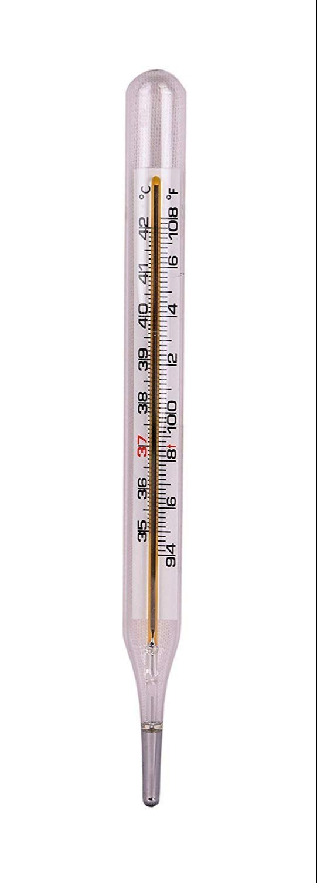
CLINICAL THERMOMETER

Slide 9
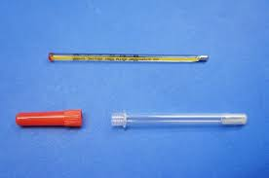
RECTAL THERMOMETER

Slide 10
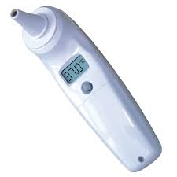
TYMPANIC THERMOMETER

Slide 11
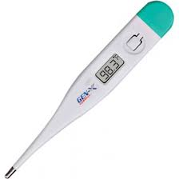
DIGITAL THERMOMETER

Slide 12
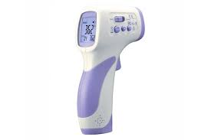
SKIN THERMOMETER

Slide 13
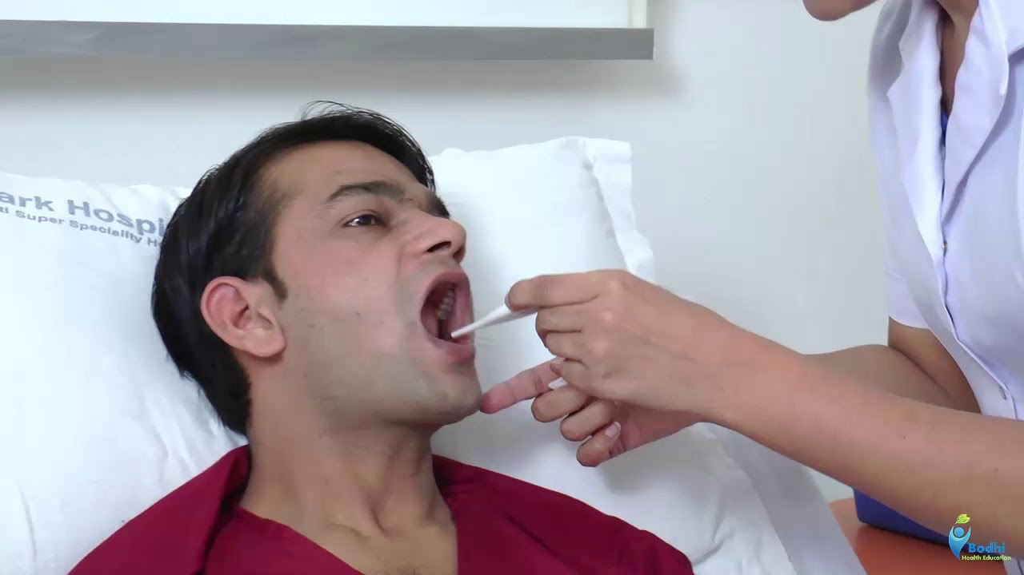
ORAL TEMPRATURE

Slide 14
Oral temperature
Temperature checked by oral cavity
Purposes
To determine the body temperature of the patient
To aid in making diagnosis

Slide 15
Preliminary assessment
To determine the need to measure clients body temperature
Assemble equipements
Identify the patient, greet the patient and explain the procedure to the patients
Place the client in comfortable position
Assess the site most appropriate for temperature measurement
Wait 20 to 30 minutes before measuring oral temperature if client has ingested hot

Slide 16
Equipement
Oral clinical thermometer
Swab in a container
Kidney basin
Watch with second hand
Graphic TPR Chart

Slide 17
Procedure
Hold the thermometer with finger tips
If the thermometer stored in a disinfectant solution,rince in cold water before using
Take swab and wipe thermometer bulb towords fingers in rotating fashion and dispose the swab.
If using clinical thermometer read mercury level by holding thermometer horizontally and gently rotating at eye level. Mercury level is raised then shake the thermometer till the mercury level below the normal

Slide 18
Ask the client to open mouth and gently place the thermometer uder the tongue in posterior sublingual, lateral to center of lower jaw
Ask the client to hold thermometer with lips closed. Causion against biting down on thermometer
Leave thermometer in place for 2 minutes
Carefully remove thermometer and read thermometer by holding it horizontally

Slide 19
After care :-
Clean the thermometer with soap swab, wait swab and dry swab in rotating fashion from stem to bulb and place the thermometer in place
Record the temp on chart
Wash hands
Report any unusual variation to the senior staff nurse

Slide 20
THANK YOU

