Slide 1

Permanent Maxillary First Molar :
Occlusal Aspect
Dr Nupura Vibhute
PROFESSOR AND HEAD
DEPARTMENT OF ORAL PATHOLOGY AND MICROBIOLOGY
SCHOOL OF DENTAL SCIENCES
KVV, KARAD

Slide 2
Objectives
At the end of the session the learner should be able to
Describe the shape of occlusal aspect of the permanent maxillary first molar
Discuss the ridges on the occlusal aspect of the permanent maxillary first molar
Describe the fossae on the occlusal aspect of the permanent maxillary first molar
Discuss the grooves and pit on the occlusal aspect of the permanent maxillary first molar

Slide 3
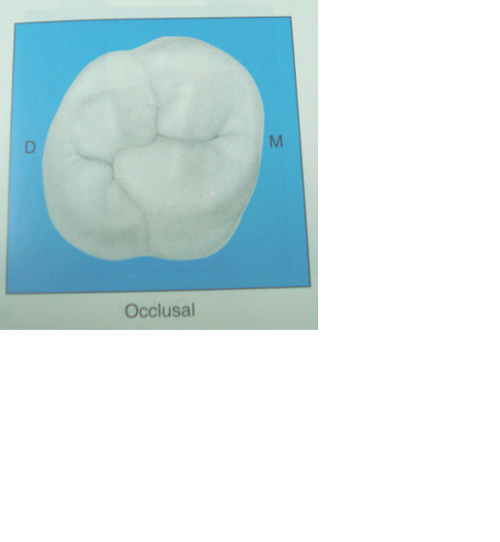
Some what rhomboidal outline
Crown wider mesially than distally
Crown wider lingually than bucally
BUCCAL
DISTAL
MESIAL
LINGUAL

Slide 4

4 major well developed cusps along with fifth cusp: Cusp of Carabelli
BUCCAL
DISTO BUCCAL
CUSP
MESIO BUCCAL
CUSP
DISTAL
MESIAL
DISTO LINGUAL
CUSP
MESIO LINGUAL
CUSP
LINGUAL
CUSP OF CARABELLI

Slide 5
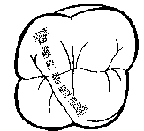
RIDGES
Triangular ridge of the distobuccal cusp
Triangular ridge of the mesiobuccal cusp
BUCCAL
MESIAL
DISTAL
Mesial traingular ridge of the mesiolingual cusp
Triangular ridge of the Distolingual cusp
LINGUAL
Distal triangular ridge of the mesiolingual cusp

Slide 6
OBLIQUE RIDGE
Ridge that crosses the occlusal surface obliquely
Triangular ridge of the distobuccal cusp
BUCCAL
DISTAL
MESIAL
Distal triangular ridge of the mesiolingual cusp
LINGUAL

Slide 7
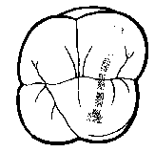
Transverse ridge
Triangular ridge of the mesiobuccal cusp
Mesial triangular ridge of the mesiolingual cusp

Slide 8
Distal & Mesial marginal ridges
Irregular ridges
Confluent with mesial & distal cusp ridges
BUCCAL
DISTAL
MESIAL
LINGUAL

Slide 9
Fossae
2 major fossae:
Central
Distal
2 minor fossae:
Mesial marginal fossa
distal marginal fossa

Slide 10
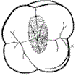
Central fossa
Central fossa is roughly triangular and mesial to oblique ridge
BUCCAL
Oblique ridge
DISTAL
MESIAL
LINGUAL

Slide 11
Distal fossa
Distal fossa is roughly linear and distal to oblique ridge
BUCCAL
Oblique ridge
DISTAL
MESIAL
LINGUAL

Slide 12
Distal & Mesial triangular fossae
Distal triangular fossa
is mesial to distal marginal ridge
Mesial triangular fossa
is distal to mesial marginal ridge
BUCCAL
DISTAL
MESIAL
LINGUAL

Slide 13
Pit and Grooves
In centre of the central fossa, there is a central developmental pit
From this pit 3 developmental grooves, radiate at obtuse angles to each other

Slide 14
Buccal developmental groove
From the central pit it radiates buccally continuing on the buccal surface of the crown between the buccal cusps

Slide 15
Central developmental groove
From the central pit it radiates in mesial direction
and terminates at the apex of the mesial triangular
fossa

Slide 16
Transverse groove of the oblique ridge
A short developmental groove radiates from the central pit of the central fossa, and crosses the oblique ridge transversely.
It joins the central and distal fossae.
BUCCAL
Oblique ridge
DISTAL
MESIAL
LINGUAL

Slide 17
Distal Oblique Groove
Traverses deepest portion of distal fossa
It connects with lingual developmental groove

Slide 18
Lingual developmental groove
Marks the junction of the lingual cusps
It connects with distal developmental groove

Slide 19
Fifth cusp groove
If the fifth cusp development is distinct, a developmental groove outlining it joins the lingual groove
Any part of the groove that outlines the fifth cusp is called the fifth cusp groove

Slide 20
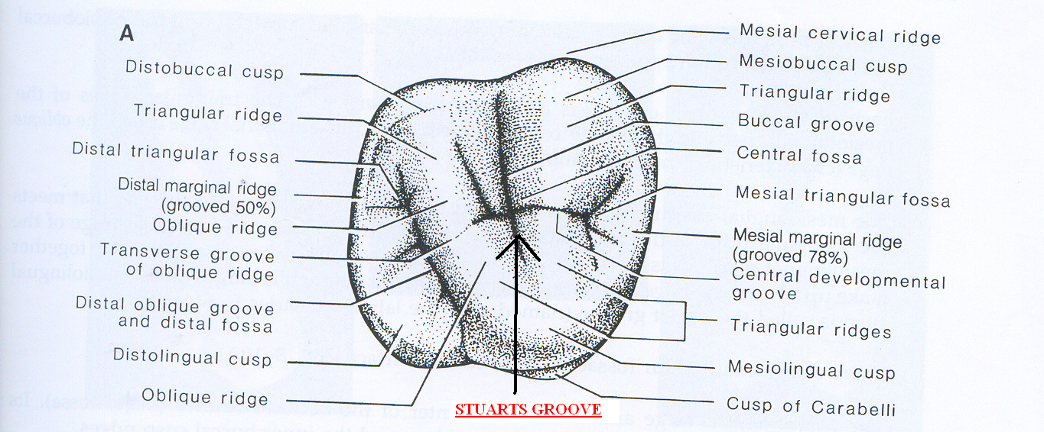
Stuart’s groove
The groove between the 2 ridges on the mesiolingual cusp is Stuart’s groove

Slide 21
Summary: RIDGES
Triangular ridge of the distobuccal cusp
Triangular ridge of the mesiobuccal cusp
BUCCAL
DISTAL
MESIAL
Mesial triangular ridge of the mesiolingual cusp
Triangular ridge of the Distolingual cusp
Distal triangular ridge of the mesiolingual cusp
LINGUAL

Slide 22
Central fossa
Summary: FOSSAE
BUCCAL
DISTAL
Distal marginal fossa
MESIAL
Distal fossa
Mesial marginal fossa
LINGUAL

Slide 23
Buccal developmental groove
Summary: PIT & GROOVES
Transverse groove of oblique ridge
Central
developmental
groove
Distal oblique groove
Lingual developmental groove

Slide 24
References
Wheeler's Dental Anatomy, Physiology and Occlusion, 1st South Asia Edition By Elsevier India · 2015
Textbook of Oral Anatomy, Physiology, Histology and Tooth Morphology. Authors, K. Rajkumar, R. Ramya. Publisher, Wolters kluwer india Pvt Ltd, 2017. ISBN .

Slide 25
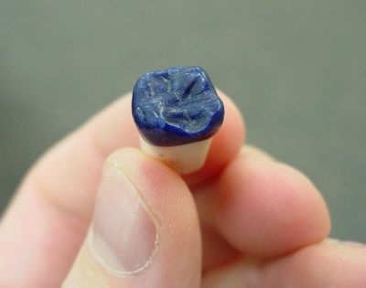
THANK YOU!!!

