Slide 1
GOOD MORNING

Slide 2
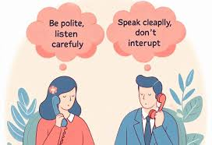
TELEPHONIC ETIQUATES

Slide 3
Telephonic Etiquette
Importance of good manners on the phone
Creates a positive impression
Builds trust and professionalism

Slide 4
Greeting
Answer promptly (within 3 rings)
Use a polite greeting (Hello/Good morning)
Introduce yourself if needed

Slide 5
Clarity
Speak clearly and at a moderate pace
Avoid slang, mumbling, or shouting
Confirm important details
Listening
Pay full attention to the caller
Do not interrupt
Use phrases like “I understand”

Slide 6
Politeness & Professionalism
Always use “please” and “thank you”
Stay calm in all situations
Avoid background noise
Maintain confidentiality

Slide 7
Closing the Call
Summarize key points discussed
Ask if the caller has any more questions
End with a polite goodbye (e.g., “Thank you, have a nice day”)

Slide 8
THANK YOU

