Slide 1
Stability Testing Framework
Resource Person
Dr. Sarika J. Patil
Assistant Professor
Department of Regulatory Affairs,
Krishna Institute of Pharmacy,
Krishna Vishwa Vidyapeeth (Deemed to be University), Karad, Maharashtra, INDIA

Slide 2
Learning Outcomes
After completing this session, students will be able to:
Explain different types of stability studies (long-term, accelerated, intermediate, stress, and photostability) and their role in predicting product shelf life.
Apply Accelerated Regulatory-Compliant Considerations.
Interpret Harmonized ICH Protocols.
Develop Audit-Ready Documentation.

Slide 3
Contents
01
Types of Stability Studies & Their Roll
04
Accelerated Regulatory-Compliant Considerations
02
Purpose of Stability Testing
05
Harmonized ICH Guidelines (Q1 Series)
03
Core Approaches to Stability Testing
06
Design of Stability Studies & Documentation Requirements

Slide 4
Contents
07
Regulatory Expectations
08
Common Pitfalls to Avoid

Slide 5
Types of Stability Studies & Their Roll
1. Long-Term Stability Studies
Conditions: Conducted under recommended storage conditions (e.g., 25°C/60% RH for 12–24 months).
Purpose: Provides real-time data on how the product behaves over its intended shelf life.
Role in Shelf Life: Forms the primary evidence for establishing expiry dates and storage conditions.

Slide 6
2. Accelerated Stability Studies
Conditions: Elevated stress conditions (e.g., 40°C/75% RH for 6 months).
Purpose: Predicts degradation patterns quickly and supports early shelf-life estimation.
Role in Shelf Life: Allows extrapolation of shelf life before long-term data is complete; useful for regulatory submissions and post-approval changes.

Slide 7
3. Intermediate Stability Studies
Conditions: Moderate stress (e.g., 30°C/65% RH for 6 months).
Purpose: Conducted when accelerated studies show significant changes.
Role in Shelf Life: Provides supportive data bridging accelerated and long-term studies, ensuring reliability of predictions.

Slide 8
4. Stress Testing
Conditions: Extreme conditions (heat, humidity, oxidation, pH, light).
Purpose: Identifies degradation pathways, potential impurities, and stability-limiting factors.
Role in Shelf Life: Helps in formulation design and packaging selection; ensures robustness against environmental stress.

Slide 9
5. Photostability Testing (ICH Q1B)
Conditions: Exposure to defined light sources (UV and visible).
Purpose: Determines sensitivity of drug substances/products to light.
Role in Shelf Life: Ensures proper packaging and labeling (e.g., “Protect from light”) to maintain product quality.

Slide 10
Overall Role in Predicting Shelf Life
1. Integration of Data: Long-term data confirms shelf life, while accelerated and intermediate studies provide early predictions.
2. Risk Mitigation: Stress and photostability studies identify vulnerabilities, guiding formulation and packaging.
3. Regulatory Compliance: Together, these studies fulfill ICH and WHO requirements, ensuring global acceptance of shelf-life claims.

Slide 11
Reflection Spot
How does integration of data ensure regulatory compliance?

Slide 12
2. Core Approaches to Stability Testing
Real-Time (Long-Term): Conducted under recommended storage conditions (e.g., 25°C/60% RH for 12–24 months).
Accelerated Testing: Uses elevated stress conditions (e.g., 40°C/75% RH for 6 months) to predict shelf life.

Slide 13
Intermediate Testing: Applied when accelerated data shows significant change (e.g., 30°C/65% RH).
Stress Testing: Identifies degradation mechanisms under extreme conditions (heat, humidity, light, oxidation).
Photostability Testing (ICH Q1B): Evaluates light sensitivity using defined light sources.

Slide 14
3. Accelerated Regulatory-Compliant Considerations
Must be scientifically justified and supported by real-time data.
Used for early-stage development, post-approval changes, and conditional approvals.
Requires validated analytical methods and robust statistical evaluation.
Regulatory bodies may accept extrapolated shelf life if supported by sound data.

Slide 15
4. Harmonized ICH Guidelines (Q1 Series)
Guideline | Focus Area
Q1A(R2) | Stability Testing of New Drug Substances and Products
Q1B | Photostability Testing
Q1C | Stability Testing for New Dosage Forms
Q1D | Bracketing and Matrixing Designs
Q1E | Evaluation of Stability Data
Q1F | Stability Data for Climatic Zones III & IV

Slide 16
5. Climatic Zone-Based Protocols
Zone I: Temperate (21°C/45% RH)
Zone II: Subtropical (25°C/60% RH)
Zone III: Hot/Dry (30°C/65% RH) – e.g., India
Zone IVa/b: Hot/Humid (30°C/75% RH) – e.g., Southeast Asia

Slide 17
6. Design of Stability Studies
1. Sample Size & Batches: Minimum 3 primary batches recommended.
2. Storage Conditions: Defined per ICH zone and product type.
3. Time Points: 0, 3, 6, 9, 12, 18, 24 months (as applicable).
4. Parameters: Assay, degradation products, pH, dissolution, appearance, microbial limits.

Slide 18
7. Documentation Requirements
1. Stability Protocol: Includes objectives, design, conditions, intervals, and test methods.
2. Raw Data & Summary Tables: Must be traceable and audit-ready.

Slide 19
3. Graphical Trends: Visual representation of degradation or stability.
4. Justification of Shelf Life: Based on statistical analysis and regulatory expectations.
5. Packaging & Labeling: Must reflect tested conditions and validated shelf life.

Slide 20
8. Regulatory Expectations
Compliance with ICH, WHO, and country-specific guidelines (e.g., CDSCO in India).
Data integrity and traceability are critical.
Stability data must support product quality, safety, and efficacy claims.
Required for:
New drug applications (NDAs)
Abbreviated NDAs (ANDAs)
Post-approval changes
Global harmonization efforts

Slide 21
9. Common Pitfalls to Avoid
Incomplete documentation or missing time points.
Use of non-validated methods.
Lack of justification for extrapolated shelf life.
Ignoring zone-specific requirements for global submissions.

Slide 22
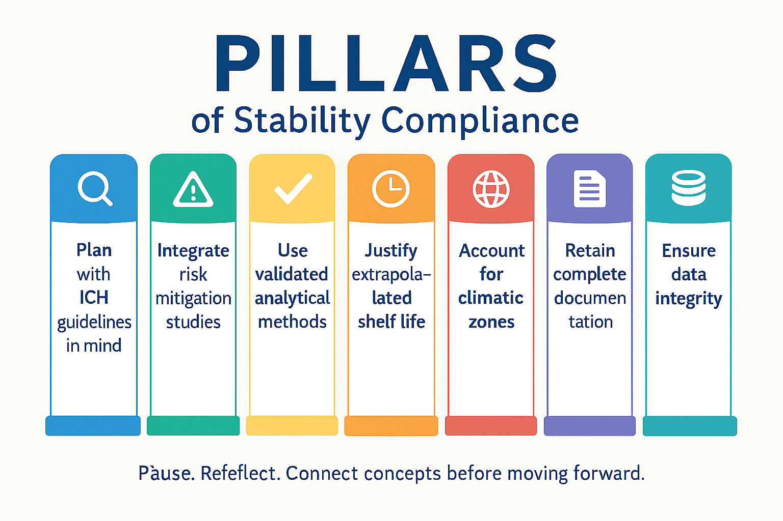
PILLARS of Stability Compliance
Strong pillars prevent pitfalls in stability studies.

Slide 23
Reflection Spot
How can you proactively avoid these pitfalls when designing or documenting stability studies?

Slide 24
