Slide 1
KRISHNA VISHWA VIDYAPEETH ,KARAD.
KRISHNA INSTITUTE OF NURSING SCIENCES ,KARAD.

Slide 2
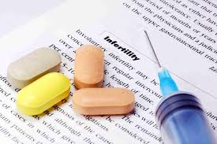
PRESENTED BY : MISS. KAVITA KADAM
2nd YEAR MSC NURSING

Slide 3


Slide 4
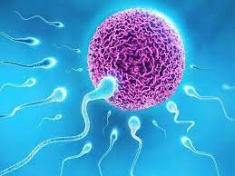
INFERTILITY
Infertility is defined as a failure to conceive within one or more years of regular unprotected intercourse.

Slide 5
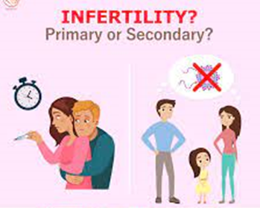
TYPES OF INFERTILITY

Slide 6
There are two types of infertility
Primary infertility : primary infertility denotes couples who have never been able to conceive.
Secondary infertility : secondary infertility denotes indicates difficulty in conceiving after already having conceived.

Slide 7
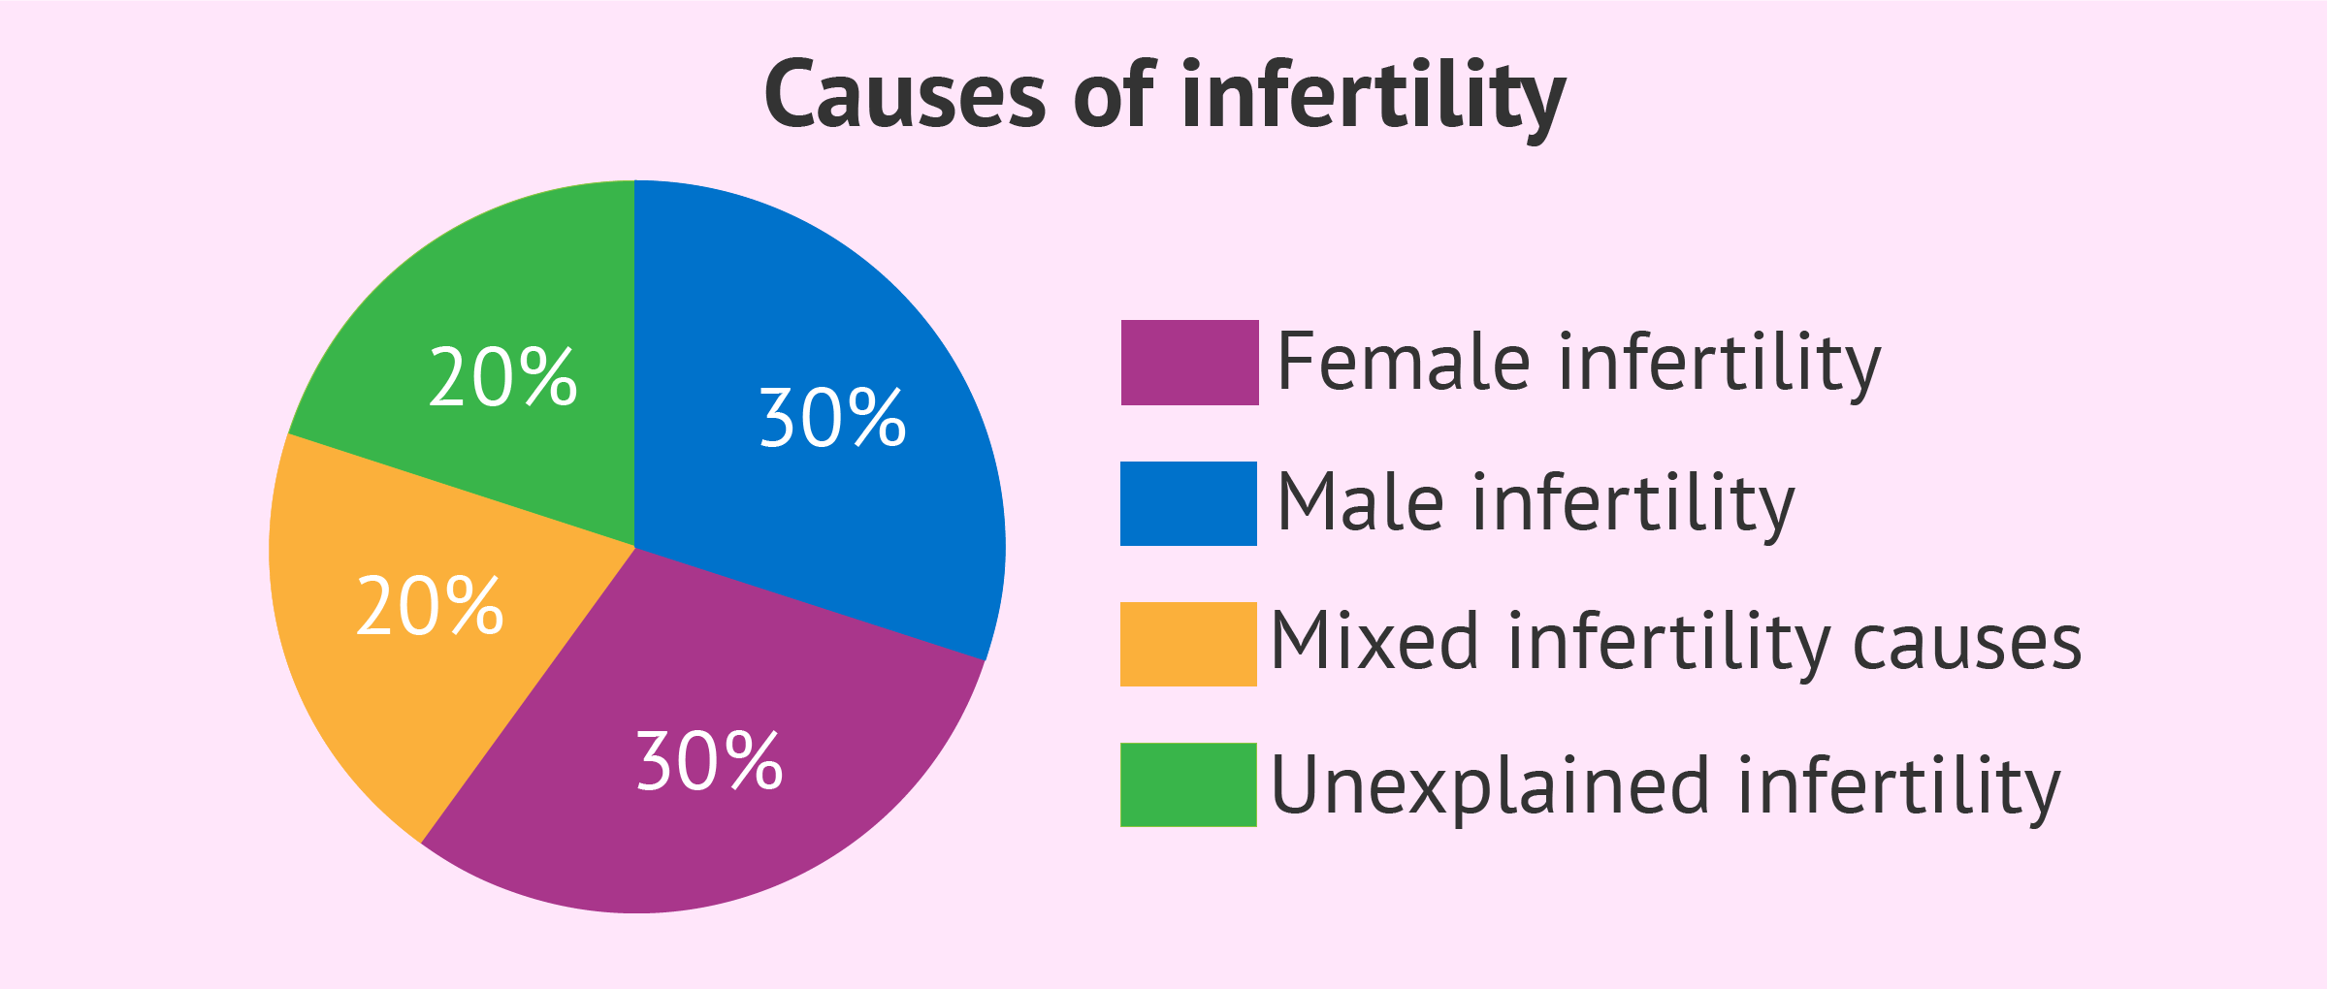
INCIDENCE

Slide 8
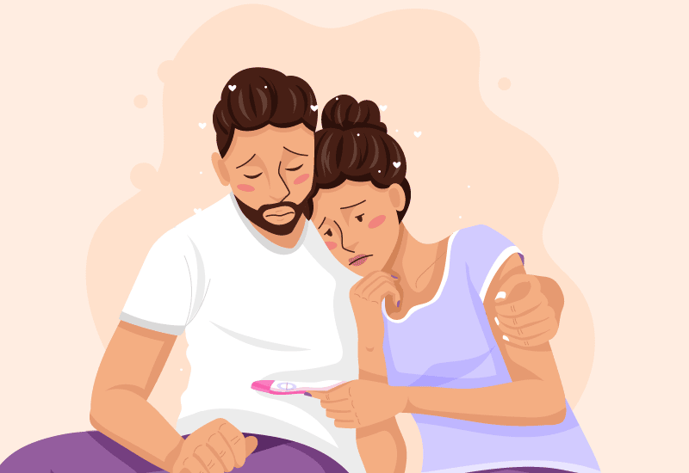
CAUSES

Slide 9
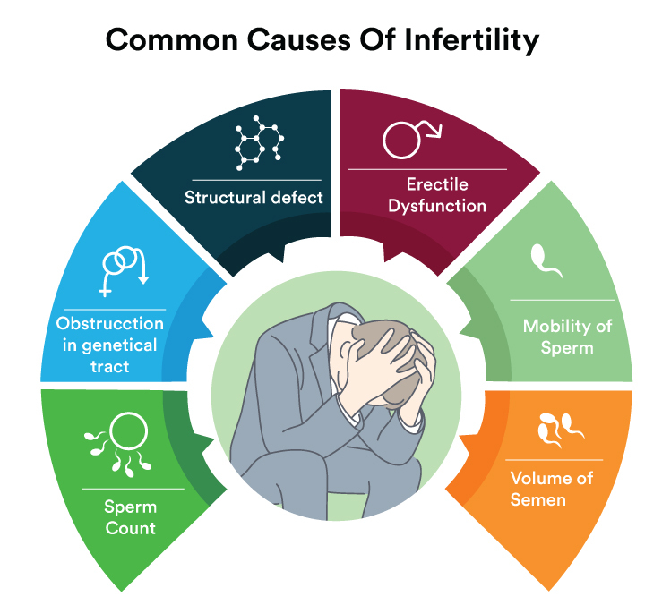
MALE CAUSES

Slide 10
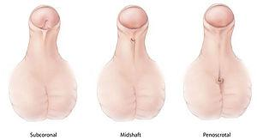
Male Factors
DEFECTIVE SPERMATOGENESIS
Congenital: Due to undescended testes spermatogenesis is depressed.
Hypospadias

Slide 11
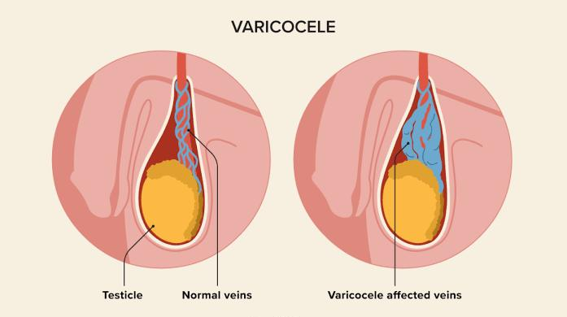
Cont…
3. Thermal factor: Vericocele

Slide 12
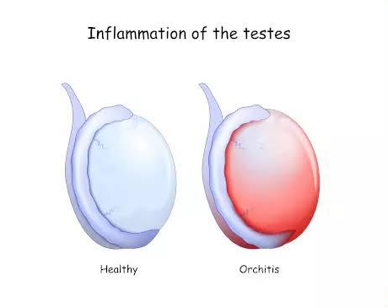
Cont…
4. Infection: Mumps, Orchitis damage the spermatogenesis

Slide 13
Cont…
5.Gonadotrophin suppression: It happens in the malnutrition, heavy smoking and high alcohol consumption.

Slide 14
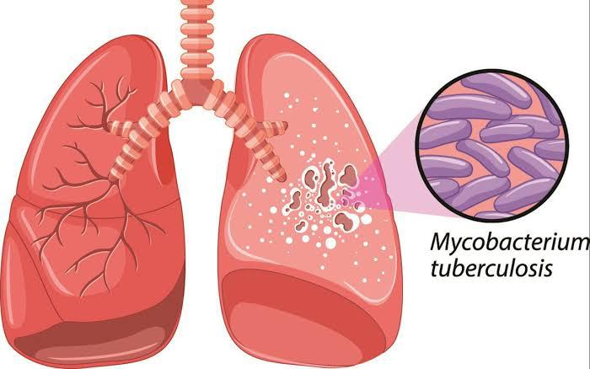
Cont…
OBSTRUCTION OF EFFERENT DUCT
Gonococcal or tubercular infection
Surgical trauma during vasectomy.

Slide 15
Cont…
FAILURE TO DEPOSIT SPERM HIGH IN THE VAGINA:
Erectile dysfunction
Ejaculatory defects such as premature retrograde or absence of ejaculation
Hypospadias.

Slide 16
Cont…
ERROR IN THE SEMINAL FLUID :
Low fructose content
High prostaglandin content
Unusually low volume of ejaculation.

Slide 17
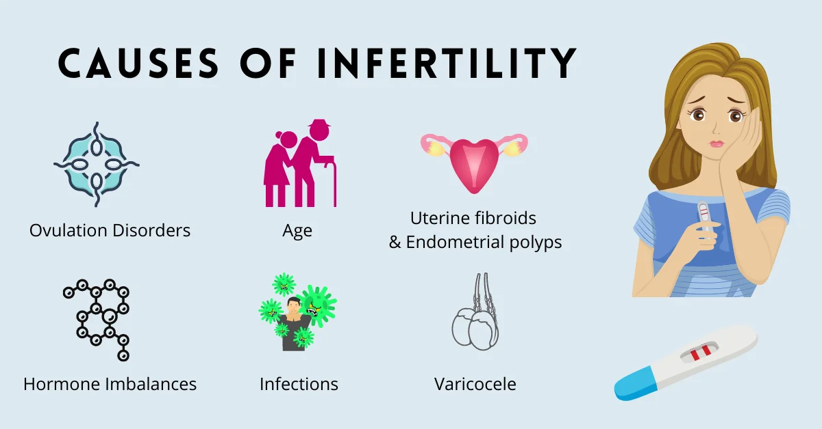
FEMALE CAUSES

Slide 18
1.Ovulation problems:
An hormonal imbalance: FSH or LH secretion
Anovulation
Polycystic ovarian disease
Eating disorders such as anorexia or bulimia
Stress
Alcohol or drug use
Intense exercise that causes a loss of body fat.

Slide 19
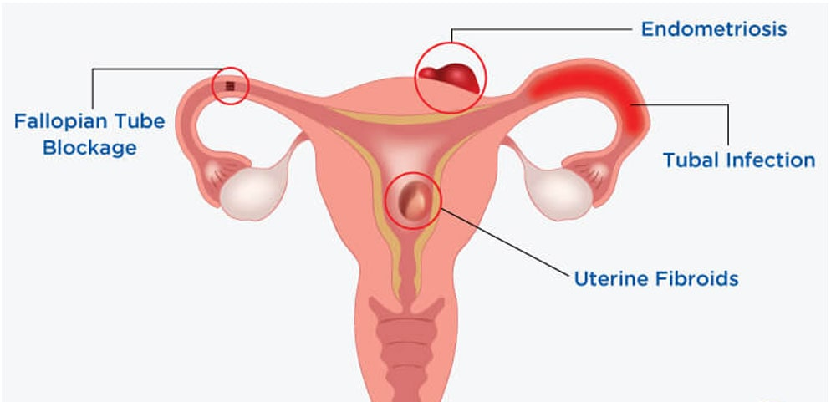
2.FALLOPIAN TUBE DAMAGE

Slide 20

RISK FACTORS
AGE :

Slide 21

SMOKING :

Slide 22

OVER WEIGHT AND OVER EXERCISING :

Slide 23
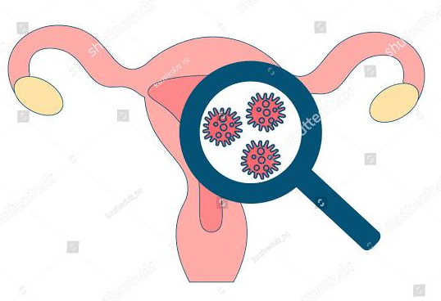
SEXUALLY TRASMITTED DESEASE :

Slide 24

STRESS :

Slide 25
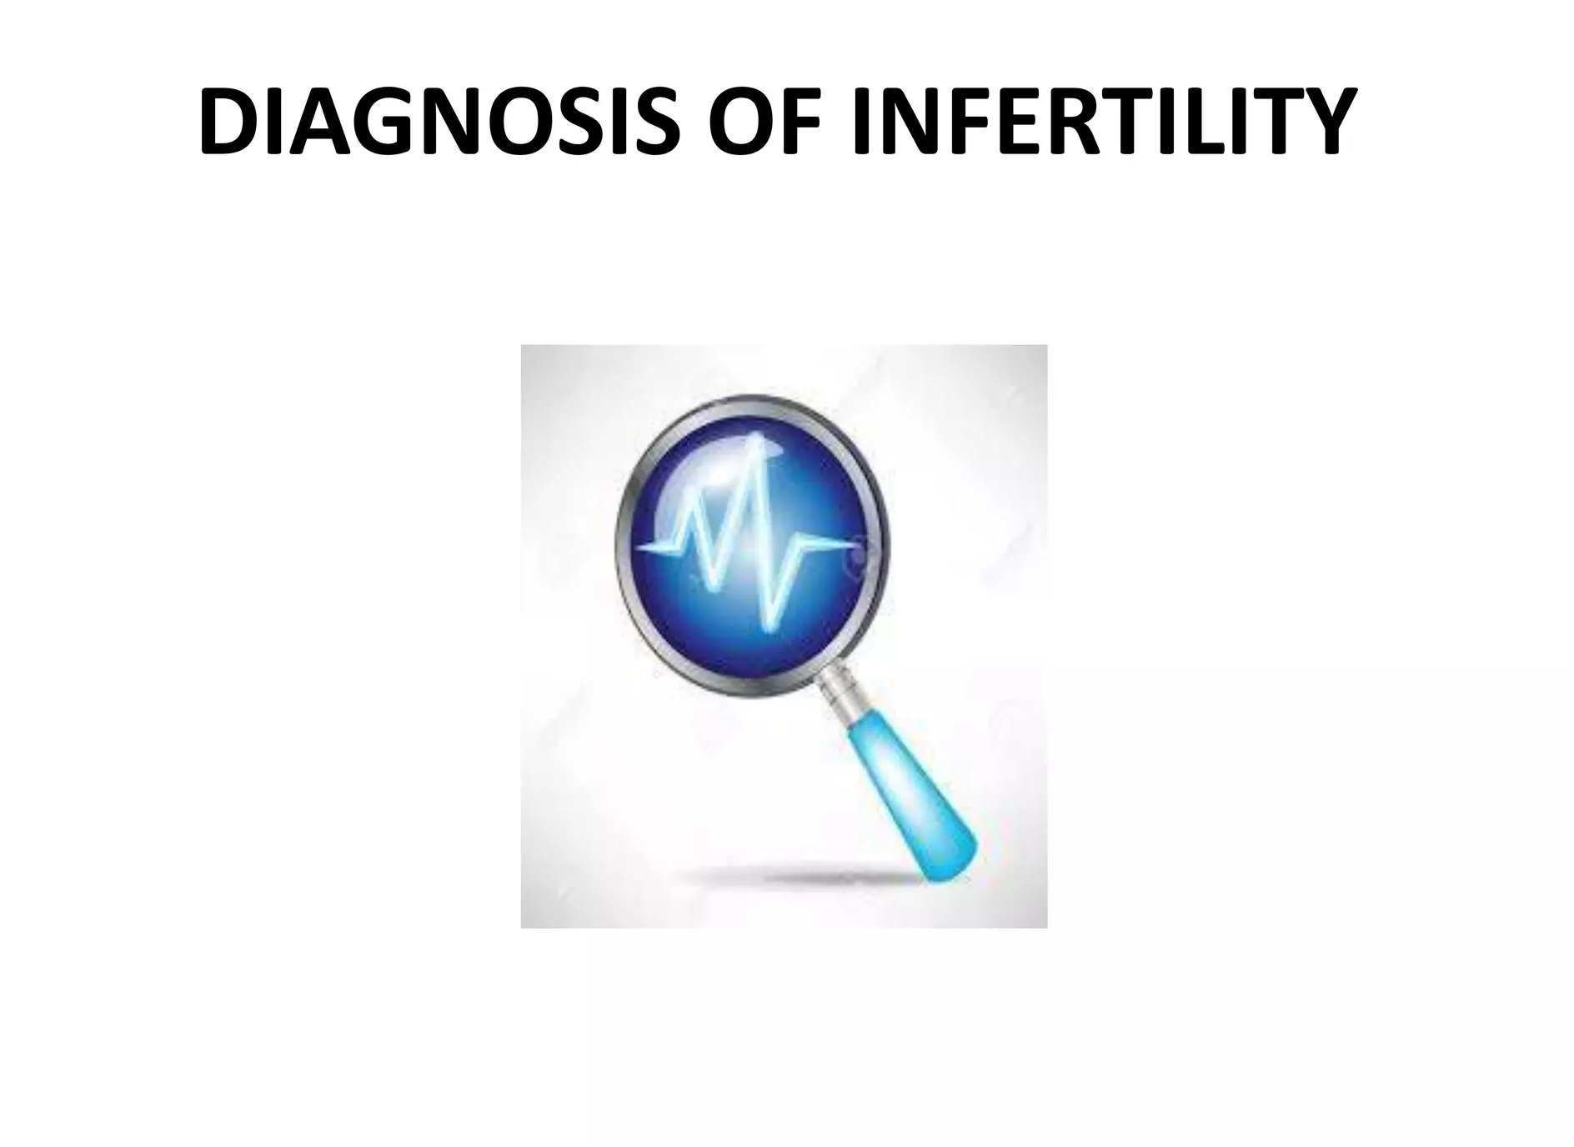

Slide 26
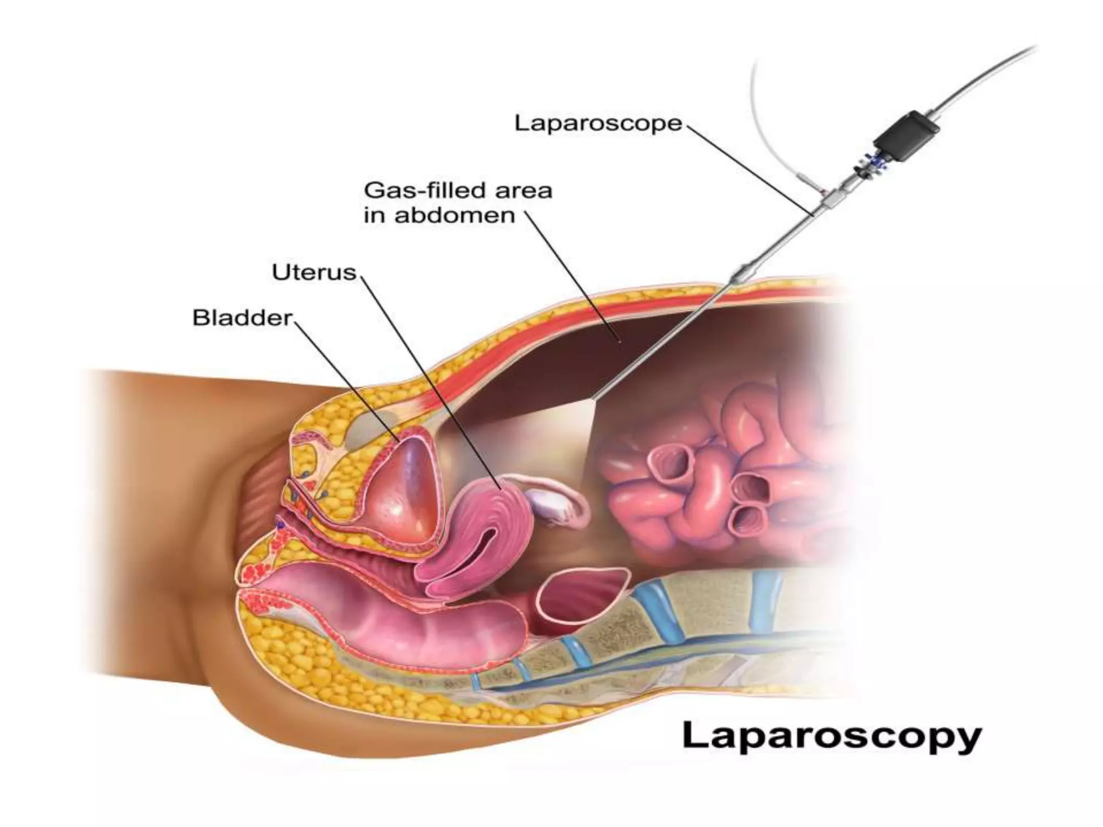

Slide 27
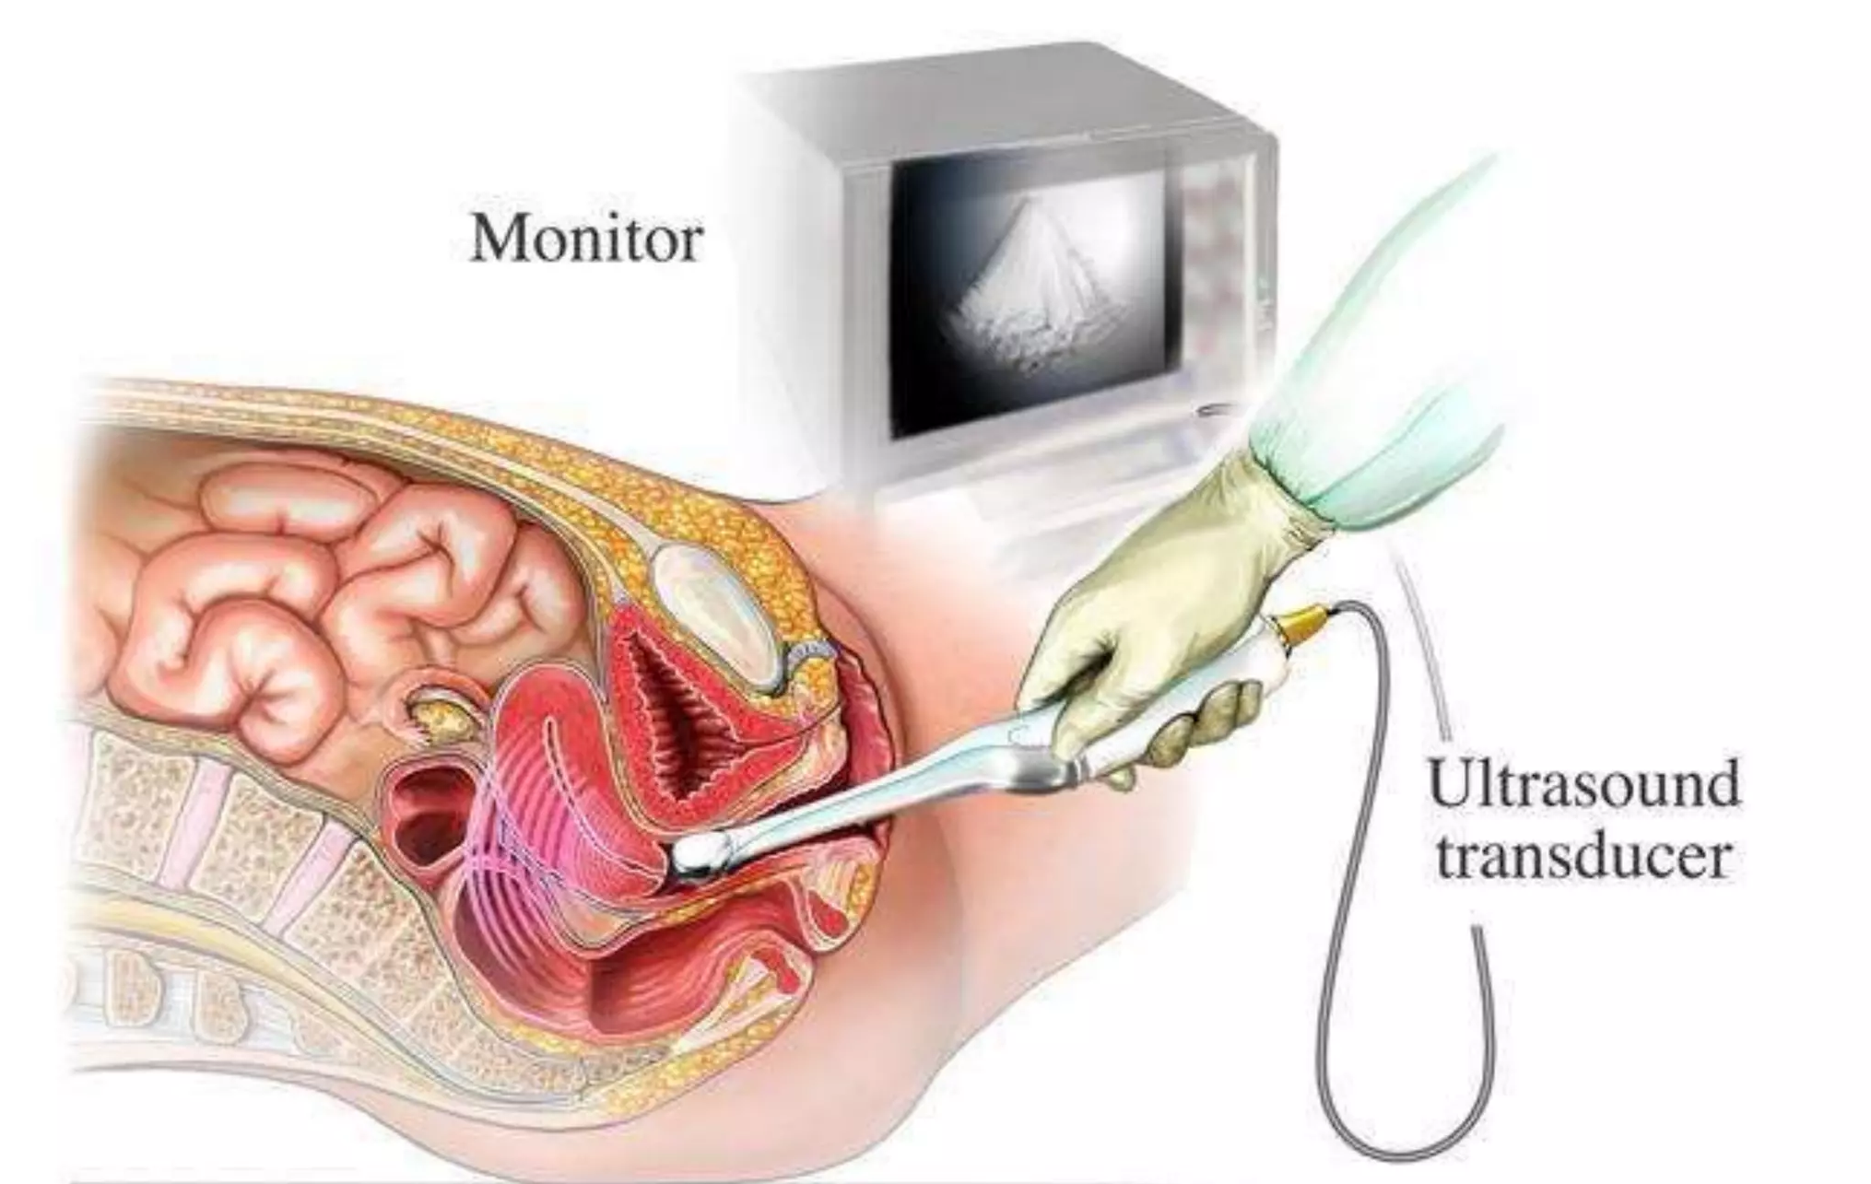

Slide 28

TREATMENT

Slide 29
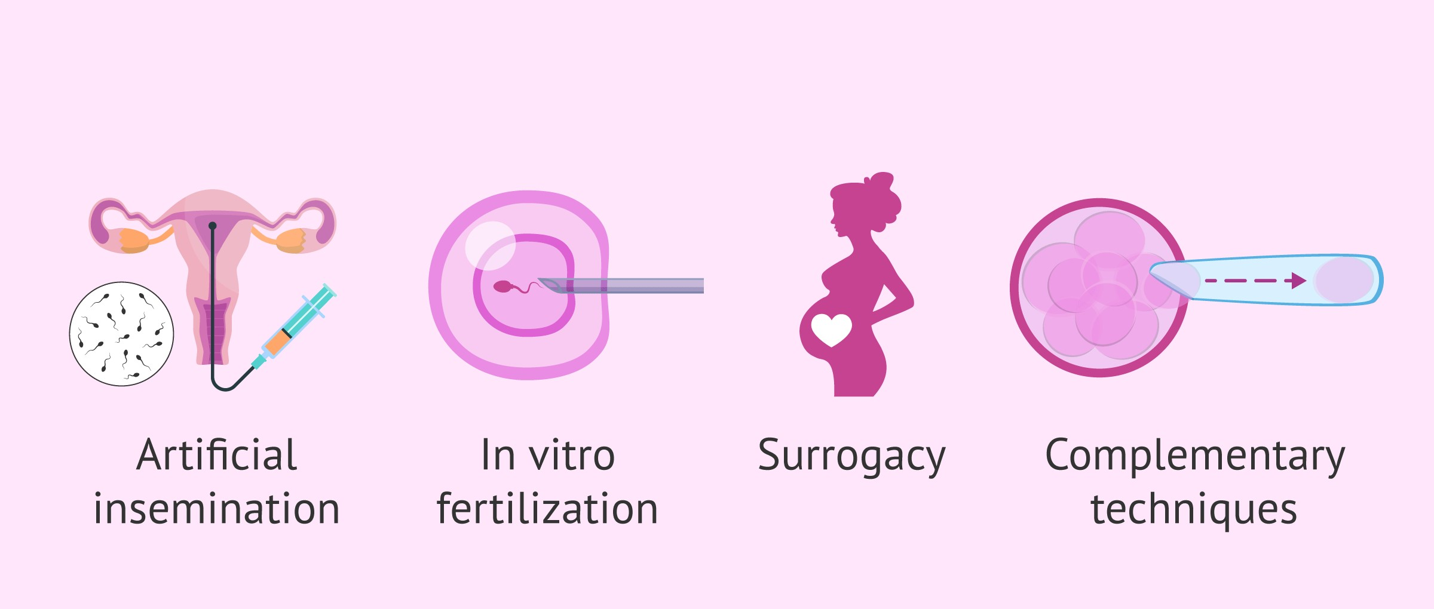

Slide 30
INTRAUTERINE INSEMINATION (IUI)
IUI is a procedure in which a catheter is inserted through the cervix into the uterus to deposit a sperm sample directly into the uterus.

Slide 31
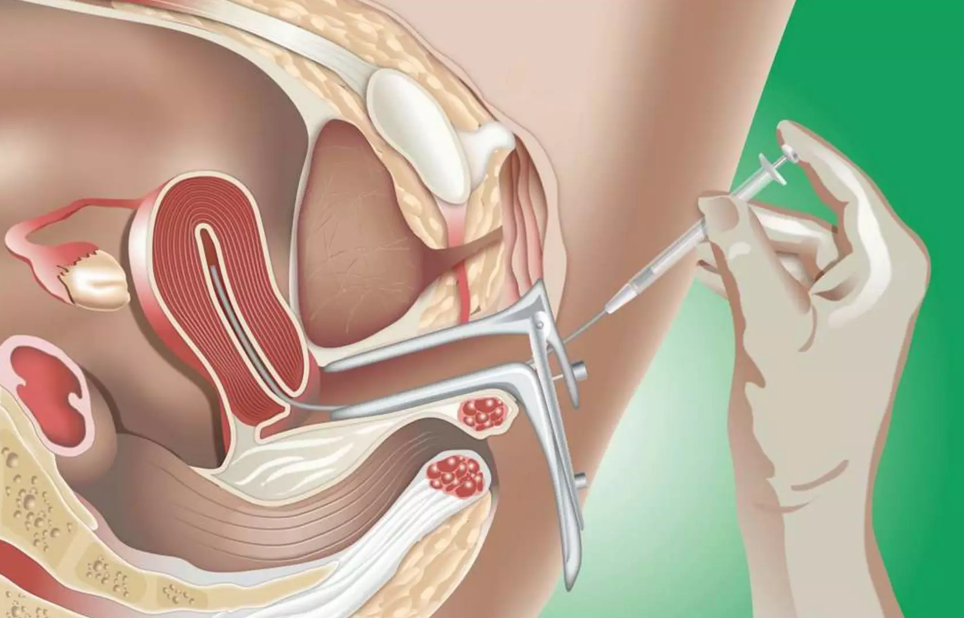

Slide 32
INVITRO FERTILIZATION( IVF)
IVF is a process by which an egg is fertilized by sperm outside the body.
In Vitro= In glass.

Slide 33
INTRACYTOPLASMIC SPERM INJECTION(ICSI)
ICSI is the most successful form of treatment who are infertile.
ICSI only requires one/single sperm which is injected directly into the egg and fertilized egg is transferred to uterus.

Slide 34
To stimulate ovulation
Drugs are:
Clomophene citrate
Human menopausal gonadotrophins
Follicle stimulating hormone
Gonadotrophin releasing hormone analog
Bromocriptine.

Slide 35
Cont…
FERTILITY RESTORATION SURGERIES:
Tissue removal: This surgery removes endometrial or pelvic adhesions with lasers or ablation.
Tubal surgeries: If fallopian tubes are blocked or filled with fluid, tubal surgery improve chances of becoming pregnant.

Slide 36
FEMALE INFERTILITY TREATMENT
Treatment of female infertility consists of fertility restoration drugs, fertility restoration surgeries, Assisted reproductive technologies( ART) .

Slide 37
Cont…
Laparoscopic surgery is performed to remove adhesions and create a new tubal opening.
Salpingectomy: It can improve chances of pregnancy with in vitro fertilization.

Slide 38
Cont…
Intrauterine insemination
Invitro fertilization
Zygote intrafallopian transfer( ZIFT) .
Gamete intrafallopian transfer( GIFT)
Intracytoplasmic sperm injection(ICSI)

Slide 39
Zygote intrafallopian transfer
ZIFT is an ART designed to transfer the fertilized embryo into the fallopian tube instead of the uterus
Here zygote is place in the fallopian tube through which it will reach into the uterus
It is similar to IUF

Slide 40
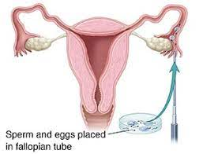
Gamete intrafallopian transfer
GIFT involves transferring eggs and sperm into the women's fallopian tubes so fertilization occurs in the woman's body.

Slide 41
THANKS FOR SUPPORT AND GUIDANCE
Dr. Vaishali Rajsinh Mohite ,
Dean, KINS,Karad.
Special thanks to
Dr. M.V. Ghorpade,
Registrar, KVV, Karad.
Dr. Yugantara Kadam
( Prof & Head )

Slide 42
CAST
Miss. Kavita kadam
Concept
Dr. Jyothi Salunkhe
Professor and Dean ( Academics )
K.I.N.S. Karad
Narration
Miss. Kavita Kadam
K.I.N.S. Karad.
Editor
Aditya

Slide 43
Technical Support
Raju Bhosale
Wasim Pathan

Slide 44
E Content Development
Dr. Balkrishna Damle
Director , Centre for Distance and Online Education

Slide 45
Thanks for Special Guidance
Hon’ble Dr. Suresh Bhosale
Chancellor , KVV

