Slide 1
Fundamentals of Solubility Studies
Resource Person
Miss. Vaishnavi A.Mane
Assistant Professor
Department of Pharmaceutics,
Krishna Institute of Pharmacy,
Krishna Vishwa Vidyapeeth (Deemed to be University), Karad, Maharashtra, INDIA

Slide 2
Learning Outcomes
After completing this session, students will be able to:
Define solubility and explain its pharmaceutical importance
Identify factors affecting solubility of drug substances
Describe methods used for solubility determination
Apply solubility concepts in drug formulation and development

Slide 3
Contents
01
Introduction to Solubility
04
Solubility Classification
02
Definition and Types of Solubility
05
Methods of Solubility Determination
03
Factors Affecting Solubility
06
Applications of Solubility Studies

Slide 4
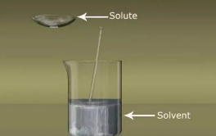
Solubility
Solubility is the maximum amount of a solute that can dissolve in a given amount of solvent at a specified temperature and pressure.
Usually expressed as mg/mL, g/L, or molarity.

Slide 5
Importance of Solubility Studies
Determines bioavailability of drugs
Essential for formulation development
Helps in dose design
Important for quality control and stability
Affects absorption, distribution, and therapeutic efficacy

Slide 6
Types of Solubility
Intrinsic solubility: Solubility of the unionized form of a drug
Apparent solubility: Solubility including ionized form at a given pH
Aqueous solubility: Solubility in water
Lipid solubility: Solubility in lipids/fats

Slide 7
Factors Affecting Solubility
Nature of solute and solvent (polarity)
Temperature
pH of the medium
Particle size
Crystal form (polymorphism)
Presence of electrolytes and additives

Slide 8
Solubility Classification (USP)
Descriptive Term | Parts of Solvent Required per Part of Solute
Very soluble | Less than 1
Freely soluble | From 1 to 10
Soluble | From 10 to 30
Sparingly soluble | From 30 to 100
Slightly soluble | From 100 to 1000
Very slightly soluble | From 1000 to 10,000
Practically insoluble | 10,000 and over

Slide 9
Biopharmaceutics Classification System (BCS):
BCS Class | Solubility | Permeability | Absorption Characteristics | Examples
Class I | High | High | Rapid and complete absorption | Paracetamol, Metoprolol
Class II | Low | High | Absorption limited by solubility | Ibuprofen, Ketoconazole
Class III | High | Low | Absorption limited by permeability | Cimetidine, Atenolol
Class IV | Low | Low | Poor oral bioavailability | Furosemide, Hydrochlorothiazide

Slide 10
Methods of Solubility Determination
Shake flask method
Equilibrium solubility method
pH solubility profile
Spectrophotometric method

Slide 11
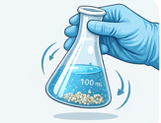
Shake flask method
Excess drug is added to solvent
Flask is shaken until equilibrium is reached
Undissolved drug is removed by filtration
Simple and widely used method

Slide 12
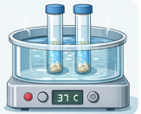
Equilibrium solubility method
Drug is mixed with solvent and maintained at constant temperature
System is allowed to reach equilibrium
Clear supernatant is analyzed
Provides accurate solubility values

Slide 13
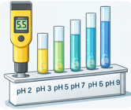
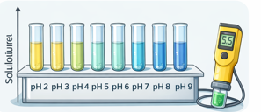
pH solubility profile
Solubility measured at different pH values
Buffers of varying pH are used
Shows effect of ionization on solubility
Useful for weak acids and bases

Slide 14
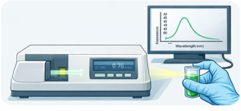
Spectrophotometric method
Drug solution absorbance is measured
Concentration determined using calibration curve
Quick and sensitive method
Suitable for low solubility drugs

Slide 15
Applications of Solubility Studies
Drug discovery and development
Selection of suitable dosage form
Enhancement of drug solubility
Predicting in-vivo performance

