Slide 1
Particle Size of Drug Substances: Technologies, Biopharmaceutical Relevance, and Formulation Implications
Resource Person
Dr. Sopan N. Nangare
Assistant Professor
Department of Pharmaceutics,
Krishna Institute of Pharmacy,
Krishna Vishwa Vidyapeeth (Deemed to be University), Karad, Maharashtra, INDIA

Slide 2
Learning Outcomes
After completing this session, students will be able to:
Understand the importance of mathematics in pharmaceutical calculations.
Apply basic mathematical concepts to pharmaceutical problem-solving.
Convert between different measurement units commonly used in pharmacy.
Avoid common calculation errors to enhance accuracy and patient safety

Slide 3
Contents
01
Introduction
04
Particle Size Reduction Techniques
02
Fundamental Concepts of Particle Size
05
Particle Size Enlargement Techniques
03
Theoretical Background (Dissolution & Diffusion Principles)
06
Particle Size Characterization Technologies

Slide 4
Contents
07
Biopharmaceutical Relevance
10
Formulation Implications
08
Impact on Various Dosage Forms
11
Advantages and Challenges
09
Regulatory Considerations
12
Recent Advances in Particle Engineering

Slide 5
Importance of Particle Size in Pharmaceuticals
Controls dissolution rate (surface area dependent)
Affects bioavailability, especially in oral dosage forms
Influences:
  Flow properties
  Compressibility
  Content uniformity
  Stability
Critical in:
  Suspensions
  Inhalation products
  Parenteral formulations

Slide 6
Fundamental Concepts – Particle Size & Distribution
Particle size: Diameter of individual solid particles
Particle Size Distribution (PSD): Range and frequency of particle sizes in a sample
PSD is more important than single particle size
Common statistical expressions:
  D10 (10% below this size)
  D50 (median diameter)
  D90 (90% below this size)
Narrow vs wide distribution and its formulation impact

Slide 7
Surface Area and Dissolution Relationship
Smaller particles → Larger surface area
Increased surface area enhances dissolution rate
Explained by Noyes - Whitney equation
Dissolution rate ∝ Surface area
Particularly important for BCS Class II drugs

Slide 8
Additional Fundamental Parameters
Polydispersity Index (PDI) - a measure of size uniformity
Shape factors (spherical vs irregular particles)
True diameter vs aerodynamic diameter
Micronization (1–10 µm range)
Nanonization (<1000 nm range)
Impact of particle aggregation and agglomeration

Slide 9
Overview of Dissolution and Diffusion
Dissolution: Process by which solid drug particles dissolve in a solvent
Diffusion: Movement of dissolved drug molecules from high to low concentration
Both processes govern drug absorption
Critical for oral bioavailability
Especially important for poorly water-soluble drugs

Slide 10
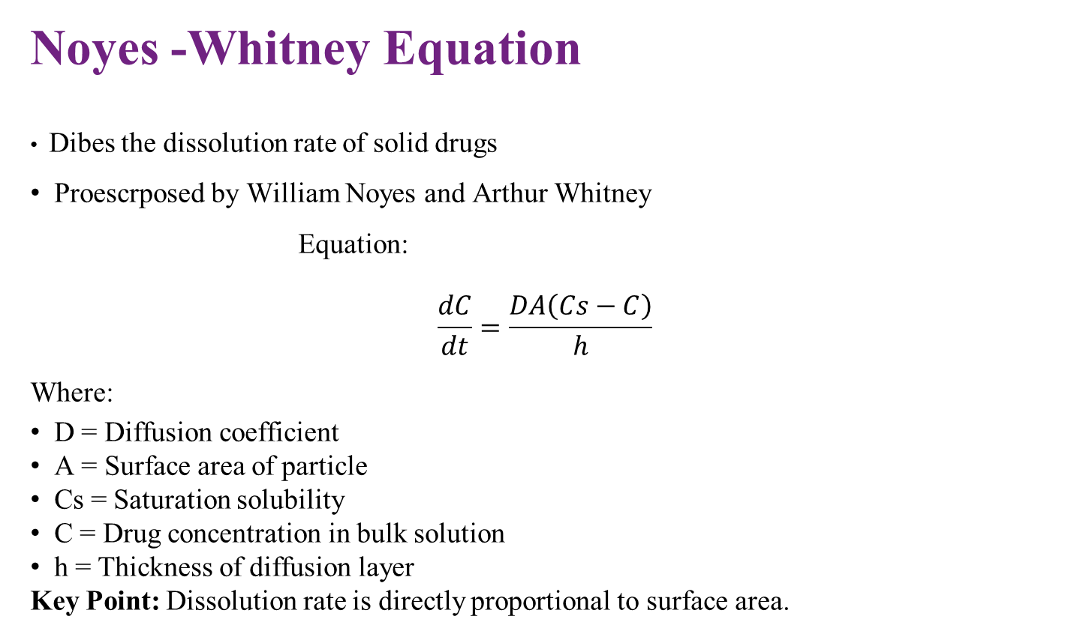
Noyes -Whitney Equation
Dibes the dissolution rate of solid drugs
Proescrposed by William Noyes and Arthur Whitney
Equation:
$$\frac{dC}{dt}=\frac{DA\left(Cs−C\right)}{h}$$
Where:
D = Diffusion coefficient
A = Surface area of particle
Cs = Saturation solubility
C = Drug concentration in bulk solution
h = Thickness of diffusion layer
Key Point: Dissolution rate is directly proportional to surface area.

Slide 11
Diffusion Layer Theory
Proposed by William Nernst and Ernest Brunner
A stagnant liquid layer (diffusion layer) surrounds the dissolving particle
Drug must diffuse through this layer before entering bulk solution
Thinner diffusion layer → Faster dissolution
Agitation reduces diffusion layer thickness

Slide 12
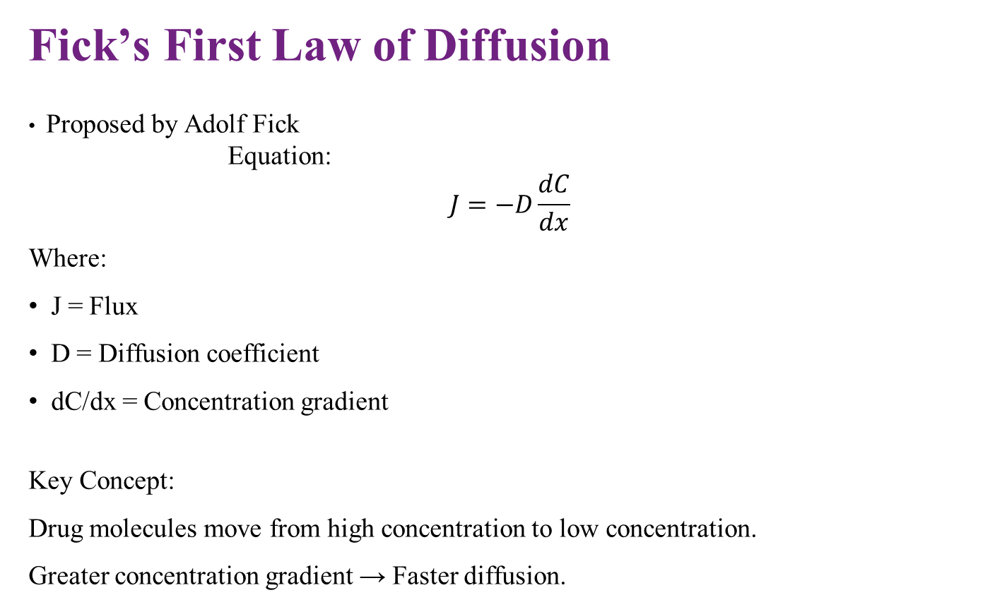
Fick’s First Law of Diffusion
Proposed by Adolf Fick
Equation:
$$J=−D\frac{dC}{dx}$$
Where:
J = Flux
D = Diffusion coefficient
dC/dx = Concentration gradient
Key Concept:
Drug molecules move from high concentration to low concentration.
Greater concentration gradient → Faster diffusion.

Slide 13
Biopharmaceutical Significance
For poorly soluble drugs:
  Dissolution is the rate-limiting step
Reduced particle size:
  ↑ Surface area
  ↑ Dissolution rate
  ↑ Absorption
Highly relevant for BCS Class II and IV drugs
Basis for micronization and nanonization strategies

Slide 14
Introduction to Particle Size Reduction
Process of decreasing the particle size of drug substances
Enhances surface area and dissolution rate
Essential for poorly water-soluble drugs
Improves bioavailability and uniformity
Used in solid, liquid, and inhalation formulations

Slide 15
Mechanical Size Reduction Methods
1. Milling (Comminution)
Ball mill
Hammer mill
Fluid energy (Jet) mill
Mechanisms involved:
Impact
Attrition
Compression
Shear
Jet milling:
Uses high-velocity compressed air
Produces particles in the micron range (1-10 µm)
Suitable for heat-sensitive drugs

Slide 16
High-Pressure Homogenization
Used for nanoparticle production
Suspension forced through narrow gap at high pressure
Mechanism:
  Cavitation
  Shear forces
  Particle collision
Produces nanocrystals (100–1000 nm)
Used in parenteral and oral nanoformulations

Slide 17
Spray Drying & Supercritical Fluid Technology
Spray Drying
Drug solution/suspension atomized into hot air
Rapid solvent evaporation
Produces fine particles
Useful for amorphous solid dispersions
Supercritical Fluid Technology
Uses supercritical CO₂
Controlled precipitation of fine particles
Produces uniform, small particle sizes
Minimal solvent residue

Slide 18
Advanced Techniques - Nanotechnology Approaches
Nanocrystal technology
Wet media milling
Precipitation techniques
Bottom-up vs Top-down approaches
Advantages:
Increased dissolution rate
Improved saturation solubility
Enhanced bioavailability
Limitations:
Agglomeration
Stability concerns
Scale-up challenges

Slide 19
Introduction to Particle Size Enlargement
Process of increasing the particle size of fine powders
Improves flowability and compressibility
Reduces dust formation and segregation
Enhances uniformity in dosage forms
Commonly used in tablet and capsule manufacturing

Slide 20
Granulation
Definition:
Process of converting fine powders into larger, free-flowing granules.
Types:
1. Wet Granulation
Uses binder solution
Forms liquid bridges between particles
Followed by drying and sizing
2. Dry Granulation
No liquid binder
Roller compaction or slugging
Suitable for moisture-sensitive drugs
Advantages:
Improves flow
Enhances compressibility
Better content uniformity

Slide 21
Pelletization
Formation of small, spherical pellets (0.5-1.5 mm)
Used in modified-release formulations
Methods:
Extrusion - spheronization
Solution/suspension layering
Powder layering
Benefits:
Uniform particle size
Improved coating efficiency
Reduced dose dumping risk

Slide 22
Agglomeration
Process of binding fine particles into larger aggregates
Mechanisms:
Solid bridges
Liquid bridges
Mechanical interlocking
Techniques:
Fluidized bed agglomeration
Spray agglomeration
High-shear mixing
Applications:
Instant powders
Suspension formulations

Slide 23
Importance in Formulation Development
Prevents poor flow and segregation
Enhances tablet hardness and uniformity
Reduces electrostatic problems
Improves handling during large-scale manufacturing
Challenges:
Over-granulation
Variation in granule strength
Moisture sensitivity
Scale-up control issues

Slide 24
Biopharmaceutical Relevance
Particle Size & Dissolution Rate
Dissolution is the first step for drug absorption
Smaller particle size → Larger surface area
Enhanced dissolution rate
Particularly important for poorly water-soluble drugs
Governed by the Noyes–Whitney equation

Slide 25
Particle Size and Bioavailability
Increased dissolution → Increased drug available for absorption
Faster onset of action
Improved therapeutic response
Reduced variability in plasma concentration
Critical for oral solid dosage forms

Slide 26
Relevance to BCS Classification
BCS Class I – No major particle size limitation
BCS Class II – Low solubility, high permeability → Particle size reduction critical
BCS Class III – Permeability limiting
BCS Class IV – Both solubility & permeability low → Advanced particle engineering
needed
Particle size reduction is most impactful for Class II & IV drugs

Slide 27
Absorption and Rate-Limiting Step
For poorly soluble drugs → Dissolution is rate-limiting
Reduced particle size:
  Shortens dissolution time
  Increases concentration gradient
  Enhances diffusion across GI membrane
Improves oral absorption profile

Slide 28
Clinical and Therapeutic Significance
Dose reduction possible
Reduced food effect
Better patient compliance
More consistent therapeutic effect
Important in the lifecycle management of drugs

Slide 29
Impact on Various Dosage Forms
Tablets
Affects powder flow and compressibility
Influences tablet hardness and friability
Controls dissolution profile
Too fine → Poor flow
Too coarse → Poor dissolution
Balance is essential for optimal performance.

Slide 30
Capsules
Uniform particle size ensures:
  Uniform filling
  Dose accuracy
Fine particles may cause:
  Electrostatic issues
  Poor flow
Particle size impacts content uniformity

Slide 31
Suspensions
Smaller particles:
  Slower sedimentation (according to Stokes’ Law)
  Improved redispersibility
Very fine particles may aggregate
Affects the physical stability of suspension
Sedimentation rate ∝ Particle size²

Slide 32
Inhalation Products
Critical parameter: Aerodynamic particle size
Optimal size: 1–5 µm for lung deposition
5 µm → Deposited in upper airway
<1 µm → Exhaled
Determines therapeutic efficiency in pulmonary delivery.

Slide 33
Parenteral & Topical Formulations
Parenteral Suspensions:
Controlled particle size prevents embolism
Ensures syringeability
Topical Formulations:
Influences skin penetration
Affects uniform drug distribution
Particle size must be carefully controlled for safety and efficacy.

Slide 34
Importance of Regulatory Control
Particle size is a Critical Quality Attribute (CQA)
Direct impact on:
  Dissolution
  Bioavailability
  Stability
Regulatory agencies require strict control of Particle Size Distribution (PSD)
Ensures batch-to-batch consistency

Slide 35
Quality by Design (QbD) Concept
QbD = Systematic approach to pharmaceutical development
Emphasizes:
  Product understanding
  Process understanding
Particle size identified during:
  Risk assessment
  Design space development
Controlled through validated manufacturing processes

Slide 36
Particle Size as a CQA
Defined based on impact on safety & efficacy
Linked to:
  Critical Material Attributes (CMA)
  Critical Process Parameters (CPP)
Example:
  Milling speed affects particle size
  Particle size affects dissolution
Scientific justification is required in regulatory submissions.

Slide 37
Regulatory Documentation Requirements
Specification limits for PSD (e.g., D10, D50, D90)
Validated analytical methods (e.g., laser diffraction)
Stability data supporting particle size control
Demonstration of equivalence in generic products
Particle size is often included in the Drug Master File (DMF).

Slide 38
Process Analytical Technology (PAT)
Real-time monitoring of particle size
In-line or at-line measurement tools
Prevents out-of-specification batches
Supports continuous manufacturing
Enhances regulatory flexibility

Slide 39
Formulation Implications
Effect on Dissolution & Drug Release
Smaller particles:
  Faster dissolution
  Faster onset of action
Larger particles:
  Slower, controlled release
Critical in modified-release formulations
Particle size directly influences release kinetics.

Slide 40
Effect on Powder Flow & Compressibility
Fine particles:
  Poor flow
  High cohesiveness
Coarse particles:
  Better flow
  Possible segregation
Impacts tablet weight variation and uniformity

Slide 41
Stability Considerations
Smaller particles:
  Higher surface energy
  Increased risk of aggregation
  Increased chemical degradation
Moisture sensitivity may increase
Requires stabilizers in nanoformulations

Slide 42
Impact on Drug-Excipient Interaction
Larger surface area → More interaction with excipients
Can affect:
  Compatibility
  Stability
  Dissolution behavior
Important in solid dispersions

Slide 43
Scale-Up & Manufacturing Impact
Milling parameters affect final PSD
Risk of variation during scale-up
Need for robust process control
Reproducibility is essential for commercialization

Slide 44
Advantages of Particle Size Optimization
Enhanced dissolution rate
Improved bioavailability
Dose reduction possible
Faster therapeutic action

Slide 45
Manufacturing Advantages
Improved content uniformity
Better tablet compaction
Enhanced suspension stability
Controlled drug release profiles

Slide 46
Challenges - Physical Stability
Agglomeration
Ostwald ripening (in nanosystems)
Sedimentation issues
Electrostatic charging

Slide 47
Challenges - Processing and Scale-Up
Reproducibility issues
Equipment limitations
Heat generation during milling
Cost of advanced technologies

Slide 48
Overall Risk-Benefit Perspective
Benefits:
Improved therapeutic performance
Better patient outcomes
Risks:
Stability concerns
Manufacturing complexity
Careful optimization and regulatory compliance are essential.

Slide 49
Introduction to Modern Particle Engineering
Advanced techniques to modify particle size, shape, and surface properties
Aim: Improve solubility, bioavailability, and stability
Focus on poorly water-soluble drugs
Integration of nanotechnology and material science

Slide 50
Nanocrystal Technology
Drug particles reduced to nanometer range (100 -1000 nm)
Prepared by:
  Wet media milling
  High-pressure homogenization
Advantages:
  Increased surface area
  Improved dissolution velocity
  Enhanced saturation solubility
Widely used for BCS Class II drugs

Slide 51
Lipid-Based Nanoparticles
Solid Lipid Nanoparticles (SLN)
Nanostructured Lipid Carriers (NLC)
Improve:
  Drug solubility
  Controlled release
  Stability
Useful in oral, topical, and parenteral delivery

Slide 52
Amorphous Solid Dispersions & Spray Technologies
Conversion of crystalline drug to amorphous form
Spray drying for controlled particle formation
Enhances apparent solubility
Prevents recrystallization with polymer stabilization
Emerging techniques:
Supercritical fluid processing
3D printing in pharmaceutics

Slide 53
Process Analytical Technology (PAT) & Continuous Manufacturing
Real-time particle size monitoring
In-line laser diffraction systems
Improved process control
Supports Quality by Design (QbD)
Enables continuous manufacturing models

Slide 54
Summary of Key Concepts
Particle size is a critical physicochemical property
Directly influences dissolution and diffusion
Governed by principles such as the Noyes–Whitney equation
Essential in formulation development

Slide 55
Biopharmaceutical Importance
Smaller particle size → Increased surface area
Enhanced dissolution and bioavailability
Crucial for poorly soluble drugs
Impacts therapeutic efficacy

Slide 56
Technological & Regulatory Significance
Advanced engineering improves drug performance
Particle size is considered a Critical Quality Attribute (CQA)
Controlled under Quality by Design (QbD) framework
Regulatory compliance ensures safety and consistency

Slide 57
Challenges & Future Outlook
Stability concerns in nanosystems
Scale-up difficulties
Need for cost-effective technologies
Future focus:
  Precision particle engineering
  Personalized medicine
  Smart drug delivery systems

Slide 58
Final Take-Home Message
Particle size optimization is essential for modern drug development
Proper characterization and control are mandatory
Advances in particle engineering are shaping the future of pharmaceutics
Scientific understanding + regulatory compliance = Successful formulation

