Slide 1
Uterine Fibroids
DR. MANISHA LADDAD
DG.,DNB,PHD,FICOG
ASSOCIATE PROFESSOR

Slide 2


Fibroid
-Def.
-Incidence
-Etiology
-Sites.
-Pathology
-Complication
-Symptoms
-Signs
(1) Uterine Fibroid
- Investigation
DD
Treatment
(2) Cervical fibroid
(3) Uterine Polypi

Slide 3
Definition
Def:-
A benign neoplasm arising from
smooth muscle fibers of the uterus.
Incidence:
- Fibroid is the commonest pelvic tumour 20 - 25% of women during reproductive years

Slide 4
Synonyms
4
leiomyoma of uterus
leiomyomas fibromyomas myofibromas fibroids fibromas myomas
2003-11-3

Slide 5
Aetiology
The exact etiology is unknown.
Estrogen dependent (excessive estrogen predisposes to fibroids)
Increase in size with Estrogen therapy, pregnancy and decrease with menopause.
More common in nulliparae and low parity.
⚫ + ve familial tendency.

Slide 6
Risk factors
Age (reproductive age) % ??????????????
Black race
Obesity
Low parity
Hyperestrogenism

Slide 7
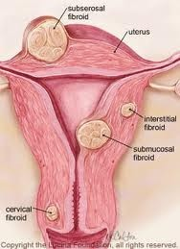
Site of origin
Corporeal fibroid (97% )
Cervical fibroid (3%)

Slide 8

According to relation to uterine
mus₈ cle
Sub mucous（10 - 15%）
Intra mural（60 - 70%）
Sub serosal（20%）
MCQ ?????????
2003-11-3

Slide 9


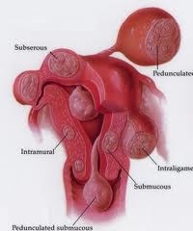

extrauterine
Submucous fibroid polyp, & pedunculated subserous fibroid,
Round lig
brood lig
Recto-vog. Sept
  utero - sacral
Special types of leiomyoma

Slide 10
Characters of fibroids
Frequently multiple
May reach 15 cm in size or larger
Firm
Spherical or irregularly lobulated
Have a false capsule
Can be easily enucleated

Slide 11
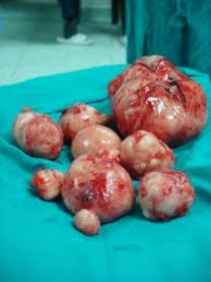
Pathology Of Fibroid
Size
Varies from very small fibroids (seedlings) to huge tumours
Shape
Starts as a small spherical tumour but as it enlarges its shape may be changed by compression.
Consistency
Firm unless affected by degeneration
connective tissue

Slide 12
Pathology Of Fibroid
Macroscopic appearance
  The tumour is white in color
  Cut section is whorled appearance
  The interstial type is surrounded by false capsule formed by compressed by uterine muscle.
Microscopic appearance
Smooth muscles & Connective tissues

Slide 13
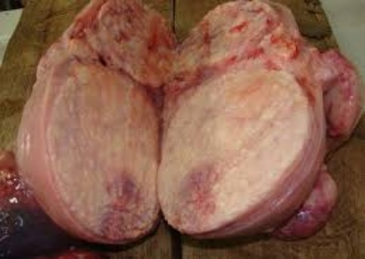
Macroscopic appearance

Slide 14
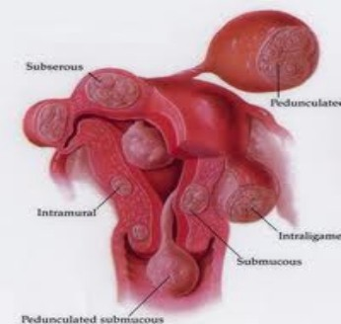
Blood supply of fibroids
Interstitial fibroid receives blood vessels from the surrounding capsule,
Subserous fibroid receives blood vessels from the pedicle
Submucous fibroid receives blood vessels from the pedicle and from the covering endometrium.

Slide 15
Secondary pathological degenerative changes and
complications of fibroids

Slide 16
Atrophy.
Necrosis.
Degeneration.
Vascualr changes.
Malignancy.
Infection.
Torsion.
Incarceration.
Inversion of the uterus.

Slide 17
Clinical picture

Slide 18
Symptoms
Asymptomatic: (50%).
Symptomatic (50%)

Slide 19
Cases ??????????
Abnormal uterine bleeding:
Menorrhagia – Polymenorrhoea- Metrorrhagia
Vaginal discharge
Abdominal Mass
Pain
Pressure symptom
Infertility
General symptoms:
Symptoms of complication

Slide 20
How do myoma cause bleeding
Excess of surface area of endometrium
Ulceration of endometrium overlying the myoma
Associated endometrial hyperplasia or corpus cancer
Pelvic congestion

Slide 21
Signs ??????????
General examination: (Signs of anaemia)
Abdominal and pelvic examination:
A pelvi-abdominal Or pelvic mass.
symmetrical enlargement of the uterus.
A symmetrical enlargement of the uterus.
  A pedunculated subserous
  A broad ligament fibroid.
A cervical fibroid
A fibroid polyp

Slide 22
Investigations of
Fibroid

Slide 23
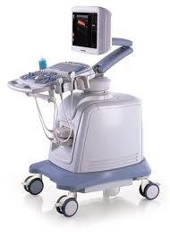
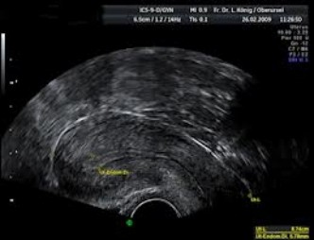
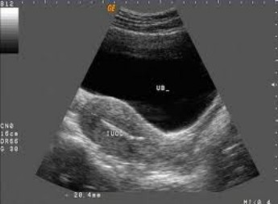
(1) Pelvic ultrasonography
TAS
TVS

Slide 24
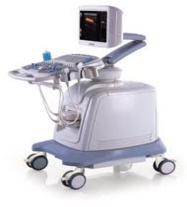
The size, site and number of fibroids and differentiates the tumour from other swellings as ovarian tumour

Slide 25
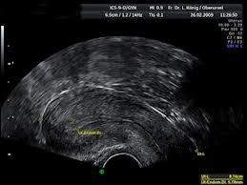

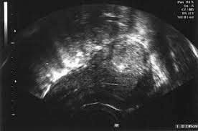
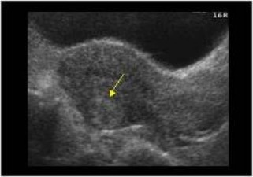

Slide 26
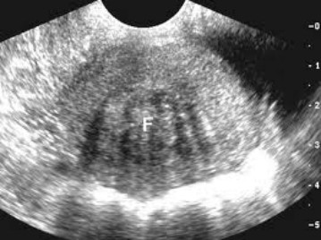

Slide 27
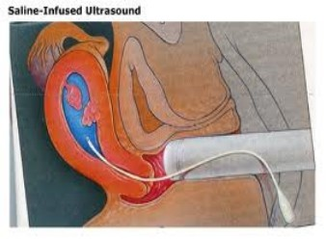
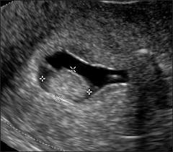
(2) Saline infusion sonography (hydrosonography)
Where saline is injected into the uterus during ultrasound allows better detection of a sub mucous myoma.

Slide 28
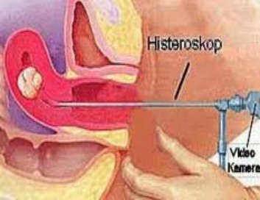
(3) Hysteroscopy
To diagnose a sub mucous fibroid or a small fibroid polyp.

Slide 29
(4) Endometrial biopsy
Irregular uterine bleeding to exclude associated endometrial carcinoma.

Slide 30
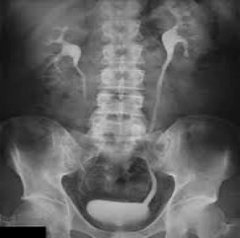
(5) Intra venous pyelogram (IVP)
In cases of cervical and broad ligament fibroid
to show
Course of ureter.
Hydroureter & hydroneprosis
Kidney function.

Slide 31
(6) CT scan or MRI
When ???????????????????????????
Ultrasound cannot differentiate
between
Myoma and localized adenomyosis
Broad ligament fibroid and ovarian tumour.

Slide 32
Differential diagnosis
Causes of a pelvi-abdominal swelling (ovarian tumour).
Causes of symmetrically enlarged uterus as diffuse adenomyosis.
Fibroid polyp is to be differentiated from any mass protruding from the cervix as chronic inversion of uterus.

Slide 33
Differential diagnosis
A broad ligament fibroid may be confused with a broad ligament cyst or a tubal mass as hydro- or pyo-salpinx.
Posterior wall fibroid (other masses felt in Douglas pouch) RVF?????????

Slide 34
Treatment

Slide 35


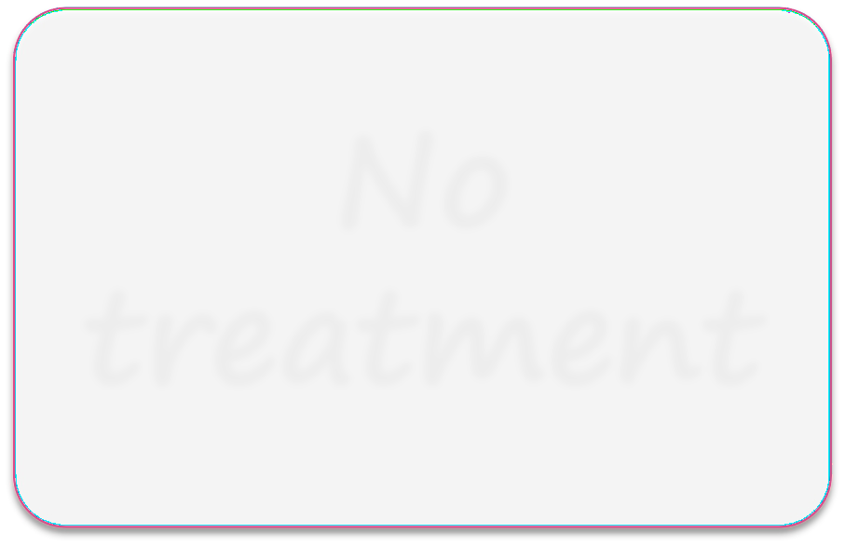
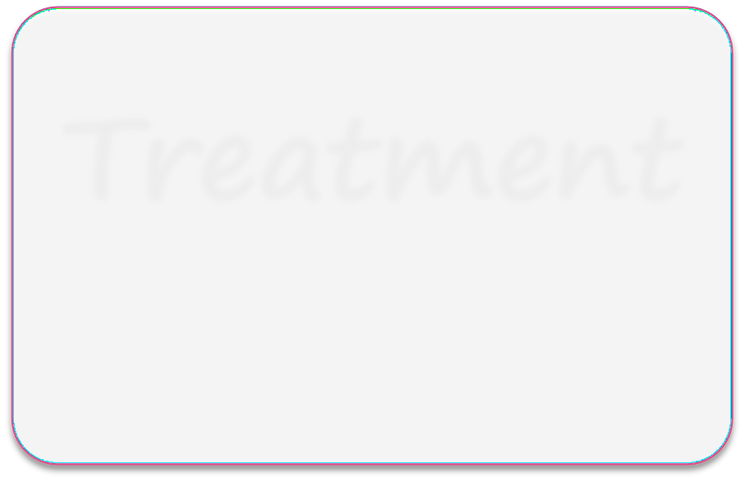
Treatment of fibroid
No treatment
Treatment

Slide 36

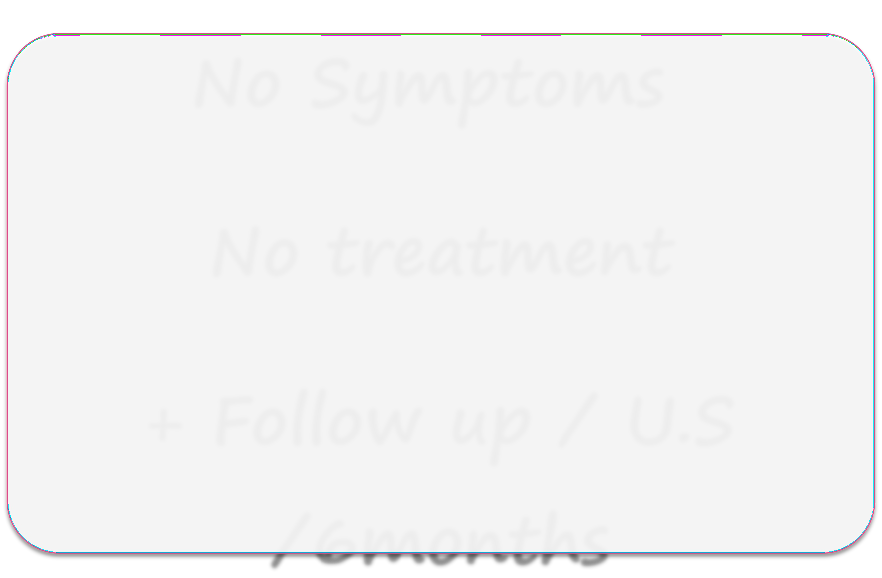
Treatment of fibroid
No Symptoms
No treatment
+ Follow up / U.S
/6months

Slide 37
Treatment
Embolizatio n of both uterine arteries
MRI-guided Focused Ultrasound (MRI-FUS)
Medical
Surgical
Myomectomy
Hysterectom y

Slide 38
Medical Treatment
A progestogen,
uterine contraction & induce normal sheeding)
menstrual flow.
COCPs
Danazol
17-alpha-ethinyl testosterone
(modified progestogen) ------------ GN
& inhibit ovarian steridogenesis -------- estrogen ------- size & symptoms

Slide 39
Gonadotrophin releasing hormone analogue (agonist)
Is the most recent medical treatment.
It leads to GN --------- estrogen ----
-------amenorrhoea and reduction of tumour size by 25-50%.
Advantage:
This makes subsequent operation easier and with less blood loss.
Disadvantage:
Osteoporosis - rapid re-growth of the myoma occurs after cessation of treatment.

Slide 40
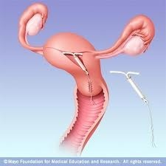
Mifepristone: a progesterone receptor antagonist It reduces the size of myomas by 50%.
Mirena coil treats menorrhagia, and reduces the size of fibroids + contraception)

Slide 41
Medical Treatment
Antiprostaglandin,
Antifibrinolytic (tranexamic acid) ----- cyclokapron,

Slide 42
Surgical
Myomectomy
Hysterectomy

Slide 43

Indications of Surgical treatment
Large tumours: If the size of the tumour is > 12 week pregnancy.
Symptomatic tumours not responding to medical treatment.
Myomectomy
Hysterectomy

Slide 44
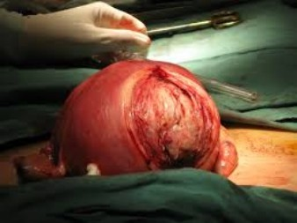
Myomectomy
Definition:
It means removal of fibroids from the uterus leaving behind the organ to carry its function.

Slide 45
Myomectomy
Indications:
Young age below the age of 40 who want to become pregnant.

Slide 46
Contraindication of Myomectomy
Age > 40.
Multiple fibroids (leave behind a useless organ).
Cervical fibroid is usually treated by hysterectomy.
If malignancy is suspected.
The presence of other lesions in the uterus as adenomyosis.

Slide 47
Types of Myomectomy
Abdominal Myomectomy.
Vaginal Myomectomy.
Hysteroscopic Myomectomy (for sub mucous fibroid less than 5 cm in diameter).
Laparoscopic Myomectomy ( for pedunculated sub serous fibroid).

Slide 48
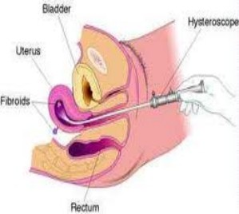
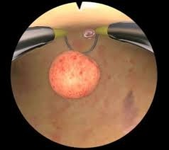
Hysteroscopic Myomectomy

Slide 49
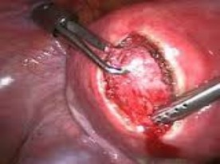
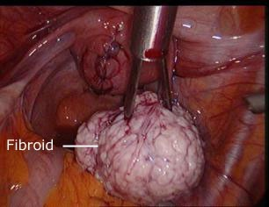
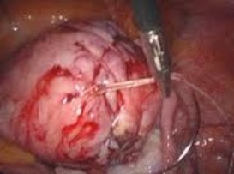
Laparoscopic Myomectomy

Slide 50
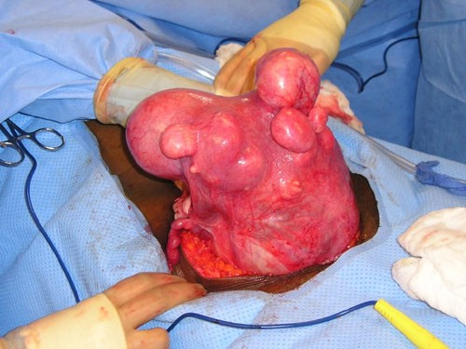
Hysterectomy
Indication:
When myomectomy is contraindicated.
When the woman completes her family.
Uncontrollable bleeding during myomectomy

Slide 51
Hysterectomy
N.B
⚫
Hysterectomy may be total vs. subtotal
Hysterectomy abdominal vs. laparoscopic.
Total hysterectomy is preferred ???????? why
If the patient is 50 years or above, we remove both ovaries. ??????????? why

Slide 52
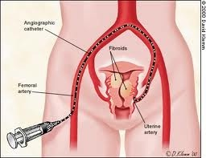
(3) Embolization of both uterine arteries
A local anaesthesia is given and a catheter is passed along the femoral artery to reach the aorta. A radio- opaque dye is injected to show the pelvic arteries.
A catheter is then passed to block the uterine artery on both sides using small pieces (2 x 2 x 2 mm) of Gelfoam or other material.

Slide 53
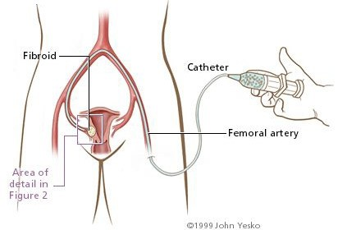
Embolization of both uterine arteries

Slide 54
Embolization of both uterine arteries
The tumour size is reduced by about 50%.
Complication
Uterine infection in the form of endometritis and pyometra as well as infection of the necrotic fibroids.
Indicated when patient is unfit for hysterectomy or refuses it.

Slide 55
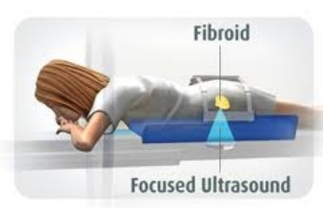
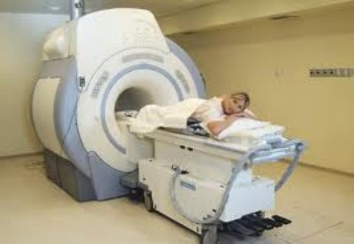
MRI-guided Focused Ultrasound (MRI- FUS)

Slide 56
MRI-guided Focused Ultrasound (MRI- FUS)
This technique is a new non invasive thermal ablation device integrated with MR imaging system for the ablation of soft tissue.
What is the advantage?
(a fertility conserving option).

Slide 57
Cervical fibroid

Slide 58
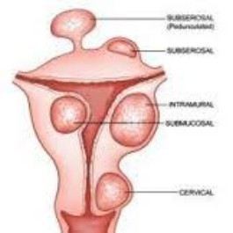
Cervical Fibroid
Incidence:
  The neoplasm arises from the smooth muscle fibres of the cervix.
  It accounts for about 3% of all fibroids and is usually single
.

Slide 59
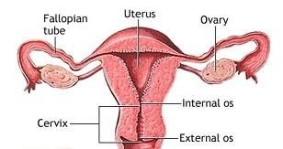
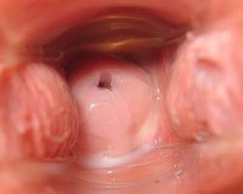
Types of Cervical Fibroid
Arising in the supra vaginal portion
Causes displacement and compression of one or both ureters.
Arising in the portio vaginalis Causing barrel-shaped enlargement of the cervix or it forms a cervical polyp.

Slide 60
Symptoms of cervical fibroid
Pelvic Pressure Symptoms:
  Renal colic, frequency, dysuria or acute retention of urine as the cervical fibroid stretches the urethra and interferes with the opening of the internal urethral sphincter.
  Retention (few days before menstruation).
  Pressure on the rectum leads to constipation and piles.

Slide 61
Symptoms of cervical fibroid
.
Infertility (obstruction of the cervical canal).
Vaginal discharge (ulceration and infection of a fibroid polyp).
Dyspareunia (a large cervical polyp).
Metrorrhagia (ulcerated).

Slide 62
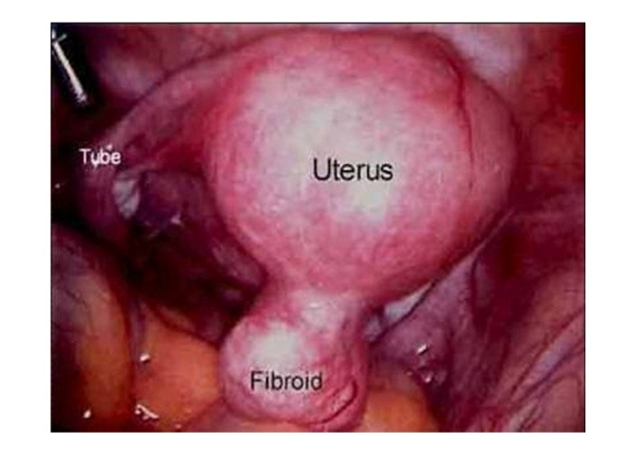
Signs of cervical fibroid
A firm fixed pelvic mass with the uterus lying on its top.
Barrel-shaped enlargement of the cervix.
A cervical polyp.

Slide 63
Treatment of cervical fibroid
The interstitial cervical fibroid is usually treated by abdominal hysterectomy as myomectomy is difficult (difficult to control bleeding and to obliterate the dead space left after myomectomy).
N.B: Before operation, IVP is done to show the course of the ureters and assess kidney function.
A cervical fibroid polyp is removed by vaginal polypectomy (myomectomy)

Slide 64

Uterine polypi

Slide 65
Uterine Polyp
Corporeal polyp
Adenomatous or mucous polyp
-Fibroid polyp
Placental polyp
Malignant polyp
Cervical polyp
Adenomatous or mucous polyp
Fibro-adenomatous polyp
Fibroid polyp Maliganant polyp Bilharzial polyp Tuberculous polyp-

Slide 66
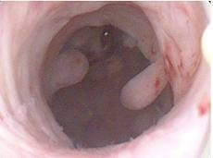
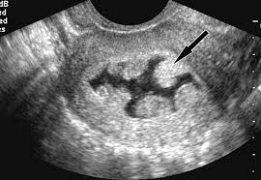
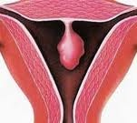
Corporeal polypi
(1) Adenomatous or mucous polyp
It arises from the endometrium. Types:
Multiple polypi: (Commonest uterine body polyp)
estrogen) as in case of PCO, firoids, or endometriosis.
Single adenomatous polyp:
(an adenoma of the endometrium).
It is composed of endometrial glands in a connective tissue stroma and covered by columnar epithelium.

Slide 67
Diagnosis & Treatment of cervical
fibroid
Diagnosis
Presented by menorrhagia & intermenstrual bleeding.
Inspection: if the polyp protrudes from the
cervix, , hysterography or hysteroscopy
Treatment
- Uterine curettage.
- A single polyp is removed by hysteroscope.

Slide 68
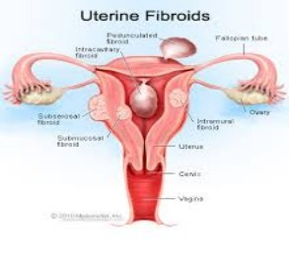
2-Fibroid polyp
The polyp forms a firm mass, its tip is liable to necrosis and infection due to poor blood supply.
Symptoms:
1- Menorrhagia.
2- Irregular vaginal bleeding
3- Offensive vaginal discharge .
4- Colicky pain.
Treatment: vaginal myomectomy or hysterectomy.

Slide 69
3-Placental polyp:
Cause:
Retained placental fragment in the uterus after an abortion or labor,
Blood becomes coagulated in layers over the retained fragment forming a polyp which is dark red in color and firmly adherent to the wall of the uterus.
The uterus is sub involuted and the cervix may remain dilated.
Treatment is curettage and histological examination.

Slide 70
Malignant polyp
Malignant change may occur in a fibroid or adenomatous polyp. Primary malignant tumor as carcinoma, sarcoma or choriocarcinoma may form a polyp projecting into the uterine cavity.

Slide 71
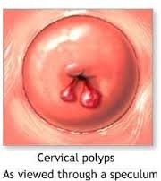
Cervical polyp
Adenomatous or mucous polyp:
  Pathology:
  It arises from the endocervix mostly caused by chronic cervicitis.
  The polyp is composed of cervical glands embedded in a connective tissue stroma and covered by columnar epithelium.
  Treatment:
  Surgical excision with cauterization of
the base of the polyp to prevent recurrence.

Slide 72
2- Fibro-adenomatous polyp:
It is an adenomatous polyp in which the stroma is dense and fibrous.
3- Fibroid polyp:
It is firm in consistency. It is attached by a pedicle to the cervical canal or it may arise from the ectocervix. The tip may undergo necrosis and infection and may resemble carcinoma of cervix.

Slide 73
4- Malignant polyp:
Carcinoma or sarcoma including the rare highly malignant sarcoma botryoids (grape- like sarcoma).
5- Bilharzial polyp:
The polypi are single or multiple and firm in consistency. Biopsy confirms the diagnosis.
6- Tuberculous polyp:
They are multiple, dark red in color and soft in consistency.

Slide 74
CLINICAL CASES

Slide 75
Case (1)
A 29-year-old woman is noted to have three consecutive first trimester spontaneous abortions.
After an evaluation for the recurrent abortions including karyotype of the parents, HSG, TVS, and testing for anti phospholipid syndrome, the obstetrician concludes the uterine fibroids are the etiology.

Slide 76

Which of the following types of uterine
fibroids would most likely lead to recurrent abortion?
Submucosal
Intramural
C. Subserous
D. Parasitic
E. Pedunculated
A

Slide 77
Case (2)
A 39-year-old woman is diagnosed as having uterine fibroids based on a pelvic examination revealing an enlarged irregular uterus.
She is currently asymptomatic and expressed surprise that she had “growths” of the uterus. If she were to develop symptoms.

Slide 78

Which of the following would be the most common manifestation?
Infertility
Menorrhagia
C. Ureteral obstruction
D. Pelvic pain
E. Recurrent abortion
B

Slide 79

Case (3)
A 29 - year- old G 2 P 1 woman at 39 weeks’ gestation had a myomectomy for infertility previously. While pushing during the second stage of labor, she is noted to have fetal bradycardia associated with some vaginal b l e e d i n g . T h e f e t a l h e a d , w h i c h w a s previously at +2 station, is now noted to be at –3 station.

Slide 80

Which of the following is the most likely diagnosis?
Sub mucosal myoma
Umbilical cord prolapse
Uterine rupture
Placental abruption
Fetal congenital heart block
C

Slide 81
Case (4)
A 65-year-old woman is noted to have suspected uterine fibroids. On physical examination. Over the course of 1 year, she is noted to have enlargement of her uterus from approximately 12 weeks’ size to 20 weeks’ size.

Slide 82

Which of the following is the best management?
Continued careful observation
Monitoring with ultrasound examinations
Exploratory laparotomy with hysterectomy
Gonadotropin-releasing hormone agonist
E. Progestin therapy
C

Slide 83
Case (5)
A 22-year-old woman, G2P1+0 at 20 weeks of g e s t a t i o n , p r e s e n t s t o t h e e m e r g e n c y department reporting acute-onset lower abdominal pain. She has a history of fibroids. Her vital signs are as follows: T = 38, BP = 1 0 5 / 6 8 , P = 1 1 0 , R = 2 8 . T h e r e i s n o costovertebral angle tenderness. Her white blood cells are elevated, urinalysis is normal.

Slide 84

The most likely diagnosis is
Leiomyomatous degeneration
Ovarian torsion
Cystitis
Preeclampsia
Appendicitis
A

Slide 85
Clinical Case
A 49-year-old woman, P2+1, who has a known myomatous uterus presents to you because of h e a v y b l e e d i n g d u r i n g h e r p e r i o d s a n d occasional spotting in between her periods. Her menses occurs every 5 to 6 weeks and lasts 6 to 10 days. It is associated with painful cramps. She has no chronic medical problems.

Slide 86

The next best step in management of this patient is:
GnRH agonist for 3 months
GnRH agonist for 6 months and add-back hormones for the last 3 months
Hysterectomy
Endometrial biopsy
E. Transvaginal ultrasound
D

Slide 87
Explanation
Abnormal bleeding in a 49-year-old woman is caused by the leiomyomas simply because she has a myomatous uterus. At this age, the risk of endometrial disease, such as polyps, hyperplasia, and carcinoma, is significant and must be ruled out.

Slide 88
MCQ

Slide 89
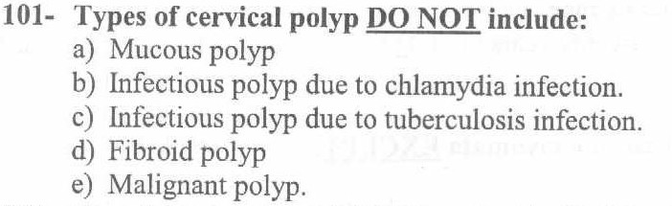
B

Slide 90
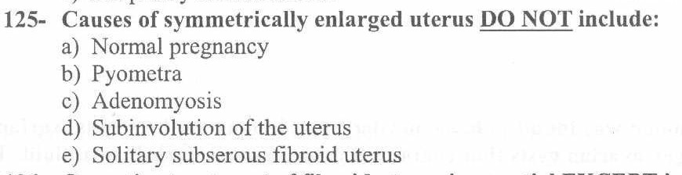

E

Slide 91
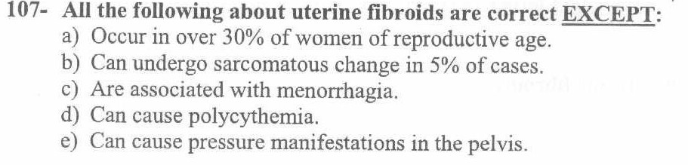

B

Slide 92
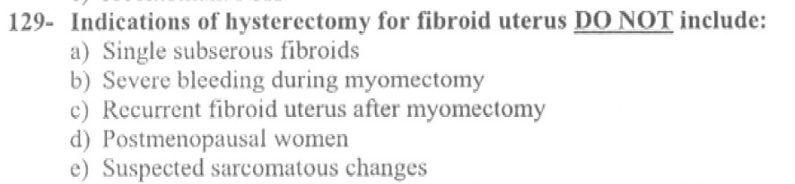

A

Slide 93
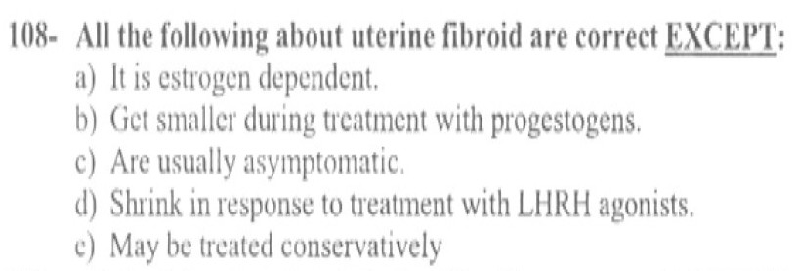

B

Slide 94
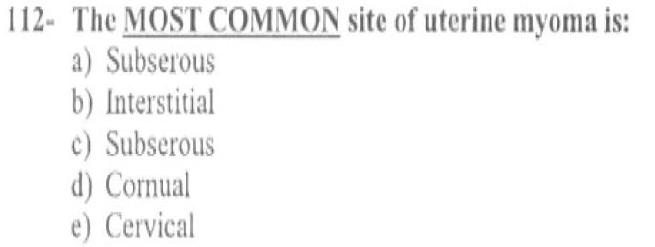
B

Slide 95
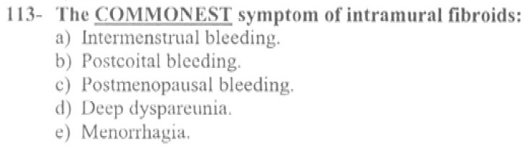

E

Slide 96
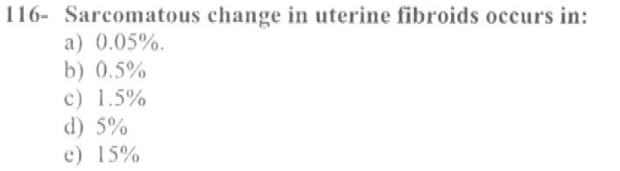
B

Slide 97
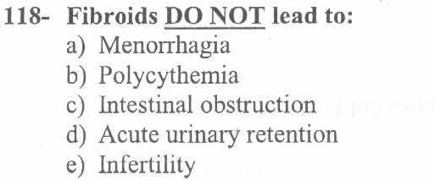
C

Slide 98


A

Slide 99


A

Slide 100

B

Slide 101
Remember That
1) 20% of women above the age of
23) 5C)o.rporeal fibroid 97%
Intra mural（60 - 70%）
Frequently multiple
Asymptomatic: (50%).
Estrogen dependent (excessive estrogen
predisposes to fibroids)

Slide 102


