Slide 1
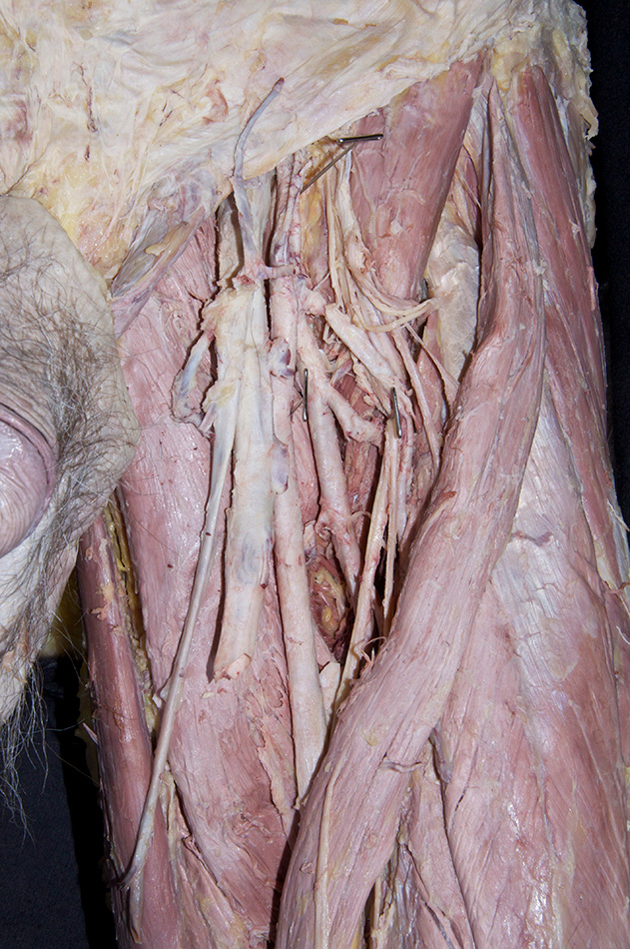
Femoral Triangle
Dr.Mrs.H.S.Mohite
Assistant professor
Anatomy Dept.

Slide 2
Femoral triangle
Triangular depression on front of upper 1/3rd of thigh below inguinal ligament
Apex directed downward
Boundaries
Laterally: medial border of sartorius
Medially: medial border of adductor longus
Base: inguinal lig
Apex: meeting point of medial borders of adductor longs and sartorius

Slide 3
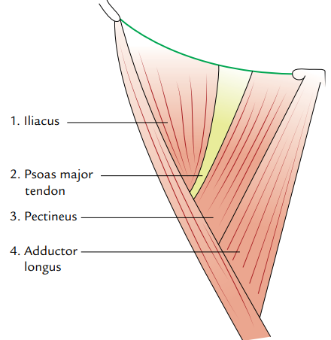
Floor: gutter-shaped and muscular
Lateral to medial side
Iliacus
Psoas major (tendon)
Pectineus
Adductor longus
Between iliacus & psoas major intervenes trunk of femoral nerve
Between psoas major & pectineus transmits medial circumflex femoral vessels
Profunda femories vessles pass through interval between pectineus & adductor longus

Slide 4
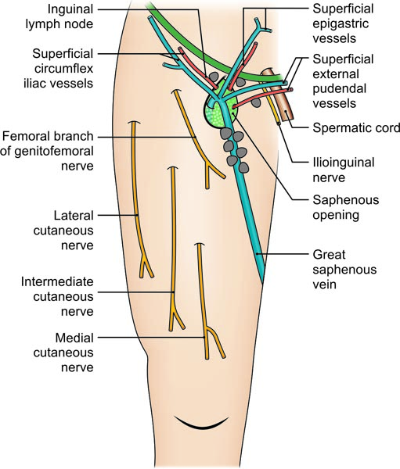
Roof:
Fascia lata having saphenous opening
Superficial fascia overlying roof contains
Superficial branch of femoral artery & accompanying veins
Upper part of great saphenous vein
Superficial inguinal lymph nodes
Femoral branch of genitofemoral nerve
Ilioinguinal nerve

Slide 5
Contents
Femoral artery and its branches
Femoral vein and its tributaries
Femoral nerve
Deep inguinal lymph nodes
Lateral cutaneous nerve of the thigh
Femoral branch of genitofemoral nerve
Fibrofatty tissue

Slide 6
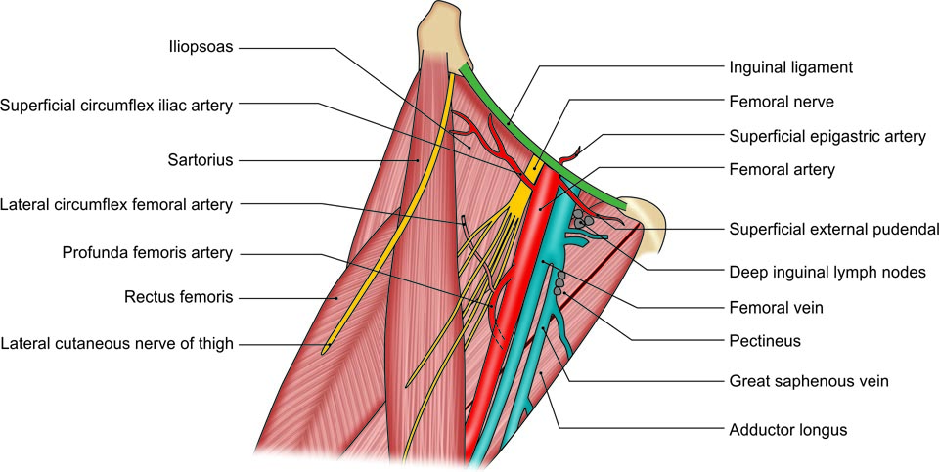
Contents of the right femoral triangle

Slide 7
Thank you

