Slide 1

Good Morning..

Slide 2

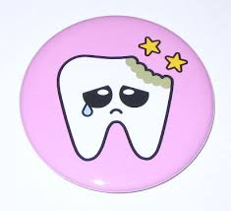
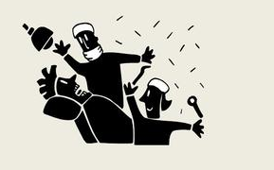
Ergonomics

Slide 3

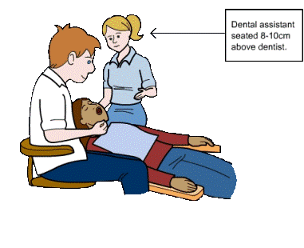
Chair Position

Slide 4
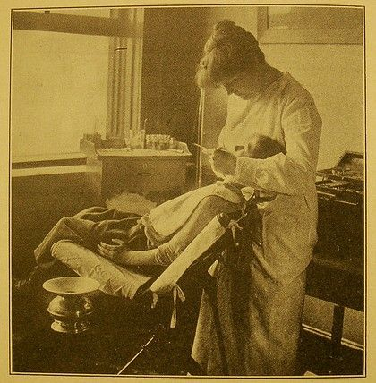
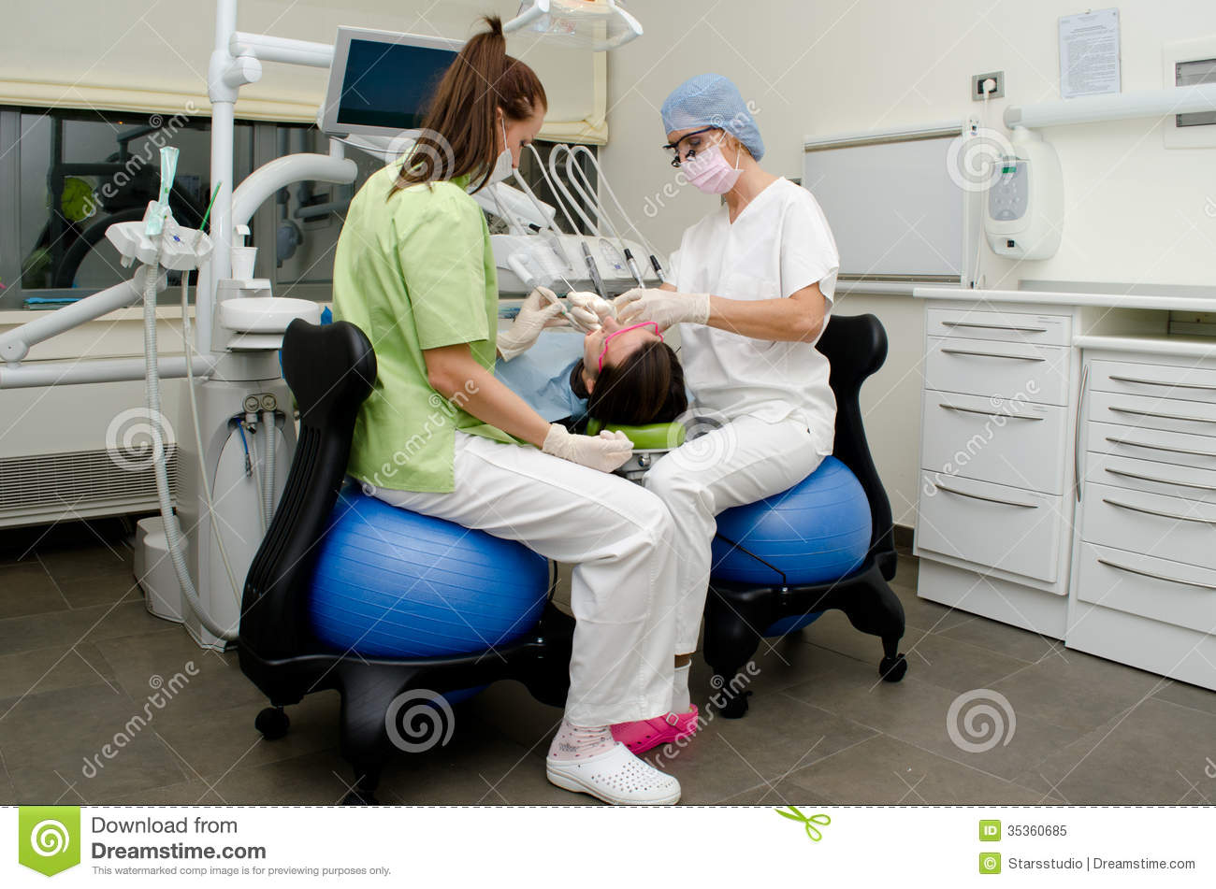
Ergonomics

Slide 5

Importance of chair position

Slide 6
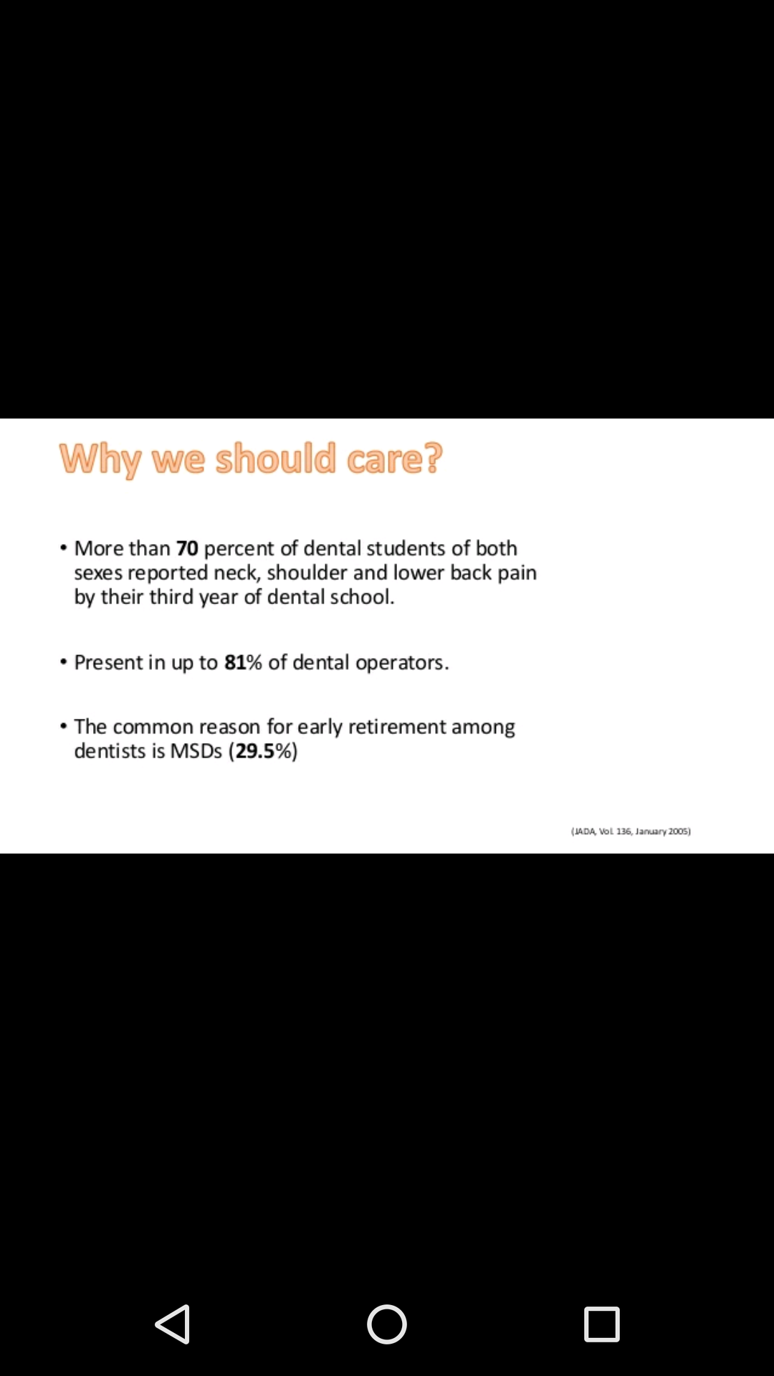
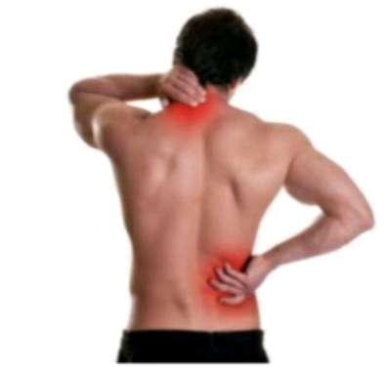
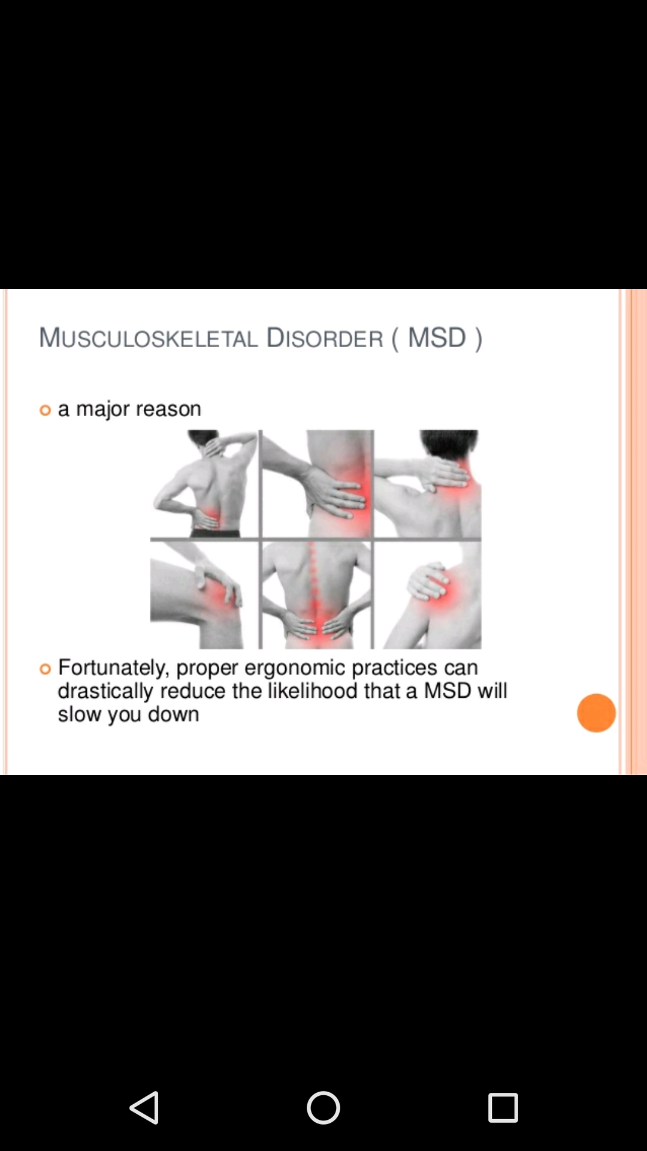

Slide 7
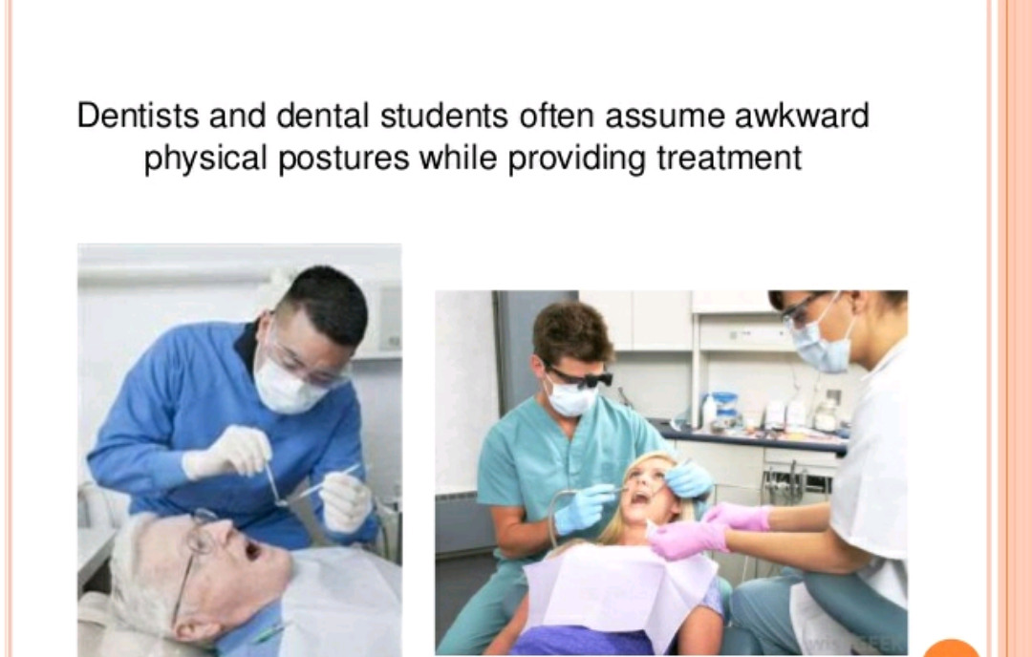

Slide 8
Patient & Operator Positions:
Essential for welfare of both persons
For operator
Less physical strain & fatigue
Reduced possibility of musculoskeletal disorders
For patient
More relaxed
Less muscular tension & more cooperation

Slide 9
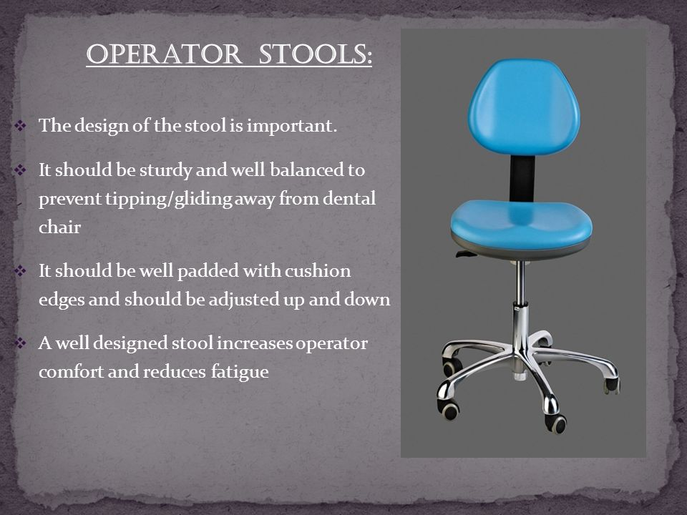

Slide 10
OPERATOR POSITIONS
Correct operator positions help to accomplish the following :
1. Reduce operator fatigue & discomfort
2. Allows the operator to have clear view of the
area of the mouth being worked upon
3. Ease of instrument accessibility
4. Saves time

Slide 11
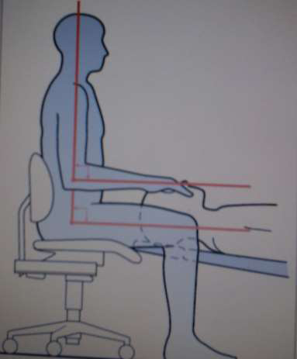
Once the patient has been comfortably positioned, the dentist and the assistant should sit themselves in the Proper positions for treatment.
Usually sitting position is preferred in Modern dentistry to relieve stress on operator's leg and support the operator's back.

Slide 12
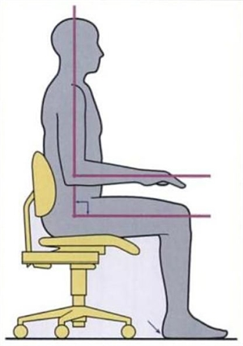
Neutral position
Should be…
1. Forearms, thighs & feet - parallel to the floor. 2. balanced weight evenly when seated 3. Head & back tilt of 0° to 15°
4. Shoulders - horizontal line
5. Elbows at waist level - held slightly away from body
6. The level of teeth being treated should be placed at same level as the level of operator's elbow.

Slide 13
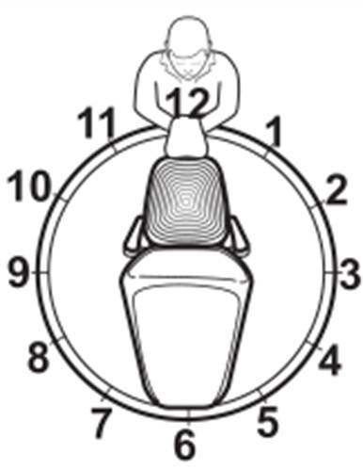
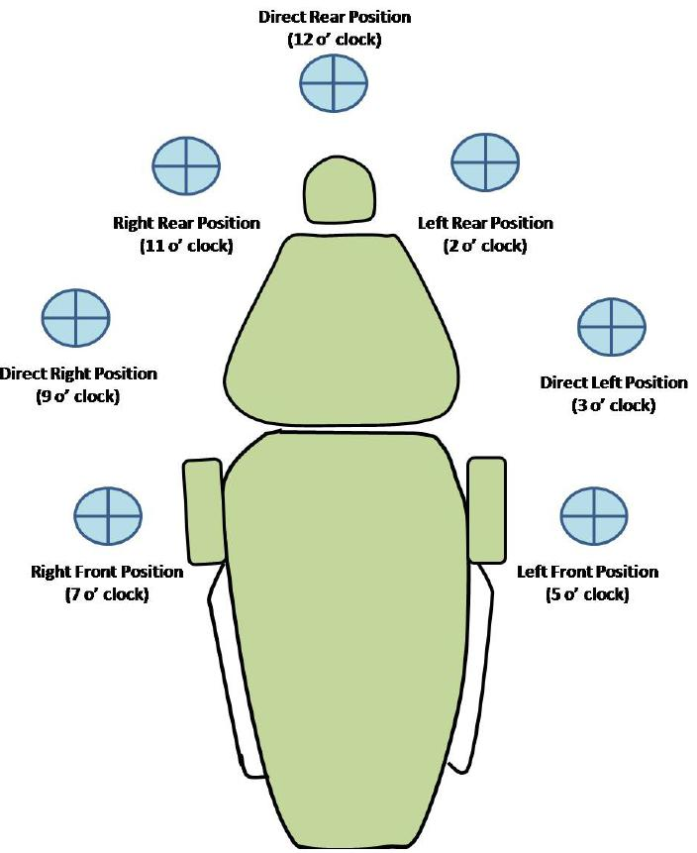
Sitting positions of operator are related to a clock
keeping the patient's head at the center of the circle.
Then the numbering to circle is given similar to a clock with the top of the circle at 12 o'clock.

Slide 14
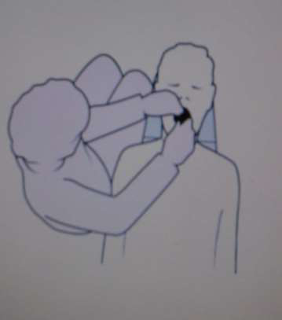
RIGHT FRONT POSITION (7 O'CLOCK)
1. It helps in examination of the patient
2. working areas include:
a) mandibular anterior
b) mandibular posterior
teeth (right side)
c) maxillary anterior teeth
3. To increase the ease and
visibility, the patient's head
may be turned towards the
operator.

Slide 15
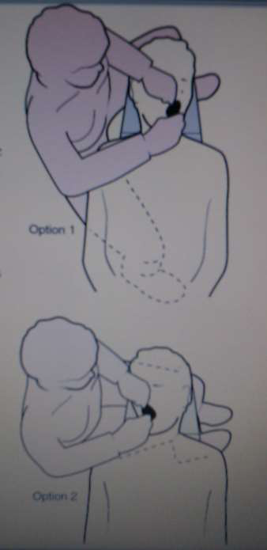
DIRECT RIGHT POSITION (9 O'CLOCK)
1. in this position, dentist sits
exactly right to the patient
2. working areas include:
a) facial surfaces of maxillary
right posterior teeth
b) facial surfaces of mandibular right
posterior teeth
c) occlusal surfaces of mandibular
right posterior teeth.

Slide 16
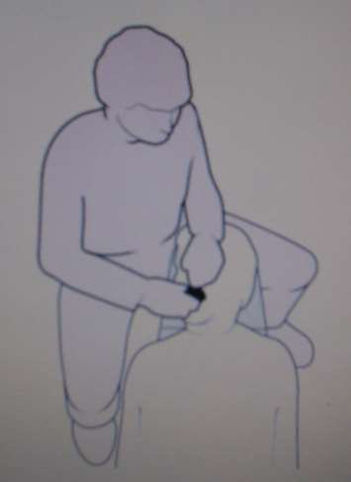
RIGHT REAR POSITION (11 O'CLOCK)
1. in this position, dentist sits behind and slightly to the right of the
patient and the left arm is positioned around patient's head
2. this is preferred position for most of dental procedures
3. most areas of mouth are accessible from this
position either using direct or indirect vision
4. working areas include:
a) palatal and incisal (occlusal) surfaces of
maxillary teeth ( indirect vision)
b) mandibular teeth (direct vision).

Slide 17
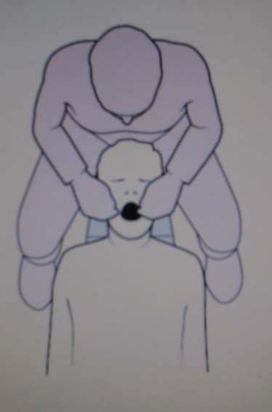
DIRECT REAR POSITION (12 O'CLOCK)
1. dentist sits directly behind the patient and looks down over the
patient's head during procedure.
2. working areas are lingual surfaces of mandibular teeth.
3. this position has limited application.

Slide 18
Right handed operator 4 preferred positions | Left handed operator 4 preferred positions
7 O’ Clock | 5 O’ Clock
9 O’ Clock | 3 O’ Clock
11 O’ Clock | 1 O’ Clock
12 O’ Clock | 12 O’ Clock

Slide 19
Patient Positions
1. Upright Position
2. Almost Supine
3. Reclined 45 Degree

Slide 20
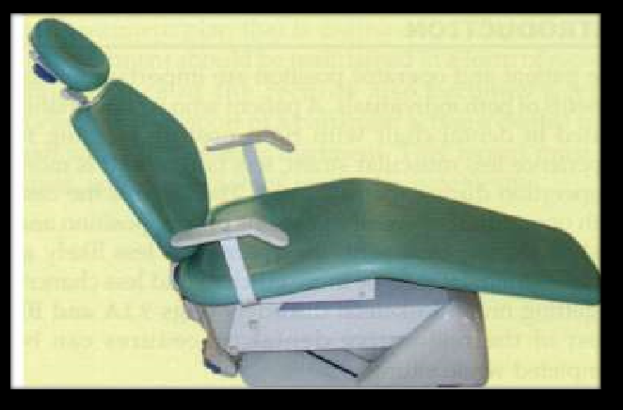
UPRIGHT POSITION
This is the initial position of chair from which further adjustments are made

Slide 21
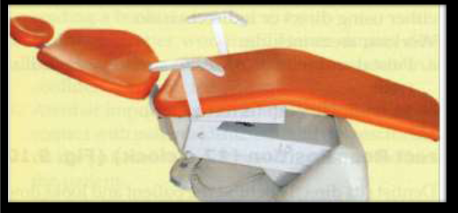
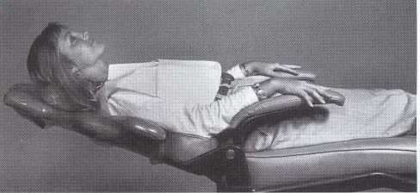
ALMOST SUPINE
• In this , chair position is such that head, knees and feet are approx. at same level
• Patient’s head should not be lower than feet except in case of syncopal attack

Slide 22
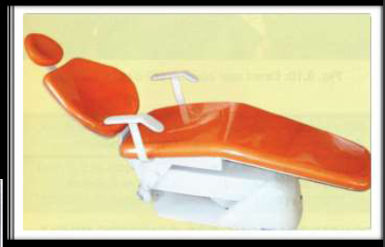
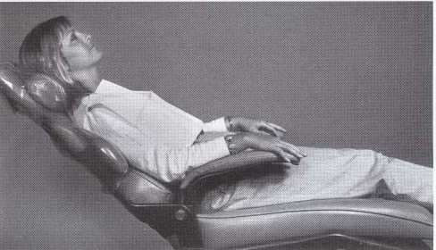
REECLINED 45 DEGREES
In this position , chair is reclined at 45 degree
Mandibular occlusal surface are almost 45 degree to the floor

Slide 23
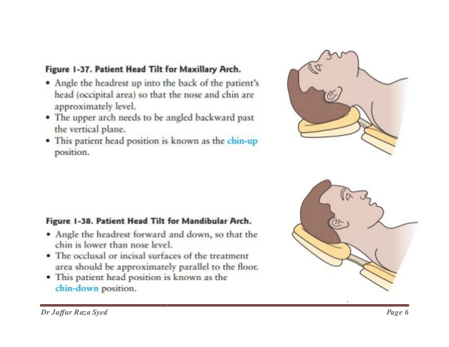
Patient headrest position
Maxilllary arch :
Angle the headrest up into the back of the patient’s head so that the nose and chin are approx. level.
The upper arch needs to be angled backword past the vertical plane.
Chin up position

Slide 24
Mandibular arch :
Angle the headrest forword & down, so that the chin is lower than nose level.
The occlusal / incisal surfaces of the treatment area should be approx. Parallel to the floor.
Chin down position

Slide 25
Considerations While Doing Patient
1. While doing work in maxillary arch, maxillary occlusal surfaces should be perpendicular to the floor.
2. In mandibular arch, mandibular occlusal surface should be oriented 45° to the floor.
3. Patient's head can be rotated backward or forward or from side to side for operators ease and visibility while doing work.

Slide 26
4. Maintain proper working distance during dental procedure. This will lead to increase cooperation and confidence among the patient.
5. Operator should not rest forearms on the patient's shoulders and hands on the face of the patient.

Slide 27
6. Dentist should not use patient's chest as A instrument trolley.
7. The operator should leave left hand free during most of dental procedures for retraction using mouth mirrors or fingers of left hand.
8. Operator should keep changing position if procedure is of long duration to decrease the muscle strain and fatigue.

Slide 28
Sequence For Practicing Positioning
“ME,
MY PATIENT,
MY EQUIPMENT,
MY NON-DOMINANT HAND,
MY DOMINANT HAND.”

Slide 29
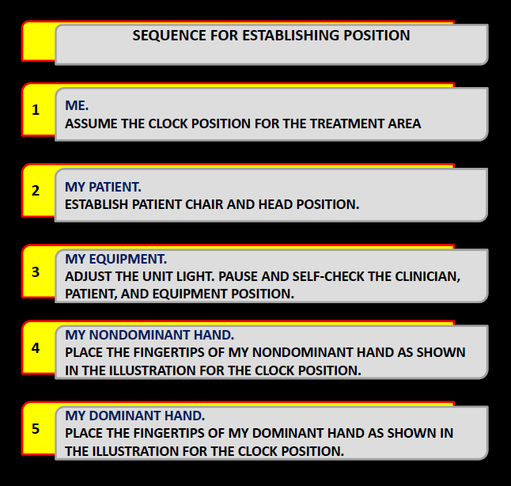

Slide 30
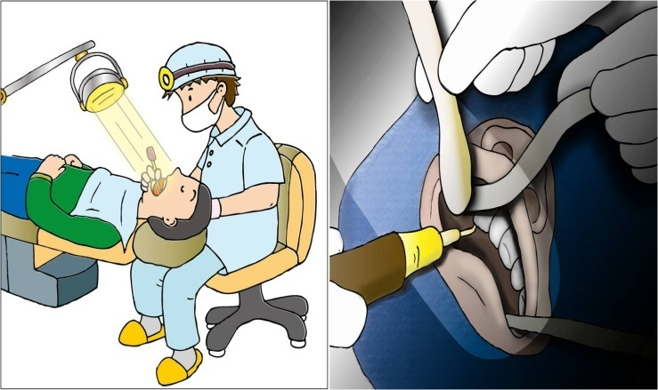
Illumination

Slide 31
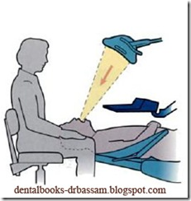
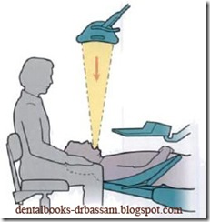
The dental light should be as far as possible while within the easy reach of the clinician.
Maxillary arch - above the patient’s chest, tilted so that the beam shines into the oral cavity at an angle.
Mandibular arch - above the patient’s head , allowing for the beam to shine directly onto the working area.

Slide 32
Operator eyes – operating field =
length arm(14-16”)
Dental light – operating field =

Slide 33
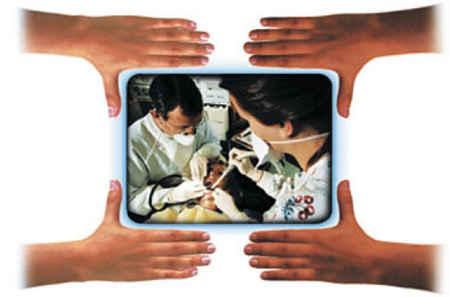
Four Handed Dentistry
Its goal is to allow the dentist and assistant to function as a team in a seated position with maximal efficiency and minimal strain.
Team efforts

Slide 34
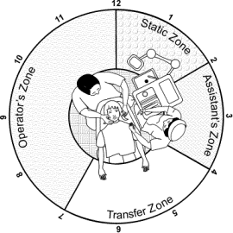
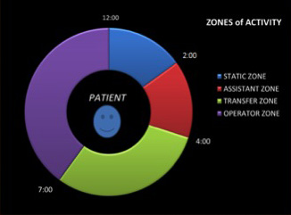
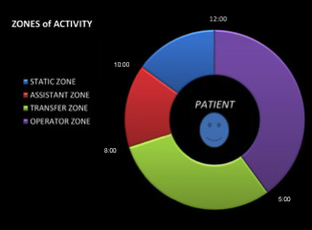
Zones of operation

Slide 35
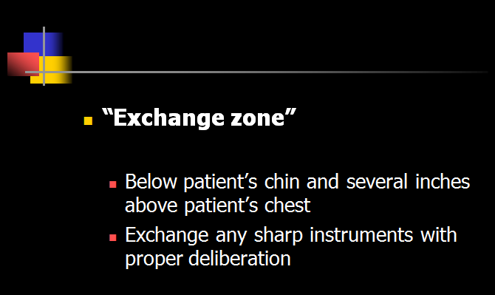

Slide 36
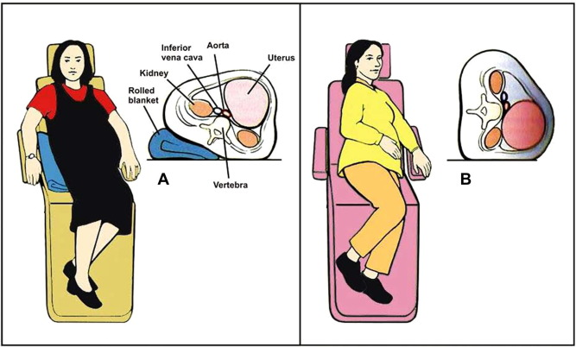
Chair Position For Pregnant Women
Flat position may cause hypotension and hypoxia
Place a small pillow under right hip – lateral displacement
Head above feet
Preferred – upright position

Slide 37

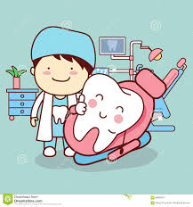
Summary
Correct posture, smart patient – operator positioning and correct use of dental light are significant allies in preventing musculoskeletal disorders.
Ergonomic = quality, efficient practice
practice long time

