Slide 1
Effect of various strength of stimuli on skeletal muscle contraction
Dr. Jharashree.K. Sahoo
Assistant Professor

Slide 2
Which property it proves?
Presence of Motor Units in the muscle.
All or None Law

Slide 3
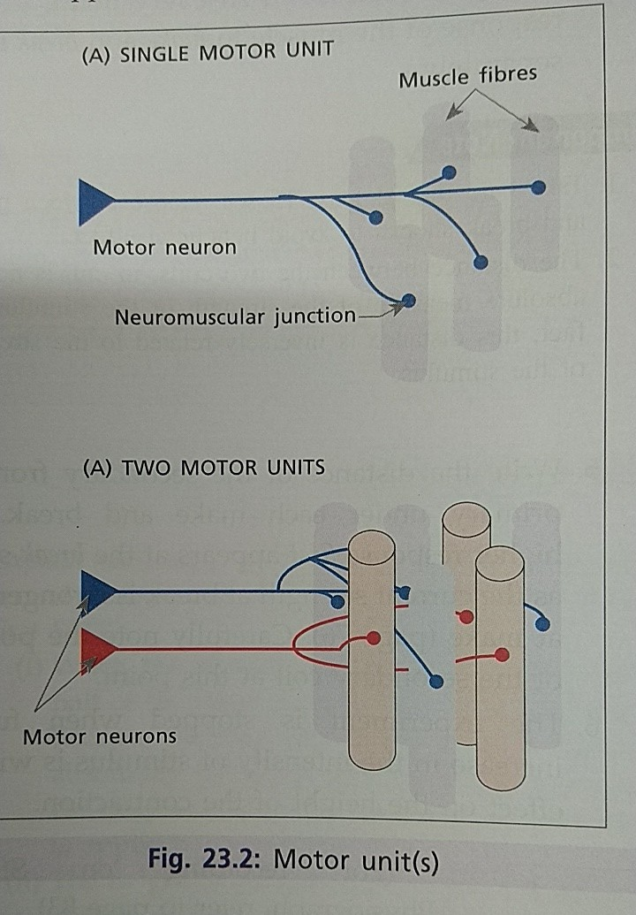

Slide 4
Motor Unit
The neuron, nerve fibers and muscle fibers supplied by the nerve fibers are called motor unit.
No. of muscle fibers in a motor unit varies inversely with the precise movement of the body part.
Muscles of hand, muscles concerned with eye movement--- 3-6 ms. Fibres /motor unit
Back and Leg muscles– 120-165ms. Fibres /motor unit

Slide 5
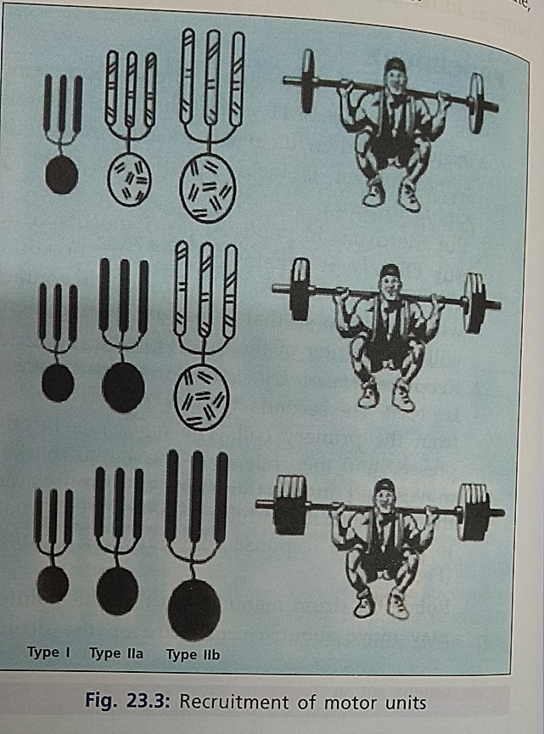

Slide 6
All or None Law
If the strength of stimulus is adequate the muscle fibres show the response --- All phenomenon
If the strength of stimulus is not adequate muscle fibres do not show any response at all---- None phenomenon
It is obeyed by the skeletal muscle by individual muscle fibre and cardiac muscle as a whole.

Slide 7
Types of Stimuli
Subminimal
Minimal
Submaximal
Maximal
Supra Maximal

Slide 8
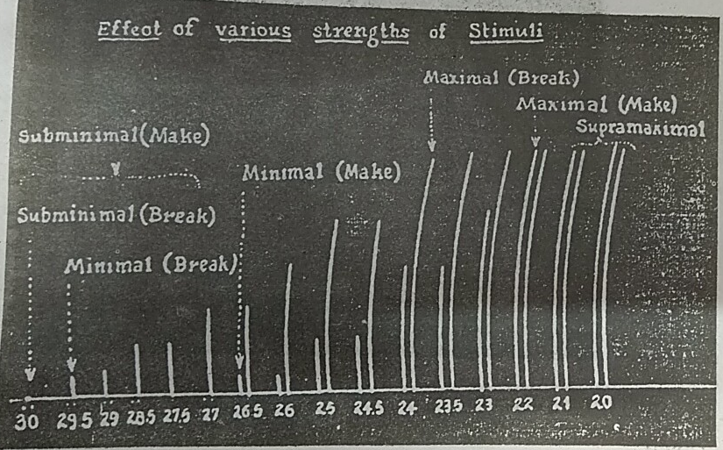
Effect of various strength of stimuli on skeletal muscle contraction

Slide 9
Make
Break
Why Break stimulus is effective first than make?

