Slide 1

DIFFERENCES BETWEEN PRIMARY AND PERMANENT DENTITION
Dr. Savita Hadakar
Associate Professor
Department of Paedodontics & Preventive Dentistry
School of Dental Sciences,
KRISHNA VISHWA VIDYAPEETH, Karad.

Slide 2
OBJECTIVES
At the end of this session, you will be able to understand:
DIFFERENCES BETWEEN PRIMARY AND PERMANENT TEETH
GENERAL DIFFERENCES
MORPHOLOGIC and HISTOLOGIC DIFFERENCES
DIFFERENCES in MINERAL CONTENT
PERIODONTAL STRUCTURES

Slide 3
GENERAL DIFFERENCES
1. NUMBER OF TEETH:
PRIMARY: 20
INCISORS :4(U) +4(L) =8
CANINES : 2(U)+2(L) =4
MOLARS : 4(U)+4(L)=8
TOTAL =20

Slide 4
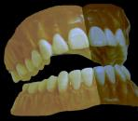
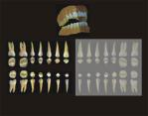
PERMANENT :32
INCISORS :4(U) +4(L) =8
CANINES : 2(U)+2(L) =4
PREMOLARS: 4(U) +4(L) =8
MOLARS : 6(U)+6(L)=12
TOTAL =32
2) DURATON OF DENTITION:
PRIMARY : 6 MONTHS TO 13 YEARS
PERMANENT : 6 YEARS ONWARDS

Slide 5


MORPHOLOGIC DIFFERENCES:
THE CROWN
PRIMARY TEETH | PERMANENT TEETH
Smaller in all dimensions The crowns are wider in their mesio-distal dimension in relation to cervico occlusal height Lighter in color, bluish white (milky white | Larger in dimensions The crowns of anterior teeth are larger in cervico occlusal dimension than the mesio-distal Darker in color, grayish or yellowish white

Slide 6
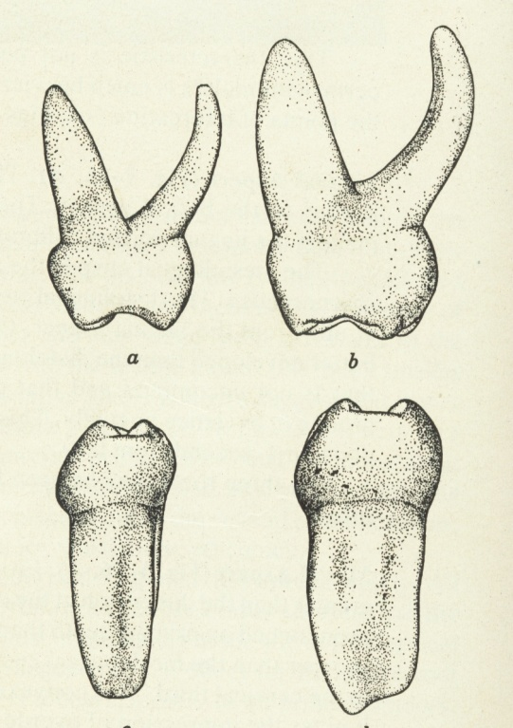
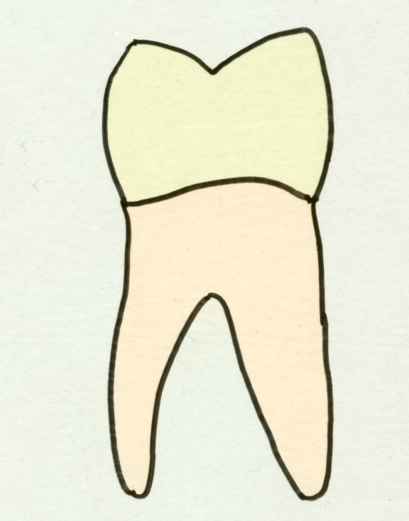
PRIMARY TEETH | PERMANENT TEETH
4.Cuspids are slender and tend to be more conical 5. The cervical ridges are more pronounced especially on the buccal aspect of first primary molar | 4. Cuspids are less conical 5. The cervical ridges are flatter
Less convergence
Flat cervical
ridge
Prominent
Cervical ridge
Marked
convergence

Slide 7
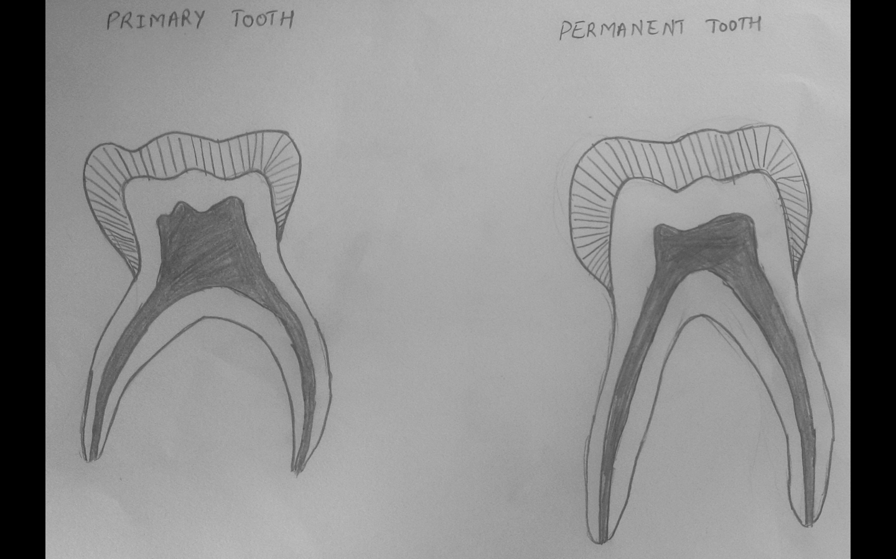
PRIMARY TEETH | PERMANENT TEETH
6. Buccal and lingual surfaces of molars, especially first molars, converge towards occlusal surfaces 7. The occlusal plane is relatively flat 8. Molars are more bulbous and are sharply constricted ( bell shaped) cervically | 6. Less convergence of buccal and lingual surfaces of molars towards occlusal surface 7. The occlusal plane has more curved contour 8. They have less constriction on neck
Less constriction
Sharp constriction

Slide 8
PRIMARY TEETH | PERMANENT TEETH
9. Enamel is thinner and has a more consistent depth of about 1 mm 10. The contact areas between molars are broader, flatter, and situated gingivally 11. The supplemental grooves are more 12. The enamel rods at the cervical slopes occlusally from DEJ | 9. The enamel is thicker and has a thickness of about 2-3mm 10. The contact points between permanent molars is situated occlusally 11. The supplemental grooves are less 12. Enamel rods oriented gingivally

Slide 10
ROOT MORPHOLOGY
PRIMARY TEETH | PERMANENT TEETH
13. The roots are larger and more slender in comparison to crown size 14. Furcation is more towards cervical area, so that root trunk is small | 13. The roots are shorter and bulbous in comparison to crown 14. Placement of furcation is apical, thus the root trunk is larger
High towards
cervical area
Furcation towards apex
Roots flare outward
Less flaring of roots

Slide 11
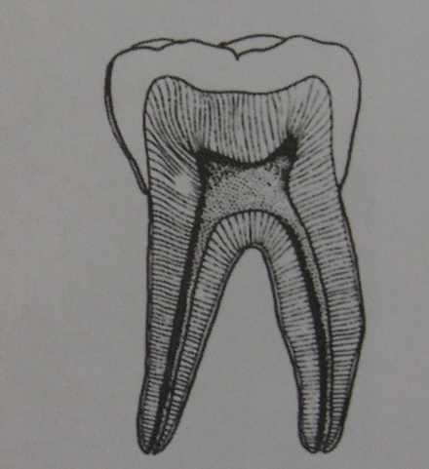
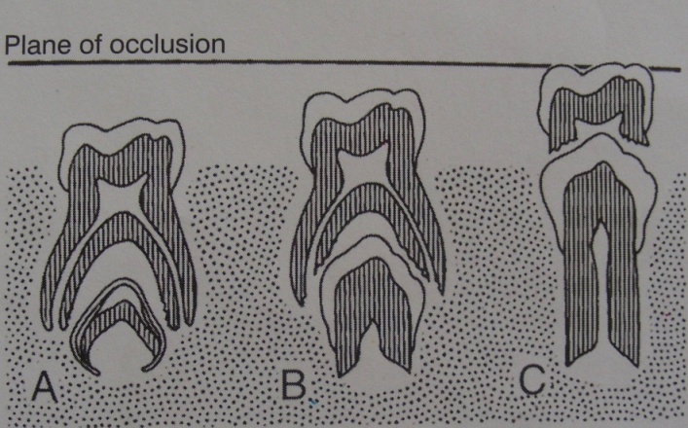
PRIMARY TEETH | PERMANENT TEETH
15. The roots are narrower mesio-distally 16. The roots flare outwards and continue to flare as they approach the apices 17. Undergo physiological root resorption | 15. The roots are broader mesio-distally 16. Marked flaring of roots absent 17. Physiological root resorption absent

Slide 12
PULP
PRIMARY TEETH | PERMANENT TEETH
18. Pulp chamber anatomy closely resembles the surface shape of the crown 19. Pulp chamber larger in relation to crown 20. Pulpal outline follow DEJ more closely | 18. Pulp chamber anatomy resembles the surface shape of the crown 19. Pulp chamber smaller in relation to crown size 20. Pulpal outline follow DEJ less closely
High pulp horn
Large pulp
chamber
Smaller pulp horn
Ribbon shape
Accessory
canals

Slide 13
PRIMARY TEETH | PERMANENT TEETH
21. Pulpal horns are closer to the outer surface 22. High degree of cellularity and vascularity 23. High potential to repair | 21. Pulpal horns are comparatively away from the outer surface 22. Comparatively less degree of cellularity and vascularity 23. Comparatively less potential to repair

Slide 14
PRIMARY TEETH | PERMANENT TEETH
24. Greater thickness of dentine over pulpal wall 25. Root canals are more ribbon like. The radicular pulp follows a thin, tortuous and branching path 26. Floor of the pulp chamber is porous. Accessory canals leads directly into the furcation | 24. Comparatively less thickness of dentine over pulpal wall 25. Root canals are well defined and less branched 26. Floor does not have any accessory canals

Slide 15
HISTOLOGICAL DIFFERENCES
PRIMARY TEETH | PERMANENT TEETH
27. Roots have enlarged apical foramen 28. Reparative dentin formation more extensive 29. Pulp nerve fibers terminate at the odontoblastic area as free nerve endings | 27. Foramens are restricted . Reduced blood supply favors calcific response 28. Reparative dentin formation less extensive 29. Nerve fibers terminate among the odontoblastic and even beyond predentin

Slide 16
PRIMARY TEETH | PERMANENT TEETH
30. Density of innervation is less (primary teeth less sensitive) 31. Localization of inflammation is poorer | 30. Density of innervation is more 31. Infection and inflammation in pulp is localized

Slide 17
DIFFERENCES IN MINERALIZATION
PRIMARY TEETH | PERMANENT TEETH
32. Enamel and dentine are less mineralized 33. Neonatal lines present 34. Enamel band of Retzius are less common | 32. Enamel and dentin more mineralized 33. Neonatal line seen only in first permanent molars 34. Enamel band of Retzius are more common

Slide 18
PRIMARY TEETH | PERMANENT TEETH
35. Dentinal tubules are less regular 36. Dentine thickness half that of permanent teeth | 35. Dentinal tubules are more regular 36. Dentine thickness double that of primary teeth

Slide 19
PERIODONTAL STRUCTURES
PRIMARY TEETH | PERMANENT TEETH
39. Cementum is very thin and of primary type Secondary cementum is absent 41. Gingivitis and periodontitis less common 42. Recession is infrequent | 39. Secondary cementum is present 41. Periodontitis is common finding in adults 42. Recession occurs

Slide 20
summary….
Primary teeth are smaller in size than the analogous permanent teeth.
They are whiter in color than the permanent teeth.
They are less mineralized, and become very worn.
They have shorter crowns with respect to their roots.
The crowns have a marked cervical constriction.

Slide 21
The layers of enamel and dentin are thinner than in permanent teeth.
The pulp cavities are proportionally larger.
The crowns on primary teeth appear bulbous.

Slide 22
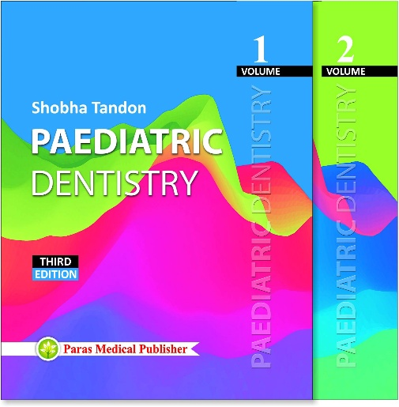
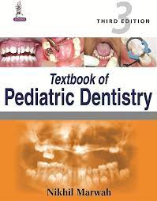
References
Textbook of Paediatric Dentistry- Shobha Tandon
Textbook of Paediatric Dentistry- Nikhil Marwah

