Slide 1
Classification of Cementum
Dr. Sameer Zope
Dept of Periodontology
SCHOOL OF DENTAL SCIENCES,
KRISHNA VISHWA VIDYAPPETH,
Karad.

Slide 2
At the end of this session, you will be able to understand:
What is Cementum and its function?
Classification of Cementum
    Based on time of formation
    Based on presence or absence of cells in the matrix
    Based on origin of collagen fibers in the matrix
Based on presence or absence of cell and nature and origin of organic matrix

Slide 3
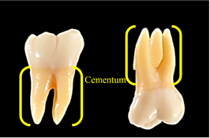
What is Cementum and its function?

Slide 4
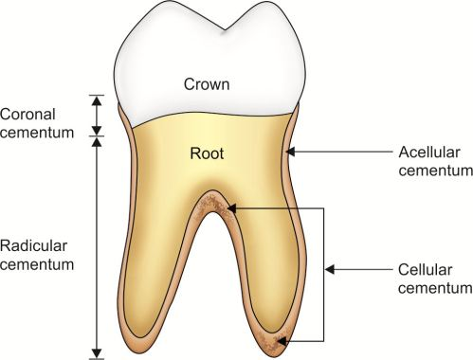
Classifications of Cementum
Adapted from: Textbook of Periodontics by Shalu Bathla

Slide 5
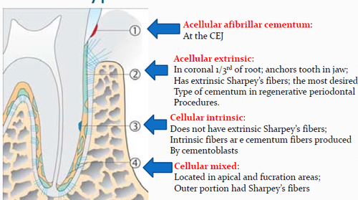
Classification is based on presence of absence of cell and nature and origin of organic matrix
Adapted from: https://quizlet.com/763128992/cementum-cementogenesis-dhs2-flash-cards/

Slide 6
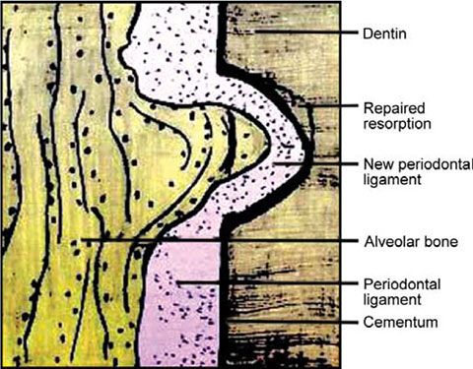
Cellular intrinsic fiber cementum
Adapted from: Textbook of Dental and Oral Histology with Embryology and Multiple Choice Questions by Dr Satish Chandra

