Slide 1

DEVELOPMENT OF OCCLUSION
Dr. Gouri R Reddy
Dept of Pediatric & Preventive Dentistry

Slide 2
OBJECTIVES
The periods of Occlusal Development
Clinical features of Predentate Period
Clinical features of Deciduous Dentition

Slide 3
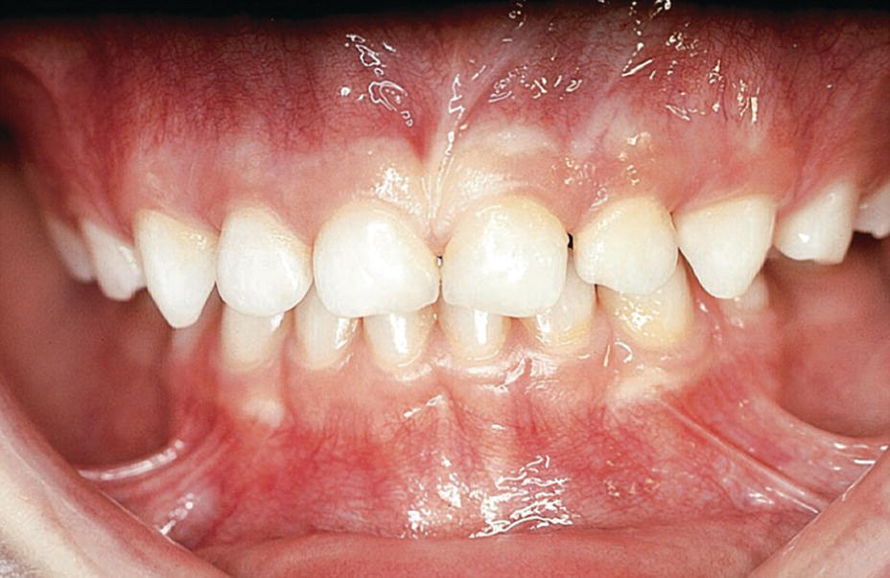
INTRODUCTION
The term Occlusion is derived from Latin word, ‘occlusio’ that is defined as “the relationship between all the components of the masticatory system in normal function, dysfunction and parafunction.”
Occlusion is a result of the three main developmental events that
includes the jaw growth, tooth formation and eruption.

Slide 4
PERIODS OF OCCLUSION DEVELOPMENT
The Predental jaw relationship that is the neonate’s mouth, also known as the stage of gum pads
The deciduous Dentition
The mixed or transitional Dentition
The permanent Dentition

Slide 5
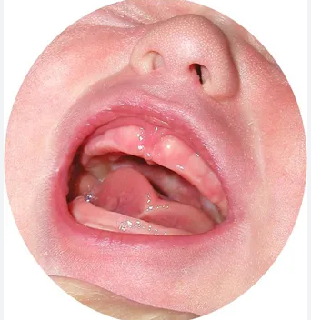
PREDENTATE PERIOD/ STAGE OF GUM PADS
The period from birth to the eruption of the first deciduous tooth in the oral cavity.
The alveolar processes at birth are called as “Gum Pads”.

Slide 6
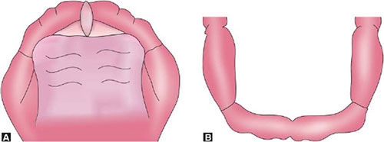

The gum pads are ‘horseshoe’ shaped in maxilla[A] and ‘u-shaped’ in the mandible[B] that are pink, firm and covered with dense fibrous periosteum.
B.Mandible

Slide 7
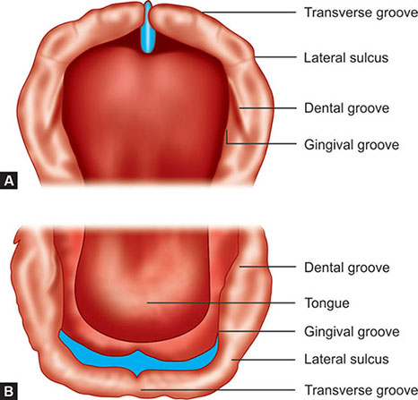
They develop in two parts that is the labial and the lingual portions that are separated by a ‘dental groove’.
The gumpads are further divided into 10 segments by a ‘transverse groove’.
The prominent transverse groove between the future canine and molar is known as the ‘lateral sulcus’ which helps in the early prediction of inter-arch relationship.
The ‘gingival groove’ in maxilla separates the gum pads from the palate and in mandible demarcates the lingual extent of the gumpad.
MAXILLA
MANDIBLE

Slide 8
The upper gum pad is forwardly placed than the lower and the gum pads come in contact only at the
molar region with no contact in the anterior region which results in ‘infantile open bite’
Vertical and anterioposterior movements are noted in this period with the absence of lateral movements.

Slide 9
Sometimes, an infant may be born with teeth, which are precociously erupted. Such teeth can be
termed as ‘Premature teeth’ if they emerge before the first 3 months of life.
Those present at birth are called as ‘natal teeth’; those that erupt within 30 days of birth are called as the ‘neonatal teeth’

Slide 10
SUMMARY
The process of development of occlusion from infancy through adolescence is a continuous and dynamic process.
The major goal of pediatric dentistry is the establishment of a functional and esthetically acceptable adult occlusion.

Slide 11
REFERENCES
Paediatric Dentistry, Shobha Tandon, 3rd Edition
Textbook of Pediatric Dentistry, Nikhil Marwah, 4th Edition

Slide 12

THANK YOU

