Slide 1

Hello Friends….
Greetings for the Day…!
Dr. Amit Jadhav
Dept of Prosthodontics & Crown and Bridge
SCHOOL OF DENTAL SCIENCES,
KRISHNA VISHWA VIDYAPPETH,
Karad.

Slide 2
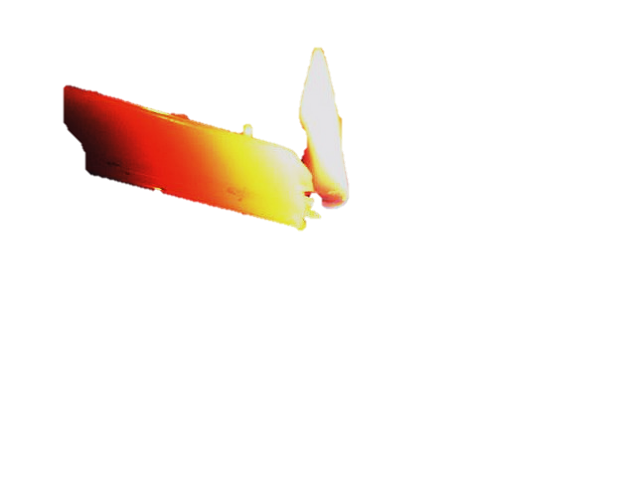
DENTAL WAXES

Slide 3
CONTENTS
Introduction
History
Structure of waxes
Characteristics of individual waxes
Classification of waxes
Properties of waxes
Conclusion
References

Slide 4
INTRODUCTION
Waxes are thermoplastic materials which are solids at room temperature but melt without decomposition to form mobile liquids
Variety of natural waxes and resins have been used in dentistry for specific and well defined applications.
They consist of two or more components which may be natural or synthetic waxes, resins, oils and pigments.

Slide 5


INTRODUCTION
Candle production.
Softening skin
Preserving valuable objects
Making sculptures & statues

Slide 6

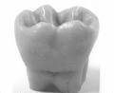

HISTORY
OLDEST WAX USED – BEESWAX. APPROXIMATELY 3000 B.C - Egyptians For Mummification.
MORE THAN 200YRS AGO, Beeswax – First Used To Make Impression.
WAX MODELS IN PROSTHETIC WORK – FIRST MENTIONED BY- M G PURMANN IN 1700. -Models were carved in wax first and then reproduced in ivory or bone.

Slide 7
HISTORY
FIRST INLAY IN DENTISTRY IS CREDITED TO “JOHN MURPHY” OF LONDON,WHO WAS FABRICATED PORCELAIN INLAY IN 1855.
FIRST CAST INLAY IS ATTRIBUTED TO “PHILBROOK”-1897.
1907 – WILLIAM H TAGGART - ‘LOST WAX TECHNIQUE’ -EVER SINCE, WAXES HAVE BEEN AND CONTINUE TO BE USED IN THE CASTING OF METAL FRAMEWORKS.
FIRST LIQUID PARAFFINS WERE PRODUCED ACCORDING TO FISCHER- TROP’S PROCEDURE IN 1935.

Slide 8
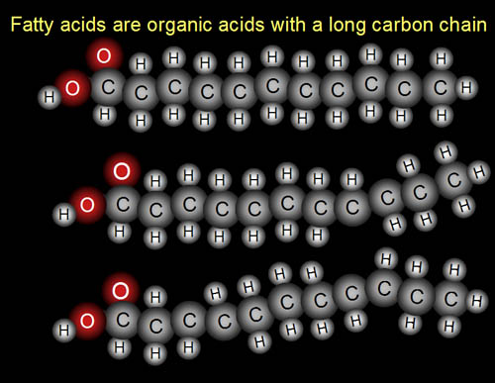
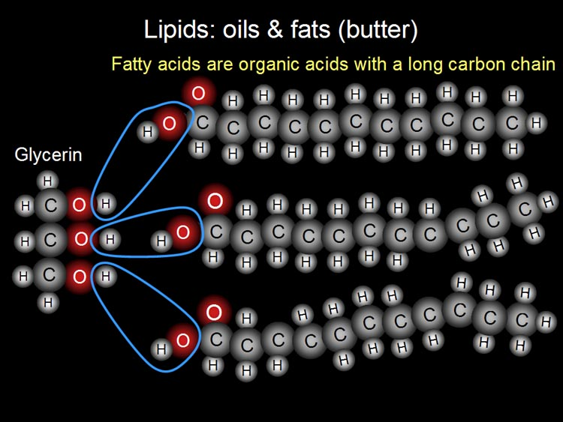
DEFINITION
ACCORDING TO ANUSAVICE—
“A LOW MOLECULAR WEIGHT ESTERS OF FATTY ACIDS WITH MONOHYDRATE ALCOHOL DERIVED FROM NATURAL AND SYNTHETIC COMPONENTS SUCH AS PETROLEUM DERIVATIVES THAT SOFTENS TO A PLASTIC STATE AT A RELATIVELY LOW TEMPERATURE “.

Slide 9
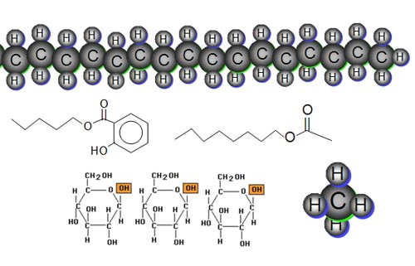
STRUCTURE
IN MOST MINERAL WAXES HYDROCARBONS RANGING FROM 17 – 44.
IN PLANT WAXES SATURATED ALKANES FROM 19 – 31.
THEREFORE DENTAL WAXES CONTAIN MOLECULES HAVING A RANGE OF MOLECULAR WEIGHTS THAT EFFECT THE MELTING AND FLOW PROPERTIES OF THE WAXES.

Slide 10
CLASSIFICATION
The wide variety of dental waxes can be classified into two groups
Depending upon Use
Clinical
Laboratory
Bite Registration Wax
Disclosing Wax
Utility Waxes
Type I Inlay Waxes
Boxing Wax
Baseplate Wax
Sticky Wax
Beading Wax
Utility Wax
Type II Inlay Waxes

Slide 11
CLASSIFICATION
CONSTITUENTS
CONSISTENCY
USES
Natural
Additive
Synthetic
Natural
Hard
Medium
Pattern
Impression
Processing

Slide 12

Thank you…

