Slide 1
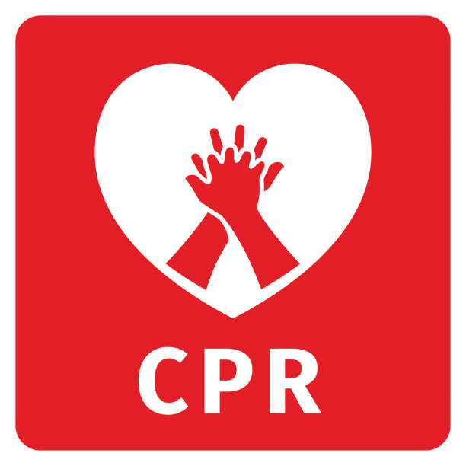
CARDIOPULMONARY RESUSCITATION
Miss – Smita Handiphode
Msc Nursing
KINS , Karad

Slide 2
INTRODUCTION
Cardiopulmonary resuscitation (CPR) is a lifesaving technique useful in many emergencies including heart attack or near drowning in which someone's breathing or heartbeat has stopped.

Slide 3
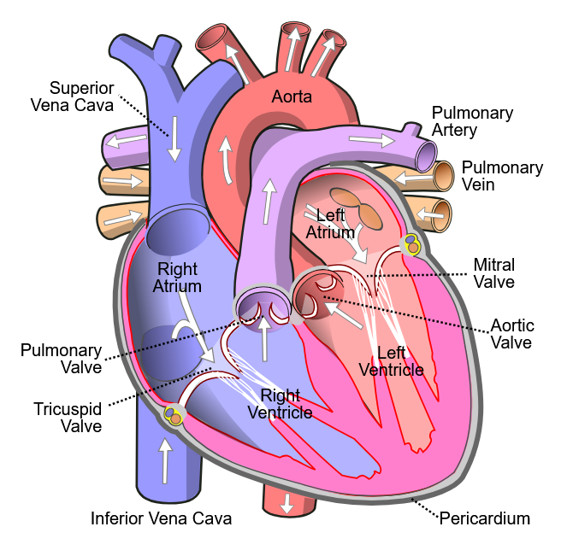
ANATOMY AND PHYSIOLOGY

Slide 4
DEFINITION
Cardio pulmonary Resuscitation is a technique of basic life support for oxygenating the brain and heart until appropriate, definitive medical treatment can restore normal heart and ventilatory action.

Slide 5
Purposes
To maintain an open and clear airway (A).
To maintain breathing by external ventilation (B).
To maintain Blood circulation by external cardiac massages (C).
To save life of the Patient.
To provide basic life support till medical and advanced life support arrives.

Slide 6
Indication
Cardiac Arrest
Ventricular fibrillation (VF)
Ventricular tachycardia (VT)
Asystole
Pulse less electrical activity

Slide 7
Respiratory Arrest
This may be result of following:
Drowning
Stroke
Foreign body in throat
Smoke inhalation

Slide 8
Cont…
Drug overdose
Suffocation
Accident, injury
Coma
Epiglottis paralysis.

Slide 9
Principles of CPR
To restore effective circulation and ventilation.
To prevent irreversible cerebral damage due to anoxia. When the heart fails to maintain the cerebral circulation for approximately four minutes the brain may suffer irreversible damage.

Slide 10
CPR Procedure
Sequences of procedures performed to restore the circulation of oxygenated blood after A sudden pulmonary and / or cardiac arrest
chest compressions and pulmonary ventilation performed by anyone who knows how to do it, anywhere, immediately, without any other equipment

Slide 11
Approach Safely
Check Response
Shout For Help
Open Airway
Check breathing
Call 108
30 Chest Compressions
2 Rescue Breaths

Slide 12
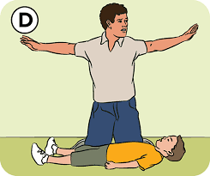
Approach Safely

Slide 13
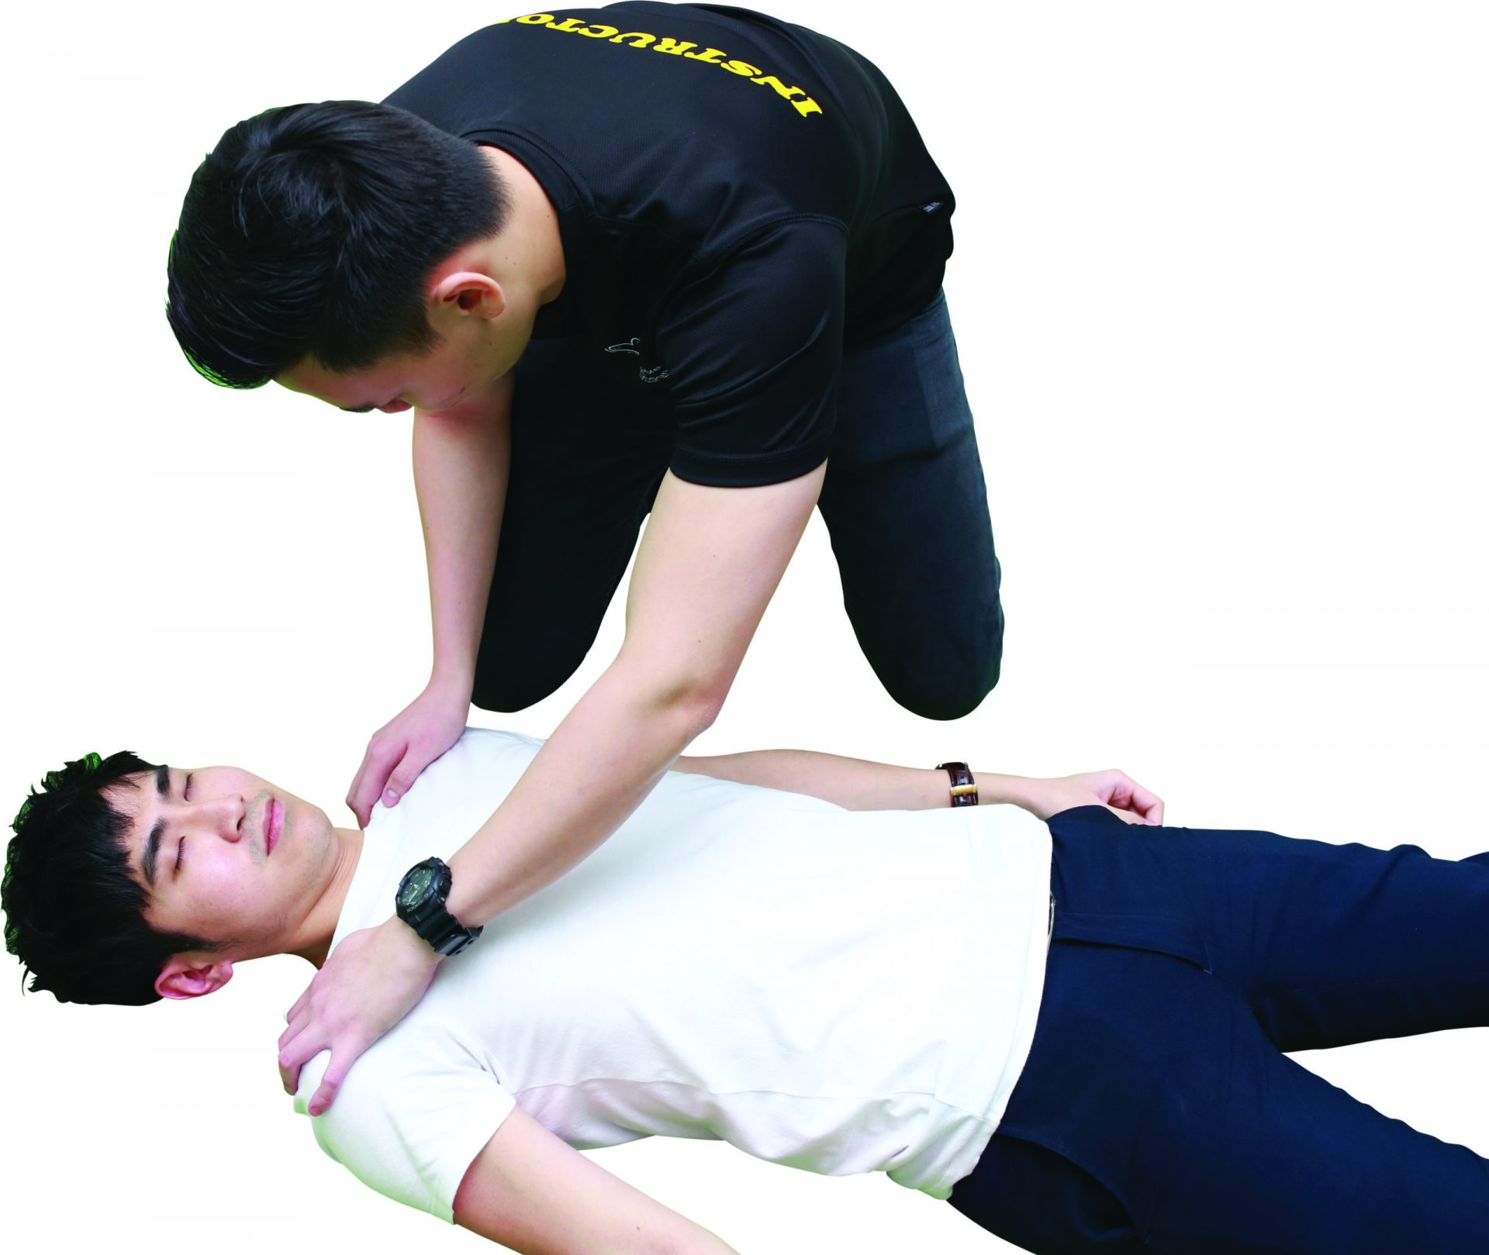
Check Response
Shake shoulders gently Ask “Are you all right?” If he responds
• Leave as you find him.
• Find out what is wrong.
• Reassess regularly.

Slide 14
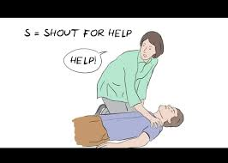
Shout For Help

Slide 15
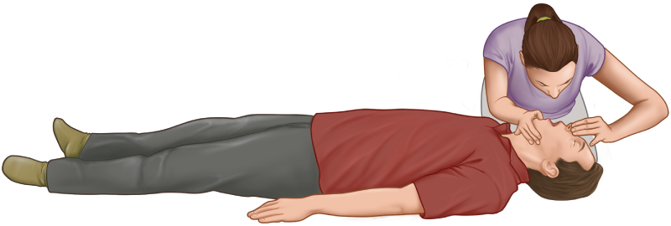
Open Airway
Head tilt and chin lift
- lay rescuers
non-healthcare rescuers
No need for finger sweep
unless solid material can be seen in the airway
Head tilt, chin lift + jaw thrust

Slide 16
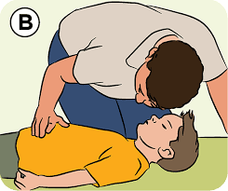
Check Breathing
Look, listen and feel for NORMAL breathing
• Do not confuse agonal breathing with NORMAL breathing
Occur shortly after the heart stops in up to 40% of cardiac arrests
Described as barely, heavy, noisy or gasping breathing
Recognize as a sign of cardiac arrest

Slide 17
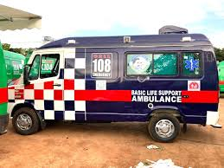
Call 108

Slide 18
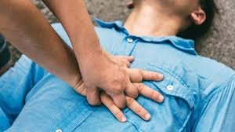
30 Chest Compressions
Place the heel of one hand in the centre of the chest
Place other hand on top
Interlock fingers
Compress the chest
– Rate 100 min-1
– Depth 4-5 cm (1.5 to 2 inch) – Equal compression : relaxation
• When possible change CPR operator every 2 min

Slide 19

Rescue Breaths
Pinch the nose
Take a normal breath
Place lips over mouth
Blow until the chest rises
Take about 1 second
Allow chest to fall
Repeat

Slide 20
Cont….
Recommendations :-
Tidal volume
-500 – 600 ml
Respiratory rate
- give each breaths over about 1s with enough volume to make the victim’s chest rise
Chest-compression-only
-continuously at a rate of 100 min

Slide 21

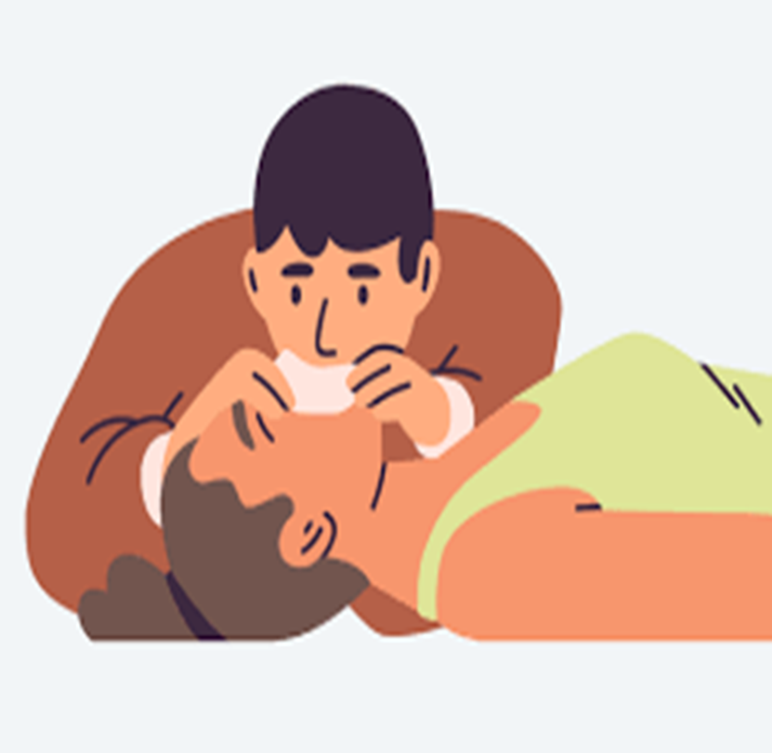
Continue CPR

Slide 22
Possible Complication
Coronary vessel injury
Diaphragm injury
Hemopericardium
Hemothorax
Interference with ventilation
Liver injury

Slide 23
Cont….
Myocardial injury
Pneumothorax
Rib fractures
Spleen injury
Sternal fracture

Slide 24
Medical Management
Adrenaline
Adrenaline (epinephrine)is the main drug used during resuscitation from cardiac arrest.
Atropine
Atropine as a single dose of 3mg is sufficient to block vagal tone completely and should be used once in cases of asystole. It is also indicated for symptomatic bradycardia in a dose of 0.5mg - 1mg.

Slide 25
Nursing Management
Maintains airway patency with use of airway adjuncts as required (suction, high flow oxygen with O2 or bag valve mask ventilation).
Assist with intubation and securing of ETT
Inserts gastric tube and/or facilitates gastric decompression post intubation as required.
Assists with ongoing management of airway patency and adequate ventilation

Slide 26
Cont…..
Supports less experienced staff by coaching/guidance e.g. drug preparation.
If a shockable rhythm is present (VF/VT) ensure manual defibrillator pads are applied and connected.
If CPR is in progress, prepare and independently double check and label 3 doses of adrenaline
Prepare and administer IV fluids
Document medications administered (including time)

Slide 27


