Slide 1
CLASSIFICATION OF MALOCCLUSION

Slide 2
Dr. Seema Patil

Slide 3
Content
What is Malocclusion?
Angle’s Classification Malocclusion
Angle’s Class I malocclusion
Angle’s Class II malocclusion
Angle’s Class III malocclusion

Slide 4
What is a Malocclusion
A malocclusion is a misalignment or incorrect relation between the teeth of the two dental arches when they approach each other as the jaws close.

Slide 5
Edward Angle, who is considered the father of modern orthodontics, was the first to classify malocclusion.
He based his classifications on the relative position of the permanent MAXILLARY FIRST MOLAR.
Angle believed that the anteroposterior dental base relationship could be assessed reliably from first permanent molar relationship, as its position remained constant following eruption.

Slide 6
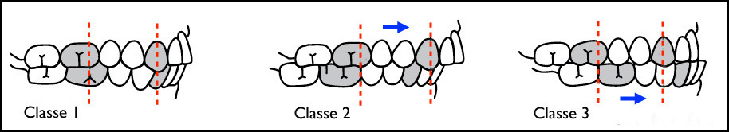
Angle’s Classification of Malocclusion

Slide 7
Angle’s class I Malocclusion
THE MESIOBUCCAL CUSP OF THE UPPER FIRST PERMANENT MOLAR OCCLUDES WITH THE MESIOBUCCAL GROOVE OF THE LOWER FIRST MOLAR, BUT LINE OF OCCLUSION IS INCORRECT BECAUSE OF MALPOSED TEETH, ROTATIONS OR OTHER DISCREPANCIES.

Slide 8
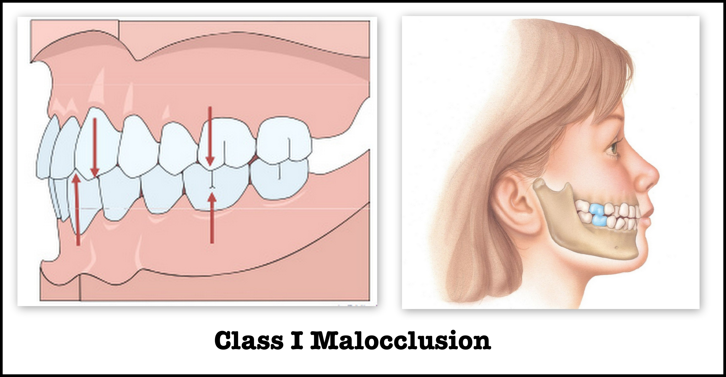

Slide 9
Angle’s class II Malocclusion
THE DISTOBUCCAL CUSP OF THE UPPER FIRST PERMANENT MOLAR OCCLUDES DISTAL IN THE MESIOBUCCAL GROOVE OF THE LOWER FIRST PERMANENT MOLAR.

Slide 10
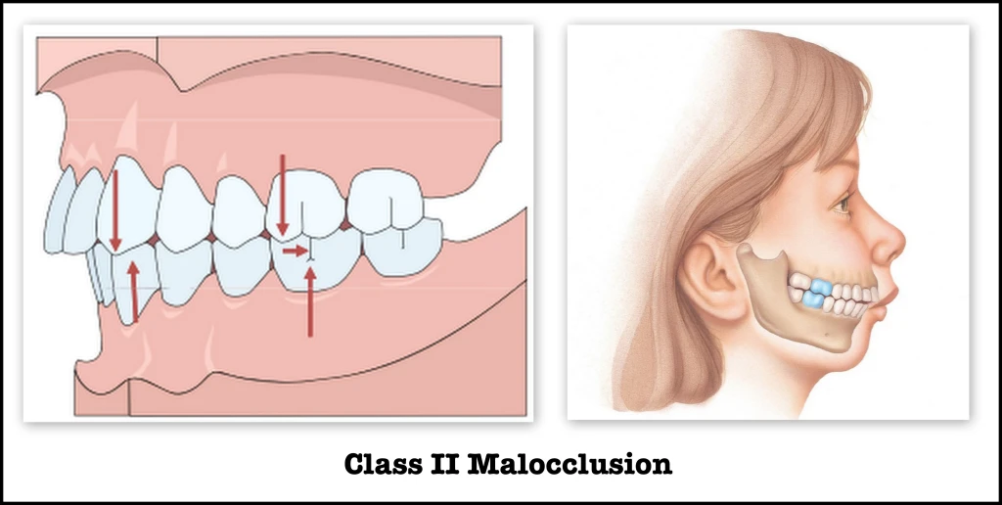

Slide 11
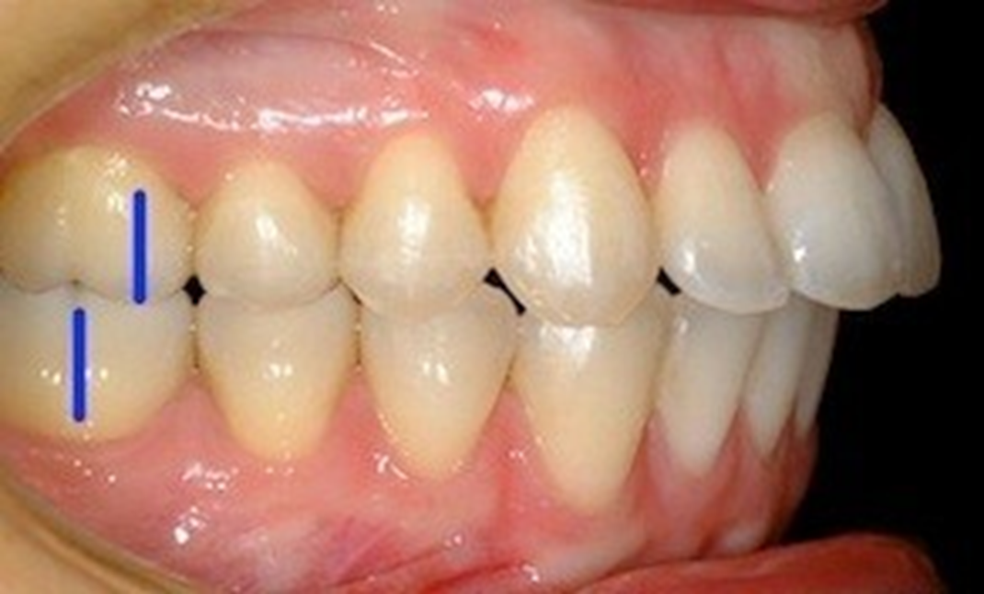
CLASS II DIVISION 1
Condition when class II molar relationship is present with proclined upper central incisors.
There is an increase in overjet.

Slide 12
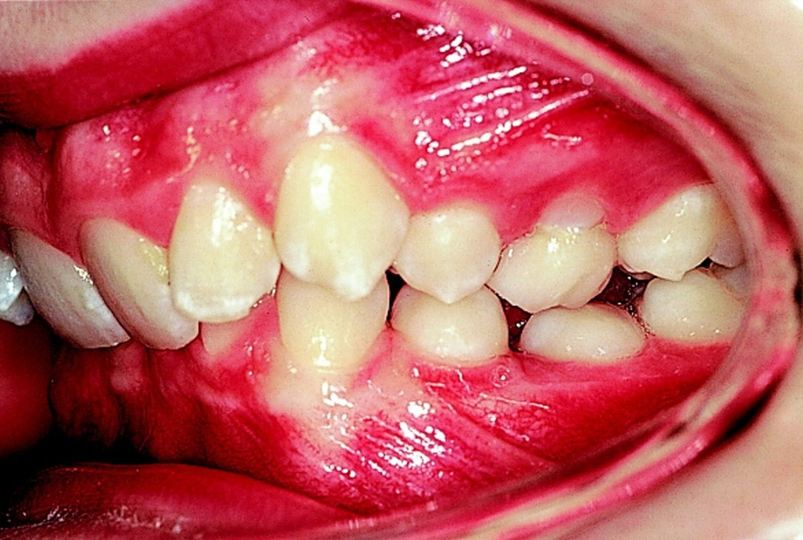
CLASS II DIVISION 2
Condition when class II molar relationship is present with retroclined upper central incisors, upper lateral ncisors may be proclined or normally inclined.
Overjet is usually minimal
or may be increased.

Slide 13
CLASS II SUB-DIVISION
Condition when the class II molar relationship exists on only one side with class I molar relationship on the other side.

Slide 14
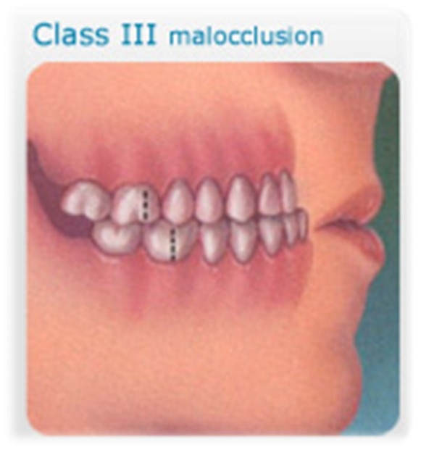
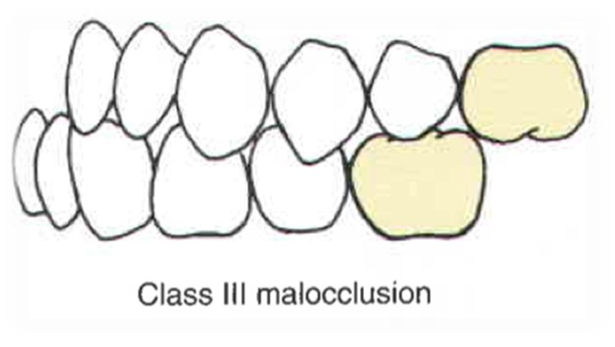
CLASS III MALOCCLUSION
THE MESIOBUCCAL CUSP OF THE UPPER FIRST MOLAR OCCLUDES IN THE INTERDENTAL SPACE BETWEEN THE MANDIBULAR FIRST AND SECOND MOLAR.

Slide 15
True Class III Malocclusion
Which is genetic in origin due to excessively large mandible or smaller than normal maxilla.

Slide 16
PSEUDO CLASS III MALOCCLUSION
Due to occlusal prematurity, when the mandible moves from rest position to occlusion, it slides forward into a pseudo class III position. It’s also known as postural class III.

Slide 17
CLASS III SUB-DIVISION
Condition in which class III molar relationship is present only on one side with normal relation on the other side.

Slide 18
Thank You

