Slide 1






Biofertilizer

Slide 2


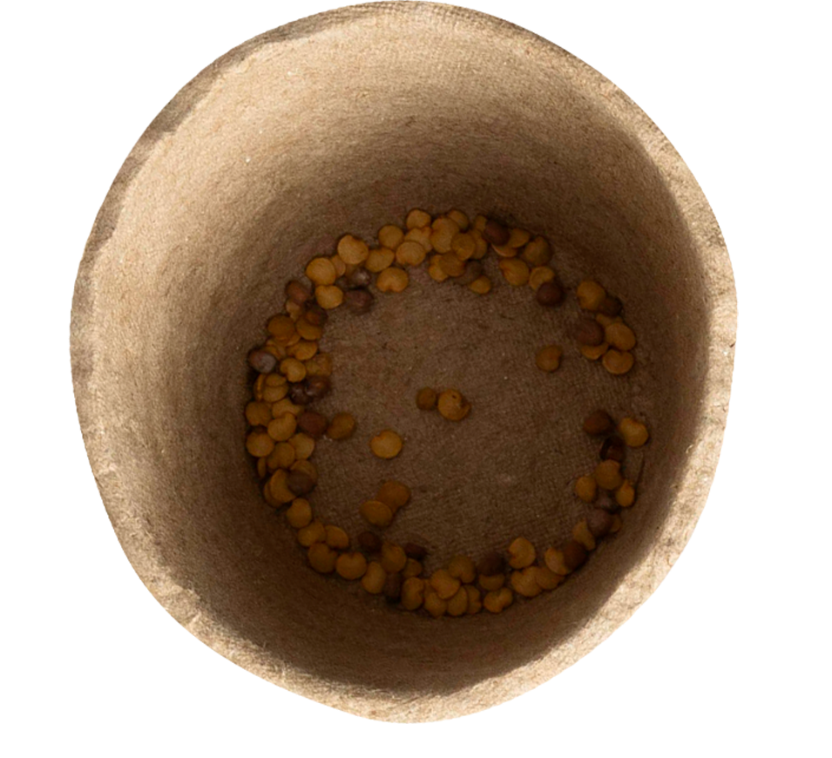

contents
02
01
Introduction
Basics Classifcation of fertilizers
What is soil health?
Effect of chemical fertilizers on soil and environments
Need of microorganisms in soil fertility.
Definition
Historical development and evolution
Basic classification
Nitrogen Fixers
Phosphate soulbilizers
Potassium mobilizers
Mycorrhizal Fungai (VAM)

Slide 3
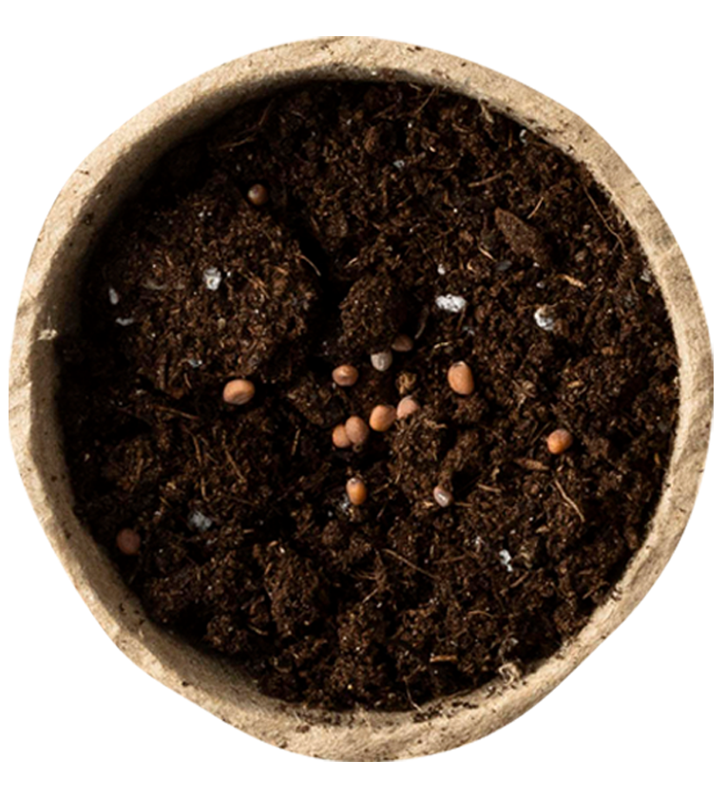
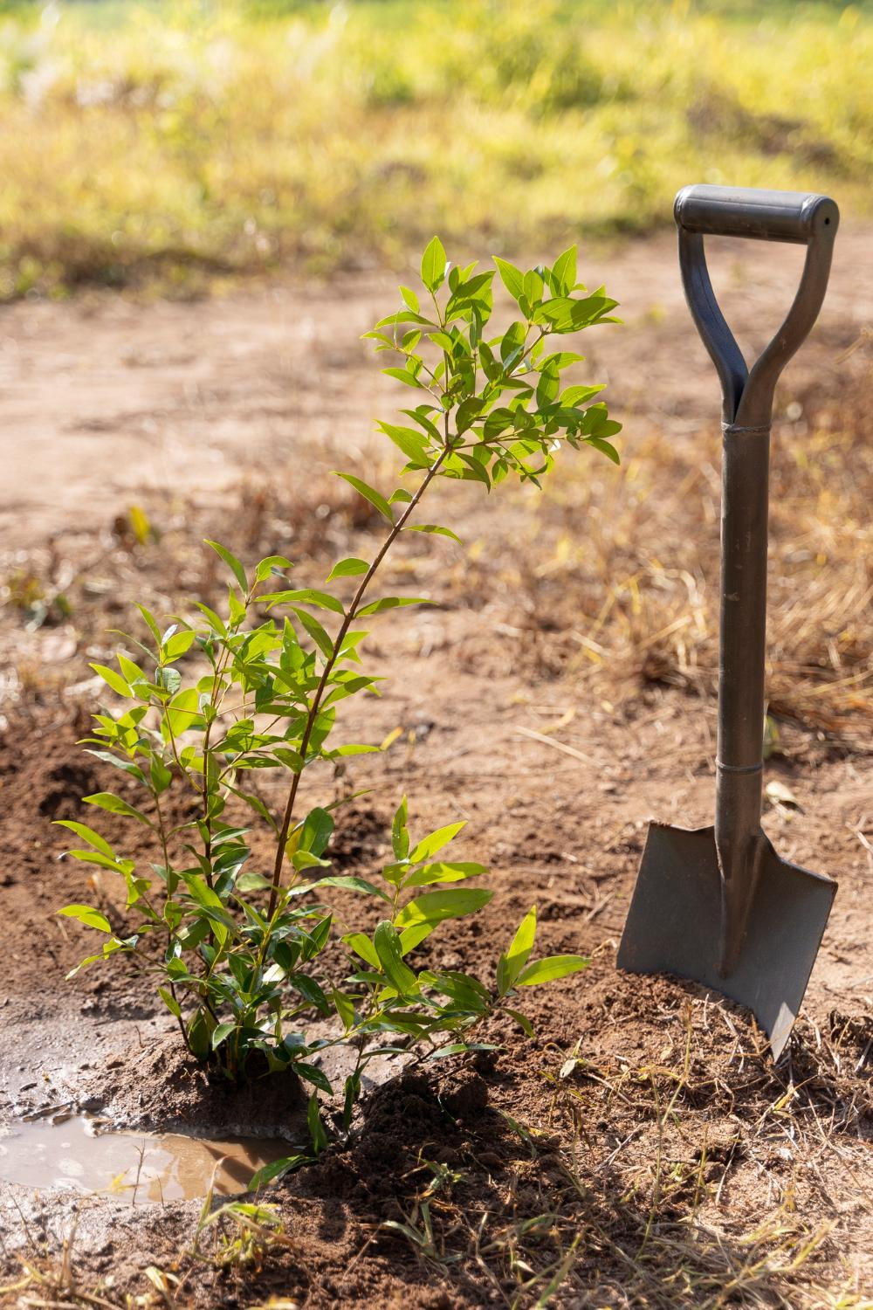

Introduction
Biofertilizers are natural inputs containing beneficial microorganisms that improve soil fertility and plant growth. They help in nutrient cycling, such as nitrogen fixation and phosphate solubilization. Unlike chemical fertilizers, they are eco-friendly and do not harm soil health. With increasing awareness about sustainable agriculture, biofertilizers are gaining importance. They are essential to restore microbial balance in the soil and reduce chemical dependency.

Slide 4


What is soil health?
Soil health is the capacity of soil to function as a vital living system that sustains biological productivity, maintains environmental balance, and promotes the health of plants, animals, and humans.
Implementing Soil Health Management Systems can lead to increased organic matter, more diverse soil organisms, reduced soil compaction and improved nutrient storage and cycling. As an added bonus, fully functioning, healthy soils absorb and retain more water, making them less susceptible to runoff and erosion. This means more water will be available for crops when they need it.

Slide 5
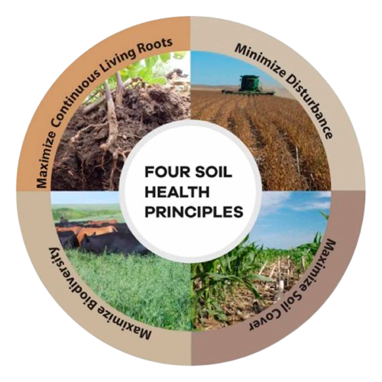
The Four Principles of a Soil Health Management System

Slide 6
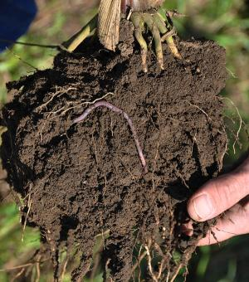
Maximize Presence of Living Roots
Healthy soil depends on the activity in the rhizosphere the zone near plant roots where microbes are most active. Plants release food (like sugars) from their roots to attract helpful microbes. These microbes, in return, help provide nutrients and water to the plant. Growing crops for a longer time, or adding cover crops, keeps feeding these microbes. The more food the microbes get (from roots, dead plants, or organic matter), the better they support plant growth by cycling essential nutrients. This feeding process builds a strong soil food web, which is key for soil health.

Slide 7
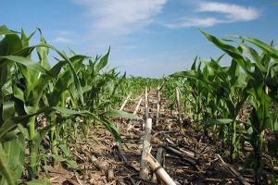
Minimize Disturbance
Tillage can destroy soil organic matter and structure, along with the habitat that soil organisms need. It reduces water infiltration, increases runoff, and makes the soil less productive by disrupting natural biological cycles and making it more prone to erosion. On the other hand, reduced or no-till practices help retain moisture and organic matter in the soil, support better root growth, enhance nutrient cycling, and reduce erosion. These practices also lower input costs by saving fuel, labor, and fertilizers, while also providing food and shelter for wildlife. However, improper use of fertilizers or poor grazing practices can disturb the soil’s biological balance. Adopting systems like rotational grazing helps protect soil health and improve productivity.

Slide 8
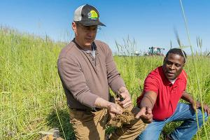
Maximize Soil Cover
Maximizing soil cover through the use of cover crops, annual and perennial crops, as well as leaving crop residues and living mulches on the soil surface, is a key practice to improve and maintain soil health. These methods protect the soil from wind and water erosion and enhance its overall structure. Cover crops play a vital role during fallow seasons by contributing to organic matter, improving water infiltration, and supporting beneficial soil organisms. Planting diverse species of cover crops such as legumes, radishes, and grasses can offer multiple benefits like restoring soil health, protecting natural resources, providing livestock feed, and creating habitat for wildlife and pollinators. Thus, the thoughtful use of cover crops contributes significantly to a sustainable and productive farming system.

Slide 9
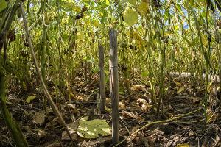
Maximize Biodiversity
Biodiversity is the variety of life forms like plants, animals, and microorganisms in an ecosystem. In farming, increasing biodiversity through crop rotation, cover crops, and livestock improves soil health, reduces pest and disease problems, lowers costs, and boosts productivity. Healthy soil biodiversity supports nutrient, water, and energy cycles, making agriculture more sustainable and profitable.

Slide 10
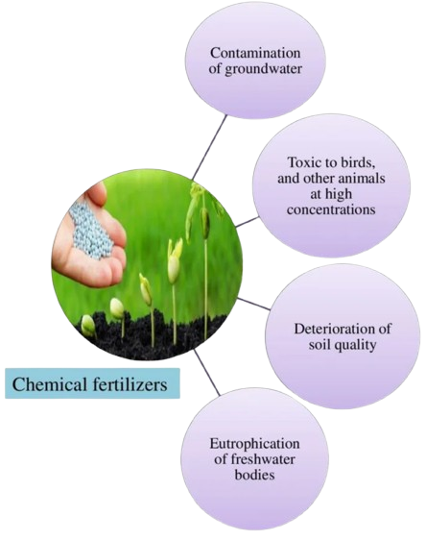
Effects of chemical fertilizers soil & environment
Nutrient Imbalance: Excessive use of chemical fertilizers can disrupt the nutrient balance in the soil, resulting in deficiencies or toxicities in plants. For example, unnecessary nitrogen application can promote rapid vegetative growth while inhibiting flowering and fruiting, reducing crop yield and quality.
Soil Degradation
Prolonged use of chemical fertilizers can cause soil degradation and nutrient depletion.
Overreliance on specific nutrients can cause soil pH imbalances, resulting in acidification or alkalization.
Chemical fertilizer can disrupt soil microbial communities, resulting in reduced fertility over time.

Slide 11
Effects of chemical fertilizers soil & environment
Reduced Nutrient Absorption: Plants grown in soils with high levels of chemical fertilizers may become dependent on external inputs, resulting in reduced nutrient absorption capacity. This dependence can reduce plants’ natural resilience, making them more vulnerable to pests, diseases, and environmental stressors.
Environmental Pollution: Runoff from chemically fertilized fields can contaminate water bodies, causing eutrophication and harmful algal blooms. Nitrogen and phosphorus runoff can also lead to groundwater pollution, endangering human health and aquatic ecosystems.
Plant Physiology: Long-term exposure to high concentrations of chemical fertilizers can disrupt plant physiology and metabolism, affecting photosynthesis, respiration, and hormone regulation. These disruptions may impede plant growth and lower overall productivity.

Slide 12
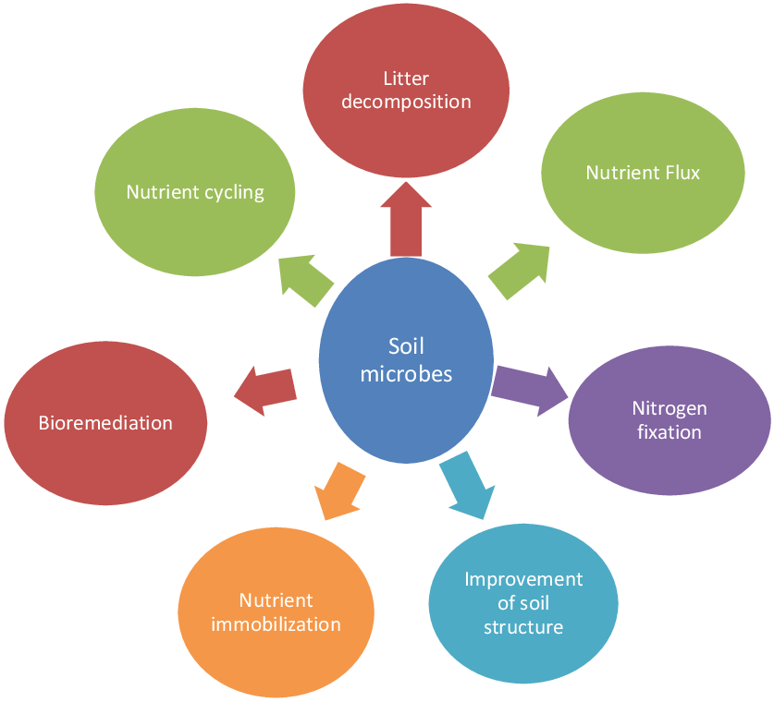
Role of microorganisms in soil fertility

Slide 13
Role of microorganisms in soil fertility
Soil hosts a diverse community of microorganisms such as bacteria, fungi, algae, protists, and small animals that play a crucial role in soil fertility and ecosystem functioning. These microbes release nutrients from organic matter, secrete substances that bind soil particles and improve soil structure, and aid in nutrient cycling through processes like nitrogen fixation, mineralization, and litter decomposition. Fungi form thread-like structures that bind soil particles, while bacteria contribute to both nutrient immobilization and release. Soil microbes also help in bioremediation by converting harmful pollutants like heavy metals, dyes, crude oil, and chemical fertilizers into non-toxic forms. Nitrogen-fixing microbes supply essential nitrogen to plants, which they cannot absorb directly from the atmosphere. Soil microbial biomass, considered the living portion of soil organic matter, acts as a nutrient reservoir and is sensitive to soil conditions and management practices. The type and function of microbes vary with climate and substrate availability, with tropical areas rich in nitrogen-fixing bacteria and temperate zones rich in mycorrhizae. Thus, microbial diversity and activity are key indicators of soil health, nutrient status, and ecosystem recovery.

Slide 14


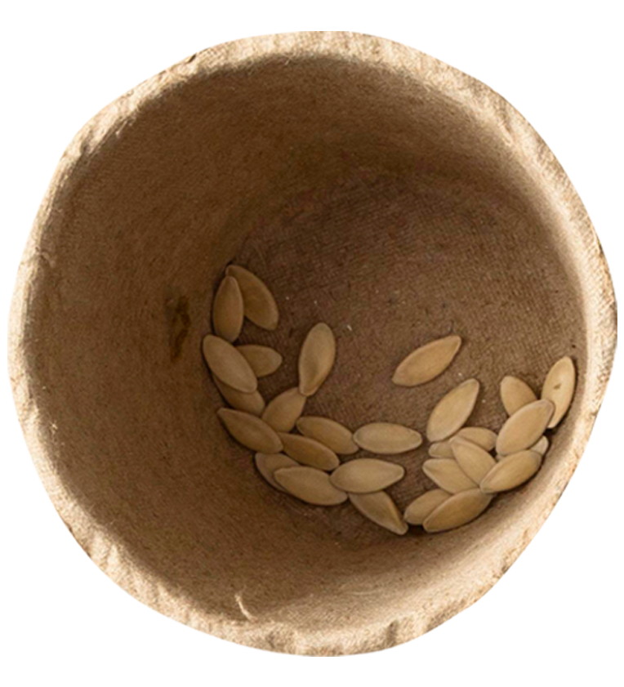
Basic of Biofertilizer

Slide 15
Defination
Living Microbes
Biofertilizer
Natural Soil nutrient enhancer
Biofertilizers are substance that contains microbes, which helps in promoting the growth of plants and trees by increasing the supply of essential nutrients to the plants. • It comprises living organisms which include bacteria, fungi, mycorrhizal and blue-green algae. • Biofertilizer also include organic fertilizers(manure, etc.) • Use of bio-fertilizer is recommended for improving the soil fertility in organic farming

Slide 16
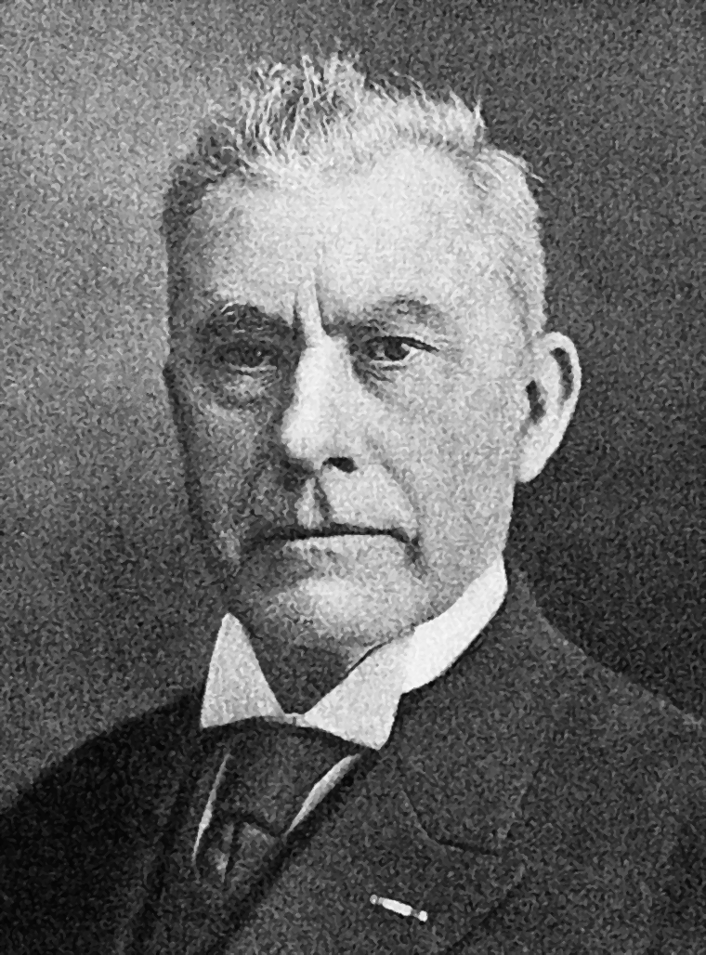
Historical Development and Evolution
Historical Discovery of Nitrogen Fixation and Rhizobia
Ancient Knowledge:
Farmers noticed legumes (peas, soybeans) improved crop yields through crop rotation since Roman times.
Scientific Breakthrough – 19th Century
Hermann Hellriegel (1831–1895) discovered that legumes fix atmospheric nitrogen (N₂) into ammonium (NH₃) via root nodules.
Martinus Beijerinck's Contribution:
Identified microorganisms (bacteria) in legume root nodules.
Named them Rhizobia – bacteria responsible for nitrogen fixation.
Established symbiotic relationship between Rhizobia and legumes.
His work laid the foundation for biofertilizer development.
Martinus Beijerinck

Slide 17
Historical Development and Evolution
Discovery of Phosphate Solubilizing Biofertilizers
The ability of microbes to solubilize insoluble phosphates was first reported by Pikovskaya in 1903.
developed a screening medium (Pikovskaya’s agar) to isolate and study these microorganisms.
Over the years, several bacterial and fungal genera were identified as phosphate solubilizers, including:
  Bacteria: Bacillus, Pseudomonas, Rhizobium, Azotobacter, Enterobacter
  Fungi: Aspergillus, Penicillium
These microbes enhance plant phosphorus uptake, promoting better crop yield and soil fertility.

Slide 18
Historical Development and Evolution
Discovery of Potassium Mobilizing Biofertilizers
The discovery of potassium-mobilizing bacteria (KMB) is not attributed to a single scientist, but rather to a body of research conducted by various scientists over time. These microorganisms were identified through studies focusing on plant growth promotion and nutrient solubilization in soil. Researchers have identified numerous bacterial species, such as Bacillus, Pseudomonas, and Burkholderia, that can solubilize and release potassium from soil minerals

Slide 19
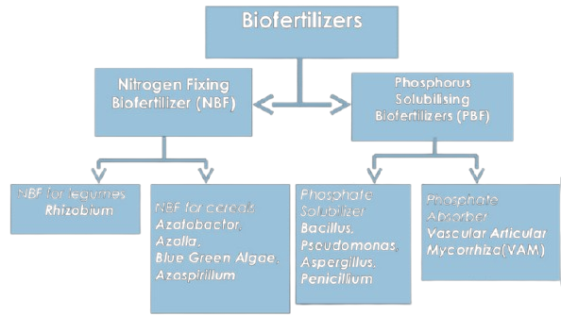
Classification of Biofertilizer

Slide 21
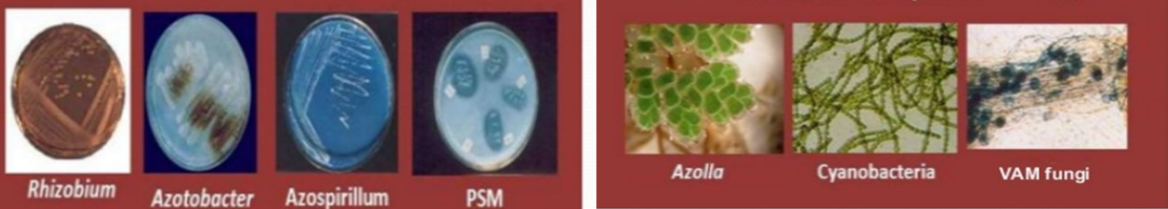

Slide 22

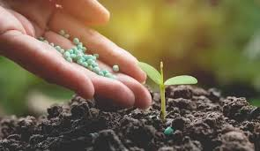
Thanks
yashpatil8011@gmail.com
+91 7768867575

