Slide 1
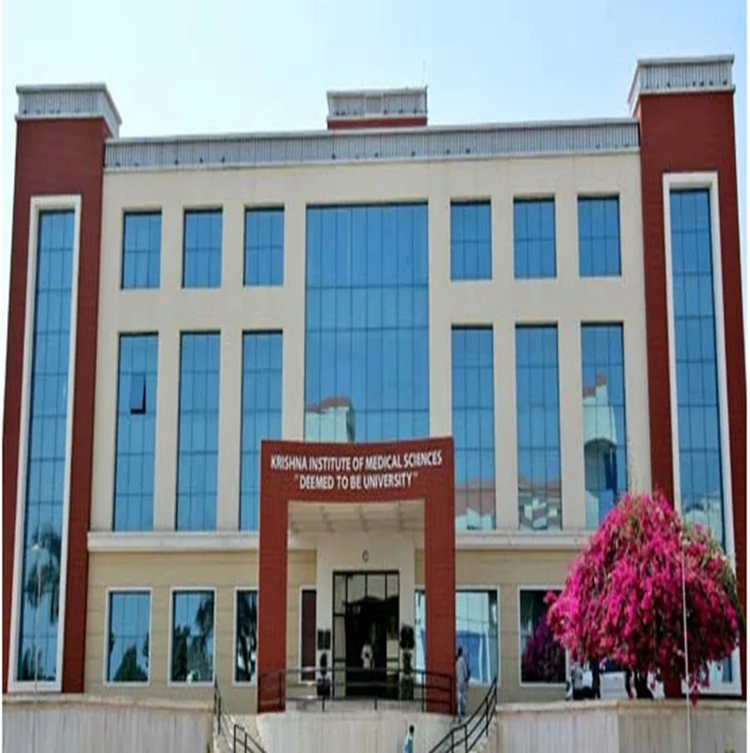

Slide 2
KRISHNA INSTITUTE OF NURSING SCIENCES, KARAD
TOPIC: Role of Hormones in Menopause
Progesterone and Testosterone role in the body
Presented By -
Mrs. Anagha V. Katti
Assist. Professor
MSc ( N)

Slide 3
Learning Objectives -
At the end of the lecture, the learner will be able to-
Describe the roles of Progesterone, Testosterone Follicle-Stimulating Hormone (FSH), and Luteinizing Hormone (LH) in the menstrual cycle and during menopause.
Explain how hormone levels change during menopause.
Understand the impact of hormonal changes in menopause.

Slide 4
Learning Objectives -
List common symptoms of menopause.
Explain the psychological impact of menopause.
Prepare appropriate health care advice that leads to positive lifestyle changes for women at menopause.

Slide 5
INTRODUCTION
Menopause, a natural part of aging, is characterized by the decline and cessation of menstrual cycles due to decreased ovarian function.
This decline leads to a decrease in estrogen and progesterone levels, resulting in various physiological and psychological changes.

Slide 6
Progesterone
Progesterone is produced mainly by the ovaries after ovulation and to a lesser extent by the placenta.
It is responsible for controlling ovulation and menstruation, stimulates increased endometrial thickness, helps prepare the uterus to accept and implant a fertilized egg, helps maintain pregnancy, and regulates some of the basic functions of the body.

Slide 7
Progesterone's role in the Body
Progesterone is a steroid hormone produced by the body during ovulation. Its main role is to prepare a woman’s body for pregnancy.
Once ovulation has occurred, a small mass of cells called the corpus luteum forms at the location where the ovary released an egg.
The corpus luteum starts to produce progesterone.
The progesterone prepares the body for pregnancy. Under normal circumstances, progesterone levels peak on day 21 of the menstrual cycle.

Slide 8
Progesterone levels during the menopause
During the normal menstrual cycle, progesterone works in an opposite manner to oestrogen to keep both hormones in balanced.
Oestrogen rises in the first phase of the menstrual cycle to promote the development of an egg, while in the next phase progesterone takes over, preparing the body for pregnancy or until the period occurs.

Slide 9
CONT-
During the perimenopause as the ovaries become less responsive levels of oestrogen and progesterone fluctuate, so a woman’s menstrual cycle is less predictable and low progesterone levels can also cause heavier menstrual bleeds.
In addition to changes in a woman’s menstrual cycle, declining progesterone levels can also cause other symptoms such as vaginal dryness.
Progesterone helps to thicken the mucus in the cervix but declining levels during the menopause can lead to vaginal dryness.

Slide 10
CONT-
Menopause symptoms are caused by the declining levels of progesterone, which can no longer balance oestrogen levels, causing oestrogen to become dominant before it, too, declines.

Slide 11
Low progesterone symptoms
Irregular menstrual cycle
Infertility
Miscarriages
Hot flushes
Headache
Mood changes

Slide 12
Testosterone
Testosterone’s role in the body
Testosterone is often associated more with men than women and is seen as the ‘male hormone’. However, testosterone plays a key role in a woman’s body too.
Testosterone in women is produced in the ovaries and the adrenal gland and contributes to libido, sexual arousal and orgasm in women as well as maintaining a normal metabolic function, muscle and bone strength, mood, and cognitive function.

Slide 13
CONT--
Low oestrogen levels are sensed by the hypothalamus and pituitary gland, and lead to an increase in the secretion of gonadotrophins (especially FSH) (i.e. there is loss of the usual negative feedback by oestrogen on FSH secretion, and FSH levels rise to try to increase stimulation of the ovaries).

Slide 14
CONT--
As menopause nears, ovaries no longer release eggs each month, it means stop ovulation.
It is a normal process that leads to a reduction in reproductive hormone levels (e.g. oestrogen, progesterone and androgens).
As a result the frequency of menstrual periods initially become less regular and then eventually stops altogether and their menstrual cycle last.

Slide 15
Androgens
After menopause, the stromal cells of the ovary continue to produce androgens because of an increase in LH.
The main androgens are androstenedione and testosterone.
Though the secretion of androgens from the postmenopausal ovary is higher, their peripheral levels are reduced due to conversion of androgens to oestrone in adipose tissue.

Slide 16
CONT-
The effect is a decrease in the oestrogen: androgen ratio.
This results in increased facial hair growth and a change in voice.
As the obese patient converts more androgens into oestrone, they are less likely to develop symptoms of estrogen deficiency and osteoporosis but vulnerable to endometrial hyperplasia and endometrial carcinoma.

Slide 17
Follicular Stimulating Hormone (FSH)
Follicular Stimulating Hormone (FSH) is made by the pituitary gland. It stimulates the growth of eggs in the ovaries and prepares them for fertilization.
It also affects sexual development during the reproductive years.
Without sufficient levels of FSH, the ovaries lose the ability to mature enough eggs, impacting the ability to reproduce and leading to infertility.

Slide 18
Luteinizing Hormone (LH)
Luteinizing hormone (LH) is produced by the pituitary gland.
It is responsible for triggering the release of an egg from the ovary so that it can be ready for fertilization.
If LH levels are too low, ovulation will not occur, thus impacting the ability to reproduce.
Too much LH can result in the formation of ovarian cysts.

Slide 19
Gonadotrophins
Gonadotropin-Releasing Hormone (GnRH) is a key hormone in the reproductive system, produced by the hypothalamus and responsible for regulating the release of Follicle–Stimulating Hormone (FSH) and Luteinizing Hormone (LH) from the pituitary gland.

Slide 20
CONT-
The secretions of both FSH and LH are increased due to absent negative feedback effect of estradiol and inhibin.
During menopause, there is a fall in the level of prolactin and inhibin.
Due to physiologic ageing, GnRH and both FSH, LH decline along with the decline of estrogens.

Slide 21
Other Female Sex Hormones
Endorphin Endorphin is a hormone that is secreted by the pituitary gland when the body is happy, satisfied and relaxed.
If the body is stressed, the level of this hormone will decrease.
We can increase endorphin levels by doing activities that make us feel happy and relaxed, such as enjoyable activities, exercise or meditation.

Slide 22
Serotonin
Serotonin is released from the brain as well as in part from the gastrointestinal tract.
It helps regulate muscle function, mood and behavior, and plays a key role in helping with sleep patterns.

Slide 23
CONT-
Low levels of serotonin can impact sleep and cause irritability, lack of concentration and headaches.
Long-term, it may also result in depression.
Regular exercise and a healthy diet, especially rich in protein, can help to increase and maintain serotonin levels.

Slide 24
Adrenaline
Adrenaline, or epinephrine, is a hormone made and released by the adrenal glands. It is released when the body is in an emergency situation and is preparing to use energy in response.
Normally, the body secretes more of this hormone only in response to a specific stimulus.
An abnormality can lead to excess secretion of the hormone, causing tachycardia and chronic high blood pressure.

Slide 25
CONT-
When menopause is fully reached, the body’s production of estrogen, progesterone, and testosterone is reduced greatly, while Follicle Stimulating Hormone (FSH) and Luteinizing Hormone (LH) levels are increased.
This can impact sex drive, cause changes to the skin, result in decreased bone mass, which means bones become more brittle and can break more easily, and cause an increased risk of cardiovascular disease and stroke.

Slide 26
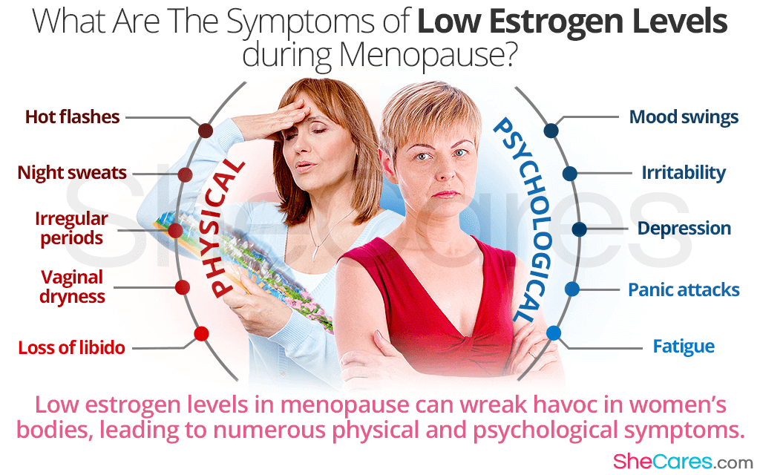
Impact of Hormonal Changes-

Slide 27
Menopause Diagnosis-
Hormone levels can be measured to diagnose and confirm menopause, specifically, if elevated FSH levels and decreased estradiol (E2) levels are observed.

Slide 28
Healthcare Advice for Menopause
1. Maintain a Healthy Diet
Eat a balanced diet rich in calcium and Vitamin D to support bone health, which includes whole grains, fruits, vegetables, and lean proteins.
Limit intake of saturated fats, coffee to reduce the risk of cardiovascular issues and hot flashes.
The body should be getting at least 800 – 1,000 IU of vitamin D per day and 1,000 – 1,200 mg of calcium per day.

Slide 29
CONT--
2. Regular Physical Activity
Engage in at least 30 minutes of moderate exercise every alternate day of the week.
Include weight-bearing exercises (like walking or light weightlifting) to strengthen bones and prevent osteoporosis.
Try stretching exercises to reduce stress and improve flexibility. Exercise regularly to build muscle mass.

Slide 30
CONT---
3. Manage Menopausal Symptoms
Hot flashes: wear cotton clothes. keep cool, and avoid triggers like spicy foods or stress.
Vaginal dryness: Use water-based lubricants or vaginal moisturizers; consult a doctor about low-dose estrogen therapy if needed.
Sleep disturbances: Maintain a regular sleep schedule, avoid screens before bedtime, and create a cool, quiet sleep environment.

Slide 31
CONT-
4. Mental and Emotional Well-being
Mood swings and irritability are common; talk to a physician.
Practice stress-reducing techniques like meditation, deep breathing.
If depression or anxiety becomes severe, seek professional help.

Slide 32
CONT--
5. Regular Health Check-ups
Get regular bone density tests, mammograms, pelvic exams, and blood pressure monitoring.
Discuss screening for cholesterol, blood sugar, and thyroid function.
Get some sunlight in the morning to prevent the onset of osteoporosis.

Slide 33
CONT--
6. Stay Hydrated
Drink plenty of water to manage bloating, dry skin, and fatigue.

Slide 34
Summary:
Progesterone levels also drop, which contributes to irregular menstrual bleeding in the perimenopausal phase and may increase the risk of endometrial hyperplasia.
The imbalance and eventual depletion of estrogen and progesterone signal the end of natural fertility and the onset of menopause.
These hormonal changes not only affect reproductive functions but also have widespread effects on various systems in the body, including the cardiovascular, skeletal, and nervous systems.

Slide 35
Conclusion
In today’s lecture, we have seen that the decline in estrogen and progesterone is central to the biological process of menopause.
Estrogen deficiency is primarily responsible for most of the physical and emotional symptoms experienced during this transition, while the reduction in progesterone affects menstrual regularity and uterine health.
Understanding the role of these hormones helps in managing menopausal symptoms, ultimately improving quality of life during and after menopause.

Slide 36
References
https://www.healthline.com/health/female-sex-hormones#types
https://beyondivf.com/balancing-female-hormones/
https://www.medicalnewstoday.com/articles/324887#summary
https://www.chulacancer.net/faq-list-page.php?id=332
https://www.samitivejhospitals.com/article/detail/female-hormones-menopause-guide
Datta D.C Textbook of Gynaecology 5th edition , Published by New Central Book Agency. P.No.56

