Slide 1
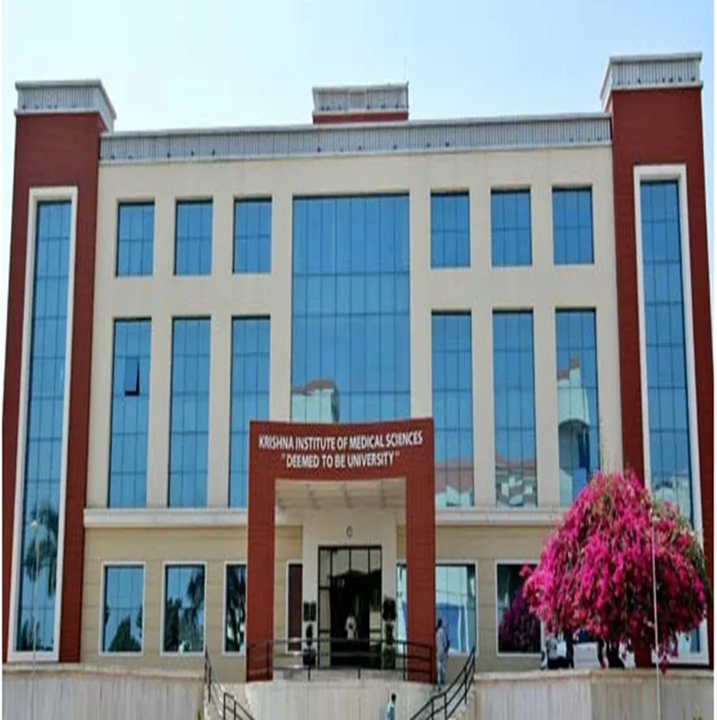

Slide 2
KRISHNA INSTITUTE OF NURSING SCIENCES, KARAD
TOPIC: Role of Hormones in Menopause
- Oestrogen hormone changes during menopause
Presented By -
Mrs. Anagha V. Katti
Assist. Professor
MSc ( N)

Slide 3
Learning Objectives -
At the end of the lecture, the learner will be able to-
Describe the roles of estrogen, progesterone, Follicle-Stimulating Hormone (FSH), and Luteinizing Hormone (LH) in the menstrual cycle and during menopause.
Explain how hormone levels change during menopause.
Understand the impact of hormonal changes in menopause.

Slide 4
CONT-- Learning Objectives -
List common symptoms of menopause.
Explain the psychological impact of menopause.
Prepare appropriate health care advice that leads to positive lifestyle changes for women at menopause.

Slide 5
Introduction
Menopause, a natural part of aging, is characterized by the decline and cessation of menstrual cycles due to decreased ovarian function.
This decline leads to a decrease in estrogen and progesterone levels, resulting in various physiological and psychological changes.

Slide 6
Cont-
Estrogen levels drop during perimenopause, before menopause.
With menopause, estrogen levels drop and no longer ovulate.
The primary estrogen in body changes from estradiol (E2) to estrone (E1) during menopause.

Slide 7
Cont-
During the transition time before menopause, the supply of mature eggs in a woman’s ovaries diminishes, and ovulation becomes irregular.
At the same time the production of estrogen and progesterone level decreases. It is the big drop in estrogen level causes most of the symptoms of menopause.

Slide 8
Cont-
Hormones are chemicals produced by the body to help control the normal functioning of various systems in the body.
The main female sex hormones are estrogen, progesterone, FSH, and LH.

Slide 9
Cont-
The main hormones are oestrogen, progesterone, and testosterone, but others such as the control hormones.
Follicle-stimulating hormone (FSH) and Luteinizing Hormone (LH), also play a part.
As women enter the perimenopause phase to menopause, the ovaries produce less oestrogen and progesterone.

Slide 10
Cont-
The ovaries become less responsive to the control hormones released by the pituitary gland in the brain - FSH and LH - resulting in higher levels of these control hormones.

Slide 11
Hormone changes during menopause
Oestrogen- Oestrogen is mainly produced in the ovaries (95%), but small amounts are also produced in the adrenal glands (5%) and is one of the two main sex hormones in women, with the other being progesterone.
The 3 main types of oestrogen in the body:
Oestrone (E1)
Oestradiol (E2)
Oestriol (E3)

Slide 12
Cont--
Oestradiol is the most common type of oestrogen in women of childbearing age.
Oestriol is the main oestrogen during pregnancy and oestrone is the only oestrogen the body produces after menopause.

Slide 13
Oestrogen's Role in the Body
Oestrogen has a role throughout the body and is a key hormone during puberty helping to bring about physical changes and the start of the menstrual cycle.
Oestrogen helps control the menstrual cycle, is a key hormone in fertility and helping to maintain pregnancy.

Slide 14
Cont--
Oestrogen levels in women change throughout the month, being highest during the menstrual cycle and lowest during a woman's period.
Oestradiol production enables the development and release of an egg, a process known as ovulation.

Slide 15
Cont-
Oestrogen is also important in brain function, including mood, as well as contributing to bone and heart health.
Oestrogen helps keep cholesterol in control which is why women going through the menopause will have increased cholesterol levels.

Slide 16
Oestrogen
Oestrogen is an important hormone responsible for regulating the female reproductive system.
It is produced primarily in the ovaries, with a small portion produced by the adrenal glands and fat cells.
Oestrogen affects sexual development, female characteristics, menstruation, pregnancy, and menopause.

Slide 17
Cont--
Excess oestrogen can lead to increased fat storage, resulting in weight gain or obesity, irritability and mood swings.
It can also increase the risk of certain cancers and hyperlipidemia.

Slide 18
Cont-
Oestrogen is a hormone primarily produced by the ovaries and is essential for female reproductive health.
It regulates the menstrual cycle, influences the development of secondary sexual characteristics, and plays a role in maintaining bone density and bone strength, skin elasticity and cardiovascular function.
During menopause, a woman's ovaries produce less estrogen, leading to a variety of symptoms.

Slide 19
Oestrogen levels during the menopause
The normal levels of oestrogen in pre-menopausal women is 45-854 pmol/L.
The levels fall to less than 100 pmol/L during the menopause and beyond.
During the normal cycle, the levels of oestrogen and progesterone are in balance with each other.
However, as women approach their mid-30s to early 40s, progesterone levels begin to fall, and the ovaries begin to produce less oestrogen.

Slide 20
Cont--
As a result, women may notice a change in their periods.
They may be more or less frequent, last for longer or shorter amounts of time, maybe heavier or lighter. It's not unusual during perimenopause to have missed periods.
The sharp decline in oestrogen, known for causing the symptoms associated with the menopause like hot flushes, vaginal dryness, and memory issues, occurs towards the end of the perimenopause. Here, periods may be lighter and occur less frequently.

Slide 21
Symptoms of estrogen imbalance :
Menstrual irregularities
Premenstrual syndrome (PMS)
Mood swings
Irritability
Difficulty sleeping

Slide 22
Cont-
Lack of concentration
Brittle bones
Vaginal dryness and atrophy, which affect sexual intercourse and can cause cysts and tumors in the breasts, uterus, and ovaries

Slide 23
The result of increased estrogen in women-
Menstrual irregularity
Heightened emotionality
Memory problems
Insomnia
Hair loss
Frequent migraines
Breast tenderness
Uncontrolled weight gain

Slide 24
Organ changes during menopause
Ovaries, Fallopian tubes, uterus, vagina, breast, bladder and urethra.
Uterus: The uterus become small and fibrotic due to atrophy of the muscles after the menopause.
The cervix become smaller and appears to flush with vagina. In older women the cervix may be impossible to identify separately from vagina. The vaginal and cervical discharge decreases in amount and later disappear completely.

Slide 25
Cont-
Ovaries: The ovaries become smaller and shriveled in appearance.
The ovaries which produce little androgen during reproductive life begin to produce it in increasing amounts.

Slide 26
Cont-
Vagina: The vaginal mucous membrane becomes thin and loses its rigidity after the menopause.
Decreased secretion make vagina dry.
Sexual intercourse become painful and difficult due to pain from the dry vagina.

Slide 27
Cont-
Vulva or external genital organs:
The fat in the labia majora and the Mons pubis decreases and pubic hair becomes spare.
Breast: In thin-built women, the breasts become flat and shrivelled, while in heavy-built women they remain flabby and pendulous.

Slide 28
Cont-
Loss of muscle tone
After menopause, the tissues of the labia minors (which surround the opening of the vagina and urethra), clitoris, vagina, and urethra become thin (atrophy). This thinning can result in chronic irritation and dryness of the vagina.
Vaginal discharge and urinary tract infections are more likely to develop.
Also after menopause, the uterus, Fallopian tubes, and ovaries become smaller.

Slide 29
Cont-
Breast
Because there is less estrogen to stimulate milk ducts, the breasts decrease in size.
The connective tissue that supports the breasts also decreases.
The loss of support contributes to changes in breast shape. Fibrous tissue in the breasts is replaced with fat, making the breasts less firm.

Slide 30
Cont-
Bone
The drop in oestrogen levels that occurs around the time of menopause results in increased bone loss.
It is estimated that, on average, women lose up to 20 per cent of their bone mass in the first five years after menopause and 20% of bone loss occurs within your first five years of menopause.

Slide 31
CHANGES IN THE GENERAL APPEARANCE
Skin: The skin loses its elasticity and becomes thin and fine. This is due to the loss of elastin and collagen from the skin.
Weight: weight increase is more likely to be the result of irregular food habit due to mood swing.
There is more deposition of fat around hips, waist and buttocks.

Slide 32
Cont-
Hair: Hair become dry and coarse after menopause.
There may hair loss due to the decreasing level of estrogen.
Voice: Voice become deeper due to thickening of vocal cords.

Slide 33
CHANGES IN THE VASOMOTOR SYSTEM
Hot flashes : Hot flashes are incidents where women in menopause gets a sudden feeling of warmth and flushing that starts in the face and quickly spread all over the neck and upper body .
This `hot flushes’ can occur at any time of the day or night.

Slide 34
Cont--
Night sweat: Night sweat are closely related to hot flashes. Both usually occur simultaneously.
Sweat can occur any time of the day or night, they are more common at night.
The sweat can be severe enough to wake up the women from a sound sleep and may make it difficult for her to go back to sleep.
The sudden waking up from sleep can cause palpitation and sometimes panic attacks.

Slide 35
PSYCHOLOGICAL CHANGES
The psychological changes are mainly manifested by frequent headache, irritability, fatigue, depression and insomnia.

Slide 36
Cont-
Menopause symptoms are caused by the declining levels of progesterone, which can no longer balance oestrogen levels, causing oestrogen to become dominant before it, too, declines.

Slide 37
Cont-
Low oestrogen levels are sensed by the hypothalamus and pituitary gland, and lead to an increase in the secretion of gonadotrophins (especially FSH) (i.e. there is loss of the usual negative feedback by oestrogen on FSH secretion, and FSH levels rise to try to increase stimulation of the ovaries).

Slide 38
Cont--
As menopause nears, ovaries no longer release eggs each month, which means stop ovulation. It is a normal process that leads to a reduction in reproductive hormone levels (e.g. oestrogen, progesterone and androgens ).
As a result, the frequency of menstrual periods initially become less regular and then eventually stops altogether. and their menstrual cycle lasts.

Slide 39
Menopause Diagnosis-
Hormone levels can be measured to diagnose and confirm menopause, specifically, if elevated FSH levels and decreased estradiol (E2) levels are observed.

Slide 40
Management of Menopause
1. Maintain a Healthy Diet
Eat a balanced diet rich in calcium and vitamin D to support bone health, which includes whole grains, fruits, vegetables, and lean proteins.
Limit intake of saturated fats, coffee to reduce the risk of cardiovascular issues and hot flashes.
The body should be getting at least 800 – 1,000 IU of vitamin D per day and 1,000 – 1,200 mg of calcium per day.

Slide 41
CONT--
2. Regular Physical Activity
Engage in at least 30 minutes of moderate exercise every alternate day of the week.
Include weight-bearing exercises (like walking or light weightlifting) to strengthen bones and prevent osteoporosis.
Try stretching exercises to reduce stress and improve flexibility. Exercise regularly to build muscle mass.

Slide 42
Cont-
3. Manage Menopausal Symptoms
Hot flashes: wear cotton clothes. keep cool, and avoid triggers like spicy foods or stress.
Vaginal dryness: Use water-based lubricants or vaginal moisturizers; consult a doctor about low-dose estrogen therapy if needed.
Sleep disturbances: Maintain a regular sleep schedule, avoid screens before bedtime, and create a cool, quiet sleep environment.

Slide 43
CONT--
5. Regular Health Check-ups
Get regular bone density tests, mammograms, pelvic exams, and blood pressure monitoring.
Discuss screening for cholesterol, blood sugar, and thyroid function.
Get some sunlight in the morning to prevent the onset of osteoporosis.

Slide 44
CONT--
6. Stay Hydrated
Drink plenty of water to manage bloating, dry skin, and fatigue.

Slide 45
Summary
Estrogen and progesterone are two primary female sex hormones that play a crucial role in the regulation of the menstrual cycle and overall reproductive health.
As a woman approaches menopause, the ovaries gradually reduce their hormone production.
Estrogen levels begin to decline significantly, which disrupts the menstrual cycle and leads to menopausal symptoms such as hot flashes, night sweats, mood swings, vaginal dryness, and reduced bone density.

Slide 46
Conclusion
In today’s class, we have seen that oestrogen deficiency is primarily responsible for most of the physical and emotional symptoms experienced during this transition, while the reduction in progesterone affects menstrual regularity and uterine health.
Understanding the role of these hormones helps in managing menopausal symptoms, ultimately improving quality of life during and after menopause.

Slide 47
References
https://www.healthline.com/health/female-sex-hormones#types
https://beyondivf.com/balancing-female-hormones/
https://www.medicalnewstoday.com/articles/324887#summary
https://www.chulacancer.net/faq-list-page.php?id=332
https://www.samitivejhospitals.com/article/detail/female-hormones-menopause-guide
Datta D.C Textbook of Gynaecology 5th edition , Published by New Central Book Agency. P.No.56

