Slide 1
Proximal Tibia Fractures
DR. VIKAS ANANDA SATRE
Ms orthopaedics
PROFESSOR & HEAD OF DEPARTMENT OF ORTHOPAEDICS
KIMS ,KVV
KARAD

Slide 2
Learning Objectives
Define proximal tibia fracture patterns and mechanisms.
Classify these fractures using the Schatzker system.
Identify early signs of Acute Compartment Syndrome (ACS).
Evaluate popliteal artery and peroneal nerve injuries.
Outline emergency management and definitive fixation options.

Slide 3
Surgical Anatomy: Osseous & Articular
Proximal tibia consists of medial and lateral condyles.
Lateral plateau: Higher, convex, more frequently fractured.
Medial plateau: Lower, concave, stronger bone density.
Tibial tubercle serves as the patellar tendon insertion.
Intercondylar eminence anchors the cruciate ligaments.

Slide 4
Anterior compartment: Tightly bound by deep fascia.
Minimal subcutaneous tissue covers the anteromedial tibia.
Poor soft tissue coverage increases open fracture risk.
High-energy trauma causes massive perioperative swelling.
Blisters: Clear fluid vs. hemorrhagic blisters dictate surgical timing.

Slide 5
Vascular Anatomy
Popliteal artery passes through the adductor hiatus.
Tethered closely to bone at the soleal cleft.
Divides into anterior tibial and tibioperoneal trunk.
High risk of traction or transaction in displaced fractures.
Collateral circulation around the knee is often insufficient.

Slide 6
Neurological Anatomy
Common peroneal nerve winds around the fibular neck.
Vulnerable to direct impact or lateral distraction forces.
Divides into deep and superficial peroneal nerves.
Deep branch: Controls ankle dorsiflexion (foot drop risk).
Superficial branch: Controls foot eversion and lateral calf sensation.

Slide 7
Mechanism & Classification
Low-energy: Valgus stress in elderly (osteoporotic bone).
High-energy: Motor vehicle accidents, falls from height.
Axial loading: Drives femoral condyles into tibial plateau.
Direct blow: "Bumper injury" from car pedestrian accidents.
Combination forces cause severe comminution and soft tissue tearing.

Slide 8
Schatzker Classification (Types I–III)
Type I: Pure cleavage fracture of lateral plateau.
Type II: Cleavage combined with depression of lateral plateau.
Type III: Pure central depression of lateral plateau.
Clinical Note: Types I–III typically result from low-energy trauma.

Slide 9
Schatzker Classification (Types IV–VI)
Type IV: Medial plateau fracture (high-energy, neurovascular risk).
Type V: Bicondylar fracture (both plateaus separated from shaft).
Type VI: Plateau fracture with complete metaphyseal-diaphyseal dissociation.
Clinical Note: Types IV–VI carry extreme soft-tissue and vascular risk.

Slide 10
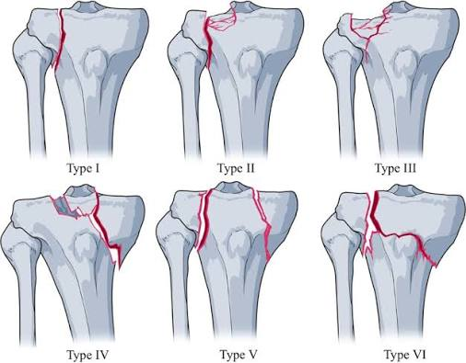

Slide 11
Clinical Presentation & Bedside Evaluation
Severe pain, swelling, and inability to bear weight.
Hemarthrosis: Knee looks tense, ballotable patella.
Deformity: Varus/valgus malalignment or limb shortening.
Always check skin integrity for punctures or abrasions.
Document mechanical skin tenting immediately to prevent necrosis.

Slide 12
Radiological Evaluation Protocol
AP and Lateral Views: Standard initial trauma series.
Oblique Views (45 degrees): Helps visualize subluxation.
CT Scan: Essential for articular depression mapping.
MRI: Indicated if soft tissue/ligamentous injury suspected.
CT Angiography: Mandatory if distal pulses are abnormal.

Slide 13
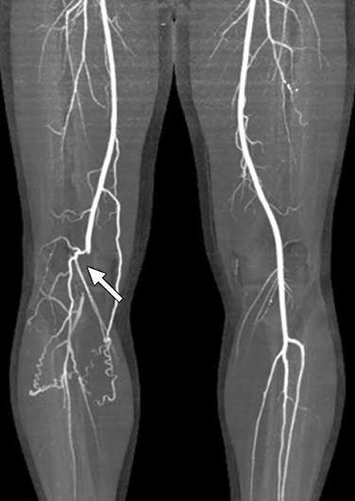
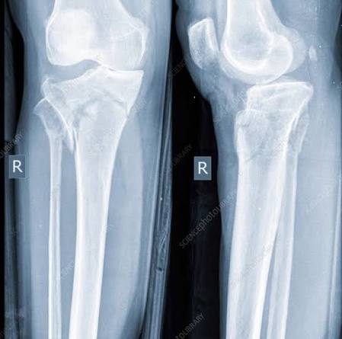

Slide 14
Neurovascular Injuries
High-energy Schatzker IV, V, VI have highest risks.
Popliteal artery injury occurs in up to 10% of high-energy cases.
Peroneal nerve injury occurs in 2–5% of lateral injuries.
Knee dislocation combinations skyrocket neurovascular
complication rates.

Slide 15
Popliteal Artery Injury
Direct transection: Bone shards slice through the vessel.
Traction injury: High energy stretches and tears the intima.
Intimal flap tear: Leads to delayed thrombosis and ischemia.
Spasm: Diagnosis of exclusion; treat as occlusion first.

Slide 16
Clinical Assessment of Vascularity
Hard Signs: Absent distal pulses, active hemorrhage, expanding hematoma.
Soft Signs: Diminished pulses, asymmetric capillary refill, cool extremity.
Compare posterior tibial and dorsalis pedis pulses to the uninjured limb.
Measure Ankle-Brachial Index (ABI): Normal value is >0.9.
Rule: ABI <0.9 requires immediate CT angiography or vascular consult.

Slide 17
Peroneal Nerve Assessment
Motor function: Ask patient to dorsiflex big toe and ankle.
Sensory function: Test first dorsal webspace (deep peroneal nerve).
Test lateral aspect of the foot (superficial peroneal nerve).
Document nerve status before any reduction attempt.
Foot drop requires early splinting in a neutral position

Slide 18
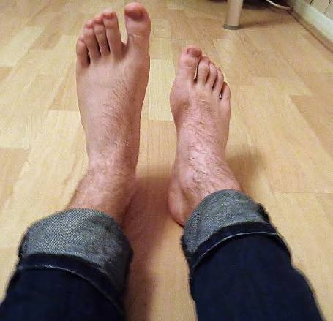

Slide 19
Management Protocol: Vascular Emergency
Time is muscle: Warm ischemia over 6 hours
causes irreversible damage.
Immediate provisional fracture reduction and alignment.
Re-evaluate pulses post-reduction; if absent, head to OR.
Vascular repair takes precedence over definitive orthopaedic fixation.
Temporary Vascular Shunt: Placed to restore
flow during bone stabilization.

Slide 20
Orthopaedic Stabilization in Vascular Injury
Apply a rapid spanning knee external fixator first.
External fixation provides bone stability to protect vascular grafts.
Avoid prolonged internal fixation operations during active ischemia.
Perform prophylactic fasciotomies after vascular repair
(reperfusion injury risk).

Slide 21
Acute Compartment Syndrome
Increased tissue pressure within a closed fascial space.
Vicious cycle: Trauma → Edema → Increased pressure → Venous collapse.
Reduced local perfusion pressure leads to muscle ischemia.
Ischemia triggers further cellular swelling and necrosis.
Irreversible nerve damage begins within 2–4 hours.

Slide 22
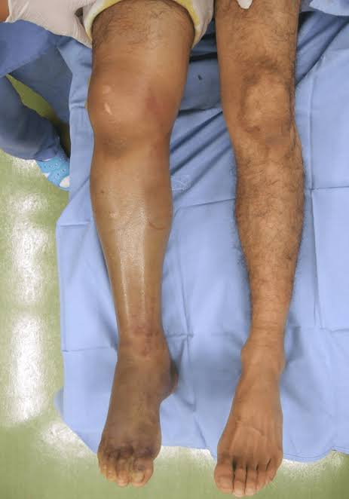

Slide 23
The Leg Compartments
Anterior: Deep peroneal nerve, anterior tibial artery/vein.
Lateral: Superficial peroneal nerve.
Superficial Posterior: Gastrocnemius, soleus, sural nerve.
Deep Posterior: Tibialis posterior, popliteal vessels, tibial nerve.
Proximal tibia fractures can trigger ACS in all four compartments.

Slide 24
Clinical Diagnosis: The 5 'P's
Pain: Out of proportion to injury, unmanageable
with opioids.
Pain with passive stretch: Earliest, most reliable clinical sign.
Paresthesia: Numbness along nerve pathways passing
through compartments.
Pallor / Poikilothermia: Pale, cold skin (late signs).
Pulselessness: Extremely late sign; damage is already done.

Slide 25
Intracompartmental Pressure (ICP) Monitoring
Clinical diagnosis is paramount; ICP is used in obtunded/
comatose patients.
Whitesides or Stryker device: Measures hydrostatic pressure.
Absolute pressure: >30–40 mmHg indicates compartment syndrome.
Delta Pressure (Δ P): Diastolic BP minus ICP.
Diagnostic Threshold: Δ P < 30 mmHg confirms ACS.

Slide 26
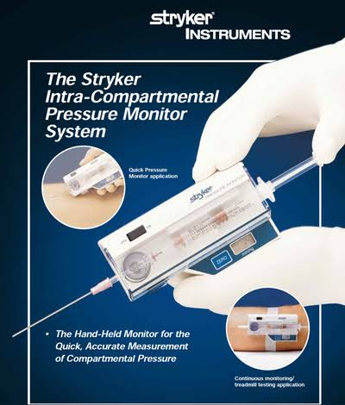
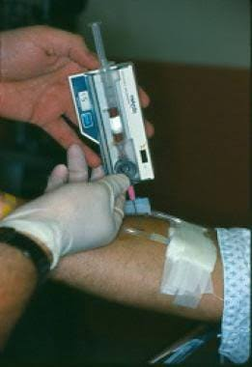

Slide 27
Emergency Management of Compartment Syndrome
Step 1: Remove all restrictive casts, splints,
or tight dressings.
Step 2: Place limb at heart level (do NOT elevate;
elevation lowers perfusion).
Step 3: Provide high-flow oxygen and maintain
systemic blood pressure.

Slide 28
Step 4: Re-evaluate within 15–30 minutes.
If no improvement or if clinically certain:
Emergency Fasciotomy.

Slide 29
Surgical Technique: Four-Compartment Fasciotomy
Requires two long incisions: Anterolateral and Posteromedial.
Anterolateral incision: Accesses anterior and lateral
compartments.
Posteromedial incision: Accesses superficial and deep posterior compartments.

Slide 30
Avoid damaging the saphenous vein/nerve medially
and peroneal nerve laterally.
Leave wounds wide open; cover with sterile dressings
or negative pressure therapy.

Slide 31
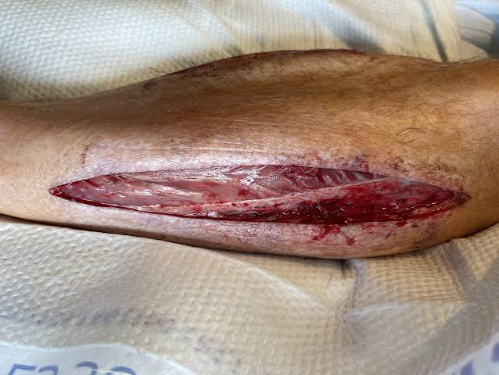

Slide 32
Definitive Management & Complications
Indications: Severe soft tissue swelling, open fractures,
neurovascular damage.
Spanning External Fixator: Pins placed in distal femur
and tibial shaft.
Bypasses the zone of injury to let soft tissues rest.
"Damage Control Orthopaedics" (DCO) minimizes systemic
inflammatory second-hit.

Slide 33
Definitive Surgical Management
Open Reduction and Internal Fixation (ORIF): Standard
for stable soft tissues.
Anterolateral Plating: For Schatzker I–III.
Dual Plating (Medial + Lateral): For high-energy Schatzker V and VI.
Bone Grafting/Subchondral Void Fillers: To support
depressed articular fragments.

Slide 34
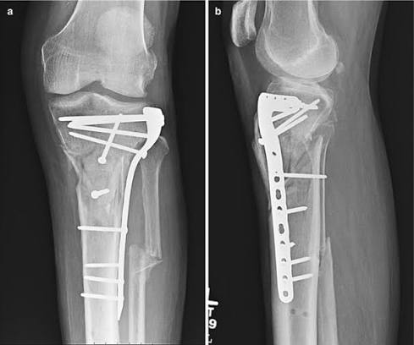

Slide 35
Minimally Invasive Percutaneous Osteosynthesis (MIPO):
Protects biology.

Slide 36
Postoperative Protocols & Rehabilitation
Early knee range of motion (ROM) exercises
to prevent arthrofibrosis.
Weight-bearing status: Strictly non-weight bearing (NWB)
for 6–12 weeks.
Serial radiographs at 2, 6, and 12 weeks to assess healing.
Deep Vein Thrombosis (DVT) prophylaxis is mandatory
for all patients.

Slide 37
Early Complications
Infection & Wound Dehiscence: High risk due to
poor subcutaneous coverage.
Deep Vein Thrombosis (DVT) / Pulmonary Embolism (PE).
Loss of reduction: Hardware failure or premature weight bearing.
Pin tract infections in cases treated with external fixators.

Slide 38
Late Complications
Post-Traumatic Osteoarthritis: Due to residual articular step-off >2 mm.
Malunion/Non-union: Varus collapse is a frequent complication.
Knee Stiffness / Arthrofibrosis: Result of prolonged immobilization.
Chronic Foot Drop: Secondary to neglected peroneal nerve palsy.

Slide 39
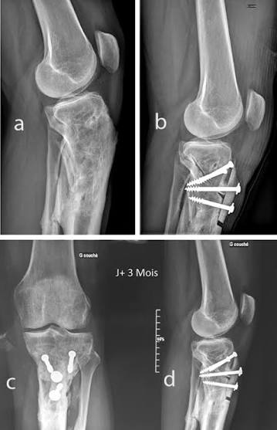

Slide 40
Summary
Proximal tibia fractures are high-stakes,
soft-tissue-driven injuries.
Schatzker classification dictates the injury energy level
and surgical plan.
Vascular check is priority #1: ABI and Angiography save limbs.

Slide 41
Compartment Syndrome is a clinical diagnosis: Treat with
early decompression.
Never compress a swollen leg; prioritize damage control
external fixation.

Slide 42
THANK YOU

