Slide 1
Pre-Hospital Care and Emergency Hospital Management
DR. VIKAS ANANDA SATRE
Ms orthopaedics
PROFESSOR & HEAD OF DEPARTMENT OF ORTHOPAEDICS
KIMS ,KVV
KARAD

Slide 2
Learning Objectives
Understand the structure of Emergency Medical Services
(EMS) in India.
Master pre-hospital and in-hospital triage systems
(START and ESI protocols).
Perform primary (ABCDE) and secondary surveys efficiently.
Identify and execute immediate life-saving interventions.

Slide 3
Navigate Medico-Legal Cases (MLC) and ethical dilemmas
in emergency care.

Slide 4
Pre-Hospital Care
Definition: Emergency medical care provided before a
patient reaches a hospital.
Primary Goal: Stabilise vital signs, prevent secondary injury,
and ensure safe transport.

Slide 5
The "Golden Hour": The critical first 60 minutes
where rapid intervention saves lives.
The "Platinum Ten Minutes": The target window
for on-scene stabilization by first responders.

Slide 6
Emergency Medical Services (EMS) Systems in India
The Universal Access Number: 108 (Centralised toll-free
emergency response).
Components: Communications (dispatch), transport (ambulances), and trained personnel.

Slide 7
Challenges: Traffic congestion, public awareness, and lack
of regional tiering.
The "Good Samaritan Law" (India): Legal protection
for bystanders who assist victims.

Slide 8
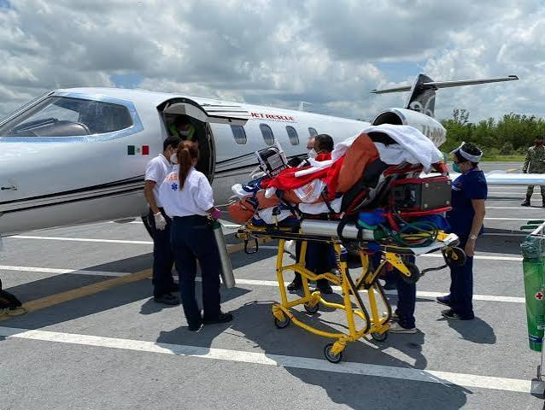
Ambulance Categorization
Type A / First Responder: Basic transport, minimal medical gear.
Basic Life Support (BLS): Non-invasive care
(oxygen, splints, automated external defibrillator).
Advanced Life Support (ALS): Invasive care
(intubation, IV access, cardiac monitors, emergency drugs).
Air Ambulance: Utilized for remote terrains or critical,
time-sensitive transfers.

Slide 9
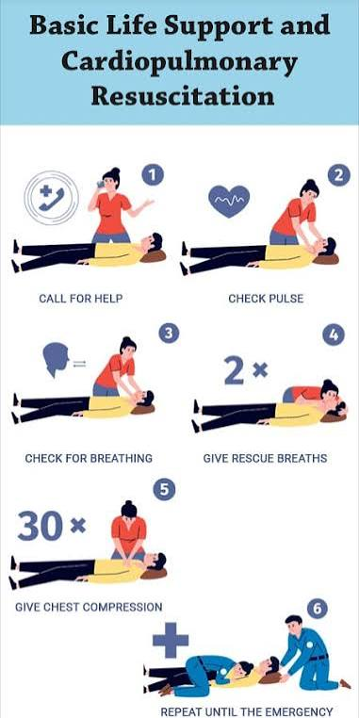
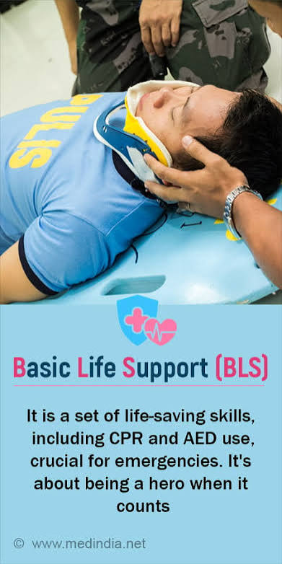

Slide 10
Pre-Hospital Triage: The START Protocol
START: Simple Triage and Rapid Treatment.
Used when patients outnumber available healthcare resources.
Assessment parameters: Respiration, Perfusion, and Mental Status (RPM).
Time limit: Max 30 seconds per patient to
tag and move on.

Slide 11
Triage Color-Coding Tags
  🔴 Red (Immediate): Life-threatening injuries but salvageable
  (e.g., airway obstruction, shock).
  🟡 Yellow (Delayed): Serious but not immediately life-threatening
  (e.g., stable major fractures).
  🟢 Green (Minor): Walking wounded; require minimal or
  delayed care.
  ⚫ Black (Deceased/Expectant): Dead or injuries incompatible with life given current resources.

Slide 12
Airway and Cervical Spine Management
Priority 1: Clear the airway using non-invasive maneuvers
(Jaw thrust, Chin lift).
Note: Avoid head-tilt if a spinal injury is suspected;
use jaw-thrust only.

Slide 13
Airway adjuncts: Oropharyngeal (OPA) and Nasopharyngeal (NPA) airways.
C-Spine Protection: Manual in-line stabilization followed
by rigid cervical collar application.

Slide 14
Breathing and Ventilation Field Interventions
Assessment: Look for chest expansion, tracheal deviation,
and cyanosis.
Oxygenation: High-flow oxygen via non-rebreather mask (NRBM)
at 10-15 L/min.

Slide 15
Tension Pneumothorax: Immediate field needle decompression
(14G needle in 2nd ICS, MCL).
Open Pneumothorax: Application of a three-sided occlusive dressing (flutter valve).

Slide 16
Circulation and Hemorrhage Control
Direct Pressure: The primary step for any active,
accessible external hemorrhage.
Tourniquet Use: Applied high and tight on limbs if
direct pressure fails to halt catastrophic bleeding.

Slide 17
Pelvic Binder: Used to control retroperitoneal bleeding
in suspected pelvic fractures.
Vascular Access: Insertion of large-bore peripheral
IV lines (14G or 16G) or intraosseous (IO) access.

Slide 18
Disability & Neurological Assessment
AVPU Scale: Quick assessment (Alert, responds to Voice,
responds to Pain, Unresponsive).
Glasgow Coma Scale (GCS): Baseline evaluation of Eye,
Verbal, and Motor responses.

Slide 19
Pupillary Reflex: Checking for size, symmetry,
and reactivity to light (indicates intracranial pressure shifts).
Stroke Recognition: Utilization of the FAST scale
(Face, Arm, Speech, Time).

Slide 20
Exposure and Environmental Safety
Log Roll: Cut away clothing to inspect the entire
body for hidden injuries while preserving C-spine.
Hypothermia Prevention: Cover the patient promptly with warm blankets (hypothermia worsens coagulopathy).

Slide 21
Chemical Exposure: Decontaminate the scene and patient
before initiating close physical transport.

Slide 22
Spinal Immobilization and Splinting
Log-Roll Technique: Requires minimum 3-4 personnel to
safely move a spinal patient.
Devices: Long Spine Board (LSB), Scoop Stretcher,
Vacuum Mattress, and Kendrick Extrication Device (KED).

Slide 23
Fracture Splinting: Immobilize the joints above and
below the fracture site to avoid neurovascular compromise.
Check Distal Pulses: Assess PMS (Pulse, Motor, Sensory)
before and after applying any splint.

Slide 24
Pre-Hospital Resuscitation Pharmacology
Crystalloids: Judicious use of Normal Saline or
Ringer's Lactate (target: permissive hypotension).
Tranexamic Acid (TXA): 1g IV bolus administered
within 3 hours of severe trauma to curb bleeding.

Slide 25
Adrenaline: 1mg (1:10,000) IV/IO every 3-5 minutes
during active cardiopulmonary arrest.
Analgesia: Fentanyl or Morphine titrations for severe,
non-hemodynamically compromising pain.

Slide 26
Pre-Hospital Documentation and Handover
MIST Handover Protocol:
  Mechanism of injury / Medical illness.
  Injuries sustained / Illness signs.
  Signs & symptoms (vital trends).
  Treatment given on-scene.
Continuity of Care: Critical to prevent errors
during the chaotic shift to hospital staff.

Slide 27
Hospital Emergency Management
Designed for unidirectional workflow from entry to
triage to definitive beds.
Red Zone (Resuscitation): Dedicated to unstable,
crashing patients requiring immediate airway or
circulatory intervention.

Slide 28
Yellow Zone (Urgent): For stable patients needing rapid
diagnostic workup and continuous monitoring.
Green Zone (Non-Urgent): Ambulatory patients with minor
illnesses (the fast-track clinic model).

Slide 29
Emergency Severity Index (ESI) Triage
Level 1: Requires immediate life-saving intervention
(e.g., cardiac arrest).
Level 2: High-risk situation, confused, lethargic, or severe pain/distress.
Level 3: Stable vitals but requires multiple diagnostic resources
(e.g., labs + X-rays).

Slide 30
Level 4: Requires only one resource
(e.g., simple suture or single X-ray).
Level 5: Requires no resources
(e.g., prescription refill).

Slide 31
The Trauma Team Activation
Trauma Team Leader: Directs the resuscitation,
assigns roles, and maintains a bird's-eye view.
Airway Doctor/Anesthetist: Secures the airway and
maintains C-spine control.

Slide 32
Primary Surveyor: Performs physical exams, calls out findings,
and places lines.
Scribe Nurse: Logs all events, medication doses,
and vital signs in real-time.

Slide 33
In-Hospital Primary Survey: Airway & Breathing
Airway (A): Assess for patency. If GCS ≤ 8, proceed
directly to Endotracheal Intubation.
Breathing (B): Auscultate lung fields. Identify and treat
lethal chest injuries immediately.

Slide 34
Bedside Interventions: Insert an intercostal chest drain (ICD)
for confirmed hemothorax or pneumothorax.
Monitoring: Continual capnography (EtCO₂) and pulse oximetry monitoring.

Slide 35
In-Hospital Primary Survey: Circulation & Shock
Recognize Shock: Hypotension, tachycardia, delayed capillary refill, and altered mental state.
Massive Transfusion Protocol (MTP): Activated if severe
hemorrhage is present; transfuse 1:1:1 ratio (PRBC:FFP:Platelets).

Slide 36
Avoid the "Lethal Triad": Hypothermia, Acidosis,
and Coagulopathy.
Source Control: Urgent surgical, orthopedic, or interventional radiology consultation to stop internal bleeding.

Slide 37
In-Hospital Primary Survey: Disability & Exposure
Re-evaluate GCS: Look for motor lateralization indicating
focal intracranial mass lesions.
Metabolic Check: Check point-of-care blood glucose levels
to rule out hypoglycemia.

Slide 38
Log Roll: Re-examine the spine, flanks, and
perineum for bruising, wounds, or structural deformities.
Environment: Maintain room temperature and activate active
fluid warmers.

Slide 39
Diagnostic Adjuncts to the Primary Survey
eFAST: Extended Focused Assessment with Sonography for Trauma (checks perihepatic, perisplenic, pelvic, pericardial, and pleural spaces).
Portable X-Rays: Chest AP view and Pelvis AP view
(performed right in the resuscitation bay).

Slide 40
Arterial Blood Gas (ABG): Provides lactate levels
and base deficit trends to track resuscitation success.

Slide 41
The Secondary Survey
Initiated only after the primary survey is completed and the patient's vitals are stabilized.
History Taking: The AMPLE mnemonic:
  Allergies, Medications, Past medical history, Last meal,
  Events leading to injury.

Slide 42
Physical Exam: Meticulous head-to-toe evaluation, including cranial nerve assessments and digital rectal exams.

Slide 43
Definitive Management & Disposition
Operating Theatre (OT): For emergent damage-control surgery
(e.g., laparotomy for splenic rupture).
Intensive Care Unit (ICU): For continuous hemodynamic support, mechanical ventilation, or invasive monitoring.

Slide 44
Wards/Observation: For stable patients requiring further
evaluation or specialty care.
Discharge with Safety Netting: Clear instructions on
when to return if symptoms worsen.

Slide 45
Hospital Disaster Preparedness & Surge Capacity
Hospital Incident Command System (HICS): Structured chain
of command during a major disaster.
Surge Capacity: The ability to rapidly expand beds,
staff, and supplies beyond standard limits.

Slide 46
Decontamination Protocol: Setup of external wash stations
for chemical, biological, or radiological events.
Reverse Triage: Expeditiously discharging stable inpatients
to free up acute care beds for incoming casualties.

Slide 47
Infection Control & Universal Precautions
Personal Protective Equipment (PPE): Appropriate use of gloves, fluid-resistant gowns, and eye protection during resuscitations.
Hand Hygiene: Strict adherence to WHO's
"5 Moments for Hand Hygiene" to minimize cross-contamination.

Slide 48
Bio-Medical Waste Management (BMW) Rules (India):
  🟡 Yellow: Anatomical waste, blood-soaked gauze.
  🔴 Red: Plastic tubes, catheters, syringes without needles.
  ⚪ White: Needles, scalpels (sharps container).
  🔵 Blue: Glass vials, ampoules.

Slide 49
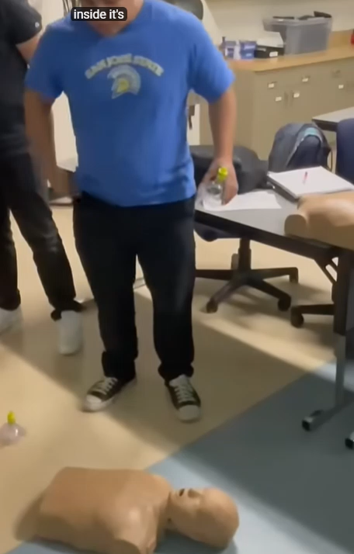

Slide 50
THANK YOU

