Slide 1
CEREBRAL PALSY
DR. VIKAS ANANDA SATRE
Ms orthopaedics
PROFESSOR & HEAD OF DEPARTMENT OF ORTHOPAEDICS
KIMS ,KVV
KARAD

Slide 2
Competency & Learning Objectives
  Define Cerebral Palsy accurately based on current
  consensus.
  Identify key antenatal, perinatal, and postnatal etiological
  risk factors.
  Classify CP clinically based on physiology, topography,
  and function.

Slide 3
  Recognize early developmental markers and primary
  red flags.
  Outline multidisciplinary management goals and early
  intervention strategies

Slide 4
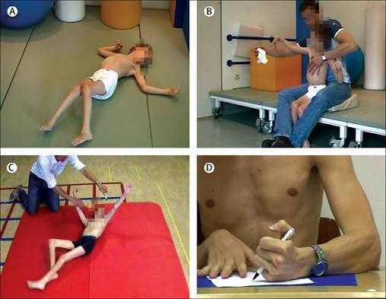
Defining Cerebral Palsy
Permanent disorder of movement and
postural control.
Causes significant activity limitations in the individual.
Attributed to non-progressive disturbances
in early development.

Slide 5
Occurs within the developing fetal or infant
brain architecture.
Motor disorders often co-exist with sensory and
cognitive impairments

Slide 6
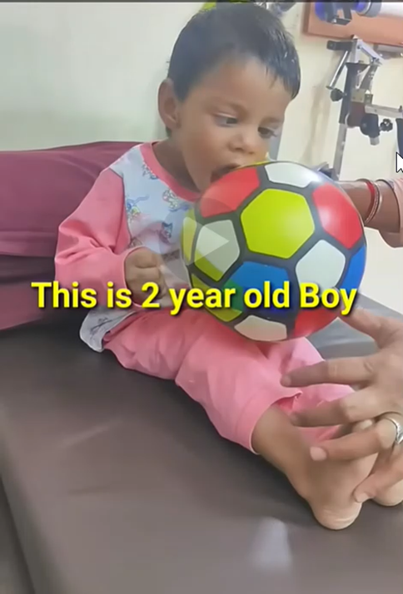

Slide 7
Global & Regional Epidemiology
Prevalence is 2 to 2.5 per
1000 live births globally.
Significantly higher incidence rates documented
in developing regions.

Slide 8
Remains the most common cause of
motor disability in early childhood.
Risk increases exponentially with extreme prematurity
and very low birth weight

Slide 9
Pathophysiology of Brain Injury
Insult occurs during critical phases of
early brain development.
The underlying central nervous system
lesion is completely static.

Slide 10
Clinical expression and motor signs evolve as
the nervous system matures.
Periventricular leukomalacia is typical in preterm insults.
Selective neuronal necrosis is frequently observed
in term infants.

Slide 11
Etiology: Antenatal Factors (70-80%)
  Maternal intrauterine infections (TORCH panel, chorioamnionitis).
  Congenital structural malformations of the cerebral cortex.
  Maternal medical conditions such as severe pre-eclampsia.
  Fetal growth restriction and chronic placental insufficiency.

Slide 12
Perinatal & Postnatal Factors
Severe perinatal asphyxia and hypoxic-ischemic encephalopathy.
Severe neonatal hyperbilirubinemia causing structural kernicterus.
Central nervous system infections during infancy (meningitis, encephalitis).
Accidental or non-accidental head trauma during early infancy.

Slide 13
Classification
Physiological Classification: Based on the type of
underlying motor disorder.
Topographical Classification: Delineates the specific limbs involved.
Functional Classification: Evaluates the objective severity of
activity limitations.

Slide 14
Physiological: Spastic CP (70-80%)
Characterized by significantly increased, velocity-dependent
muscle tone.Exhibits hyperreflexia and sustained ankle
clonus upon evaluation.Positive Babinski sign present
bilaterally in most clinical variants.Primary neuromuscular
injury is localized strictly to the
pyramidal system.

Slide 15
Physiological: Dyskinetic CP (10-15%)
Characterized by involuntary, uncontrolled, recurring
movements.Athetoid type: Slow, writhing, distal limb
movements.Dystonic type: Intermittent trunk and proximal
limb twisting.Neuromuscular injury is localized to
the deep basal ganglia structures.

Slide 16
Physiological: Ataxic & Mixed CP
Ataxic type: Hypotonia, unsteadiness, and wide-based
gait patterns.Exhibits prominent kinetic coordination issues
and intentional tremors.Anatomical injury is localized
precisely to the cerebellum.
Mixed type: Combines distinct spastic and
dyskinetic clinical features.

Slide 17
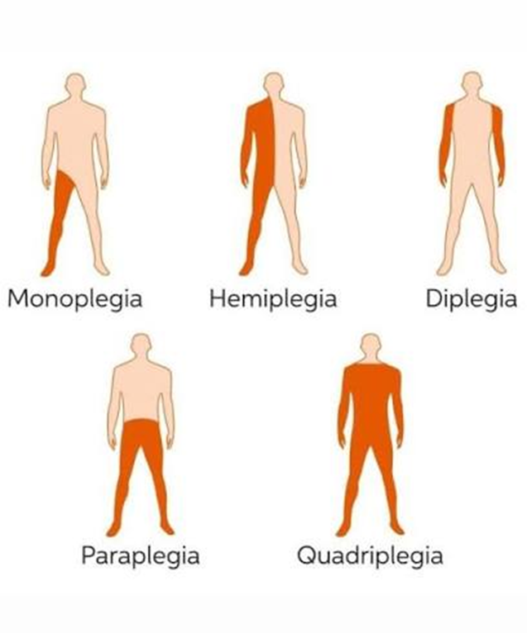
Topographical Patterns
Diplegia: Lower extremities are affected significantly more
than upper limbs.
Hemiplegia: One vertical half of the body
is affected.
Quadriplegia: All four limbs are extensively and
equally involved.

Slide 18
Monoplegia and triplegia variations occur
rarely in true practice.

Slide 19
Functional Grading (GMFCS)
Level I: Walks completely without any physical restrictions.
Level II: Walks with minor limitations during
outdoor activities.
Level III: Requires hand-held mobility assistance devices
to walk.

Slide 20
Level IV: Self-mobility is highly restricted; relies
on power chairs.
Level V: Completely dependent; transported via manual wheelchair.

Slide 21
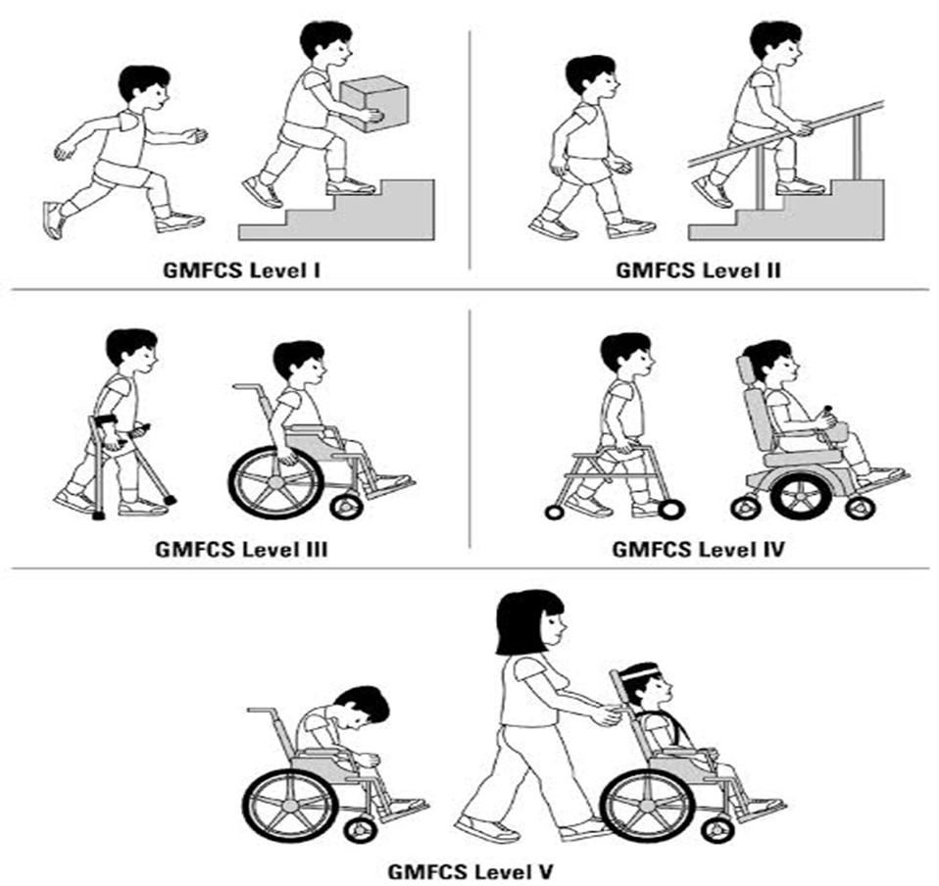

Slide 22
Early Markers & Red Flags
Documented, progressive delay in achieving
gross motor milestones.
Abnormal muscle consistency felt as extreme stiffness
or floppiness.
Asymmetric hand preference clearly demonstrated
before 12 months

Slide 23
. Severe feeding difficulties and poorly coordinated tongue movements.
Persistent asymmetric crying spells or
unexplained extreme irritability.

Slide 24
Primitive Reflex Persistence
Moro reflex persistently elicited well beyond 6 months
of age.
Asymmetric Tonic Neck Reflex (ATNR) locking the infant’s
posture

Slide 25
. Palmar grasp reflex failing to integrate
within normal timelines.
Protective parachute extension reaction failing to
develop normally.

Slide 26
Spastic Diplegia
Highly correlated with a medical history
of extreme prematurity.
Infants utilize commando crawling due to
rigid lower extremities.
Classic scissoring posture noted when suspended vertically.
Manifests as true toe-walking caused by
a tight Achilles tendon.

Slide 27
Spastic Hemiplegia
Presents as prominent asymmetric fisting of the
affected hand.
Early, clear hand preference remains a hallmark
clinical sign.
Circumductory gait pattern visible during lower extremity movement.
Affected limbs may demonstrate noticeable somatic growth retardation.

Slide 28
Diagnostic Approach
The diagnosis remains fundamentally clinical in nature.
Requires a meticulously detailed perinatal and developmental
history.
Serial, comprehensive neurodevelopmental examinations are mandatory.
Essential to definitively rule out progressive
neurodegenerative diseases.

Slide 29
Investigations & Management Paradigms
Role of Neuroimaging
Brain MRI serves as the gold-standard diagnostic
imaging modality.
Successfully identifies focal structural lesions in 85% of cases.
Periventricular leukomalacia is seen in preterm diplegic variants.
Focal vascular infarcts are clearly visible in hemiplegic cases.

Slide 30
Multidisciplinary Management
No therapeutic cure exists for the static
structural brain damage.
Management targets optimizing long-term functional independence.
Demands a highly coordinated, multi-specialty clinical
team approach.
Team: Pediatrician, physical therapist, orthopedist, psychologist.

Slide 31
Physical & Occupational Therapy
Physiotherapy: Crucial to prevent contractures and build
core strength.
Physiotherapy: Promotes ideal structural and postural alignment.
Occupational Therapy: Maximizes basic activities of daily living (ADLs).
Occupational Therapy: Adapts specialized feeding and writing orthoses.

Slide 32
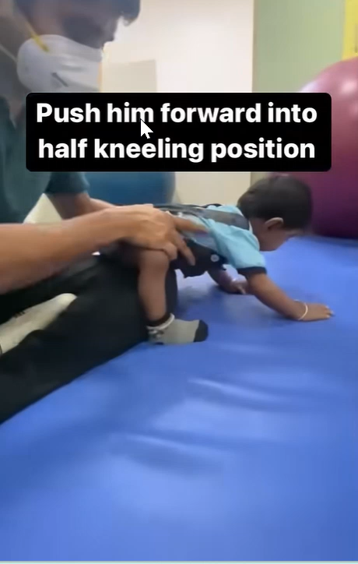

Slide 33
Medical Management of Spasticity
Oral Baclofen serves as first-line therapy
for generalized spasticity.
Oral Diazepam manages acute, painful nocturnal muscle spasms.
Focal Botulinum Toxin type A injections target specific
muscle groups.
Intrathecal Baclofen pumps manage severe, refractory quadriplegia.

Slide 34
Orthopedic Interventions
Tendon lengthening procedures address fixed muscle contractures.
Adductor tenotomy successfully corrects severe lower limb scissoring.
Hip reconstruction surgery manages progressive paralytic dislocations.
Spinal fusion addresses structural neuromuscular scoliosis changes.

Slide 35
Assistive Technology & Orthotics
Ankle-foot orthoses (AFOs) provide ankle stability during
ambulation.
Specialized corner chairs optimize early seating postural control.
Rollator walkers and gait trainers actively assist
functional mobility.
Alternative communication boards overcome severe verbal dysarthria.

Slide 36
Prevention Strategies
Primary: High-quality antenatal screening and maternal immunization.
Secondary: Antenatal Magnesium Sulfate administration during preterm labor.
Immediate therapeutic hypothermia protocols for birth asphyxia.
Tertiary: Structured early stimulation programs for high-risk neonates.

Slide 37
Long-Term Prognosis & Evaluation
The vast majority of affected children survive
safely into adulthood.
Long-term ambulatory potential relies heavily on
early milestone timelines.
.

Slide 38
Achieving independent sitting by age 2 predicts a
high walking rate.
Persistence of multiple primitive reflexes indicates
a guarded prognosis

Slide 39
Summary
CP is a permanent but strictly non-progressive
encephalopathy.
Early surveillance for subtle motor delays remains
a clinical priority.
Comprehensive tone, posture, and reflex checks are
diagnostic pillars.
Management must always be collaborative, proactive, and goal oriented.

Slide 40


