Slide 1
Patella and Distal Femur Fractures
DR. VIKAS ANANDA SATRE
Ms orthopaedics
PROFESSOR & HEAD OF DEPARTMENT OF ORTHOPAEDICS
KIMS ,KVV
KARAD

Slide 2
Fracture Patella
Learning Objectives
Understand the anatomy and biomechanics of the
knee extensor mechanism.
Classify patella and distal femur fracture patterns.
Perform a focused clinical and radiological evaluation.

Slide 3
Determine indications for conservative vs. surgical management.
Identify and prevent acute and long-term postoperative complications

Slide 4
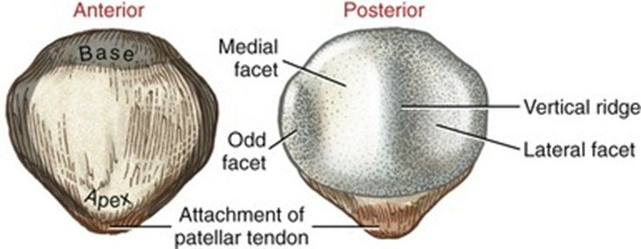
Surgical Anatomy & Biomechanics of the Patella
Type of Bone: Largest sesamoid bone in
the human body.
Function: Increases the moment arm of the
quadriceps muscle by 30%.

Slide 5
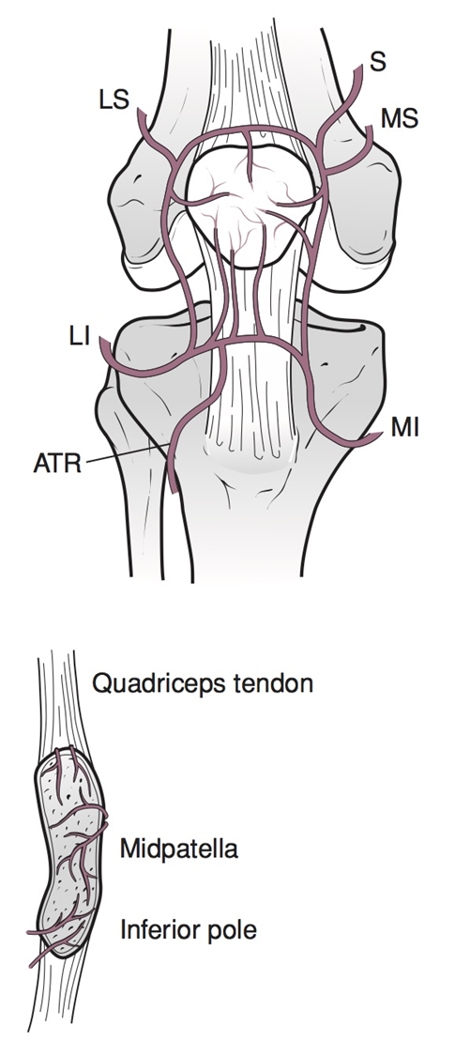
Articular Surface: Proximal 75% is covered with thick
articular cartilage.
Blood Supply: Enters primarily through the distal
pole (vulnerable to avascular necrosis)
Extensor Mechanism: Formed by the quadriceps tendon,
patella, patellar tendon, and medial/lateral retinacula.

Slide 6
Mechanism of Injury
Direct Trauma: Direct blow to the anterior
knee (e.g., dashboard injury, fall onto flexed knee).
Often results in comminuted or stellate fractures.
Indirect Trauma: Sudden, violent contraction of the
quadriceps muscle while the knee is flexing.
Typically causes transverse fractures with retinacular tearing

Slide 7
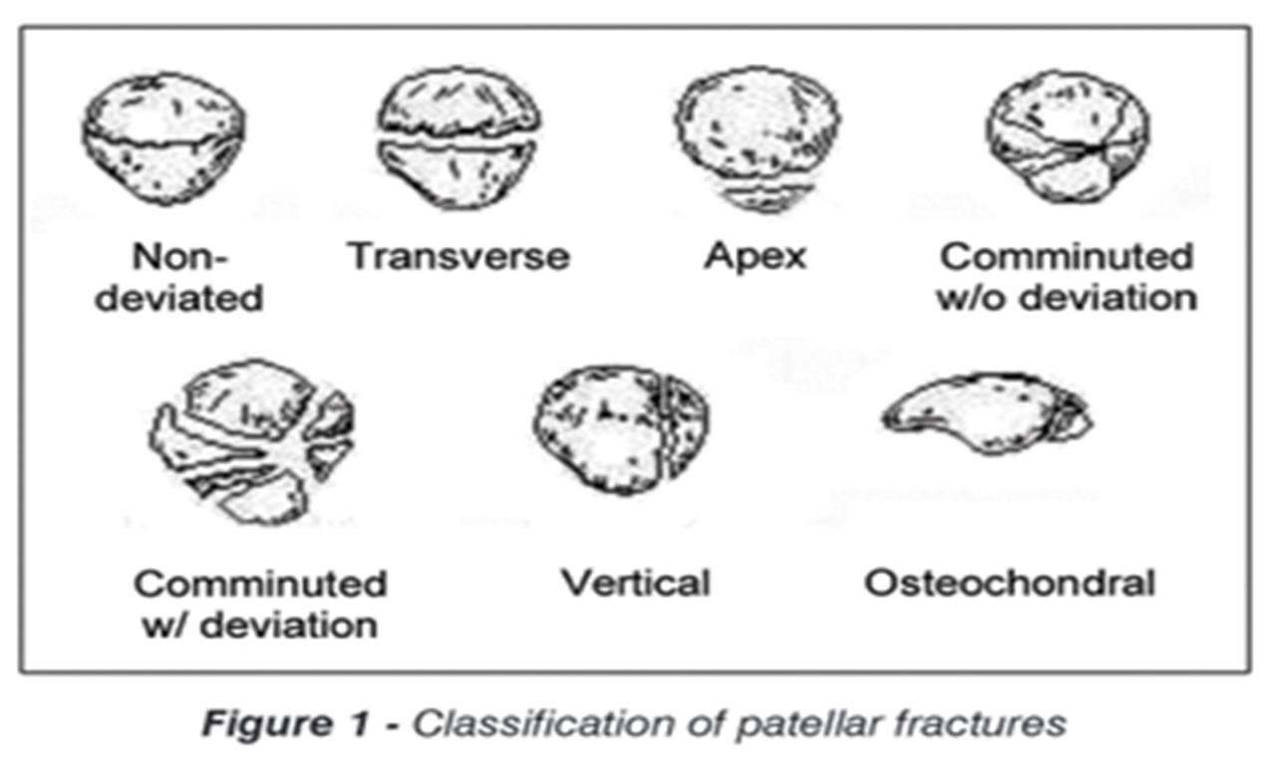
Classification:
Transverse (most common)
Stellate / Comminuted
Vertical or Marginal
Polar (Superior or Inferior pole avulsions)

Slide 8
Clinical Presentation & Bedside Examination
Symptoms: Acute anterior knee pain, rapid swelling
(hemarthrosis), and inability to bear weight.
Inspection: Knee held in slight flexion; look
for abrasions or open wounds
(high risk of septic arthritis if joint is breached).

Slide 9
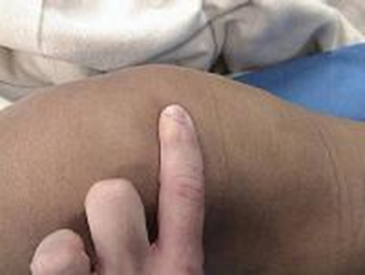
Palpation: A palpable gap or "defect" felt over
the patella surface.
The Definitive Bedside Test: Straight Leg Raise (SLR)
test. Inability to actively lift the leg
against gravity indicates a completely disrupted
extensor mechanism

Slide 10
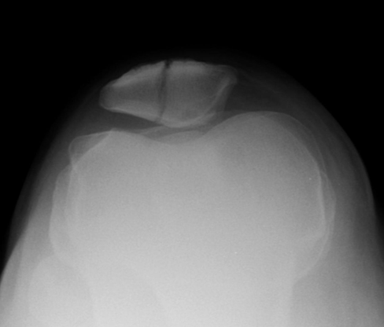
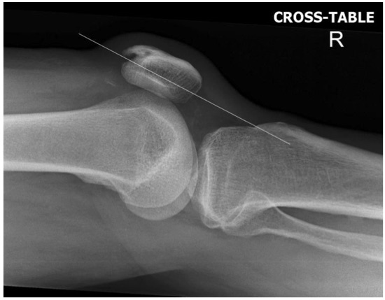
Radiological Evaluation Protocol
Anteroposterior (AP) View: Shows fracture configuration but
shadows can obscure details.
Lateral View: The gold standard for assessing
displacement, articular step-off, and proximal/distal pole
fragments.

Slide 11
Skyline / Axial View: Indicated for vertical or
marginal fractures; avoid if acute severe flexion
causes extreme pain.
Pitfall to Avoid: Bipartite Patella. A normal anatomical
variant usually found in the superolateral pole,
characterized by smooth, sclerotic margins

Slide 12
Non-Operative Management
Indications:
  Undisplaced fractures (< 2mm separation).
  Intact articular congruity (< 2mm step-off).
  Intact extensor mechanism (Patient can successfully perform
  a Straight Leg Raise).

Slide 13
Protocol: Cylindrical cast or rigid knee immobilizer
in full extension for 4 to 6 weeks.
Rehabilitation: Immediate weight-bearing as tolerated,
isometric quadriceps exercises started early to prevent
muscle atrophy.

Slide 14
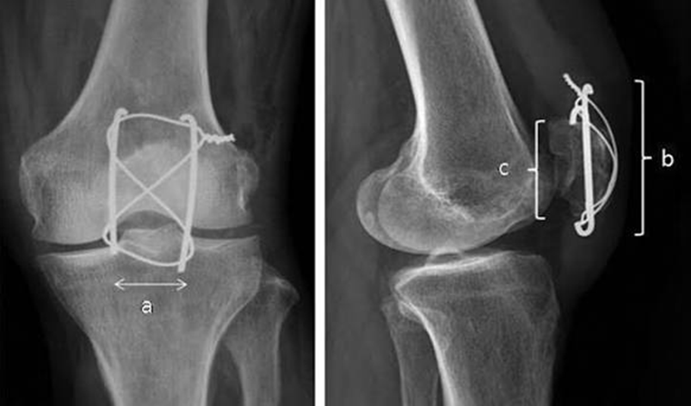
Surgical Management: Tension Band Wiring (TBW)
Indications: Displaced fractures (> 2mm), articular incongruity
(> 2mm), or failure of the extensor mechanism.
Principle of TBW: Converts distracting tensile forces
of the quadriceps muscle into compressive forces
across the articular surface.

Slide 15
Technique: Two parallel longitudinal K-wires are passed
across the fracture, and an 18-gauge stainless
steel wire is looped in a "figure-of-eight“
pattern over the anterior surface.
Alternative: Interfragmentary screw fixation combined with
a tension band.

Slide 16
Surgical Management for Comminuted Patella Fractures
Partial Patellectomy: Indicated when one pole
(usually inferior) is highly comminuted and unsalvageable,
while the remaining fragment comprises > 50% of the patella.
The patellar tendon is reattached directly to
the remaining bone bone-to-bone.

Slide 17
Total Patellectomy: A salvage procedure for severe,
unsalvageable comminution.
Clinical Consequence: Total removal results in a
permanent 30% loss of knee extension power and
persistent patellofemoral instability.

Slide 18
Complications of Patella Fractures
Early Complications: Infection, skin necrosis over the
anterior knee, and hardware prominence causing pain.
Late Complications:
  Knee Stiffness: Most common complication due to
  prolonged immobilization.

Slide 19
  Post-Traumatic Osteoarthritis: Secondary to residual articular
  step-off.
  Non-union / Hardware Failure: Wire breakage or migration
  necessitating a second surgery for removal.

Slide 20
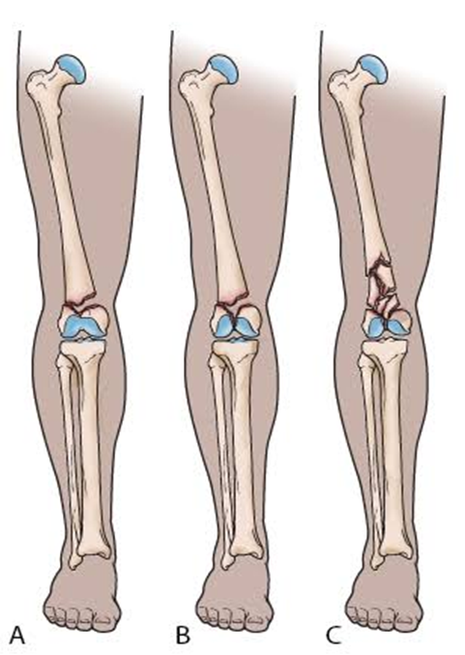
Fracture Distal Femur
Anatomical Boundaries: Includes fractures extending from the
articular surface of the femoral condyles
up to the metaphyseal-diaphyseal junction
(roughly the distal 9–15 cm of the femur).
Key Features: Wide metaphyseal canal, thin cortex,
and proximity to the knee joint.

Slide 21
Epidemiology
Bimodal distribution.
High-energy trauma in young males
(motorcycle crashes).
Low-energy falls in elderly, osteoporotic females.

Slide 22
Deforming Muscle Forces
Distal femur fragments are subject to highly
predictable muscle pulls:
Gastrocnemius: Originates from the posterior femoral condyles.
Pulls the distal articular fragment into posterior
flexion/rotation, risking compression of the adjacent
popliteal artery.
ormity.

Slide 23
Quadriceps & Hamstrings: Cause proximal migration and shortening
of the limb.
Adductor Magnus: Pulls the proximal fragment medially,
inducing a characteristic varus def

Slide 24
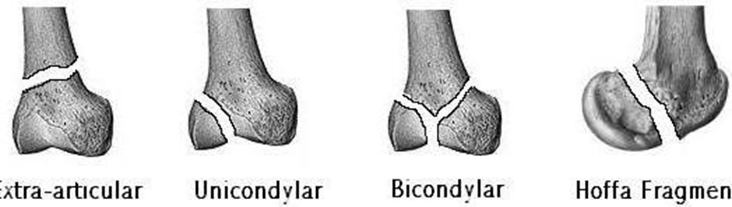
CLASSIFICATION
Descriptive
supracondylar
intercondylar

Slide 25
AO/OTA Classification of Distal Femur Fractures
Type 33-A (Extra-articular): Fracture does not involve
the joint surface (e.g., supracondylar fractures).
Type 33-B (Partial articular): One condyle is fractured
(medial or lateral), while the other remains
continuous with the femoral shaft
(e.g., Hoffa fracture – coronal plane fracture).

Slide 26
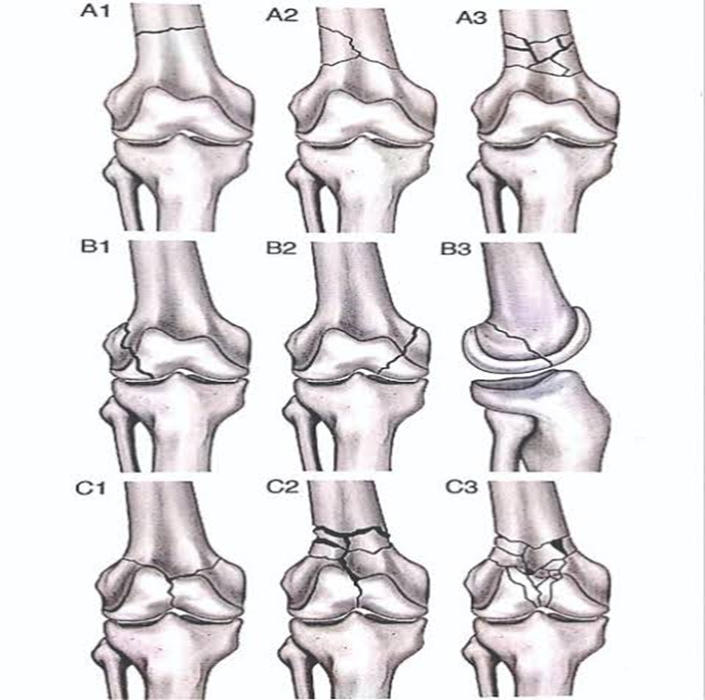
Type 33-C (Complete articular): Both condyles are fractured
and completely separated from the femoral diaphysis
(intercondylar or T/Y-shaped patterns).

Slide 27
Clinical Presentation & Critical Neurovascular Check
Clinical Features: Severe thigh and knee pain,
gross deformity, shortening, and inability to move
the lower limb. Swelling can be massive
due to hematoma formation in the thigh.

Slide 28
Neurovascular Emergency Check:
  The popliteal artery and tibial nerve sit
  directly behind the distal femur.
  Posterior displacement of the distal fragment can
  impinge or lacerate these structures.

Slide 29
Action: Palpate dorsalis pedis and posterior tibial
pulses. Measure Ankle-Brachial Index (ABI) immediately if pulses are weak.

Slide 30
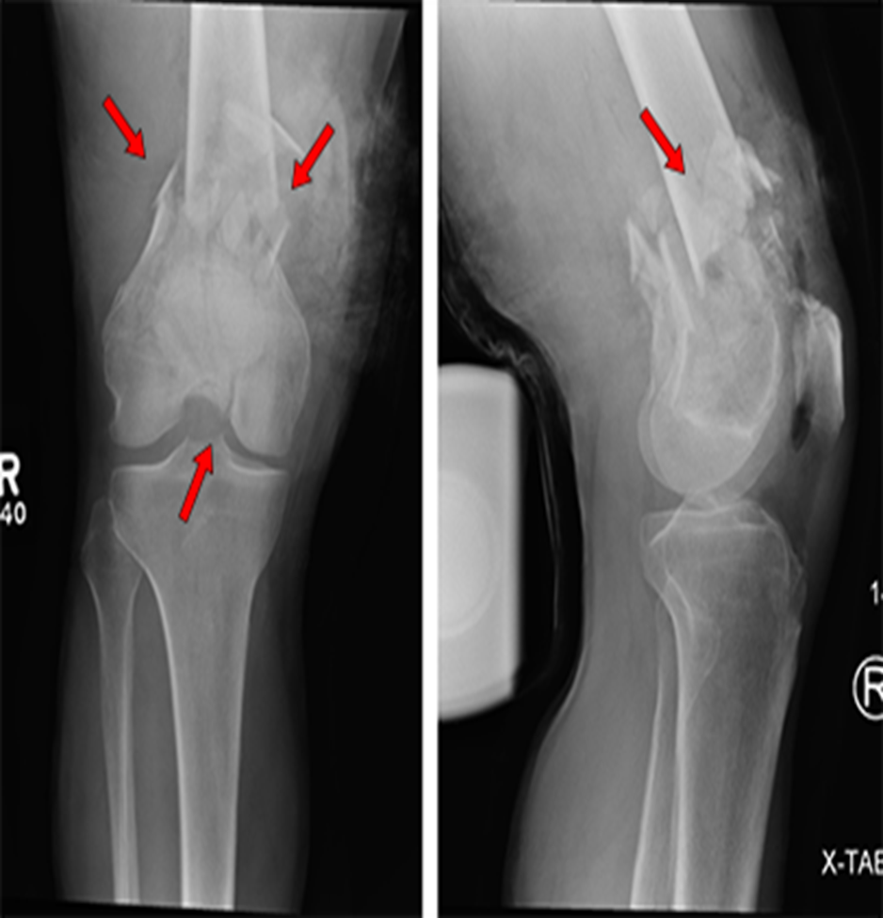
Radiological Workup & Advanced Imaging
Standard Radiographs: AP and Lateral views of
the distal femur and knee joint.
Must include views of the entire femur
to rule out proximal shaft or hip fractures.

Slide 31
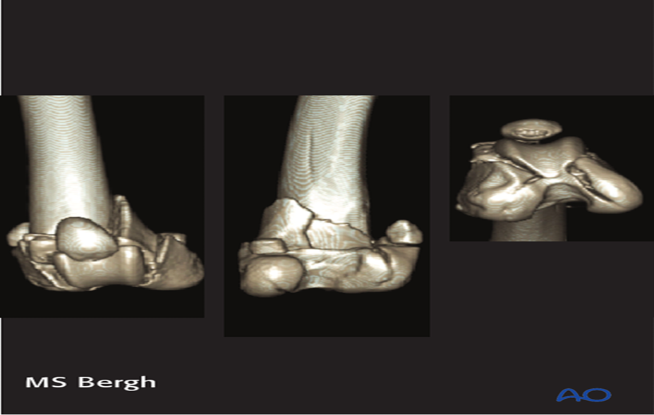
Traction Views: Highly useful preoperatively to restore
length and clarify the fracture pattern.
CT Scan with 3D Reconstruction: Essential for
all intra-articular (Type B and C) fractures. It identifies
coronal plane fractures (Hoffa fragments) that are
easily missed on standard X-rays.

Slide 32
Temporary & Non-Operative Management
Skeletal Traction: Form of provisional stabilization. A
pin is placed in the proximal tibia
to maintain limb length and alignment while
waiting for surgery.

Slide 33
Non-Operative Indications: Strictly reserved for patients
with severe medical comorbidities who are completely
unfit for anesthesia, or non-ambulatory patients.
Method: Knee brace or cast bracing.
Risks: High rate of malunion, non-union, knee
stiffness, and prolonged bed-rest complications (DVT, bedsores).

Slide 34
Definitive Surgical Management Strategy
Goal: Anatomical reduction of the joint surface,
restoration of limb length/rotation, and stable
internal fixation to allow early knee range
of motion.

Slide 35
Options:
  Locking Plates (Less Invasive Stabilization System –
  LISS / Distal Femoral Locked Plate): The gold
  standard for comminuted and intra-articular fractures.
  Applied via a lateral approach.

Slide 36
Retrograde Intramedullary Nailing (RIMN): Excellent for
extra-articular (33-A) or simple intra-articular fractures
without severe comminution. Introduced through the
intercondylar notch.

Slide 37
Surgical Management of Unicondylar &
Open Fractures
Hoffa Fractures / Unicondylar Fractures (Type 33-B): Managed via
open reduction and fixation using
anterior-to-posterior headless compression screws or
countersunk lag screws.

Slide 38
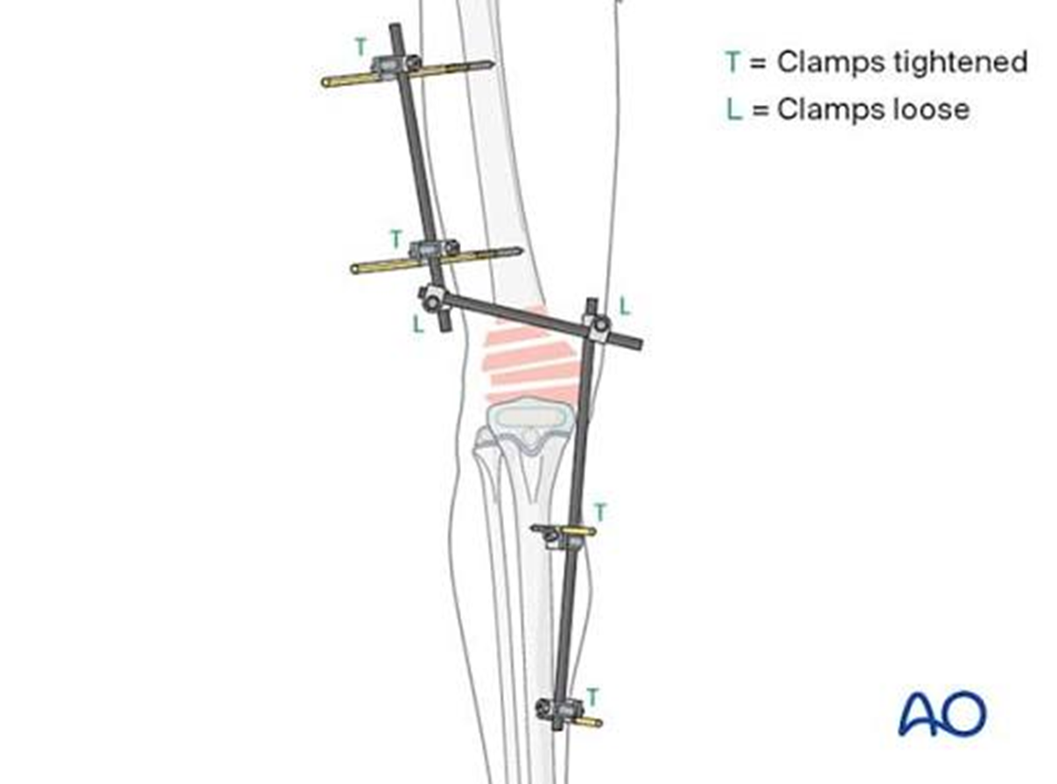
Open Fractures / Severe Soft Tissue Loss:
  Managed via emergency debridement, joint irrigation, and
  application of a spanning bridging external fixator.
  Definitive internal fixation is delayed until the
  soft tissue envelope heals ("Damage Control Orthopaedics").

Slide 39
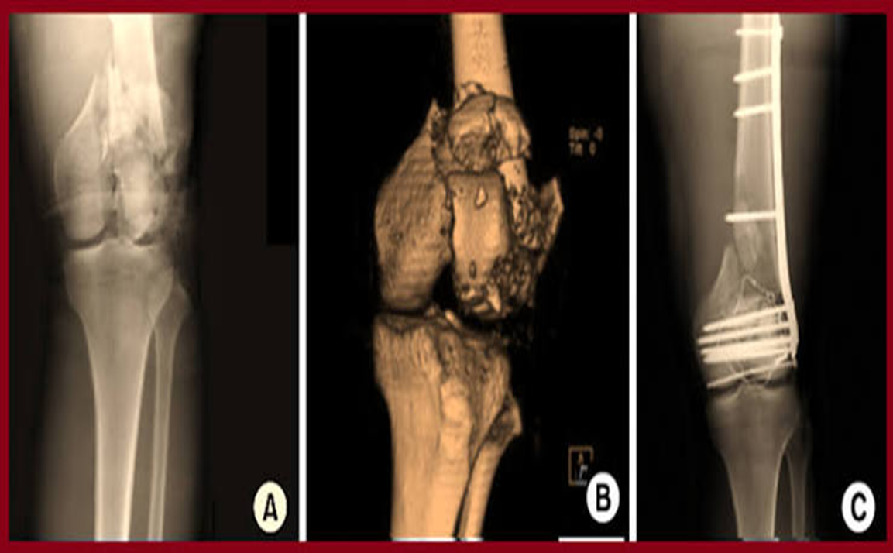

Slide 40
Complications of Distal Femur Fractures
Malunion (Varus/Valgus/Rotational): Most common when
using non-locking hardware or during
improper nail insertion.
Knee Stiffness / Arthrofibrosis: Result of inadequate fixation
strength that prevents early postoperative mobilization.

Slide 41
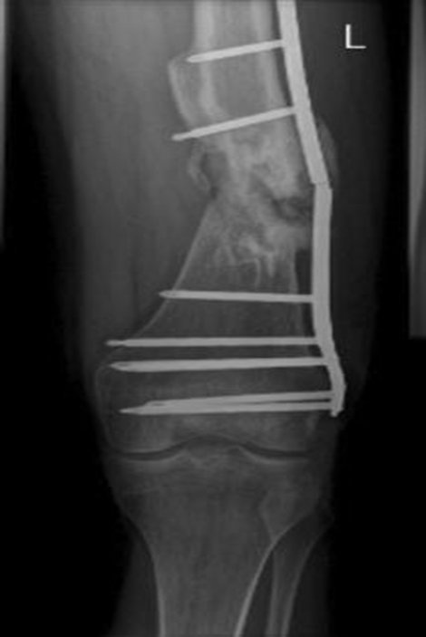
Non-union & Implant Failure: Distal femoral fractures
are prone to delayed healing at the
metaphyseal junction, leading to plate breakage over time.
Infection: Particularly high in open fractures or
extensive open surgical exposures.

Slide 42
Summary
Patella Fractures: Check the extensor mechanism with
the Straight Leg Raise test. Tension Band
Wiring (TBW) converts tensile forces to compression forces.
Distal Femur Fractures: The gastrocnemius muscle routinely
causes posterior displacement of the distal fragment.

Slide 43
Always rule out popliteal artery injury in
displaced distal femur injuries.
Early range of motion is the ultimate
goal for both fractures; rigid fixation is
required to achieve this and prevent devastating
joint stiffness.

Slide 44


