Slide 1
Well come for module certificate course
Mrs. Afsana Mulani
Assistant Professor
Krishna Institute of Nursing Sciences, Karad

Slide 2
Indication and contraindication for HRT

Slide 3
Objective
Identify the common indications and contraindications for HRT in clinical practice.

Slide 4
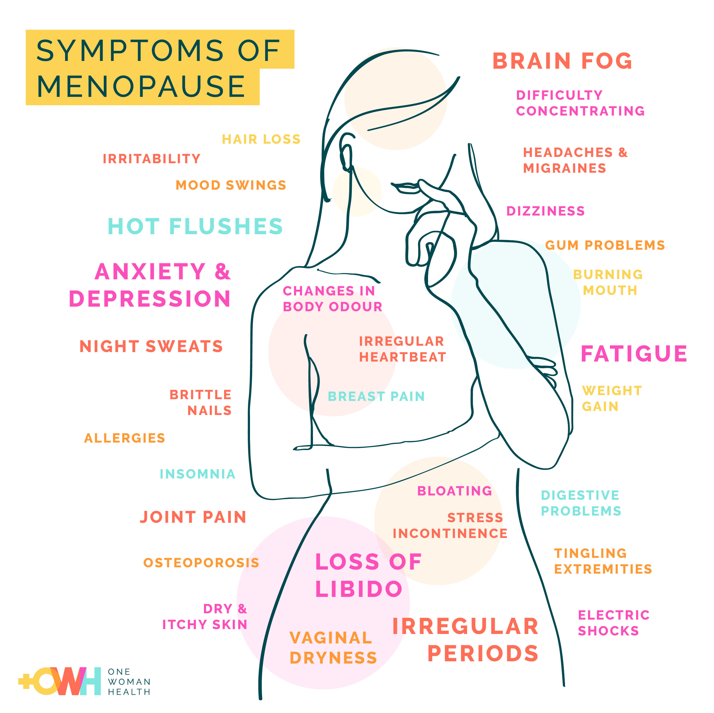
Indication of HRT
Relief of menopausal symptoms

Slide 5
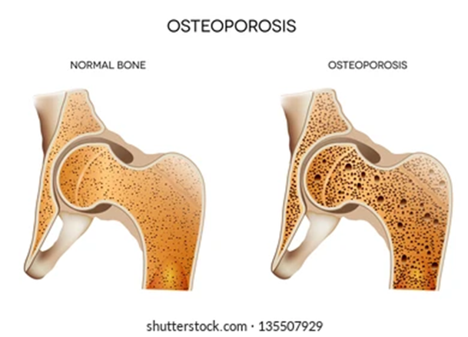
Cont…
Prevention of osteoporosis

Slide 6

Cont…
To maintain the quality of life in menopausal years.

Slide 7
Relief of menopausal symptoms
Hot flashes (vasomotor symptoms)
Night sweats
Vaginal dryness and atrophy
Mood swings and sleep disturbances

Slide 8
Cont…
Premature ovarian insufficiency (POI) or early menopause- Women under age 40 experiencing menopause symptoms
Hypogonadism- In women with decreased estrogen levels due to pituitary or ovarian disorders

Slide 9
Special group of women to whom HRT should be prescribed.
Premature ovarian failure
Gonadal dysgenesis means abnormal development of ovary.
Surgical or radiation menopause
bilateral oophorectomy (removal of ovaries)

Slide 10
Contraindication for HRT
Undiagnosed genital tract bleeding
Estrogen dependent neoplasm in the body
Estrogen-dependent malignancies (e.g., endometrial cancer)

Slide 11
Cont…
Active or past history of thromboembolic disorders like
Deep vein thrombosis (DVT)
Pulmonary embolism (PE)
Stroke or myocardial infarction

Slide 12
Cont…
Active liver disease
Gallbladder disease
Known , Suspected or history of Breast cancer

Slide 13
Conclusion
HRT is beneficial for managing menopausal symptoms and preventing osteoporosis but must be used cautiously. It is indicated in selected cases like early menopause and severe symptoms but contraindicated in conditions like breast cancer, thromboembolic disorders, and liver disease.

Slide 14
References
Annama Jacob a comprehensive text book of midwifery and gynecology nursing 5th edition
Page no. 693-695.
DC Dutta a comprehensive text book of midwifery and gynecology nursing 7th edition
Page no. 57-62

